Slide 1

BUSINESS AND SOCIO-ECONOMIC CONTEXTS OF MINI-GRID DEVELOPMENT
Lesson 5: Impact evaluation for rural energy interventions

Slide 2
Lesson 5 Outline:
SECTION 1: Introduction
SECTION 2: How energy markets and business models can benefit from impact evaluations
SECTION 3: How to conduct and impact evaluation
          3.1 Preparing for an evaluation
      3.2 Counterfactual
SECTION 4: Evaluation Methods
    4.1 Randomize Control Trial (RCT)
          4.2 Instrumental Variable (IV)
          4.3 Regression Discontinuity Design (RDD)
          4.4 Difference in Differences (DiD)
          4.5 Propensity Score Matching (PSM)
      SECTION 5: Opportunities of energy digitalization on impact evaluation

Slide 3
Lesson 5 Learning Outcomes:
SECTION 1: Introduction
By the end of the lesson, you will be able to:
Define impact evaluation and its significance in enhancing energy market and business models
Describe the main quantitative methods for conducting impact evaluation
Recognize the opportunities of energy digitization for future evaluations

Slide 4
SECTION 1: Introduction
Economic development is a process of trial and error, success and failure, experimentation, and innovation.
Access to renewable energy is recognized as contributing substantially to sustainable development. However, various approaches to electrification can yield different impacts.
What is impact evaluation?
Impact evaluation, empirically measures the causal effects of interventions on outcomes
of interest, while minimizing assumptions as much as possible
Why do we need to measure impact in energy access projects?
Energy investments increasingly seek to experiment with innovations, high-level technologies, and behavioral change approaches to ensure sustainable, efficient, and inclusive use of energy
Continued efforts on impact evaluation will be critical to ensure that these experiments can be tested to generate evidence to improve energy operations over time

Slide 5
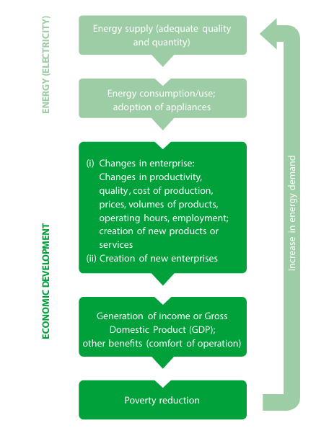
SECTION 2: How can energy markets and business models benefit from impact evaluations?
Electrification projects may lack economic viability unless markets can convert broader social and economic impacts into business values.
The areas hardest to reach are usually also the most economically disadvantaged, resulting in limited ability to afford or utilize electricity upon connection.
Challenge
Electrification projects hold the potential to expand beyond mere electricity provision, addressing other critical social services and creating greater social and economic impact.
Opportunity

Slide 6
SECTION 2: How can energy markets and business models benefit from impact evaluations?
Energy market is undergoing a paradigm shift…
Frontier impact evaluation enables market change and guides energy policy.
Monitoring, evaluating and reporting the diverse impacts of electrification projects is essential
        To capture system-wide costs and benefits, unlocking the potential of innovative business models and technology developments.
        To understand innovative policy design through which new market players can deliver accessible and aﬀordable energy goods and services to underserved communities.
        To demonstrate the effectiveness of certain instruments, such as innovative financing mechanisms that tie funding to concrete results.
        To enable rewarding high impact firms for achieving social results.

Slide 7
SECTION 3: How to conduct and impact evaluation
3.1. Preparing for an evaluation
Define the program’s outcome variables of interest
Formulate a theory of change that outlines how the project is supposed to achieve the intended results
Depict the theory of change in a results chain (also called a logic model)
Specify evaluation questions
Select performance indicators for monitoring and evaluation
After completing these steps, the next key decision is selecting methods to estimate the program's impact on outcomes, discussed in later chapters.
Note: The order of the steps is flexible, allowing for revisiting earlier stages or going back and forth, especially if unforeseen issues arise at later steps.

Slide 8
SECTION 3: How to conduct and impact evaluation
Step 1: Define the program’s outcome variables of interest.
The outcome variables selected will be used to determine whether or not a given program or reform is successful.
To define outcome variables it is needed that the project (or program or policy) is clearly defined.
Step 2: Formulate a theory of change
Theory of change can be described as “the central mechanism by which change comes about for individuals, groups, and communities” [Funnell and Rogers, 2011]
It should answer the following question: What is the causal impact of the project (P) on the outcome variables?
A tool used to display, displays the theory in a diagram is the results chain.

Slide 9
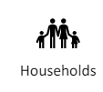





SECTION 3: How to conduct and impact evaluation
Step 3. Depict a theory of change in a results chain (logic model)
Results chain
Impact receivers /Beneficiaries
INPUT
ACTIVITIES
OUTPUTS
OUTCOMES
IMPACT or FINAL OUTCOMES
The potential short and medium-term effects of an intervention. Results likely to be achieved once the beneficiary population uses project outputs.
The long-term effects of an intervention. The final objective of the program. Typically, the impact can be influenced by multiple factors.
The resources (broadly defined) used or required for the project, including staff and budget.
The actions, events, and works performed to convert inputs into outputs.
The immediate tangible goods, products or services that the intervention produce.
PLANNED WORK (Supply side)
INTENDED RESULTS (Supply side + demand side)
Developer
…

Slide 10
SECTION 3: How to conduct and impact evaluation
Step 4: Specify evaluation questions
In an impact evaluation, the evaluation question needs to be framed as a well-deﬁned, testable hypothesis. You need to be able to frame the question in such a way that you can quantify the difference between the results obtained contrasting the treatment and comparison groups. The results chain can be used as a basis for formulating the hypothesis that you would like to test using the impact evaluation.
Step 5: Select performance indicators
The last step is to select indicators for the outcomes that the program is intended to change
The acronym “SMART” provides useful guidance on how to select performance indicators
Speciﬁc
Measurable
Attributable
Realistic
Targeted
Good indicators are SMART

Slide 11

SECTION 3: How to conduct and impact evaluation
3.2. Counterfactual
What is a counterfactual?
We define the impact as the difference of an outcome (Y) for the same unit (person, household, community…) with and without participation in a program or intervention.
The counterfactual is what would have happened in the absence of the program. What the outcome (Y) would have been for a program participant in the absence of the program?
However, it is impossible to observe the same unit simultaneously in two different states (with and without program). Thus, since we cannot directly observe the counterfactual, we must estimate it.
A valid comparison group:
Has the same characteristics, on average, as the treatment group in the absence of the program;
Remains unaffected by the program; and
Would react to the program in the same way as the treatment group, if given the program.
When the comparison group does not accurately estimate the true counterfactual, then the estimated impact of the program will be invalid. In statistical terms, it will be biased.
2 common but highly risky methods of constructing comparison group which can lead to an inappropriate estimate of the counterfactual (counterfeit):
Before-and-after
Enrolled-non-enrolled

Slide 12
SECTION 4: Evaluation Methods
In this section we will study methods that can be applied to estimate program impacts more accurately
Experimental design:
In experimental method, researchers set up the environment and controls the variables of interest. Fundamentally, researchers manipulate an independent variable (input) within controlled conditions and observe how these changes affect dependent variables (outcomes). The intervention assignment is done randomly
    Randomize control trial
    Instrumental Variable (IV)
    Regression Discontinuity Design (RDD)
Quasi-experimental design:
Does not rely on random assignment. Instead, subjects are assigned to groups based on non-random criteria.
    Difference in Differences (DiD)
    Propensity Score Matching (PSM)

Slide 13
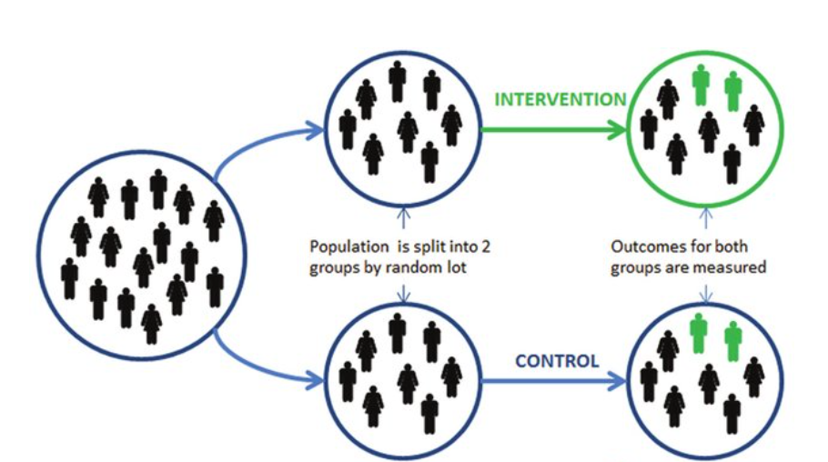
SECTION 4: Evaluation Methods
4.1. Randomized Control Trial (RTC)
In RTC, access to the program is randomly determined. Randomized assignment ensures every eligible unit (i.e., an individual, household, business, school, hospital, or community) has an equal chance of being selected for treatment, offering fairness and transparency in allocating resources
This method generates a strong counterfactual and represents the strongest method for evaluating the impact of a program
Read more in: https://www.povertyactionlab.org/sites/default/files/research-resources/2017.04.14-Real-World-Challenges-to-Randomization-and-Their-Solutions.pdf
Source: Test_Learn_Adapt_Developing_Public

Slide 14
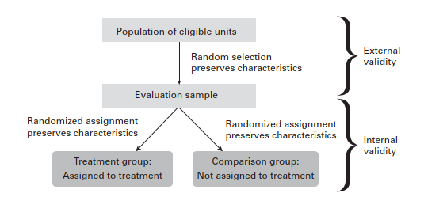
SECTION 4: Evaluation Methods
Randomized assignemnt of treatment [WB]
Externally valid if the evaluation sample accurately represents the population of eligible units. The results of the evaluation can then be generalized to the population of eligible units.
Internally valid if it provides an accurate estimate of the counterfactual through a valid comparison group.
P = 1
P = 0
Steps to calculate impact:
- Estimate the counterfactual
- Comparison of outcome variable (Y) means of both groups
- Apply Linear Regression
- Multivariate regression to control for other observable characteristics
RCT_Impact = (Y | P = 1) − (Y | P= 0)
Example: Jack, B. K. and G. Smith. 2016. Charging Ahead: Prepaid Electricity Metering in South Africa.

Slide 15
SECTION 4: Evaluation Methods
4.2. Instrumental Variable (IV)
This method is suitable when 100% compliance to treatment and comparison assignment is not possible as well as when there is risk of endogeneity or confounding issues. For example, where unmeasured factors impact both the independent and dependent variables.
This approach entails utilizing a predictor variable that correlates with the energy intervention but doesn't exert any influence on the outcomes of interest (dependent variable).
Identifying a suitable instrument can be challenging; program placement rules can be an option. For example, distance to the electricity line has been used as an instrumental variable in several studies to measure the impact of electrification on different outcomes, such as schooling completion, study time, energy consumption, or income.
It is important that the instrumental variable affects participation rates among treated and comparison groups, but it does not directly affect the outcome of interest.
Example: Allcott, H., A. Collard-Wexler, and S. O’Connell. 2016. How Do Electricity Shortages Affect Industry?
Evidence from India. American Economic Review. 106 (3). pp. 587–624.

Slide 16
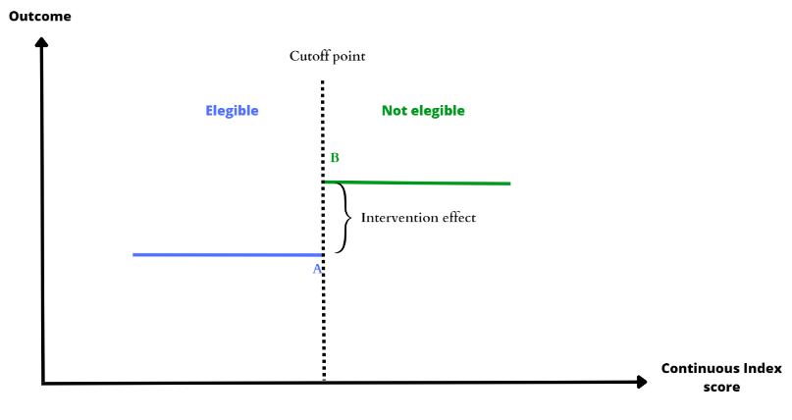
SECTION 4: Evaluation Methods
4.3. Regression Discontinuity Design (RDD):
It is suitable when there exists a clear threshold that determines the allocation of the treatment or intervention. For instance, this might involve a specific town size requirement for electrification or an income threshold for a connection subsidy.
The index scores should be continuous and the cutoff should be unique for the program evaluated.
For a review of practical issues in implementing RDD, see: Imbens, Guido, and Thomas Lemieux. 2008. “Regression Discontinuity Designs: A Guide to Practice.” Journal of Econometrics 142 (2): 615–35.
(Y | P= 0)
(Y | P= 1)
RDD Impact = (B − A)
Bastos, P., L. Castro, J. Cristia, and C. Scartascini. 2011. Does Energy Consumption Respond to Price Shocks?: Evidence from a Regression Discontinuity Design. IDB Working Paper Series. 234

Slide 17
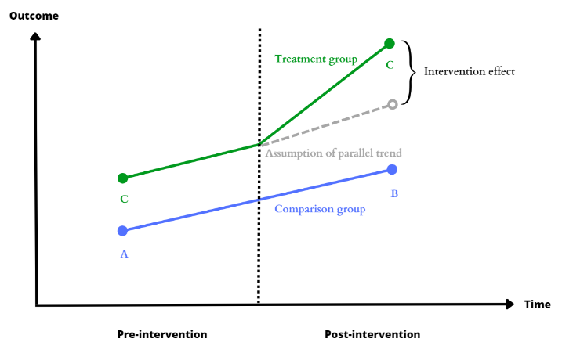
SECTION 4: Evaluation Methods
4.4. Difference-in-Differences (DiD)
It compares the changes in outcomes over time between a population enrolled in a program (treatment group) and a population that did not (comparison group)
The first comparison controls for constant factors within the enrolled group, while the second comparison captures time-varying factors by observing changes in the non-enrolled group exposed to similar conditions.
Instead of comparing outcomes between the treatment and comparison groups after the intervention, the difference-in-differences methods compares trends between the treatment and comparison groups.
It relies in the equal trends assumption
D
DiD Impact = (B − A) − (D − C)
Example: Davis, L., A. Fuchs, and P. Gertler. 2012. Cash for Coolers. NBER Working Paper. No. 18044.

Slide 18
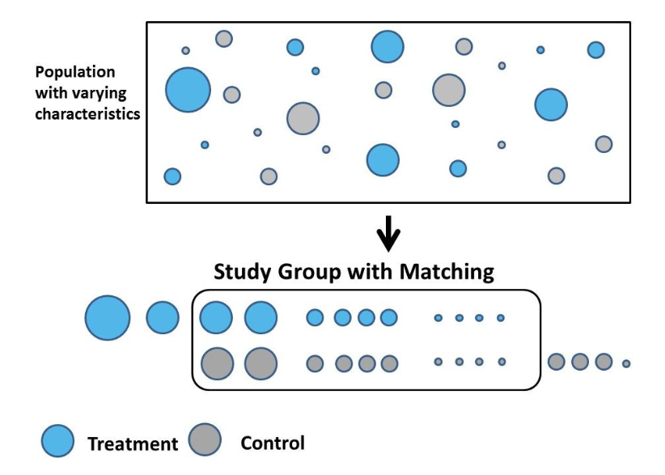
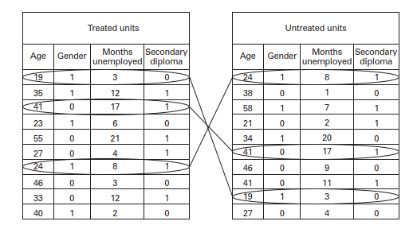
SECTION 4: Evaluation Methods
4.5. Propensity Score Matching (PSM)
Aims to replicate randomized assignment by selecting comparison group units that resemble the treatment group. It estimates the individuals´ treatment likelihood based on observed characteristics, such as demographics, using only baseline data.
Treatment group units are then matched with non-enrolled units with the closest propensity scores to create a comparison group for estimating the counterfactual scenario.
Impact is determined by comparing the average outcomes between the treatment and matched group. It can be combined with DiD method to enhance robustness.
Peters, J., C. Vance, and M. Harsdorff. 2011. Grid Extension in Rural Benin: Micro-Manufacturers and the Electrification Trap. World Development. 39 (5). pp. 773–783.

Slide 19
SECTION 5: Opportunities of energy digitalization on impact evaluation
The digitalization of the energy system, coupled with the increased availability of big data, offers new opportunities for impact evaluations and expand the number of variables and outcomes that can be included in analysis.
Data-enabled energy management systems: Facilitates data-intensive evaluation of the impact
  - Better control for heterogeneity of a large number of treatment groups through data analytics
  - End-users are more easily engaged (i.e., as part of randomized control trials).
Automated energy metering systems: Enables matching large-scale heterogeneous attributes interventions in a cost-eﬀective and timely manner.
Block chain-enabled energy monitoring systems: Enhances of transparency of an impact evaluations.
Remote sensing can detect luminosity and pollution levels with increased precision and frequency.
Billing data can be harvested to understand electricity use.
When available, administrative tax revenue data or data on business registrations can be used to explore the effect of improved energy supply on business activity.

Slide 20
References
Raitzer, D. A., Blöndal, N., & Sibal, J. (2019). Impact Evaluation of Energy Interventions: A Review of the Evidence.
Glewwe, P., & Todd, P. (n.d.). Impact Evaluation THEORY, METHODS, AND PRACTICE in International Development.
Impact Evaluation in Practice Second Edition. (n.d.).
African Development Bank (AfDB). (2020)“Preparing Evaluation of the Future: Big Data, Modern Technologies, and Shifts in Global Development Priorities”, https://idev.afdb.org/en/page/evaluation-matters-magazine
Funnell, Sue C., and Patricia J. Rogers. (2011. Purposeful Program Theory: Effective Use of Theories of Change and Logic Models. San Francisco, CA: Jossey Bass.
Paul J. Gertler, et al. "Impact Evaluation in Practice Second Edition" (2016), http://www.worldbank.org/ieinpractice.
https://crossboundary.com/advisory/data-analytics/
https://www.researchgate.net/publication/256031307_Test_Learn_Adapt_Developing_Public_Policy_with_Randomised_Controlled_Trials/figures?lo=1
https://dimewiki.worldbank.org/Difference-in-Differences

