Slide 1

Off-Grid Energy Systems Modelling with MicroGridsPy
Lesson 2:
Hybrid Mini-Grids

Slide 2

Lesson 2: Contents
Technological evolution and Components of modern Mini-Grids
The development of mini-grids over time and learning about the components and technology of modern hybrid mini-grids
Market Analysis and Projections
The current market status of mini-grids, their role in universal electricity access, and future market trends and financial aspects
Technological Trends and Cost Analysis
Technological advancements in mini-grids, including renewable integration, and understanding their cost structures and economic viability
Exploration of Electrification Planning Tools
Tools and methodologies for planning electrification strategies using mini-grids
Notes:
This unit focuses on the technological evolution of modern hybrid mini-grids, highlighting their components and development over time. The session analyzes the mini-grid market, discussing its current state, impact on universal electricity access, and financial trends. Participants will gain insights into cost analysis and the latest technological trends, particularly the integration of renewables. The lecture concludes with an introduction to planning tools for electrification strategies, crucial for implementing mini-grid solutions.

Slide 3
Lesson 2: Learning Outcomes
At the end of this unit, the participants will be able to:
Understand the development of mini-grids over time and the components and technology of modern hybrid mini-grids
Appreciate the current market status of mini-grids, their role in universal electricity access, and future market trends and financial aspects
Appreciate technological advancements in mini-grids, including renewable integration, and understand their cost structures and economic viability
Explore tools and methodologies for planning electrification strategies using mini-grids

Slide 4
Historical context of mini-grids
Mini grids are not a new technology: nearly all current centralized electricity grid systems started as isolated electricity systems, which gradually interconnected. Here a brief timeline with the historical electrification phases [1]:
The second generation of mini-grids were small, isolated systems primarily in rural areas without main grid access. These were often community or entrepreneur-built, utilizing diesel or hydro power to electrify households.
Pilot Projects
Social Scale-Up
Late 19th - Early 20th centuries
19th - Early 21th centuries
Nowadays
The first generation of mini-grids was pivotal to the early development and industrialization of modern advanced economies, facing similar regulatory and operational challenges as those currently in Asia and Sub-Saharan Africa.
Third-generation mini-grids benefit from lower technology costs and regulations tailored for private investment with developers collaborating in industry groups to shape policies that promote private-sector investment.
Technological Roll-out and Economic Expansion
Notes:
Tracing the historical context of mini-grids reveals they are far from a novel concept. Initially serving as foundational structures during the industrialization of modern economies, mini-grids have evolved through several generations. The first saw their establishment as pilot projects, laying the groundwork for electrification. The second generation featured small, isolated systems in rural areas, often entrepreneur-built, leveraging resources like diesel and hydro power. Today's third-generation mini-grids stand at the forefront of technological innovation, benefiting from reduced costs and policies encouraging private investment, representing a robust social scale-up and a milestone to the sector's maturation and potential.

Slide 5
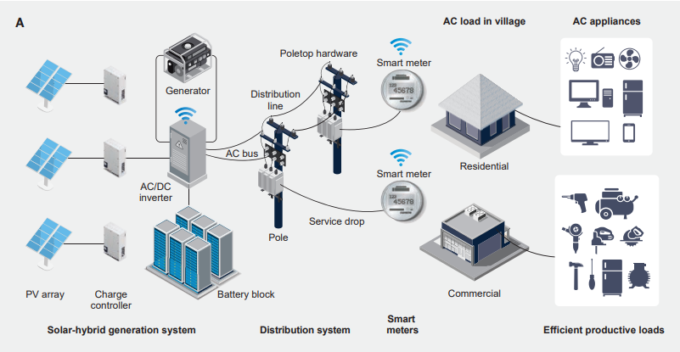
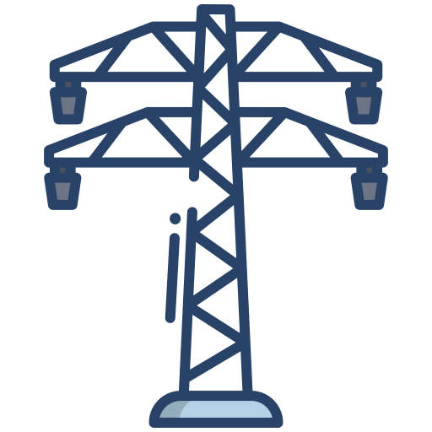
Third-Generation Hybrid Mini-Grid
Hybrid mini grids consist of specialized components for the generation, distribution, metering, and consumption of electricity.
A typical third-generation mini grid comprises:
Hybrid generation system
Renewable Generation Tech (e.g.: PV, Wind, Hydro)
Batteries
Charge controllers
Inverters
Diesel backup generators
Distribution network
Poles
Low-voltage wires
Smart meters
Not necessarily isolated
Third-generation mini-grids are being designed to be grid-compatible, deployed by private operators in areas where the state utility has failed to provide reliable service, especially during peak hours.
Example of a common third generation solar-hybrid mini grid setup [2]
Notes:
Third-Generation Hybrid Mini-Grids are usually composed of various elements specifically designed for generating, distributing, metering, and consuming electricity. They are comprised of renewable generation technologies like PV and wind systems, storage solutions such as batteries, and sophisticated controls including inverters and smart meters that work in concert to ensure electricity flows efficiently to homes, businesses or public facilities. These systems are not just standalone solutions but are increasingly designed to complement and connect with the main grid, enhancing resilience and supporting demand, embodying the latest in energy technology innovation.

Slide 6
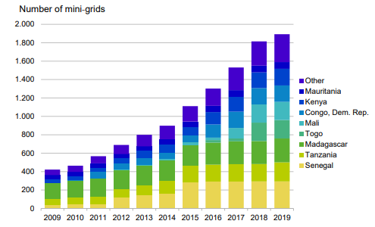
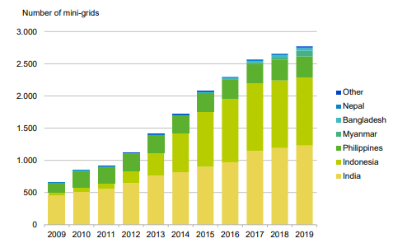
Mini-grids Market Status
Today the mini-grid market is nascent, despite being the least-cost option for electricity access in many areas.
> 21500
0,49-0,68 $/kWh
Estimated cost of electricity for isolated solar hybrid mini-grids for productive use customers and households [3]
Installed mini-grids in Sub-Saharan Africa, Asia and Latin America [2]
Historical cumulatively installed mini-grids in:
Central and East Asia
South Asia
> 7300 installed mini-grids
> 9500 installed mini-grids
Sub-Saharan Africa
Other Regions
Africa
>1000 installed mini-grids
> 3000 installed mini-grids
Asia
Number of installed mini grids by region – graphical elaboration on ESMAP data [2]
Number of cumulatively installed mini-grids [3]
Notes:
With over 21,500 installations lighting up Sub-Saharan Africa, Asia, and Latin America, mini-grids are playing a relevant role in areas where traditional grid access is challenging. The cost-effectiveness is clear, with prices for electricity from these systems ranging between 49 to 68 cents per kilowatt-hour, particularly advantageous for isolated solar hybrid mini-grids serving both households and businesses. Looking at the global distribution, South Asia lead with more than 9500 installations, while Central and East Asia follows closely with around 7300. Africa is catching up with over 3,000, reflecting a growing commitment to renewable energy infrastructures. Countries in Sub-Saharan Africa, such as Kenya and Mozambique, are leading the charge with historically upward trends in installations, as nations increasingly recognize the value of mini-grids in achieving energy independence and sustainable development goals.

Slide 7
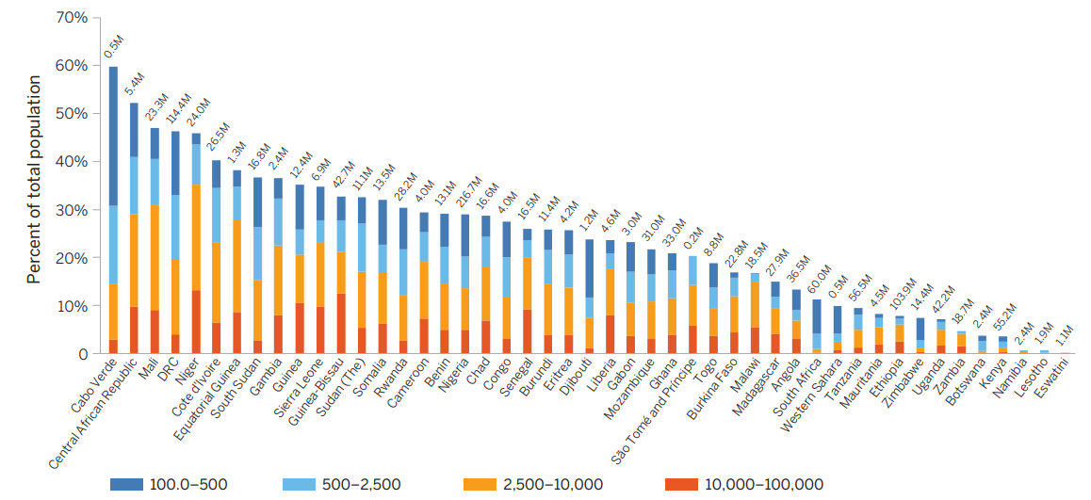
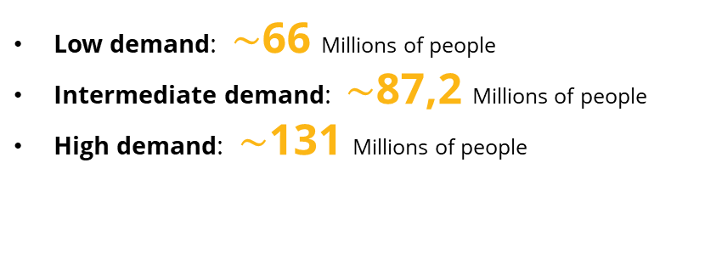
Mini-grids Addressable Market
According to an ESMAP Least-Cost Electrification analysis [2] from The Global Electrification Platform (GEP) using OnSSET, the potential addressable market for mini-grids depending on different levels of demand is:
Low demand: $\sim$66 Millions of people
Intermediate demand: $\sim$87,2 Millions of people
High demand: $\sim$131 Millions of people
Sub-Saharan Africa’s addressable market for mini grids - ESMAP Least-Cost Electrification analysis [2]
Notes:
This role is being confirmed by several studies. For instance, a recent ESMAP Least-Cost Electrification analysis sheds light on the vast market potential for mini-grids, driven by varying levels of demand. In regions with low demand, about 66 million people could benefit, while intermediate and high demand scenarios indicate opportunities for approximately 87.2 and 131 million people, respectively.

Slide 8
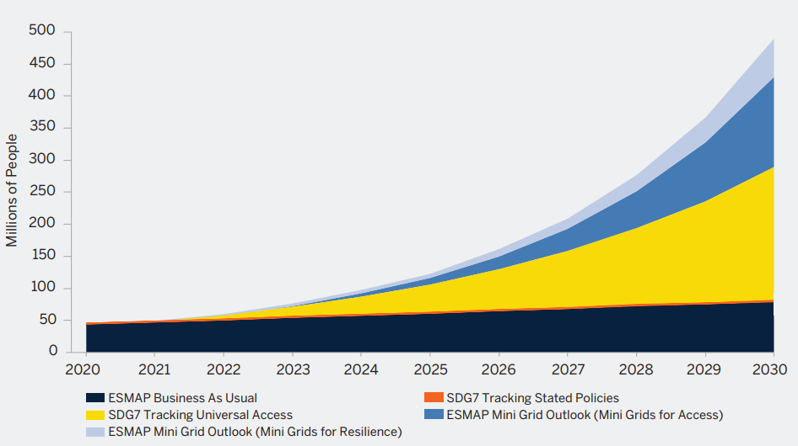
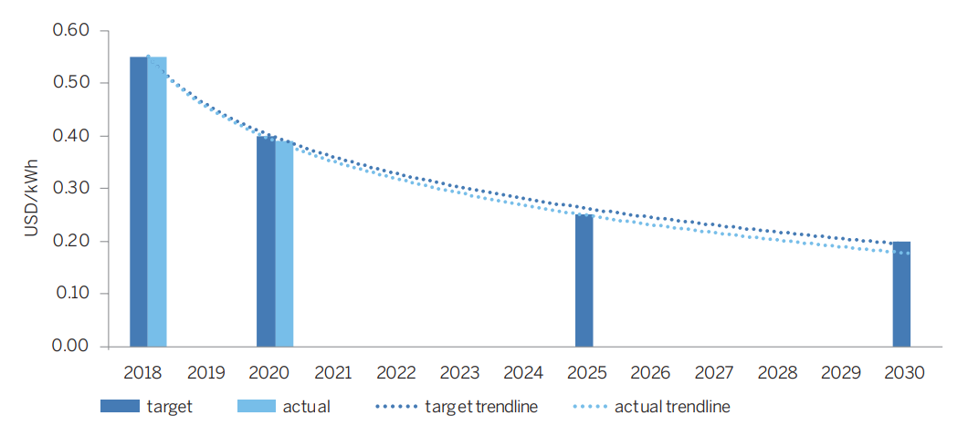
Mini-grids Market Projections
The current pace of mini grid development, as per ESMAP's analysis (Business-As-Usual or BAU scenario), forecasts serving 71.5 million people with an investment of $47 billion by 2030. However, contrasting scenarios reveal different scales of ambition. The "SDG7 Tracking 2019: Universal Access" scenario aims significantly higher, proposing to connect nearly 430 million people through over 185,000 mini grids, requiring more than $280 billion.
0,20 $/kWh
estimated LCOE by 2030 [2]
Number of people connected to mini grids under business-as-usual and universal access
scenarios, 2020–30 [2]
LCOE of best-in-class solar hybrid mini grids [2]
Notes:
Shifting focus to the future, market projections for mini-grids offer insightful perspectives for energy expansion, crucial aspect for stakeholders and policymakers. ESMAP's analysis presents a dual forecast. The Business-As-Usual scenario estimates reaching 71.5 million people with a $47 billion investment by 2030. In contrast, the 'SDG7 Tracking 2019: Universal Access' scenario is more ambitious, aiming to connect 430 million people through a network of 185,000 mini-grids, necessitating over $280 billion. This bold approach forecasts a sharp decline in solar hybrid mini-grid levelized cost of energy to 20 cents per kilowatt-hour, setting the stage for affordable and extensive clean energy deployment

Slide 9
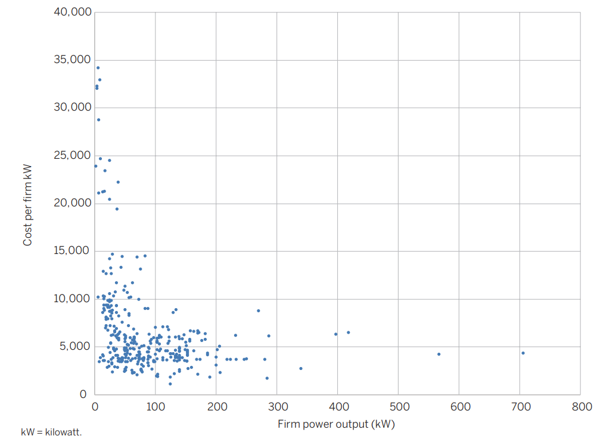
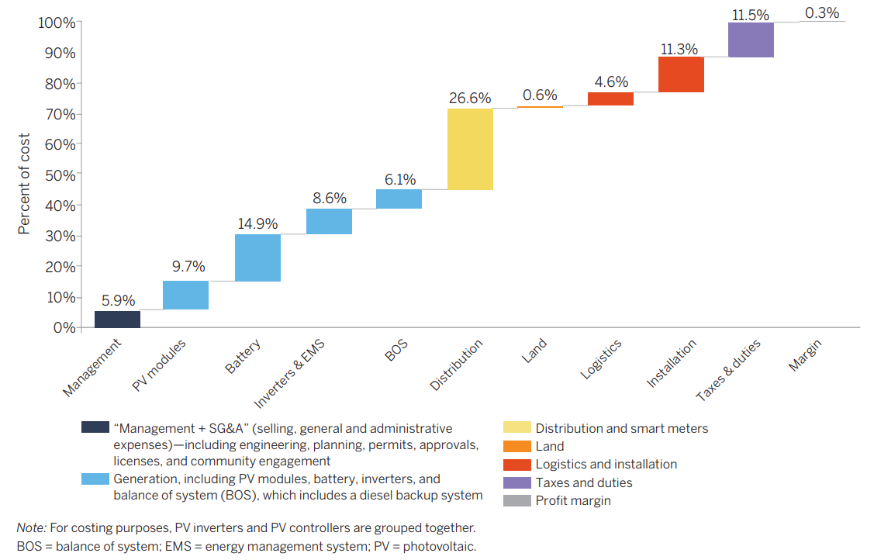
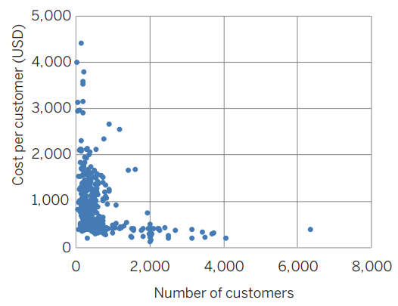

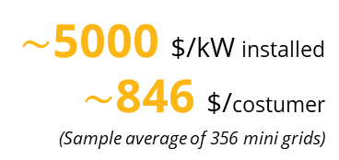
Mini-grids Costs
In the mini-grid sector, a primary concern is the total investment cost relative to the capacity provided.
$\sim$5000 $/kW installed
$\sim$846 $/costumer
(Sample average of 356 mini grids)
Total economic cost of mini grids per kW as a function of firm power output and Mini grid economic costs per customer [2]
Average share of component economic costs in total capital costs of mini grids [2]
In general, mini grids display economies of scale in generation, with smaller mini grids costing more per kW than larger mini grids. In addition, on average, for every additional 100 customers a mini grid serves, its per customer costs fall by about $9. Whereas in 2018 most mini grids had fewer than 200 customers, today most serve between 200 and 600 customers.
Notes:
In the mini-grid sector, cost concerns are front and center. A key metric in evaluating their economic viability is the investment cost relative to capacity. On average, installing capacity comes at approximately $5,000 per kilowatt, with the customer bearing around $846. As we delve deeper into the cost structure of mini-grids, it's evident that expenses are varied and multi-faceted. The bulk of economic costs are in the hardware components like generation equipment, which includes PV modules and batteries, making up over a third of total costs (almost 40%). Distribution systems and smart meters also constitute a significant expense, 26,6%, highlighting the complex nature of building a reliable mini-grid infrastructure. Economies of scale are evident in this sector; larger grids generally incur lower costs per kilowatt-hour. Moreover, for every 100 additional customers a mini-grid serves, it has been estimated that the cost per customer can decrease by about $9. This trend reflects a significant improvement from 2018, where most grids served fewer than 200 customers, to the current landscape where the customer base typically ranges between 200 to 600 individuals.

Slide 10
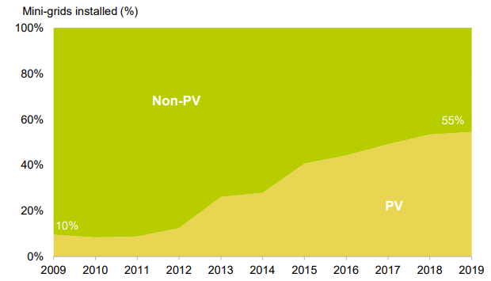
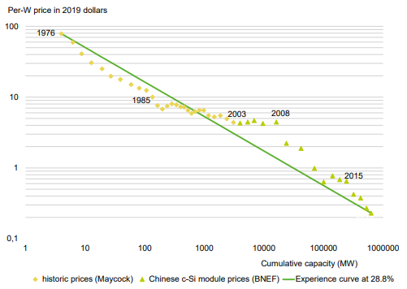
Mini-grids Technologies Trends
There is a strong mandate to hybridize diesel mini-grids with the use of solar and batteries as storage system.
55%
of operating mini-grids incorporating PV, x5 increase from 2009 to 2019 [3]
37%
further reduction in c-Si module prices can be achieved by 2025 [3]
Rapid uptake of PV in the mini-grid sector, 2009-2019 [3]
PV module experience curve (logarithmic) [3]
Notes:
Mini-grid technology trends are leaning increasingly towards green energy solutions. A striking 55% of operating mini-grids now incorporate photovoltaic, or PV, systems, which is a fivefold increase from the year 2009 to 2019. This surge reflects a global shift to hybridize diesel grids with sustainable solar energy and battery storage. Moreover, the cost of solar technology is expected to drop further, with a 37% reduction in crystalline silicon, or c-Si, module prices projected by 2025.

Slide 11
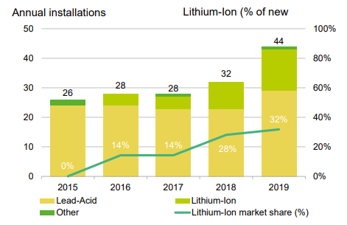
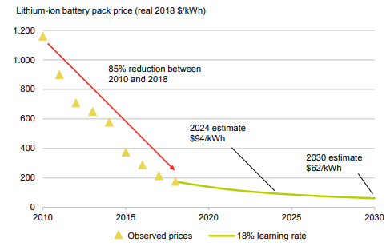
Mini-grids Technologies Trends
Mini-grids use various storage technologies, including lithium-ion, lead-acid and flow batteries. Overall, developers in emerging markets favour lead-acid batteries because they are more readily available and have a lower upfront cost even if lithium-ion batteries usage is constantly increasing over the years.
0,62 $/kWh
estimated Lithium-ion battery pack price by 2030 [3]
Battery technologies used for installed mini-grids [3]
Volume-weighted average lithium-ion battery prices, historical and forecast [3]
Notes:
Continuing the exploration of mini-grid technology trends, let’s focus on energy storage. Currently, Lithium-ion, lead-acid, and flow batteries are among the most commonly used storage solutions. While lead-acid batteries remain popular due to their widespread availability and lower initial costs, there's a noticeable uptick in the adoption of lithium-ion batteries over recent years. Projections suggest a promising future for lithium-ion technology, with an estimated price of $0.62 per kilowatt-hour for battery packs by 2030. This anticipated cost reduction underscores the potential for lithium-ion batteries to become increasingly prevalent in mini-grid deployments, offering enhanced efficiency and reliability in energy storage solutions.

Slide 12
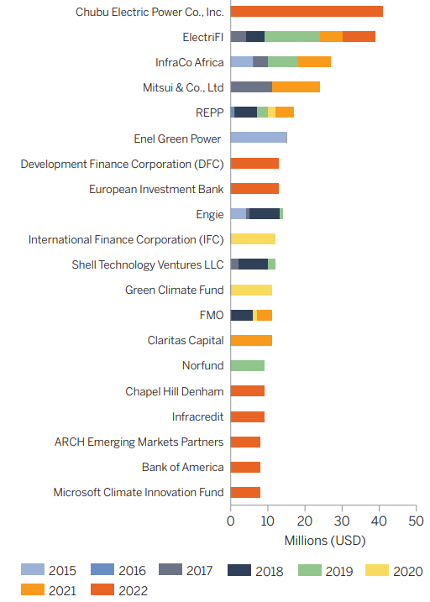
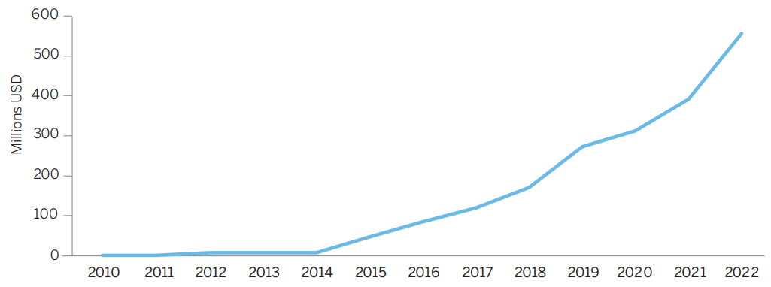
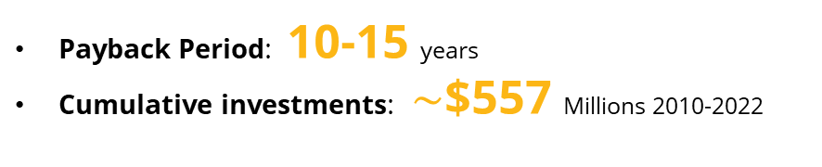
Financing Solar Mini-Grid
The financing of mini-grids is a critical area that involves both public and private sectors, focusing on the diverse financial needs of developers, from large companies to smaller, local entities, including female-led businesses. Essential financial mechanisms include equity, debt, subsidies, and risk-sharing, with options like project and corporate finance playing pivotal roles.
Payback Period: 10-15 years
Cumulative investments: $\sim$$557 Millions 2010-2022
Cumulative private-sector investment in mini grid companies [2]
Top 20 investors in mini grid companies
by cumulative investment [2]
Notes:
After addressing the intricacies of costs, it’s the turn for a more dynamic and hopeful aspect: financing solar mini-grids. The financing of mini-grids is a critical area that involves both the public and private sectors, catering to the diverse financial needs of developers, from large companies to smaller, local entities, including female-led businesses. Equity, debt, subsidies, and risk-sharing mechanisms are essential tools in this landscape, with project and corporate finance playing pivotal roles. Thanks to these strategies, investments in solar mini-grids have seen a significant boost, resulting in a payback period averaging between 10 to 15 years. Cumulative investments of approximately $557 million from 2010 to 2022 underscore the growing confidence and commitment to sustainable energy solutions, notably marked by a sharp increase in private-sector investment in mini-grid companies since 2014.

Slide 13
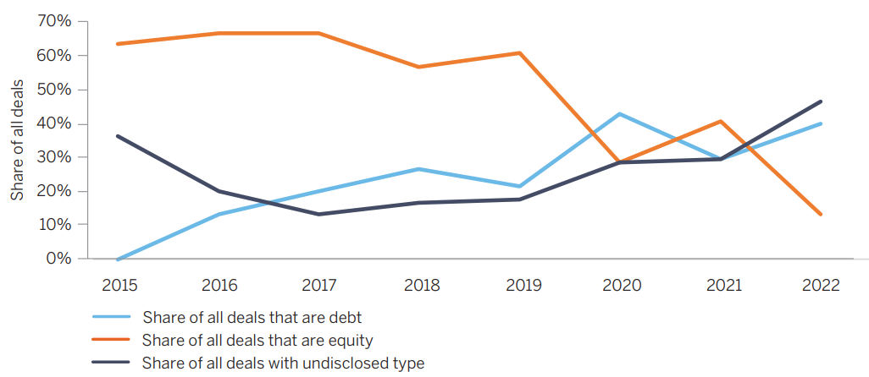

Debt and Equity Financing
In sub-Saharan Africa, the mini-grid sector faces challenges such as high capital costs and market fragmentation. Recently, there’s been notable shift in financing trends: a decrease in equity deals and an increase in debt financing. This trend suggests the industry's maturation, as more established companies with proven cash flows become less risky, attracting debt investors.
Debt Financing
Involves borrowing capital with the obligation of repayment at a high-interest rate, often unattractive due to high perceived risks in the mini-grid market.
Equity Financing
Involves investment from the developer’s own capital or project promoters and is characterized by high returns on investment due to the high-risk nature of mini-grid projects.
Trends in debt and equity [2]
Built-In Advanced Feature in MicroGridsPy:
Weighted Average Cost of Capital (WACC) implementation, modelling debt and equity financing
Notes:
Let's pause for a moment to delve deeper into the topic of equity deals and debt financing in the solar mini-grid sector. In sub-Saharan Africa, where the mini-grid industry faces challenges such as high capital costs and market fragmentation, recent financing trends have undergone a notable shift. In particular, it has been observed a decrease in equity deals and a corresponding increase in debt financing, the industry's maturation. Indeed, equity financing involves investment from the developer’s own capital or project promoters, offering high returns on investment due to the high-risk nature of mini-grid projects, while debt financing entails borrowing capital with the obligation of repayment at a high-interest rate, often perceived as unattractive due to market risks. This shift reflects the growing confidence of investors in more established companies with proven cash flows, making them less risky and attractive for debt investment. Last but not least: MicroGridsPy introduces the possibility to include the Weighted Average Cost of Capital (WACC) within the model, a key indicator that includes both debt and equity financing providing an advanced tool for financial analysis in mini-grid projects.

Slide 14




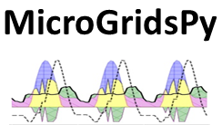




Electrification Planning Tools
Electrification planning tools are diverse and cater to different aspects of the process. They include web-based platforms, offering accessible data and analytics for a wide audience; open-source computational models, providing detailed technical analysis for in-depth research; and commercial decision support tools, delivering proprietary, professional-grade solutions for the energy sector.
Web-Based Platform
Interactive, user-friendly online platforms that provide access to data, analytics, and simulations for electrification planning. They are designed to be accessible to a wide range of users, from policymakers to project developers.
Open-Source Computational Models
More technical tools, often requiring specialized knowledge, that use algorithms and simulations to analyse electrification scenarios, costs, and impacts. They are typically used for in-depth analysis and research.
Commercial Models
Proprietary tools developed by companies, offering specialized services and features for electrification planning. They often include customer support and are tailored for professional use in the energy sector.
Notes:
Finally, let's take a moment to explore the diverse array of tools available for electrification planning. They can be grouped into three main categories:
- Web-Based Platforms: interactive, user-friendly online platforms designed to provide accessible data, analytics, and simulations for electrification planning, serving a wide range of users, from policymakers to project developers. Examples include the Energy Access Explorer or the Global Electrification Platform.
- Open-Source Computational Models which are more technical tools, requiring specialized knowledge, that use algorithms and simulations to analyze electrification scenarios, costs, and impacts, ideal for in-depth analysis and research. Examples include OseMosys, PyPSA, Calliope and, of course, MicroGridsPy.
- Commercial Decision Support Tools, proprietary tools developed by companies, offering specialized services and features for electrification planning. These tools often include customer support and are tailored for professional use in the energy sector. The main example in modelling off-grid systems is HOMER.

Slide 15
References
[1] Korkovelos et al., A Retrospective Analysis of Energy Access with a Focus on the Role of Mini-Grids. Sustainability 2020. https://doi.org/10.3390/su12051793
[2] ESMAP, MINI GRIDS FOR HALF A BILLION PEOPLE, Market Outlook and Handbook for Decision Makers. 2022
[3] Minigrid Partnership, State of the Global Mini-grids Market Report. 2020

