Slide 1

Off-Grid Energy Systems Modelling with MicroGridsPy
Lesson 7:
Technology Characterization
PART A

Slide 2

Lesson 7: Contents
Renewable Technologies Characterization in MicroGridsPy
Gain an understanding of how to characterize renewable generation technologies in MicroGridsPy, including how to input electricity output time series and basic parameters like efficiency, costs, and emissions. Learn the basic mathematical formulations used for calculating the total investment and operational & maintenance costs associated with these technologies
Storage Systems Characterization in MicroGridsPy
Develop the ability to characterize storage systems within MicroGridsPy by specifying investment and operational costs, performance metrics, and operational parameters such as depth of discharge. Understand the basic mathematical formulation for simulating the financial and operational performance
Navigating and Utilizing the MicroGridsPy Interface
Learn to navigate the MicroGridsPy interface effectively, including how to update parameters for renewable sources and storage systems
Notes:
In this lecture, you will learn how to characterize renewable generation technologies and storage systems in MicroGridsPy, including inputting electricity output time series, efficiency, costs, and emissions. You'll also understand the mathematical formulations for investment and operational costs, and navigate the MicroGridsPy interface to update parameters for renewable sources and storage systems.

Slide 3
Lesson 7: Learning Outcomes
At the end of this unit, participants will be able to :
Understand how to characterise Renewable Technologies in MicroGridsPy
Characterize Storage Systems in MicroGridsPy
Navigate and Utilize the MicroGridsPy Interface
Notes:
In this lecture, you will learn how to characterize renewable generation technologies and storage systems in MicroGridsPy, including inputting electricity output time series, efficiency, costs, and emissions. You'll also understand the mathematical formulations for investment and operational costs, and navigate the MicroGridsPy interface to update parameters for renewable sources and storage systems.

Slide 4
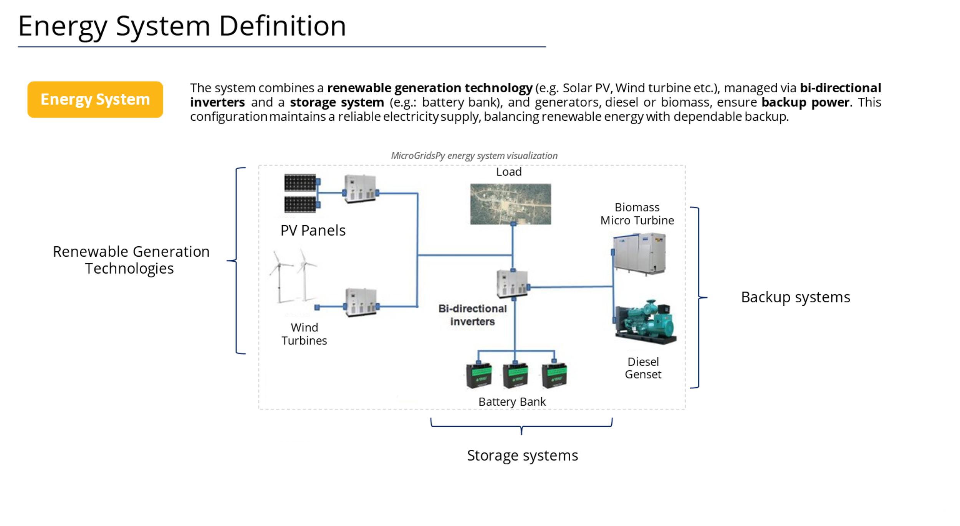
Technology Characterization in MicroGridsPy
Technology characterization in MicroGridsPy encompasses the modelling of renewable sources, energy storage, and backup systems, each defined by specific parameters that ensure a precise representation of their operational and economic profiles
Renewable Generation Technologies
Any renewable generation technologies can be accurately modelled in MicroGridsPy by inputting their electricity output time series and basic parameters like, efficiency, costs, and emissions. For solar and wind resources, the process is streamlined with integrated estimation features.
Storage system
MicroGridsPy models energy storage using a singular battery type, incorporating parameters for costs, efficiencies, discharge depth, cycle life, and charge times to simulate its operation and financial impact within the mini-grid system.
Backup system
MicroGridsPy enables the modelling of backup generators, allowing for multiple types and fuel options, such as diesel or biogas. This flexibility facilitates the design of diversified backup systems tailored to specific energy needs and fuel availability scenarios
Notes:
Technology characterization in MicroGridsPy encompasses the modeling of renewable sources, energy storage, and backup systems, each defined by specific parameters to ensure precise operational and economic profiles. In particular:
- Renewable Generation Technologies: Any renewable generation technologies can be accurately modeled by inputting their electricity output time series and basic parameters like efficiency, costs, and emissions. For solar and wind resources, integrated estimation features streamline the process.
- Storage System: MicroGridsPy models energy storage using a singular battery type, incorporating parameters for costs, efficiencies, discharge depth, cycle life, and charge times to simulate its operational and financial impact within the mini-grid system.
- Backup System: MicroGridsPy enables the modeling of backup generators, allowing for multiple types and fuel options, such as diesel or biogas. This flexibility facilitates the design of diversified backup systems tailored to specific energy needs and fuel availability scenarios.
In the current lecture, we will focus on renewables and storage, while in the next one, we will cover backup systems.

Slide 5
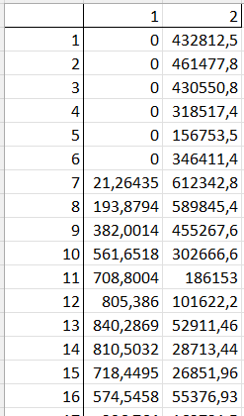



Renewable Generation Technologies
In MicroGridsPy, the process of characterizing technology involves defining the types, energy conversion efficiency, costs, and sustainability of each renewable sources
Each column maps to a renewable source's output
Types
Energy conversion
RES_Sources [unit]
Number of Renewable Energy Sources (RES) types to be included within the possible generation sources
RES_Names [text]
RES name for each sources within MicroGridsPy
RES_Nominal_Capacity [W]
Capacity per unit of electricity production provided in the RES time series data csv file
RES_Inverter_Efficiency [fraction]
Efficiency of the inverter connected to each RES (1 in case of AC bus)
Costs
Sustainability
RES_Lifetime [years]
Lifetime of each RES
RES_unit_CO2_emissions [kgCO2/kW]
Specific emissions of capacity installed (indirect emissions)
RES_Specific_Investment_Cost [$/W]
Specific investment cost for each type of RES
RES_Specific_OM_Cost [fraction]
O&M cost for each type of RES as a fraction of the specific investment cost
Code/Inputs/RES_Time_Series
Notes:
Let’s start with renewables generation technologies. The core of renewables modelling in MicroGridsPy involves time series data, which details the unit of electricity production relative to the nominal capacity of the renewable technology. This data, which can be imported from your own sources or generated using the NASA POWER API for solar and wind energy, models resource availability and energy production over a typical year.
In addition to time series data, several other parameters must be defined. Types include the number and names of renewable energy sources. Costs involve specific investment costs and operation and maintenance costs as a fraction of the investment. Sustainability parameters encompass the lifetime of each source and the unit CO2 emissions associated with the installed capacity. Energy conversion efficiency is also crucial, requiring input on nominal capacity and inverter efficiency for each source.

Slide 6
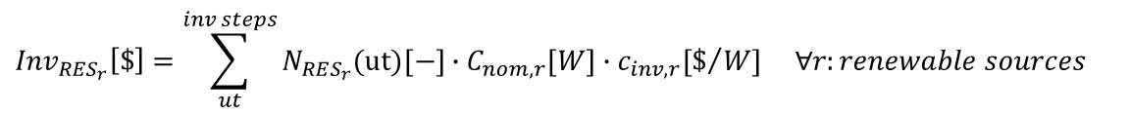
Mathematical Formulation
Here below the most relevant equations implemented within the core model involving hourly energy produced by each renewables source, total investment and fixed O&M costs.
Electricity produced by a single unit of renewable capacity
Number of renewable capacity units installed
Energy produced:
$$E_{{RES}_{r}}\left(t\right) \left[Wh\right]=η_{INVr}\left[−\right]∙E_{{RES}_{r} }^{unit}\left(t\right) [Wh]∙N_{RES_{r}}(ut)[−]$$
Nominal capacity associated to a single unit of renewable
$${Inv}_{{RES}_{r}}\left[\$\right]=\sum_{ut}^{inv steps}{N_{RES_{r}}(ut)[−]}∙C_{nom,r}[W]∙c_{inv,r}[\$/{W] ∀r:renewable sources}$$
Total Investment costs:
Specific investment costs
$${O\&M}_{{RES}_{r}}\left[\$\right]=\sum_{ut}^{inv steps}{N_{RES_{r}}(ut)[−]}∙C_{nom,r}[W]∙c_{inv}[\$/{W]}∙c_{O\&M,r}\left[−\right] ∀r:renewable sources$$
Total Fixed O&M costs:
Specific O&M costs as a fraction of the investment cost
Renewables
Notes:
Here are some of the most relevant equations implemented within the core model of MicroGridsPy, which involve calculating hourly energy production by each renewable source, total investment costs, and fixed operation and maintenance (O&M) costs. In particular:
- The energy produced by a renewable unit is determined by multiplying the inverter efficiency with the unit energy production and the number of installed capacity units which is the variable to be optimized.
- The total investment cost is calculated by summing the product of the number of units, the nominal capacity of each unit, and the specific investment cost.
- The total fixed O&M costs are found by summing the product of the number of units, their nominal capacity, the specific investment cost, and the O&M cost as a fraction of the investment.

Slide 7
Storage system
In MicroGridsPy, characterizing the storage system involves specifying the investment and operational costs, performance metrics, operational parameters such as depth of discharge as well as sustainability aspects.
Costs
Operation
Battery_Depth_of_Discharge [fraction]
Depth of discharge of the battery bank (maximum amount of discharge)
Maximum_Battery_Discharge_Time [hours]
Maximum time to discharge the battery bank
Maximum_Battery_Charge_Time [hours]
Maximum time to charge the battery bank
Battery_Cycles [unit]
Maximum number of cycles before degradation of the battery
Battery_Specific_Investment_Cost [$/Wh]
Specific investment cost of the battery bank
Battery_Specific_Electronic_Investment_Cost [$/Wh]
Specific investment cost of non-replaceable parts (electronics) of the battery bank
Battery_Specific_OM_Cost [fraction]
O&M cost of the battery bank as a fraction of the specific investment cost
Performance
Battery_Discharge_Battery_Efficiency [fraction]
Discharge efficiency of the battery bank
Battery_Charge_Battery_Efficiency [fraction]
Charge efficiency of the battery bank
Sustainability
BESS_unit_CO2_emission [kgCO2/kWh]
Emissions for each kWh of capacity installed (indirect emissions)
Notes:
Moving on, we have storage system technology. In MicroGridsPy, characterizing the storage system involves specifying various parameters. Investment and operational costs include the specific investment cost per watt-hour, electronics costs, and O&M costs. Performance metrics cover the discharge and charge efficiency of the battery. Operational parameters include the depth of discharge, maximum discharge and charge times, and the battery's cycle life. Sustainability aspects are addressed by considering the unit CO2 emissions per kilowatt-hour of installed capacity. These parameters ensure a comprehensive representation of the storage system's operational and economic profiles.

Slide 8
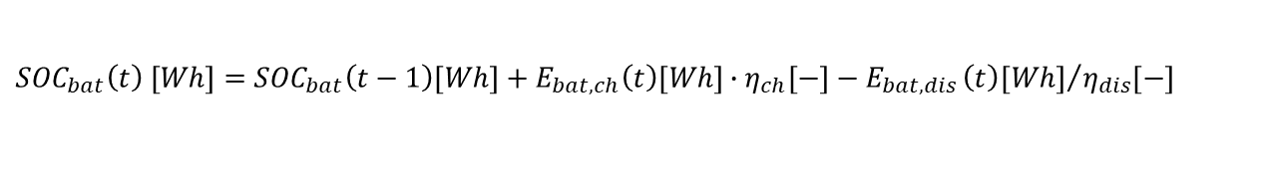

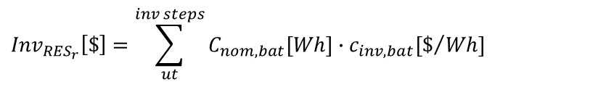

Mathematical Formulation
Here below the most relevant equations implemented within the core model involving state of charge variation, total investment and fixed O&M costs.
Energy flow charging the battery
State of Charge:
$${SOC}_{bat}\left(t\right) [Wh]={SOC}_{bat}\left(t−1\right)[Wh]+E_{bat,ch}\left(t\right)[Wh]∙η_{ch}[−]−E_{bat,dis}{\left(t\right)[Wh]}/{η_{dis}[−]}$$
$${SOC}_{bat}\left(t\right) \left[Wh\right]≤C_{nom,bat} \left[W\right]∙∆t [h]$$
Energy flow leaving the battery to supply the demand
Main Constraints:
$${SOC}_{bat}\left(t\right)\left[Wh\right]≥C_{nom,bat}\left[W\right]∙∆t \left[h\right]∙(1−{Depth}_{disch})$$
Nominal capacity of the battery bank
$${Inv}_{{RES}_{r}}\left[\$\right]=\sum_{ut}^{inv steps}{C_{nom,bat}[Wh]∙c_{inv,bat}[\$/{Wh]}}$$
Total Investment costs:
Specific investment costs
$${O\&M}_{{RES}_{r}}\left[\$\right]=\sum_{ut}^{inv steps}{C_{nom,bat}[Wh]∙c_{inv,bat}[\$/{Wh]}∙c_{O\&M,r}[−]}$$
Total Fixed O&M costs:
Specific O&M costs as a fraction of the investment cost
Batteries
Notes:
Here are the most relevant equations implemented within the core model of MicroGridsPy, focusing on the state of charge variation, total investment costs, and fixed O&M costs for storage systems. In particular:
- The state of charge of the battery is determined by accounting for the energy flow charging the battery and the energy flow discharging from the battery to supply the demand. The model ensures that the state of charge remains within the battery's capacity limits, considering the depth of discharge. In addition, it must always be less than or equal to the nominal capacity of the battery and greater than or equal to the nominal capacity adjusted for the depth of discharge, ensuring the battery operates within safe limits.
The total investment cost is calculated by summing the product of the nominal capacity of the battery bank (optimization variable) and the specific investment cost.
The total fixed O&M costs are determined by summing the product of the nominal capacity, specific investment cost, and the O&M cost fraction.

Slide 9
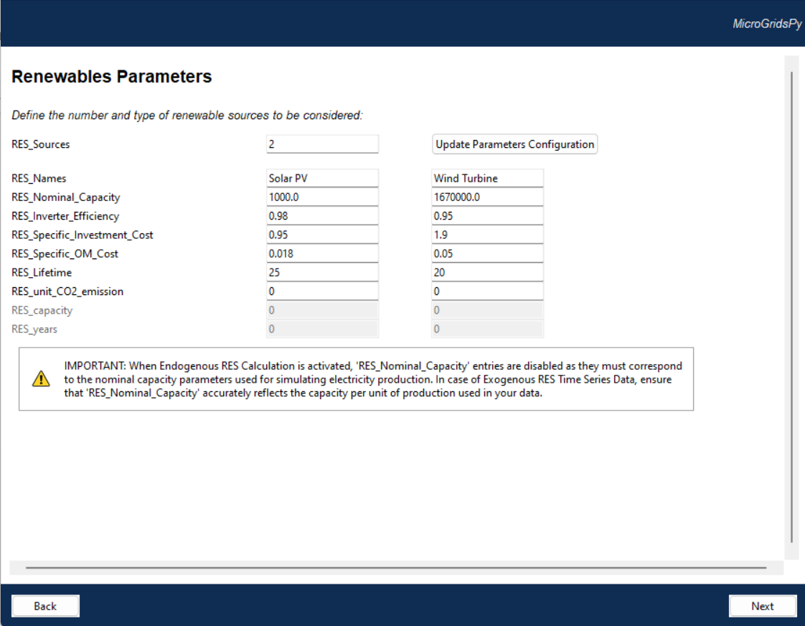

Renewables Parameters
Renewables Characterization
It allows setting types, capacities, efficiencies, costs, lifespans, emissions, and expected operational output for renewable energy technologies
Parameters that would be enabled or disabled according to specific advanced features activated (brownfield in the example)
Notes:
In the MicroGridsPy user interface, the characterization of renewables includes defining the types, capacities, efficiencies, costs, lifespans, emissions, and expected operational output.
You can specify parameters such as the nominal capacity, inverter efficiency, specific investment cost, specific O&M cost, lifetime, and unit CO2 emissions for each renewable source. Additionally, some parameters can be enabled or disabled based on specific advanced features activated within the model. For example, the type of investment, whether greenfield or brownfield, can affect which parameters are relevant and adjustable.

Slide 10
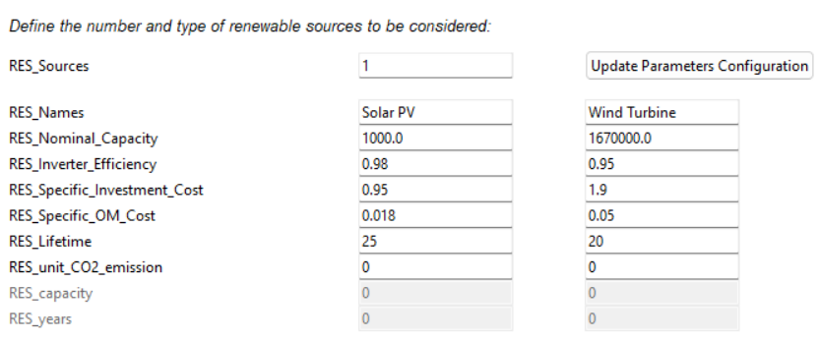

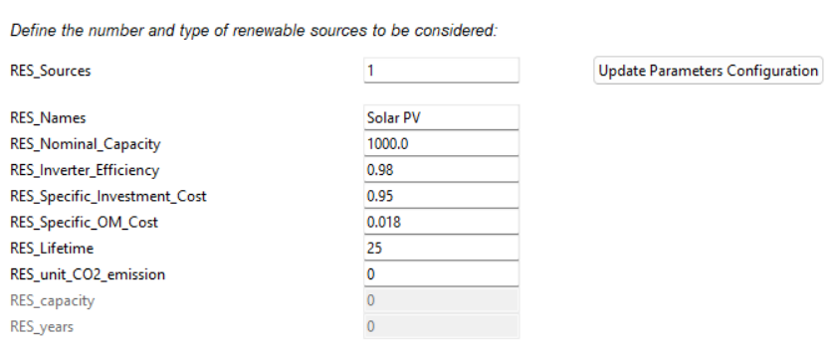
Renewables Parameters
The interface includes an "Update Parameters Configuration" button for applying new settings to renewable energy sources. In particular:
Set the number of renewable sources in RES_Sources
Press the button to update the entries for each parameter
Visualize the new set of default values for each parameter
Edit the values as preferred
Notes:
The MicroGridsPy interface includes an "Update Parameters Configuration" button for applying new settings to renewable energy sources. To configure the parameters:
Set the number of renewable sources in the "RES Sources" field
Press the "Update Parameters Configuration" button to update the entries for each parameter
Visualize the new set of default values for each parameter
Edit the values as preferred to match the specific details of your renewable energy technologies.

Slide 11
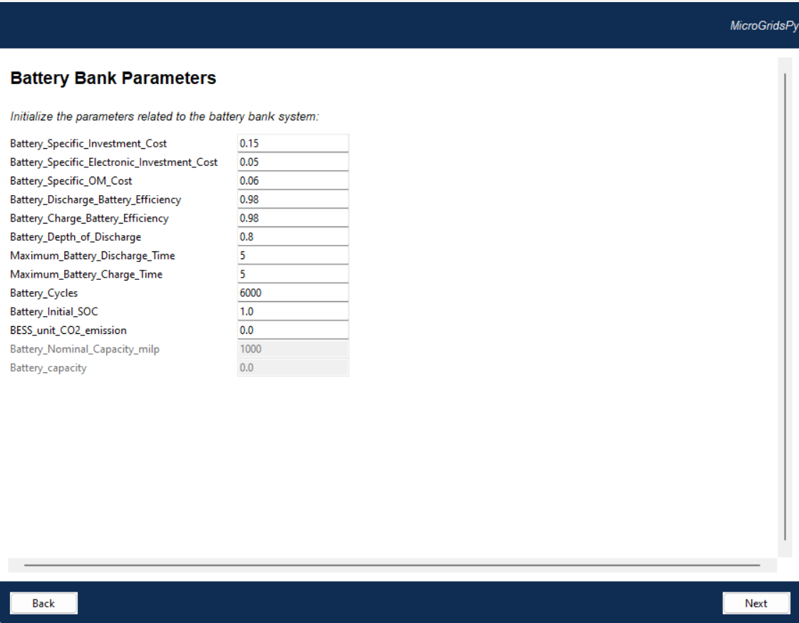
Battery bank Parameters
Battery bank Characterization
It allows setting investment costs, operational costs, charge and discharge efficiencies, battery lifecycle details, and CO2 emissions
Parameters which would be enabled or disabled according to specific advanced features activated (MILP and brownfield in the example)
Notes:
The MicroGridsPy interface allows for detailed characterization of the battery bank by setting various parameters. These include the specific investment cost per watt-hour, investment costs for non-replaceable parts, and operation and maintenance costs as a fraction of the investment. Additionally, users can define the charge and discharge efficiencies, depth of discharge, and the maximum discharge and charge times. Battery lifecycle parameters such as the number of cycles before degradation and the initial state of charge can also be specified. Sustainability aspects are covered by including CO2 emissions per kilowatt-hour of installed capacity. Some parameters may be enabled or disabled based on specific advanced features activated within the model, such as the type of investment and the selected modeling formulation.

