Slide 1

DATA FOR RENEWABLE ENERGY SYSTEMS
Lesson 4:
Data Analysis Techniques,
Part B

Slide 2
Lesson 4 Outline:
Quantitative vs Qualitative Data
2. Qualitative Data Analysis
3. Data Cleaning and Analysis Exercise

Slide 3
Lesson 4 Learning Outcomes:
At the end of this lesson, you will be able to:
Understand the differences between quantitative and qualitative analysis
Understand qualitative analysis.
Understand data cleaning and analysis using python.
Understand data visualization.
.

Slide 4
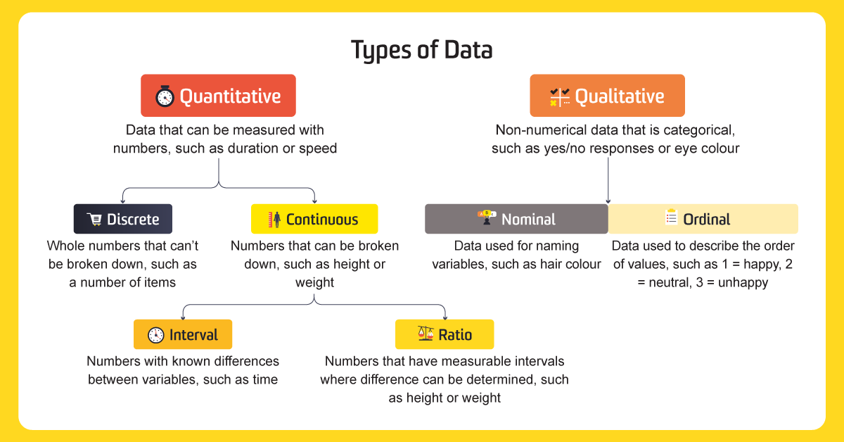
Qualitative vs Quantitative Data

Slide 5
Quantitative vs Qualitative Data
Strengths
Limitations
Qualitative Data
Allows researchers to explore complex phenomena in-depth.
Provides rich and detailed data that captures personal experiences and perspectives.
May uncover unexpected findings and generate new hypotheses
Can be time-consuming and resource-intensive to analyze data.
Data may be subjective and difficult to generalize
Data may suffer from researcher bias or interpretation
Quantitative Data
Allows researchers to test hypotheses and make causal inferences.
Provides objective and standardized data that can be easily compared
Can be analyzed using statistical techniques to identify patterns and relationships
May oversimplify or ignore complex phenomena.
May suffer from measurement error or response bias
May be limited in scope or fail to capture nuances of personal experiences
Notes:
Mixed-methods research: A combination between quantitative and qualitative where both complement and substantiate each other.

Slide 6
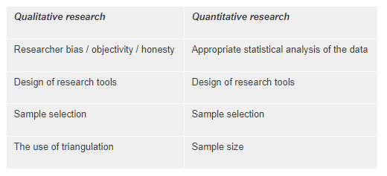
Reliability and Validity in Data
Reliability – the consistency and accuracy of the data. Usefulness of data to make an informed decision.
Validility – how well does your data measure against what what you want to measure. A measure of authenticity.
Validity and reliability share a complementary relationship
Cohen, et al., 2011 and Winter, 2000

Slide 7

Qualitative Data Analysis
Different from quantitative data analysis as it doesn’t look for the summary statistics or trying to prove a hypothesis.
Qualitative data analysis focuses on themes, contrast, diversity and connection as it is methodical and iterative.
Gives a comprehensive picture of human behaviour in various surroundings to understand the culture, processes or individuals being investigated (LaiYee, 2022).

Slide 8










Qualitative Data Analysis
Characteristics of Qualitative Research
Types of Qualitative Research
Inductive
Direct Observations
Naturalistic Inquiry
Case Study
Subjective
Researcher as participant
No right or wrong answers
Empathetic Neutrality
Interviews
Wholistic

Slide 9
Steps taken for Qualitative Data Analysis
Data Collection
1
Data Cleaning and Review
2
Developing data themes
3
Theme definition
4
Analysis
5
Report writing
6

Slide 10
Coding in Qualitative Data Analysis
Process of reviewing the data collected to develop and categories and themes that can then be linked to other similar data points.
Mainly a word or short phrase that represents the theme.
- Motivation
- Taste
- Uncertainty
- Awareness
Thematic area can be based on human behavior, concepts, research questions, key words and references.

Slide 11
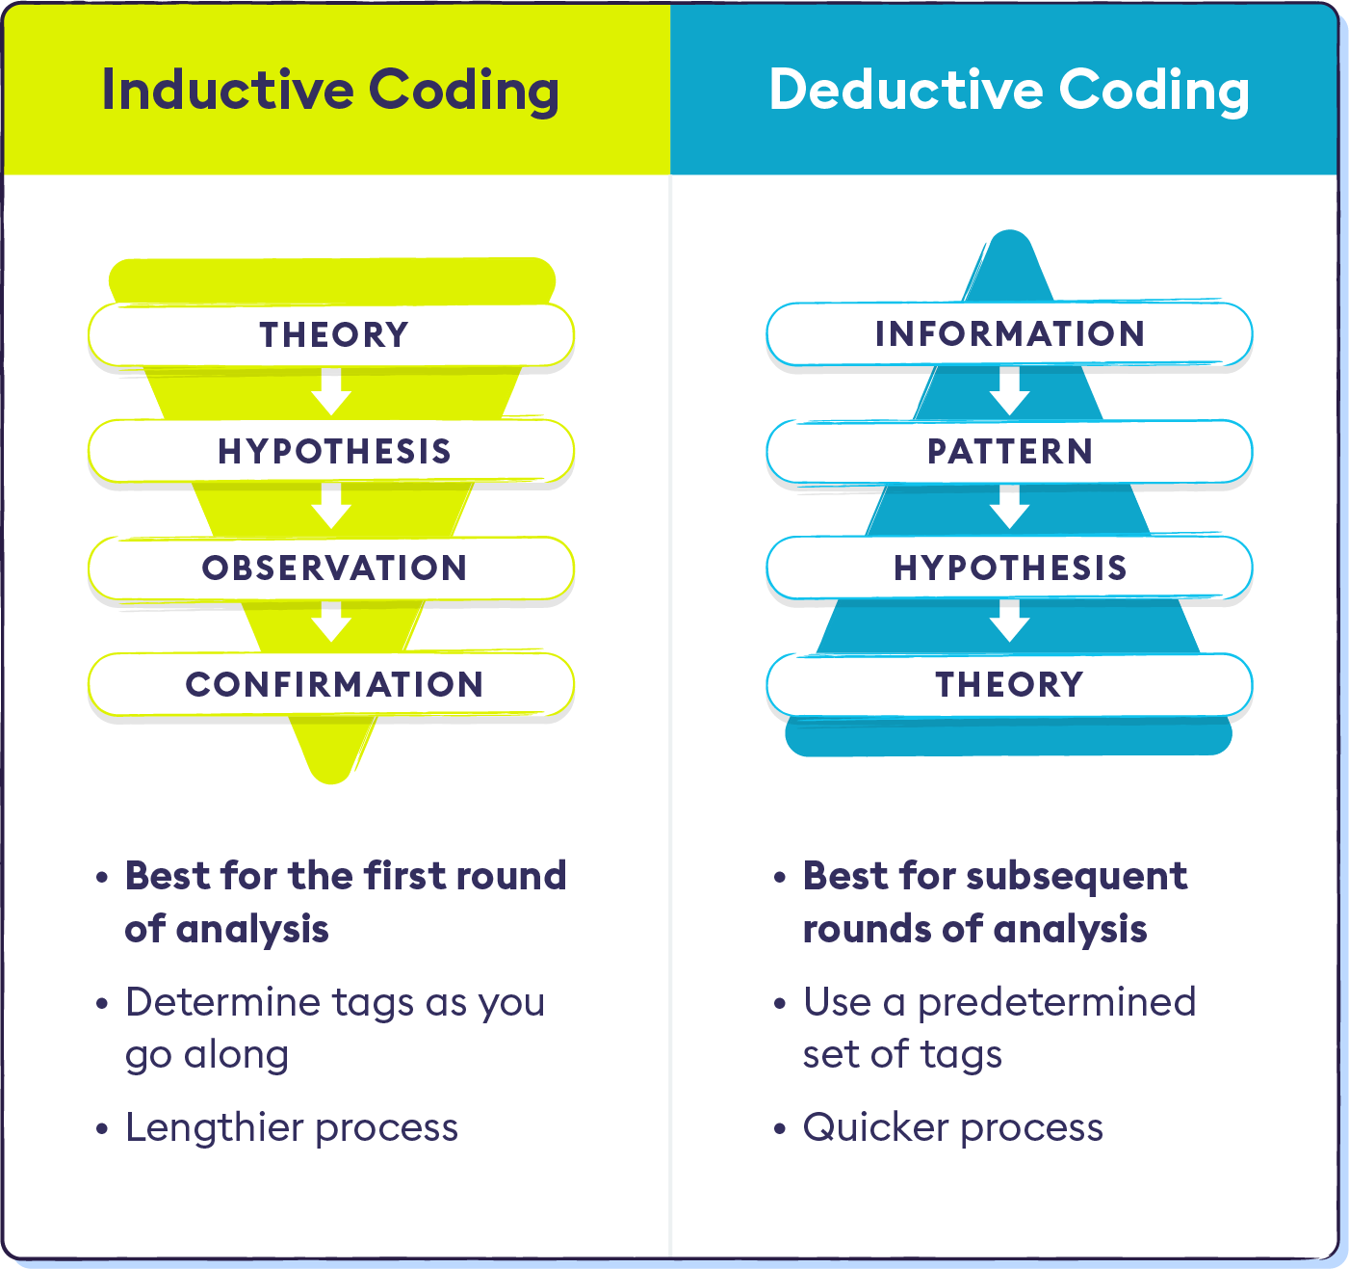
Coding in Qualitative Data Analysis
Qualitative Coding Techniques
Inductive Coding/Open Coding
        - Codes, themes or categories are developed from the data itself.
        - The data is transcribed and reviewed line by line.
        - Done at the first round of data analysis.
2. Deductive Coding/Open Coding
        - The codes, themes or categories are predetermined.
        - Done after the initial analysis or when the researcher has a theme in mind based on existing data.
Source: Chartermill

Slide 12
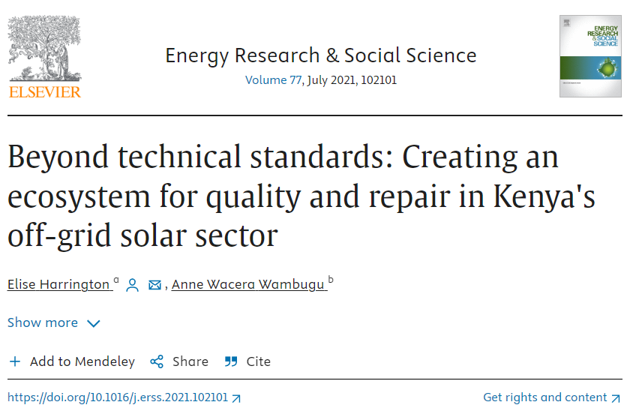
Case Study - Qualitative Data Analysis

Slide 13
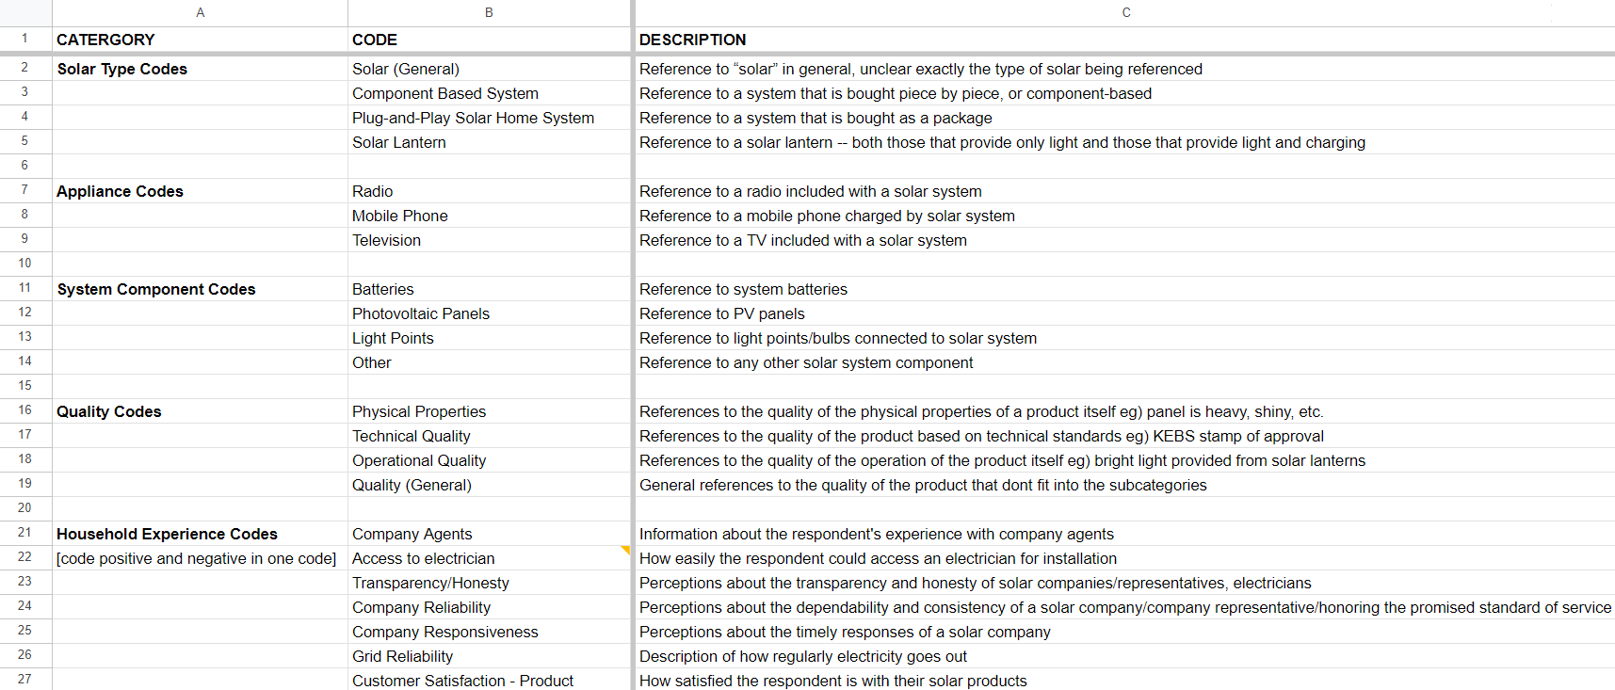
Coding in Qualitative Data Analysis
Notes:
When coding, continually ask yourself questions about the data. ❖ For example: ❖What is going on (context)? ❖What are people doing? ❖Toward what are persons orienting their thoughts? ❖What do these things take for granted? ❖How does context affect the statements?

Slide 14
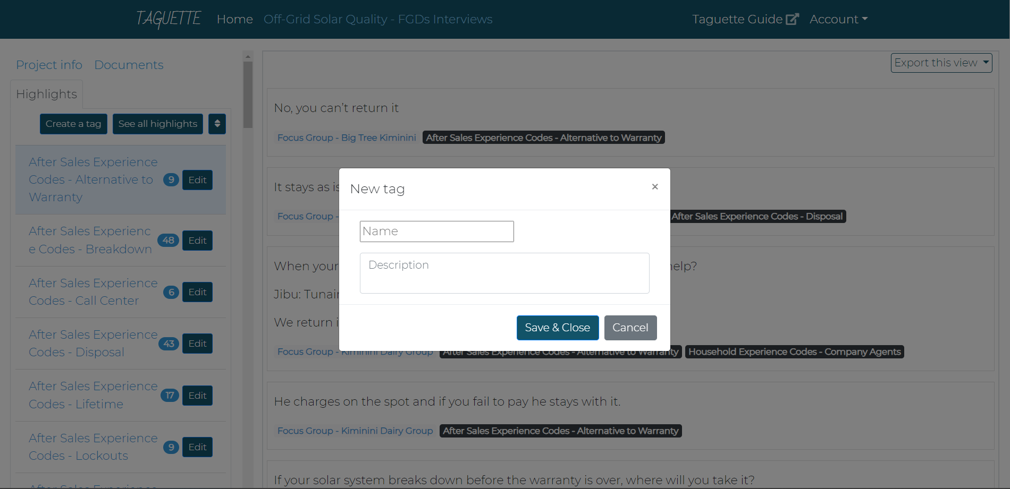
Coding in Qualitative Data Analysis
Notes:
When coding, continually ask yourself questions about the data. ❖ For example: ❖What is going on (context)? ❖What are people doing? ❖Toward what are persons orienting their thoughts? ❖What do these things take for granted? ❖How does context affect the statements?

Slide 15
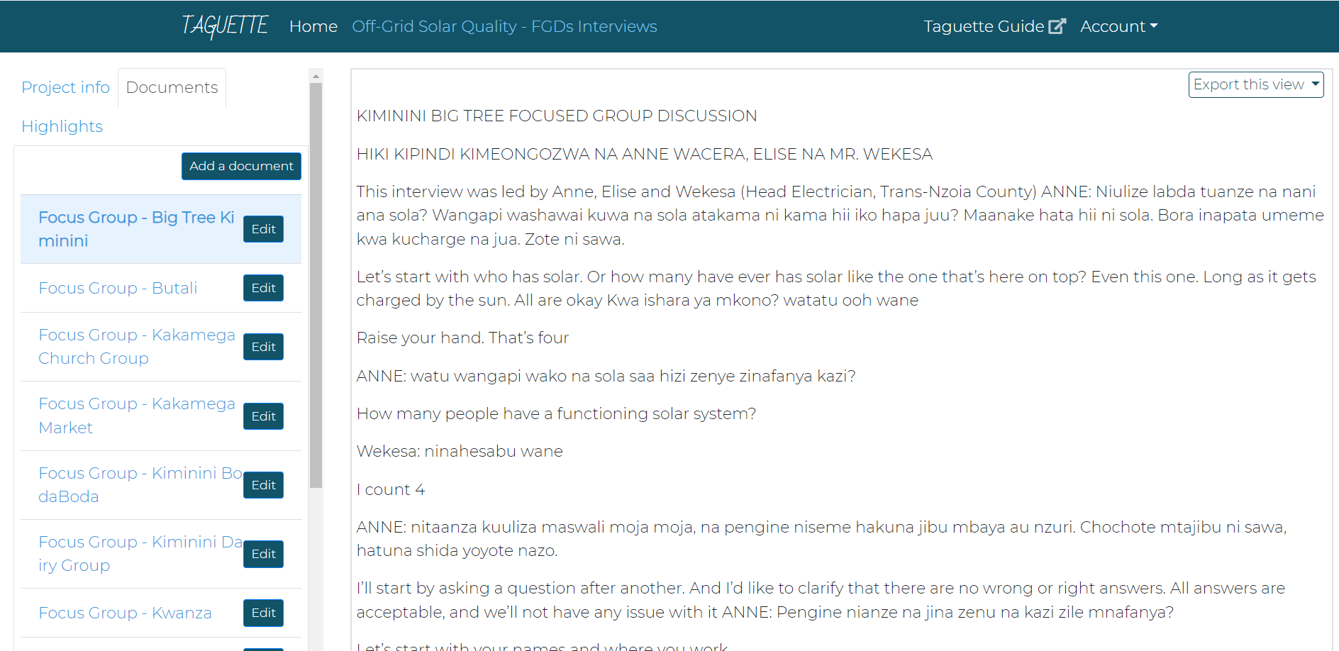
Coding in Qualitative Data Analysis
Notes:
When coding, continually ask yourself questions about the data. ❖ For example: ❖What is going on (context)? ❖What are people doing? ❖Toward what are persons orienting their thoughts? ❖What do these things take for granted? ❖How does context affect the statements?

Slide 16
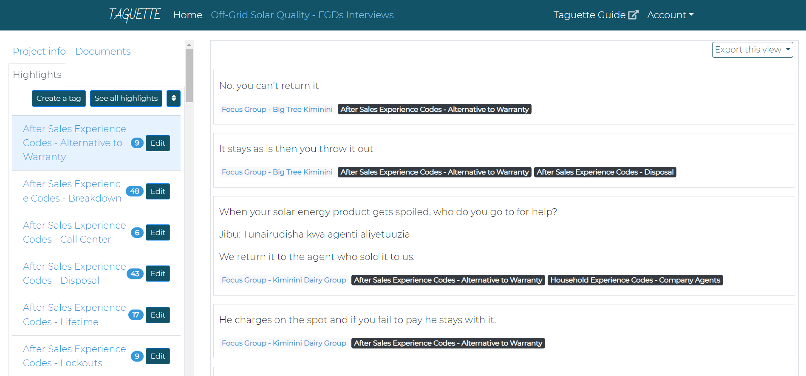
Coding in Qualitative Data Analysis
When coding, continually ask yourself questions about the data. ❖ For example:
❖What is going on (context)?
❖What are people doing?
❖Toward what are persons orienting their thoughts?
❖What do these things take for granted?
❖How does context affect the statements?
Notes:
When coding, continually ask yourself questions about the data. ❖ For example: ❖What is going on (context)? ❖What are people doing? ❖Toward what are persons orienting their thoughts? ❖What do these things take for granted? ❖How does context affect the statements?

Slide 17
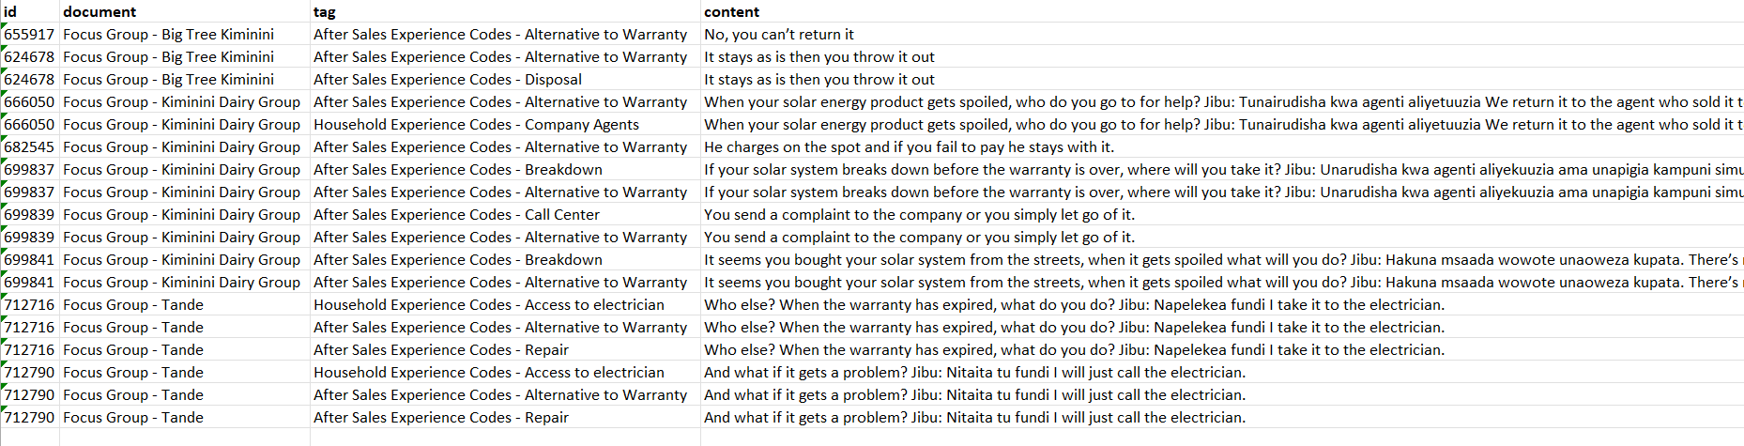
Coding in Qualitative Data Analysis
Notes:
When coding, continually ask yourself questions about the data. ❖ For example: ❖What is going on (context)? ❖What are people doing? ❖Toward what are persons orienting their thoughts? ❖What do these things take for granted? ❖How does context affect the statements?

Slide 18
Data Cleaning & Analysis Exercise (Python)
ANALYSIS OF ENERGY GENERATED FROM FAZA MINI-GRID
Dataset Description:
You have a dataset containing energy generated by a generator over a period of 5 days from the exercise in Lesson 3. The dataset includes the following columns
- Time: The time at which the measurement was taken.
- Energy Generated from Day 1 to Day 15.
Go to the link below to run the exercise
https://colab.research.google.com/drive/1RmucN651Pdhw6fjFwLuQNmXQht-ZXE_2?usp=sharing

Slide 19
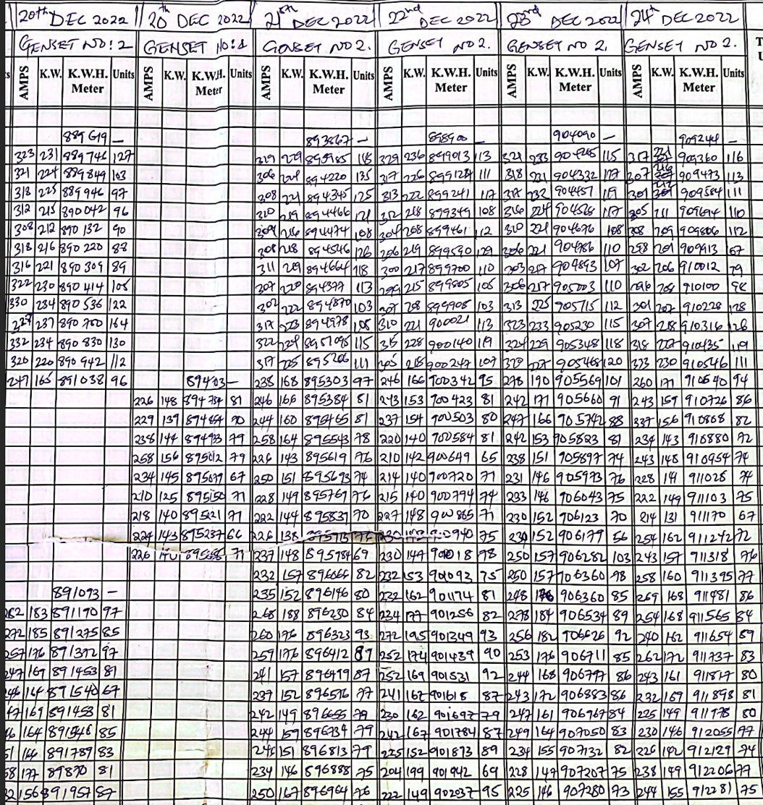
Data Cleaning & Analysis Exercise: Faza Mini-grid

Slide 20
Data Cleaning & Analysis Exercise
Pre-assessment of the existing data (Faza, Kakuma and lokichogio)
Data (log sheets) transport
Data (log sheets) scanning
Conversion to excel sheets
Data cleaning
Coding (use August 2017 log sheets as benchmark)

Slide 21
Data Cleaning and Analysis Exercise - Tasks:
1. Load the Dataset:
Load the dataset into a Pandas DataFrame.
2. Data Cleaning:
Check for and handle missing values.
Convert the Time column to a datetime format.
Correct any incorrect data types.
3. Data Preparation:
Create a new column Minutes that converts the Time column to total minutes from the start of the day.
4. Data Analysis:
Calculate the mean energy generated for each day.
Plot the energy generated over time for each day using a line plot.
Create a box plot to show the distribution of energy generated for each
1

Slide 22
Data Cleaning and Analysis - Solution
Refer to the link below to compare your answer to the same exercise with a different dataset.
https://colab.research.google.com/drive/1RmucN651Pdhw6fjFwLuQNmXQht-ZXE_2?usp=sharing

Slide 23
Credits and acknowledgment
This unit was developed by Sandra Banda and Augusta Njogo, Strathmore University, and is based on the following resources:
Onyango et al., (2020). Qualitative Data Analysis. https://nursing.uonbi.ac.ke/sites/nursing.uonbi.ac.ke/files/2020-08/Week%20%203_Data%20Analysisv2_POST.pptx_.pdf
Harrington, E., & Wambugu, A. W. (2021). Beyond technical standards: Creating an ecosystem for quality and repair in Kenya’s off-grid solar sector. Energy Research & Social Science, 77, 102101. https://doi.org/10.1016/j.erss.20
The research and results presented in this unit was supported within the framework of the LEAP-RE programme.
22

