Slide 1

Off-Grid Energy Systems Modelling with MicroGridsPy
Lesson 1:
The need for off-grid electricity solutions

Slide 2

Lesson 1: Contents
Energy and Sustainable Development
The interconnection between energy systems and sustainable development in the context of the United Nations' Agenda 2030
Global Electricity Access
The current state of global electricity access, with a particular focus on disparities between urban and rural areas, exploring also frameworks and indicators used to measure electricity access
Off-Grid Electricity Solutions
Overview of off-grid electricity solutions, their potential impact, and their practical application in various contexts
Notes:
Let’s now focus on the content of this first lecture that aims to explore the synergies between energy systems and sustainable development, examine global disparities in electricity access, and investigate off-grid electricity solutions. You will learn how these components interconnect within the framework of the United Nations' Agenda 2030, understand the critical importance of equitable electricity access and the measures used to evaluate it, and gain an overview of off-grid electricity solutions, assessing their impact and applicability in varied contexts.

Slide 3
Lesson 1: Learning Outcomes
At the end of this unit, participants will be able to :
Understand the interconnection between energy systems and sustainable development in the context of the United Nations' Agenda 2030;
Understand the current state of global electricity access, with a particular focus on disparities between urban and rural areas;
Use frameworks and indicators that measure electricity access;
Understand the options for off-grid electricity solutions, their potential impact, and their practical application in various contexts
Notes:
Let’s now focus on the content of this first lecture that aims to explore the synergies between energy systems and sustainable development, examine global disparities in electricity access, and investigate off-grid electricity solutions. You will learn how these components interconnect within the framework of the United Nations' Agenda 2030, understand the critical importance of equitable electricity access and the measures used to evaluate it, and gain an overview of off-grid electricity solutions, assessing their impact and applicability in varied contexts.

Slide 4
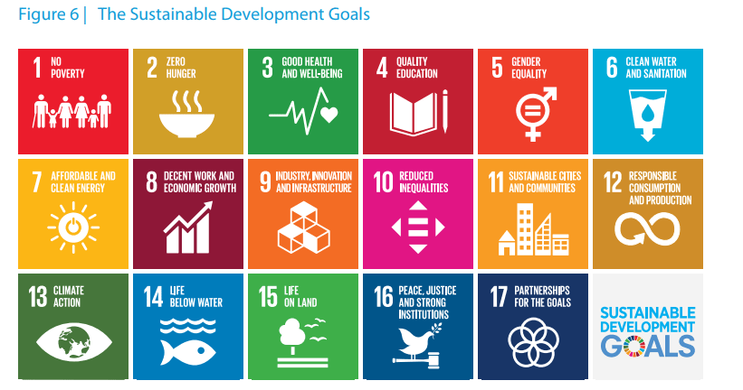
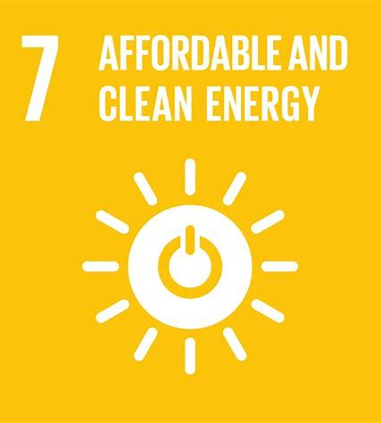
United Nations Agenda 2030 & SDG 7
Energy is essential to:
Socio-economic development
Quality of life for the people
Environmental protection
Global security
Agenda 2030 – Sustainable Development Goals
Sustainable Development Goal 7
“Ensure access to affordable, reliable, sustainable and modern energy for all” [1]
Notes:
Lack of access to energy supplies and transformation systems is a constraint to human and economic development. Energy is essential to assure and enhance quality of life, environmental protection and global security. In the context of Agenda 2030, Sustainable Development Goal 7 (SDG 7) calls for the international community to 'ensure access to affordable, reliable, sustainable, and modern energy for all.’ This goal underscores the role of energy as a cornerstone of development and aims to bridge the gap in energy access worldwide.

Slide 5

Energy and Sustainable Development
Energy - Trigger for development and instrumental human right
Economic Dimension
Social Dimension
Notes:
Energy serves as a trigger for sustainable development evidenced by the strong correlation between per capita energy supply and measures of economic and social progress, such as Gross National Income and the Human Development Index. Increased energy access is consistently associated with enhanced living standards and national prosperity. In addition, according to the UN Human Rights, Energy must be considered as a so called “instrumental” human right since it determines human dignity and with zero/poor access, fundamental rights may not be guarantee.

Slide 6
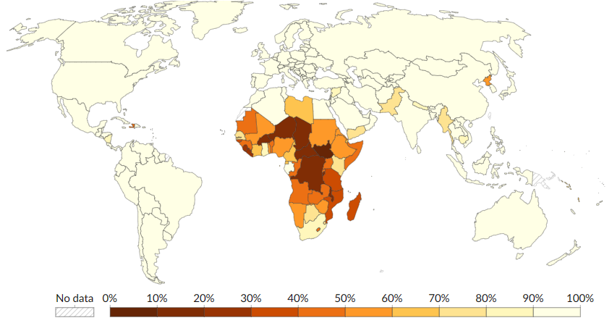
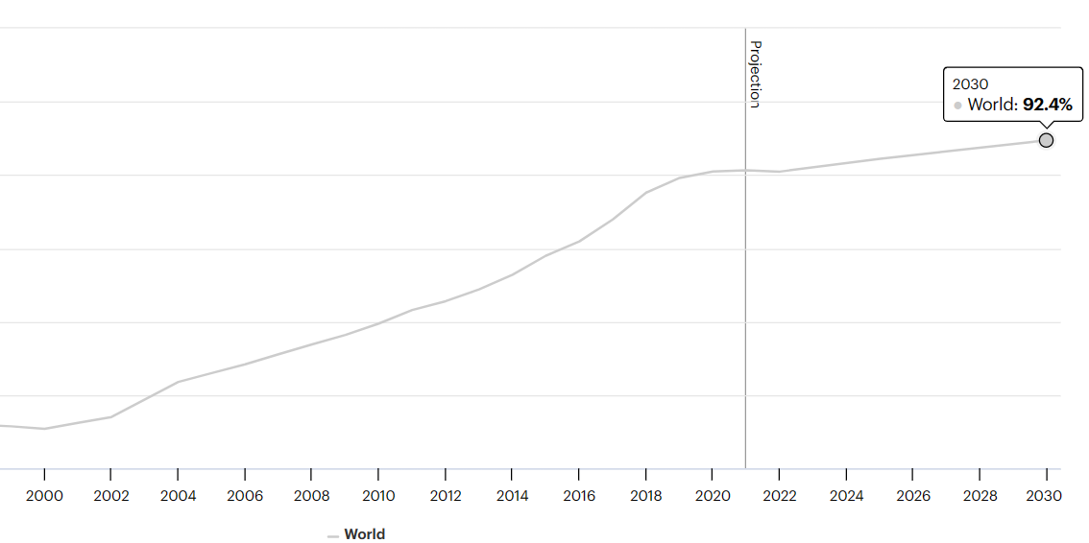
Global Electricity Access
100%
Target 7.1
“By 2030, ensure universal access to affordable, reliable and modern energy services”
675 Millions
Estimated number of people without access to electricity worldwide (2023) [2]
Share of the world population with access to electricity (2022) ³
90.2%
1990
2022
but
589,5 Millions
Estimated number of people without access to electricity in Sub-Saharan Africa (2019), almost 43% of the total population of Africa [3]
660 Millions
Projected number of people without access to electricity worldwide in 2030 under the Stated Policies Scenario, of which 85% or about 560 million people will be in Sub-Saharan Africa [4]
Share of population with access to electricity in the Stated Policies Scenario [2]
Share of population with access to electricity [3]
Notes:
Electricity access remains a global challenge, with an estimated 675 million people worldwide expected to be without this resource in 2023. The challenge is most pronounced in Sub-Saharan Africa, where 589.5 million individuals—nearly half the continent's population—are without electricity as of 2019. Looking ahead to 2030, the situation remains concerning. Projections indicate that, even with current policies, 660 million people globally will still lack electricity, with Sub-Saharan Africa constituting 85% of this number. These figures not only reflect the scale of the challenge but also the imperative to intensify efforts towards achieving universal energy access.

Slide 7
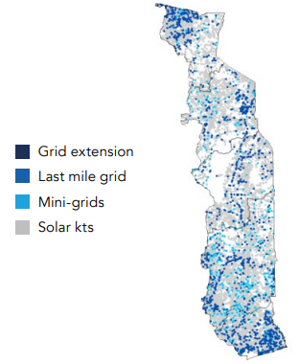
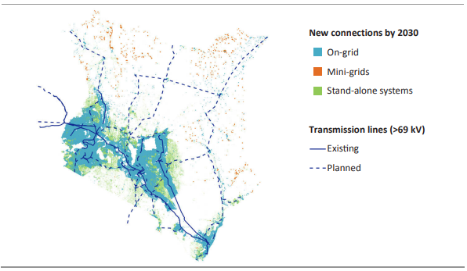
The “last mile”
When a country reaches electricity access rates close to 100%, it is usually facing the issue of the “last mile” of electrification, the struggle to reach the last, usually extremely isolated and under-served, rural communities that still lack access to electricity. Providing electricity to the last mile remains a challenge for any country because of many reasons including:
Logistical Challenges
Geographic isolation
Difficult terrain
Economic and Business Barriers
Low population density
High infrastructure costs
Low demand and low-income communities
Maintenance and operations in remote areas
Regulatory Barriers
Regulatory Challenges: permits and land ownership
Socio-Environmental Considerations
Lack of local expertise
Community involvement and local social factors
National electrification strategy by type of electricity access solutions in Togo [5] and Kenya [6]
Notes:
The term 'last mile' in electrification refers to the final leg of delivering power to the households and businesses in the most remote and hard-to-reach areas. Achieving universal electricity access by 2030 faces significant hurdles, particularly for these 'last mile' areas and communities.
The 'last mile' of electrification faces tough obstacles: isolated locations and rough terrain make logistics difficult, and economic hurdles arise from low population density and high costs. Regulatory issues, including land ownership and permit processes, add complexity. Plus, successful and sustainable energy solutions depend on local know-how and community buy-in, which aren't always available. Overcoming these barriers requires innovative, community-specific strategies that go beyond conventional grid extension.

Slide 8

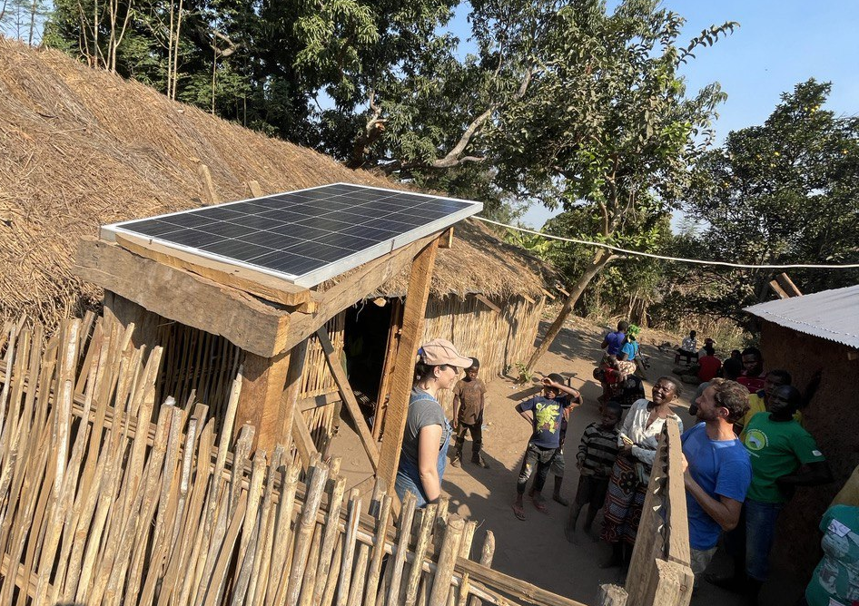
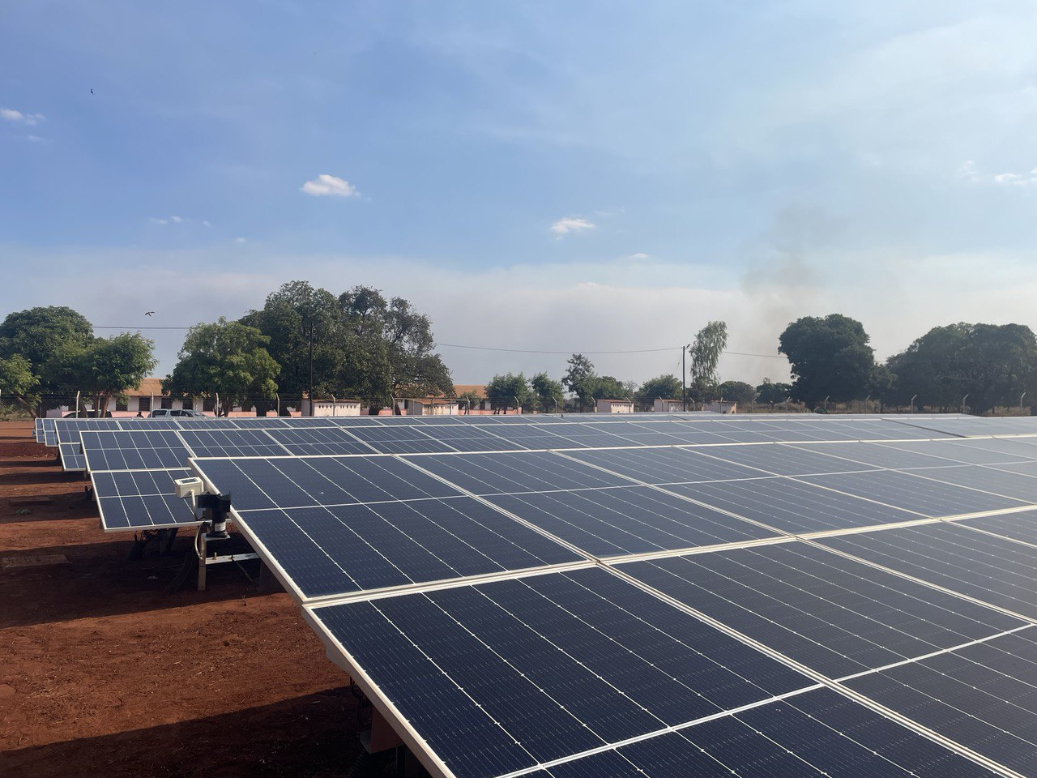
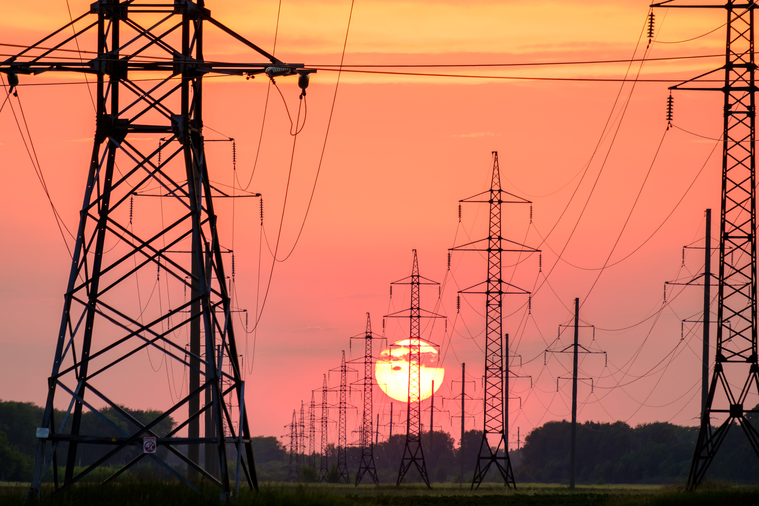
Rural Electrification
In several low-income and lower-middle-income countries, inequalities between rural and urban electrification rates are still very high [8]:
of all people without access to electricity worldwide (2023) [7] reside in remote rural areas
Sub-Saharan Africa
84%
Rural Electrification
29%
Urban Electrification
81%
Off-Grid Renewable Energy solutions
Stand-Alone Systems
These self-sufficient solutions, such as solar panels, provide quick access to electricity. They are suitable for individual households but have limited capacity and ongoing maintenance expenses.
Rural Electrification Strategies
Mini-Grids
Localized power grids serve communities, balancing scalability and reliability. They offer a steady power supply, making them ideal for remote areas. However, they demand significant initial investments and effective management.
Grid Extension
Extending the central grid to rural areas involves laying power lines for reliable electricity access. It's costly, time-consuming, and requires extensive infrastructure development.
Notes:
Addressing the critical issue of energy access, it's clear that rural areas, especially in Sub-Saharan Africa, are disproportionately affected, with only 29% electrification compared to urban areas at 81%. To close this gap, a variety of strategies are in place. Grid extension is reliable but expensive and slow. Stand-alone systems like solar panels are quicker and self-sufficient but limited in capacity and require maintenance. Mini-grids provide a balanced solution but need substantial initial investment and management.
The path forward must be a blend of these strategies, tailored to the specific needs of each community. With 84% of those without electricity living in rural areas, our focus must remain on innovative, sustainable, and cost-effective solutions to ensure universal electricity access by 2030.

Slide 9
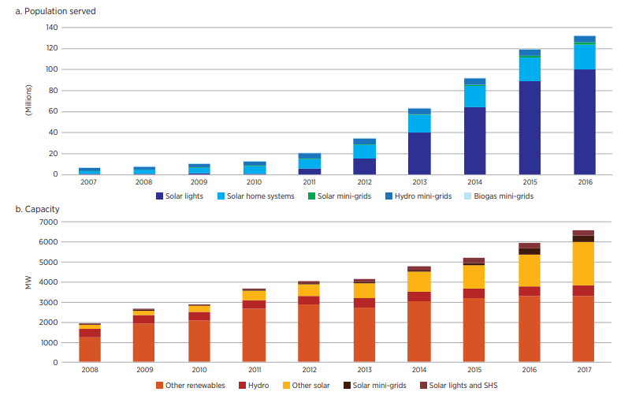
Off-grid Renewable Energy Solutions
Why Off-Grid Renewable energy?
Population served by, and capacity of, off-grid renewable energy solutions [9]
Sustainable Development Dimensions
Human development
Community Empowerment
Sustainable livelihoods
Economic
Cost-competitive
Local job creation
Environment
Environmentally sustainable
Climate resilient
Technology
Proven technology solutions
Adaptable and scalable
Notes:
Off-grid renewable energy solutions offer a path to universal electricity access, combining cost-competitive technology with sustainability. Between 2008 and 2017, such solutions tripled in capacity to over 6.5 GW. This growth not only meets basic needs like lighting and charging but fosters socio-economic development by reducing traditional fuel spending and enhancing connectivity. They empower communities, create local jobs, and offer cost-competitive technology that is both adaptable and scalable. These advancements underscore the role of off-grid solutions in achieving environmentally sustainable and climate-resilient energy access, a critical step towards achieving Sustainable Development Goal 7 and highlight the opportunity to tailor energy solutions to diverse local needs and demands.

Slide 10
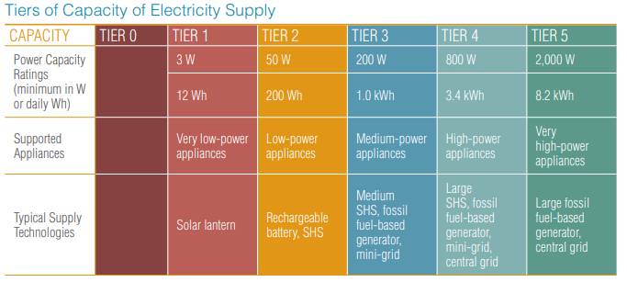


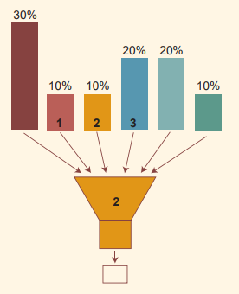
Energy Access Metrics
The Multi-Tier Framework (MTF) is a comprehensive approach that considers multiple dimensions, such as availability, reliability, quality, and affordability, to provide a more complete and refined assessment of electricity access levels.
Binary Metrics
Binary definitions have proven insufficient because they are limited to only one aspect of energy needs (e.g., electricity or cooking)
Tiers of Capacity of Electricity Supply [10]
Multi-Tier Metrics
Combination of several indicators structured along multiple thresholds and would form an overall composite index
Aggregated Index of Electricity Access
To compile the information captured by the multi-tier matrix into a single number representing the level of access to household electricity in a selected geographic area, a simple index can be calculated by weighting the tiers and arriving at a weighted average.
Notes:
As the landscape of energy provision, especially in regions striving to enhance electricity access, has been explored, it’s crucial to understand how this access is measured. Energy access metrics are the tools that help us gauge the extent and quality of electricity services available to people.
The Multi-Tier Framework (MTF) offers a nuanced view of electricity access by considering a spectrum of factors like availability, reliability, quality, and affordability. This framework moves beyond basic binary metrics, which only consider whether electricity is present or absent, and instead evaluates energy access across a range of tiers. This tiered approach acknowledges that access to electricity is not just a matter of 'have' or 'have not'. It recognizes the varied levels of energy services that people have access to, from the most rudimentary to the most advanced, and the different technologies that supply these services, from solar lanterns to central grids.
To aggregate this information into a single metric, the MTF allows for the compilation of data into an 'Aggregated Index of Electricity Access'. This index is calculated by weighting the different tiers to provide a comprehensive picture of energy access in a specific area. It's a tool that can help policymakers and stakeholders make informed decisions about where and how to invest in energy infrastructure to improve electricity access in a way that is tailored to the actual needs of different communities.

Slide 11
References
[1] UN Environment Programme, GOAL 7: Affordable and clean energy
[2] UN Department of Economic and Social Affairs, The Sustainable Development Goals Report, 2023
[3] Our World in Data, Access to Energy
[4] IEA, Access to electricity – SDG7: Data and Projections – Analysis
[5] IEA, Africa Energy Outlook 2019
[6] SEforALL, State of the Global Mini-grids Market Report 2020
[7] World Bank
[8] SEforALL, Analysis of SDG7 Progress, 2023
[9] IRENA, Off-grid renewable energy solutions to expand electricity access, 2019
[10] ESMAP, Beyond connections – Energy Access Redefined, 2016

