Slide 1

Assessment of Renewable Energy Resources
Lesson 1: An introduction to Renewable Energy Resource Assessment for Off-Grid Solutions
Authors: A. Couto, J.P. Cardoso, T. Simões, P. A. Costa, A. Estanqueiro

Slide 2
Lesson 1 Contents
The importance of mini-grids / off-grid solutions to “ensure access to affordable, reliable, sustainable, and modern energy for all.” – SDGS 7;
Variability in electricity generation from renewable energy sources (vRES)
Benefits and challenges of integrating renewable generation;
Some solutions to overcoming the challenges associated with wind and solar PV generation ;
Importance of resource assessment;
Generation complementarity to mitigate some of the variability associated with vRES generation.

Slide 3
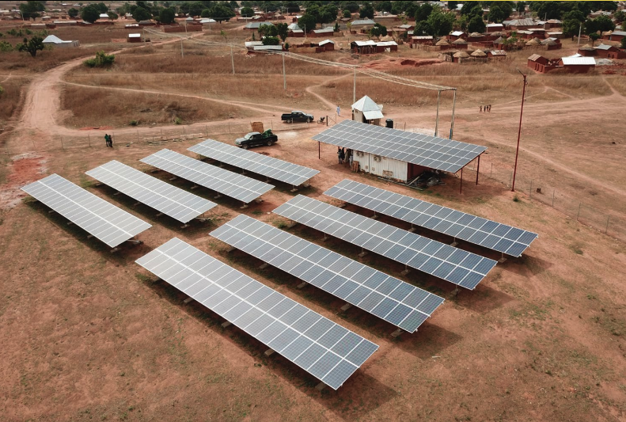
MINI-GRIDS/OFF-GRID SOLUTIONS
WHY MINI-GRIDS and OFF-GRID SOLUTIONS ARE RELEVANT:
Mini-grids/off-grid solutions have emerged as a key solution for providing energy access to dispersed or remote end-users, offering several key advantages:
Effective and economical for areas where extending the national grid is impractical due to geographical or financial constraints;
“Easier” installation compared to traditional grid expansion;
Flexible and modular / adaptable to varying electricity needs;
Enable the integration into the main power grid in the future;
Can use different generation systems, including conventional (e.g., diesel) and renewable energy (e.g., solar, wind), making them adaptable to local resource availability;
Can include energy storage systems.
Source: State of the global mini-grids market report 2020, BloombergNEF, 2020

Slide 4
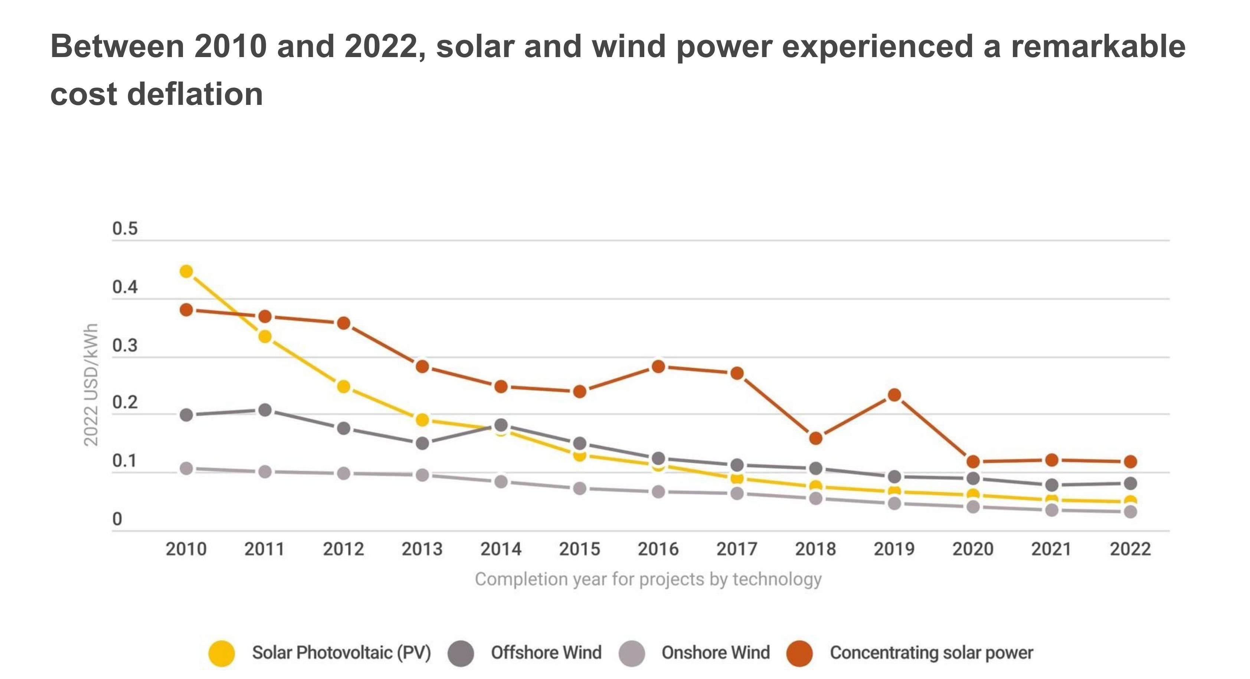
MINI-GRIDS/OFF-GRID SOLUTIONS
WHY MINI-GRIDS/OFF-GRID SOLUTIONS ARE RELEVANT:
Although the solutions are not a completely new phenomenon, the technologies they use have improved in the recent years, making them a highly attractive technical solution. These improvements, associated with the use of renewable energy sources, have led to several key benefits:
  1. Environmental Benefits:
  Increased use of renewable energy sources reduces greenhouse gas emissions and environmental impact;
  Integration of clean energy solutions supports sustainable development goals.
  2. Cost Reductions:
  Significant decreases in the cost of renewable energy technologies and energy storage solutions over the past decade;
  Lower installation and maintenance costs due to technological improvements.
Source: https://www.irena.org

Slide 5
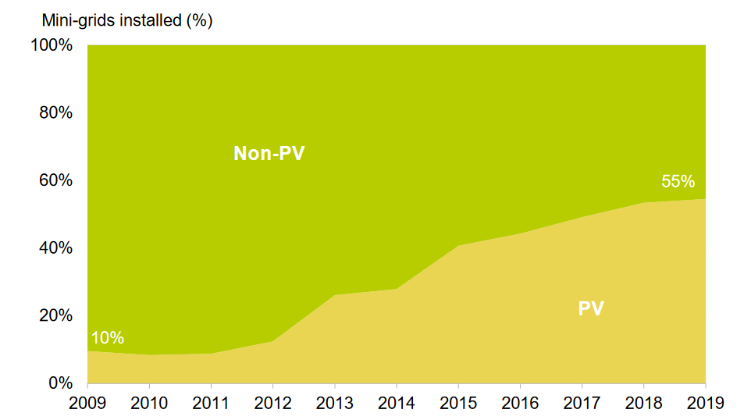
MINI-GRIDS/OFF-GRID SOLUTIONS
WHY MINI-GRIDS/OFF-GRID SOLUTIONS ARE RELEVANT:
Although the solutions are not a completely new phenomenon, the technologies they use have improved in the recent years, making them a highly attractive technical solution. These improvements, associated with the use of renewable energy sources, have led to several key benefits:
  3. Technological Advancements:
  Improved efficiency and reliability of generation and distribution systems;
  Enhanced performance of renewable energy technologies like solar and wind.
  4. Scalability:
  Modular systems allow for gradual expansion based on demand, reducing initial investment risks;
  Flexibility to start small and scale up as the community grows.
  5. Enhanced Energy Access:
  Ability to provide reliable and consistent power to remote and dispersed populations;
  Improved quality of life through better access to education, healthcare, and economic opportunities.
Source: SEforALL, and BloombergNEF. (2019). State of the Global Mini-grids Market Report 2020. Report, 53(9), 1689-1699

Slide 6
USE OF RENEWABLES IN MINI-GRIDS/OFF-GRID SOLUTIONS
Most of the previous benefits of mini-grids are strongly associated with the use of renewable energy sources (RES) such as hydropower, wind power and solar photovoltaic (PV) power.
Despite the economic and environmental benefits, the integration of RES can raise several challenges, especially, when integrated in large-scale into the power systems.
Indeed, the generation of electricity from wind power and solar photovoltaic (PV) is characterized by significant temporal and spatial variability, therefore, they are usually designated as “variable renewable energy sources (vRES)”.
Compared to conventional power plants, such as diesel generators, which can easily adjust their output levels, vRES face a major challenge due to their intrinsic variability.

Slide 7
Understanding variability of vRES - scales
The variability in electricity generation from renewable energy sources (vRES) is influenced by several factors:
- Predictable astronomical factors: Daily and seasonal changes;
- Weather phenomena: Different scales of weather patterns;
- Topography and surface conditions: Local/regional geographical features;
Technical features can also have an impact on electricity generation variability, e.g., wind power has a cubic dependence on wind speed.
Schematic representation of the variability of different RES.

Slide 8
Understanding variability of vRES - cycles
- Wind Power → No clear daily cycle.
Autocorrelation: High within one day, decreasing beyond that, indicating limited predictability over longer periods.
- Solar Power → strong 24-hour patterns due to solar daily cycle.
Autocorrelation: High variation with clear daily cycles.
- Hydropower: peaks at 12 and 24 hours, reflecting storage and regulation capabilities.
Autocorrelation of different RES. RoR – Run of river
! To effectively integrate vRES, it is essential to study their properties and mechanisms to mitigate the impact of their variability. This involves a comprehensive resource assessment and understanding the generation complementarity between different energy sources.

Slide 9
Resource assessment
How: Resource assessment involves characterizing the relevant parameters available for energy conversion at a specific location or region over a period of interest.
Importance: This characterization is crucial for identifying the capabilities of solar and wind resources to meet local needs, such as solar cooking, electricity production, etc.
Main sources of information for resource assessment:
  In situ measurement campaigns;
  Satellite remote-sensing methods;
  Meteorological model outputs.
Most relevant parameters:
  Solar power: global horizontal irradiance (GHI), direct normal irradiance (DNI), diffuse horizontal irradiance (DHI), global tilted irradiance (GTI).
  Wind power: wind speed and direction.
  Collecting further meteorological parameters, such as air temperature, is also advisable.

Slide 10
Resource assessment
Applications:
  Selecting optimum energy conversion technologies;
  Designing systems for specific locations;
  Operating and maintaining installed energy conversion systems;
  Making energy policy decisions.
Resource assessment criteria:
  Reliability: Ensuring the quality of the approach used;
  Long-Term Data: Accounting for different time-scale phenomena, intra/inter-annual patterns, and trends;
  Low Uncertainty: Reducing risk in the decision-making phase.

Slide 11
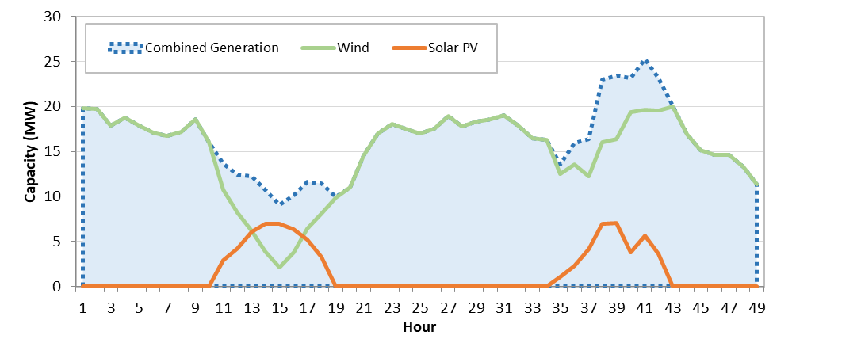
vRES generation complementarity
Exploring vRES complementarity is one solution identified by several authors to mitigate the variability of these technologies. For vRES complementarity, two different approaches can be considered:
1. Spatial complementarity - The lack of the primary energy resource in region A is complemented by its availability, at the same instant, in region B.
2. Temporal Complementarity - The lack of the primary energy resource of one vRES technology in region A is complemented temporally by the availability of a different technology.

Slide 12
Temporal complementarity
Different aspects of solar PV power systems can also be adjusted to meet consumption needs better, e.g.,
  - Technologies: Conventional vs. Bi-Facial Panels;
  - Systems: with or without Tracking (1-axis or 2-axis);
  - Orientation angles: azimuth and slope angles.
The focus should be on configurations that best satisfy specific consumption patterns or mitigate the generation variability.
  - Most of the applications use the orientation angles that produce the most energy annually.
Solar power – Fixed azimuth (A) and slope (S) angles
Solar power – tracking system
Notes:
Aqui (e nos próximos com os perfis) sugeria passar rapidamente e dizer que estes são os perfis considerados. Valores foram normalizados à capacidade de pico.

Slide 13
Final Notes
In this introduction we learned about:
The importance of mini-grids / off-grid solutions to “ensure access to affordable, reliable, sustainable, and modern energy for all.” – SDGS 7;
Benefits and challenges of integrating renewable generation;
Some solutions to overcoming the challenges associated with wind and solar PV generation were briefly presented;
Importance of resource assessment some relevant aspects associated with this assessment were highlighted → further details will be presented in the upcoming units;
Generation complementarity should be also taking into account to mitigate some of the variability associated with vRES generation.

Slide 14
Credits and acknowledgment
This unit was developed by A. Couto, J. Cardoso, T. Simões, P. Costa, and A. Estanqueiro, from LNEG and is based on the following resources:
SEforALL, and BloombergNEF. (2019). State of the Global Mini-grids Market Report 2020. Report, 53(9), 1689-1699
Couto, A., Cardoso, J., Costa, P., Simões, T., Stevanato, N., Sangiorgio, I., Mereu, R., Fioriti‬, D., & Banda, S. (2022). Characterization of the electricity needs and resource assessment methodologies. LEAP-RE Project Tech. Report , 81.
Sengupta, M., Habte, A., Wilbert, S., Gueymard, C., and Remund, J. (2021). Best Practices Handbook for the Collection and Use of Solar Resource Data for Solar Energy Applications: Third Edition. NREL/TP-5D00-77635. Retrieved from https://www.osti.gov/servlets/purl/1778700/
USAID, African Union, and Power Africa. (2021). Unlocking Africa'S Mini-Grid Market Final Report Usaid Scaling Up Renewable Energy Program (Sure). Tech. Rep. Retrieved from https://pdf.usaid.gov/pdf_docs/PA00X8SK.pdf
Zebra, E. I. C., van der Windt, H. J., Nhumaio, G., and Faaij, A. P. C. (2021). A review of hybrid renewable energy systems in mini-grids for off-grid electrification in developing countries. Renewable and Sustainable Energy Reviews, 144, 111036. https://doi.org/10.1016/j.rser.2021.111036
Y. Liu, S. Yu, Y. Zhu, D. Wang, and J. Liu, “Modeling, planning, application and management of energy systems for isolated areas: A review,” Renew Sust Energ Rev, vol. 82, pp. 460–470, 2018.
J. Widén, N. Carpman, V. Castellucci, D. Lingfors, J. Olauson, and et al., “Variability Assessment and Forecasting of Renewables: A Review for Solar, Wind, Wave and Tidal Resources,” Renew. Sustain. energy Rev., vol. 44, pp. 356–375, 2015.
A. Estanqueiro and A. Couto, “New electricity markets. The challenges of variable renewable energy,” in Local Electricity Markets, Z. Vale, T. Pinto, and S. Widergren, Eds. Academic Press, 2021, pp. 3–20.
The research and results presented in this unit was supported within the framework of the LEAP-RE programme.

