Slide 1

Data for Renewable Energy Systems
Lesson 1: Introduction to data collection and analysis

Slide 2
Lesson 1: Learning Outcomes
At the end of this lesson, you will be able to:
Identify the challenges faced in data collection by developing countries for energy planning.
Describe the fundamental concepts of data collection and analysis relevant to energy planning.
Explain the different types of data relevant to energy planning and their significance.
Discuss ethical considerations in data collection within developing countries.

Slide 3
Lesson 1 Outline:
Importance of data in energy planning and challenges in developing countries.
Fundamental concepts of data collection and analysis.
Different types of data and their relevance to energy planning.
Introduction to ethical considerations in data collection in developing countries.

Slide 4

The importance of data collection and analysis in developing countries
Energy consumption data can paint a picture of energy consumption patterns across different regions, sectors, and demographics. This allows for targeted interventions and resource allocation to areas with the most significant energy needs.
This aids in:
      Resource Assessment​
      Demand Forecasting​
      Grid Management​
      Risk Management​
      Policy Formulation​
      Technological Innovation​​

Slide 5

Challenges facing data collection and analysis in developing countries
Limited Resources
Fragile Infrastructure
Inconsistent Data
Data Fragmentation
Data Security Concerns
Privacy Concerns.
Language Barriers
Notes:
Limited Resources: Developing countries often have limited budgets for data collection initiatives. This can restrict the scope and frequency of data gathering, leading to less comprehensive datasets.
Fragile Infrastructure: Poor transportation networks, unreliable electricity, and limited internet access can make data collection in remote areas difficult and expensive.
Inconsistent Data: Data collection methods might vary across regions or government agencies, leading to inconsistencies and making it difficult to compare datasets.
Data Fragmentation: Data might be scattered across different institutions, making it challenging to access and integrate for comprehensive analysis.
Data Security Concerns: Limited resources for data storage and security can increase the risk of data breaches or loss.
Privacy Concerns: Cultural norms or a lack of trust in institutions might make communities hesitant to share personal information for data collection.
Language Barriers: Language diversity can make it difficult to design surveys and questionnaires that are easily understood by everyone.

Slide 6
Fundamental concepts in data collection and analysis
Some concepts to consider are:
  Ontology: The beginning of any research where one differentiates between one’s perception of reality and how things actually work. Realism and Relativism. ​
  Epistemology: Responsible for knowledge gathering and concerned about developing new knowledge. Secondary research. ​
  Methodology: The strategy or plan of action which decides the kinds of​
  methods used. ​
  Methods: The instruments used for the collection and analysis of data.
This will help in:
  Defining the Objective
  Sampling Techniques
  Data Quality and Cleaning
  Data Security
  Ethics

Slide 7
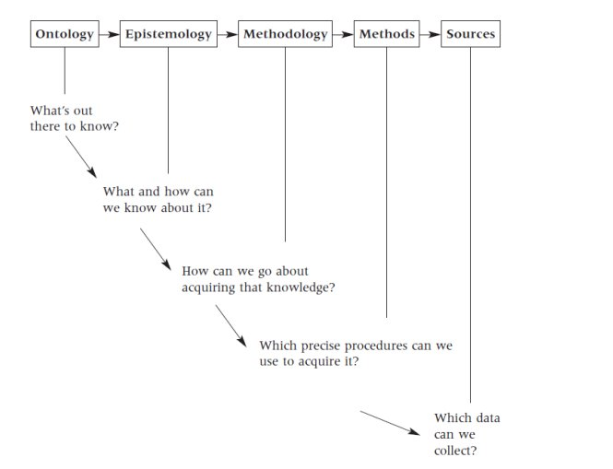
Fundamental concepts

Slide 8
Data Types
Demographic Data
Information about population size, density, age structure, and urbanization trends
Helps understand energy demand variations across regions. High population density areas might require more concentrated energy infrastructure, while rural areas might benefit from decentralized solutions.
Economic Data
:Information on Gross Domestic Product (GDP), income levels, and industry structure
Provides insights into energy consumption patterns within different sectors. Industries with high energy needs can be targeted for efficiency improvements, while income levels can inform affordability considerations for energy access initiatives
Energy Consumption Data
Information on electricity consumption, fuel use (coal, oil, natural gas), and the primary sources of energy generation.
Provides a clear picture of current energy usage patterns. This data helps identify areas with high energy consumption or dependence on unsustainable sources, informing investment decisions for renewable energy infrastructure.

Slide 9
Data Types
Environmental Data
Information on climate patterns (solar radiation, wind speed), renewable energy potential (hydro, solar, wind), and the environmental impact of current energy production (emissions data).
Crucial for promoting sustainable energy solutions. Climate data helps identify areas suitable for specific renewables, while emissions data informs policies aimed at reducing the environmental footprint of energy production.
Social Data
Information on household energy access rates, energy poverty levels, and public attitudes towards different energy sources.
Geospatial Data
Helps ensure energy planning is socially inclusive. Understanding energy poverty levels allows for targeted interventions to improve access, while public perception data can inform communication strategies for promoting new energy solutions
Enables spatial analysis of energy needs and potential. This data helps identify optimal locations for renewable energy projects (e.g., solar farms in high sunlight areas) and inform grid planning for efficient energy distribution.
Information about land use, topography, and existing energy infrastructure (power lines, transmission grids) linked to geographic locations.

Slide 10
Ethical considerations in data collection in developing countries
Informed Consent
Data Privacy
Individuals have the right to understand how their data will be used before they agree to participate.
Consent forms should be translated into local languages and presented in a clear and understandable way, avoiding jargon.
Special care needs to be taken when collecting data from vulnerable populations who may not fully understand the implications.
Data should be anonymized whenever possible, and strong security measures should be implemented to prevent data breaches.
Participants should be informed about how long their data will be stored and how it will be disposed of after use.
Community Engagement
Involve communities in the data collection process from the beginning.
Explain the purpose of the data collection and how it will benefit the community.
Seek feedback from community leaders and representatives to ensure the data collection methods are culturally appropriate.
The privacy of participants must be protected.

Slide 11
Ethical considerations in data collection in developing countries
Data Ownership and Benefit Sharing
Be transparent about who owns the data collected and how it will be used.
Consider ways to share the benefits of the data collection with the communities that participated.
This could involve providing access to the results of the analysis or using the data to inform interventions that directly benefit the community
Capacity Building:
When possible, involve local researchers and data collectors in the project.
This builds local capacity for future data collection projects and ensures a sense of ownership over the data.
Respect for Local Laws and Customs
Always comply with local data protection laws and regulations.
Be mindful of local cultural norms and sensitivities when designing data collection instruments and procedures.

