Slide 1

Off-Grid Energy Systems Modelling with MicroGridsPy
Lesson 8:
Technology Characterization
PART B

Slide 2

Lesson 8: Content
Generator Technology Characterization in MicroGridsPy
Gain an understanding of how to characterize generators in MicroGridsPy, including how to input basic parameters like efficiency, costs, and emissions. Learn the basic mathematical formulations used for calculating the total investment and operational & maintenance costs associated with this technology
Fuels Characterization in MicroGridsPy
Develop the ability to characterize fuels within MicroGridsPy by specifying basic parameters such as costs and performance metrics.
Navigating and Utilizing the MicroGridsPy Interface
Learn to navigate the MicroGridsPy interface effectively, including how to update parameters for generator types
Notes:
In this lecture, we will continue our exploration of technology characterization by focusing on backup systems in MicroGridsPy. You will gain an understanding of how to characterize generators, including how to input basic parameters like efficiency, costs, and emissions. We will cover the basic mathematical formulations used for calculating the total investment and operational & maintenance costs associated with this technology.
Additionally, you will develop the ability to characterize fuels within MicroGridsPy by specifying basic parameters such as costs and performance metrics. Finally, you will learn to navigate the MicroGridsPy interface effectively, including how to update parameters for generator types.

Slide 3
Lesson 8: Learning Outcomes
At the end of this unit, participants will be able to :
Understand how to Characterize Generator Technology in MicroGridsPy
Characterize Fuels in MicroGridsPy
Navigate and Utilize the MicroGridsPy Interface
Notes:
In this lecture, we will continue our exploration of technology characterization by focusing on backup systems in MicroGridsPy. You will gain an understanding of how to characterize generators, including how to input basic parameters like efficiency, costs, and emissions. We will cover the basic mathematical formulations used for calculating the total investment and operational & maintenance costs associated with this technology.
Additionally, you will develop the ability to characterize fuels within MicroGridsPy by specifying basic parameters such as costs and performance metrics. Finally, you will learn to navigate the MicroGridsPy interface effectively, including how to update parameters for generator types.

Slide 4
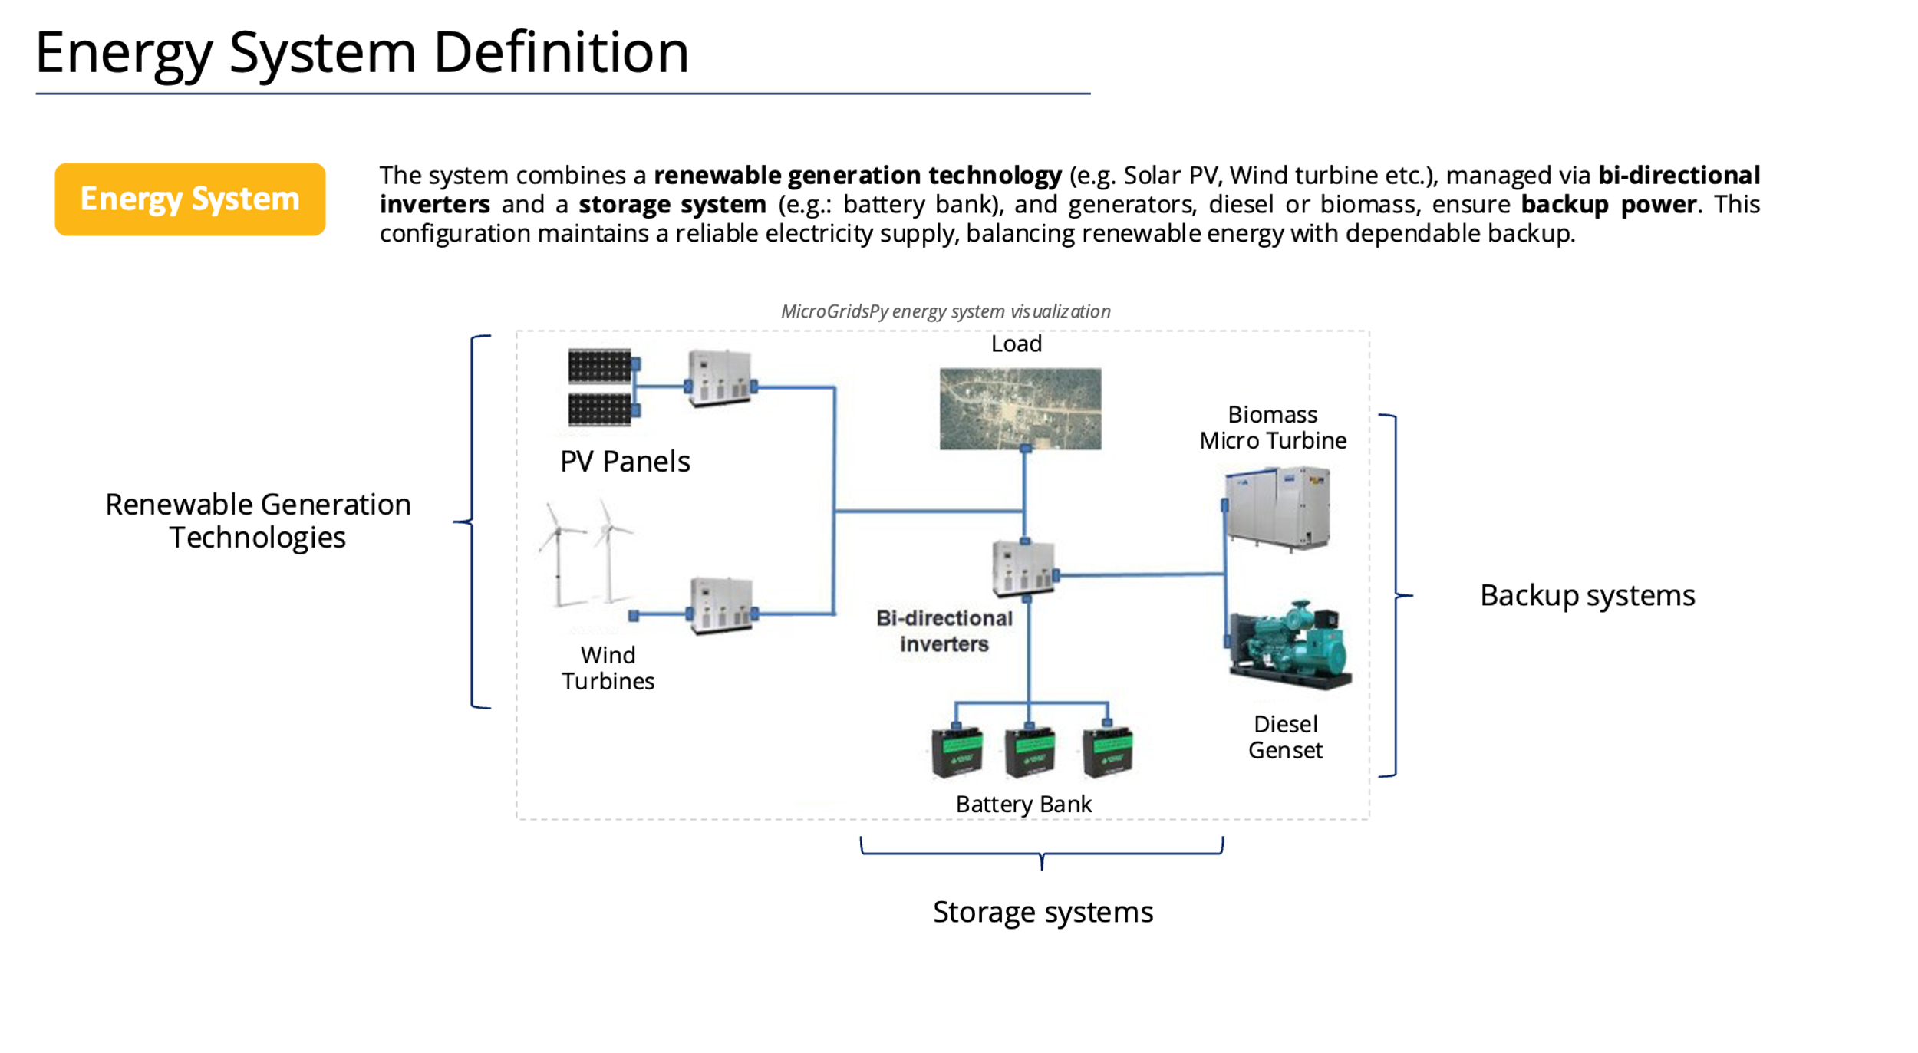
Technology Characterization in MicroGridsPy
Technology characterization in MicroGridsPy encompasses the modelling of renewable sources, energy storage, and backup systems, each defined by specific parameters that ensure a precise representation of their operational and economic profiles
Renewable Generation Technologies
Any renewable generation technologies can be accurately modelled in MicroGridsPy by inputting their electricity output time series and basic parameters like, efficiency, costs, and emissions. For solar and wind resources, the process is streamlined with integrated estimation features.
Storage system
MicroGridsPy models energy storage using a singular battery type, incorporating parameters for costs, efficiencies, discharge depth, cycle life, and charge times to simulate its operation and financial impact within the mini-grid system.
Backup system
MicroGridsPy enables the modelling of backup generators, allowing for multiple types and fuel options, such as diesel or biogas. This flexibility facilitates the design of diversified backup systems tailored to specific energy needs and fuel availability scenarios
Notes:
MicroGridsPy enables the modeling of backup generators, allowing for multiple types and fuel options such as diesel or biogas. This flexibility facilitates the design of diversified backup systems tailored to specific energy needs and fuel availability scenarios. By inputting parameters like efficiency, costs, and emissions, the model ensures accurate simulation and optimization of backup systems, contributing to the reliability and sustainability of the overall energy system.

Slide 5

Backup system
In MicroGridsPy, the backup system is characterized by detailing generator types, efficiencies, costs, and sustainability impacts, alongside the corresponding fuel specifications such as type, energy content, cost, and emissions.
Types
Types
Fuel_Names [text]
Fuel name for each generators within MicroGridsPy
Generator_Types [unit]
Number of Generators types to be included within the possible backup systems
Generator_Names [text]
Generator name for each sources within MicroGridsPy
Energy conversion
Generator_Efficiency [fraction]
Efficiency of each generator
Energy conversion
Fuel_LHV [Wh/lt]
Lower Heating value (LHV) for each type of fuel
Sustainability
Generator_Lifetime [years]
Lifetime of each generator types
GEN_unit_CO2_emissions [kgCO2/kW]
Specific emissions of capacity installed (indirect emissions)
Costs
Costs
Fuel_Specific_Cost [$/lt]
Specific cost for each type of fuel
Generator_Specific_Investment_Cost [$/W]
Specific investment cost for each type of generator
Generator_Specific_OM_Cost [fraction]
O&M cost for each type of generator as a fraction of the specific investment cost
Sustainability
GEN_unit_CO2_emissions [kgCO2/lt]
Emissions for each lt of fuel consumed (direct emissions)
Notes:
In MicroGridsPy, the backup system is characterized by detailing generator types, efficiencies, costs, and sustainability impacts, alongside the corresponding fuel specifications such as type, energy content, cost, and emissions. The model includes the number and names of generator types, efficiency of each generator, specific investment costs, and operation and maintenance costs. It also accounts for the generator's lifetime and the specific CO2 emissions associated with its capacity.
For fuel specifications, it includes the names of fuels, their lower heating values, specific costs, and the CO2 emissions per liter of fuel consumed. These comprehensive parameters ensure that backup systems are accurately modeled, reflecting both their economic and environmental impacts, and supporting effective energy system design and optimization.

Slide 6

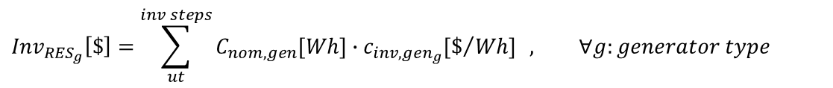
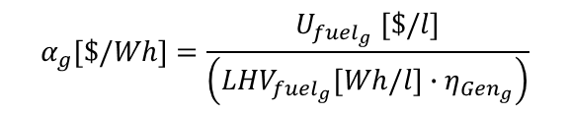
Mathematical Formulation
Here below the most relevant equations implemented within the core model involving hourly energy produced fuel consumption, total investment and fixed O&M costs.
Marginal cost (slope of the operation cost curve
Specific fuel cost
Energy produced:
$$E_{{gen}_{g}}\left(t\right) [Wh]≤C_{nom, {gen}_{g}}[W]∙∆t[h]$$
$$α_{g}[\$/Wh]=\frac{U_{fuel_{g}} [\$/l]}{\left(LHV_{fuel_{g}}[Wh/l]∙η_{Gen_{g}}\right)}$$
Fuel consumption:
$$C_{{fuel}_{g}}\left(t\right) [\$]=E_{{gen}_{g}}(t)[Wh]∙α_{g}[\$/Wh]$$
Nominal capacity of the generator
$${Inv}_{{RES}_{g}}\left[\$\right]=\sum_{ut}^{inv steps}{C_{nom,gen}[Wh]∙c_{inv,gen_{g}}[\$/{Wh]}} , ∀g:generator type$$
Total Investment costs:
Specific investment costs
$${O\&M}_{{RES}_{g}}\left[\$\right]=\sum_{ut}^{inv steps}{C_{nom,gen_{g}}[Wh]∙c_{inv,gen_{g}}[\$/{Wh]}∙c_{O\&M,g}\left[−\right] , ∀g:generator type}$$
Total Fixed O&M costs:
Specific O&M costs as a fraction of the investment cost
Generator
Notes:
Here are the most relevant equations implemented within the core model of MicroGridsPy for backup systems, involving hourly energy production, fuel consumption, total investment costs, and fixed O&M costs. In particular:
- The energy produced by a generator is determined by the product of its installed capacity (optimization variable) and the time interval, ensuring it remains within operational limits.
- Fuel consumption is calculated based on the energy produced, the fuel's lower heating value, and the generator's efficiency. This determines the fuel cost by considering the specific cost of fuel and the marginal cost of the operation.
The total investment cost for generators is calculated by summing the product of the installed capacity and specific investment cost
- The total fixed O&M costs are determined by summing the product of the installed capacity, specific investment cost, and O&M cost fraction.

Slide 7
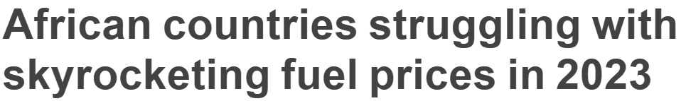

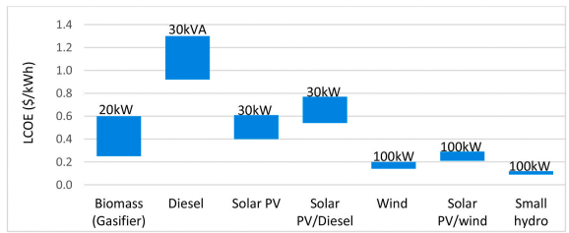

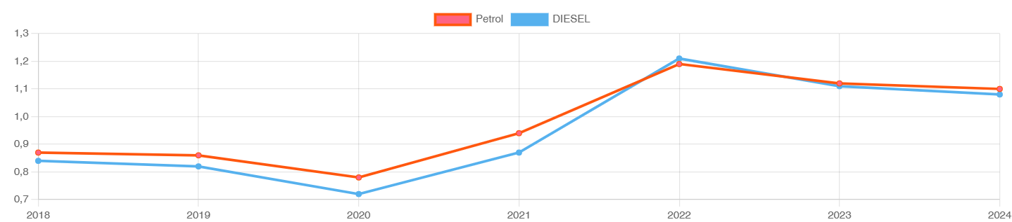

Fuel Price - Diesel
Diesel mini-grids have been the preferred option for off-grid electrification, because they have short lead times, are modular, and are easy to site and relocate. However, diesel price is highly fluctuating and heavily dependent on external factors.
Diesel mini-grid shows the highest LCOE compared to other generation sources and are highly dependent on fuel price fluctuations.
LCOE (USD/kWh) of mini-grid and hybrid mini-grid options at different scales (kVA, kW) [1]
Africa Petrol and Diesel Averages 2016 – 2022 [2]
Built-In Advanced Feature in MicroGridsPy:
Yearly variable fuel costs for generator technology
Notes:
Continuing from our discussion on backup systems, it's important to consider the impact of fuel prices on diesel generators. Diesel mini-grids are preferred for off-grid electrification due to their short lead times, modularity, and ease of relocation. However, diesel prices are highly volatile and dependent on external factors. This results in diesel mini-grids having the highest levelized cost of electricity (LCOE) compared to other generation sources and being highly sensitive to fuel price fluctuations.
In African countries, rising fuel costs have significantly impacted economies, increasing the financial burden on mini-grid projects. MicroGridsPy addresses this challenge with a built-in feature that allows for yearly variable fuel costs for generator technology, ensuring more accurate modeling and planning for fuel price fluctuations.

Slide 8
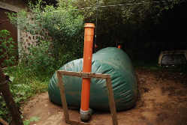
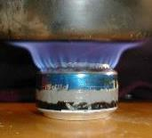

Biomass and Biogas
MicroGridsPy enables the simulation of biogas as a generator within its existing framework, utilizing adjustable parameters that are already implemented. This allows for the existing flexible parameters to accommodate the unique characteristics of biogas without the need for additional parameter inputs, thereby integrating this sustainable energy source into the energy mix of microgrid models
Generator: Biogas burner
A biogas burner is a type of generator that runs on biogas, a renewable energy source produced from the anaerobic digestion of organic waste.
Costs: biogas burners may require higher initial investment for the digestion infrastructure but often benefit from lower operational costs compared to diesel generators, due to the use of readily available organic waste.
Operational parameters for biogas burners can differ significantly, with efficiencies being influenced by the quality of biogas and the technology used.
Fuel: Biogas
Renewable fuel produced from anaerobic digestion of organic matter – the conversion of organic waste, in the absence of air (oxygen), into a mixture of combustible gases. The process usually takes place in an airtight tank called digester where animal, human and agricultural wastes produce biogas which is usually composed mainly by methane and carbon dioxide. Utilizing biogas can lead to reduced greenhouse gas emissions while. the cost and operational parameters of biogas as a fuel are influenced by local availability of feedstock and the scale of the biogas production system
On-field pictures of biomass digestor and biogas burners
Notes:
MicroGridsPy enables the simulation of biogas as a generator within its existing framework, utilizing adjustable parameters that are already implemented. This allows for the flexible accommodation of biogas characteristics without additional parameter inputs, integrating this sustainable energy source into mini-grid models.
A biogas burner runs on biogas produced from the anaerobic digestion of organic waste. These burners may require a higher initial investment for the digestion infrastructure but benefit from lower operational costs compared to diesel generators. Operational efficiencies can vary significantly based on the quality of biogas and the technology used, making biogas burners a cost-effective and environmentally friendly option for mini-grids.

Slide 9
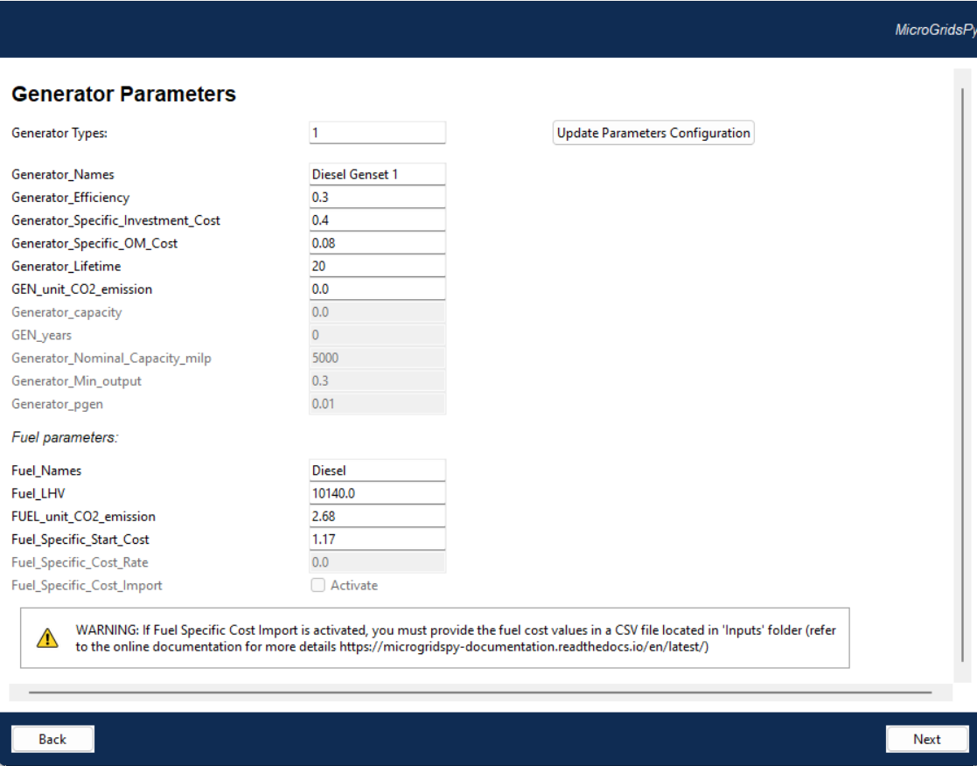


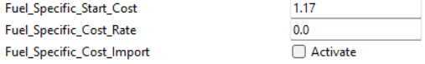
Generator Parameters
Generator Characterization
It allows setting the names, efficiencies, costs, lifespans, emissions, and capacity parameters for generators, as well as configuring fuel types, energy content, and cost parameters
Parameters which would be enabled or disabled according to specific advanced features activated (MILP, brownfield and partial load in the example)
Notes:
Let's look at the generator parameters within the MicroGridsPy user interface. This section allows for comprehensive generator characterization by setting names, efficiencies, costs, lifespans, emissions, and capacity parameters. It also includes configuring fuel types, energy content, and cost parameters.
In MicroGridsPy, you can input details such as the generator name, efficiency, specific investment and O&M costs, lifetime, and CO2 emissions. Additionally, you can specify fuel parameters, including fuel names, lower heating values, unit CO2 emissions, and specific costs. Advanced features in the interface allow for activating specific options like fuel-specific cost calculation, which requires providing cost values in a CSV file.

Slide 10
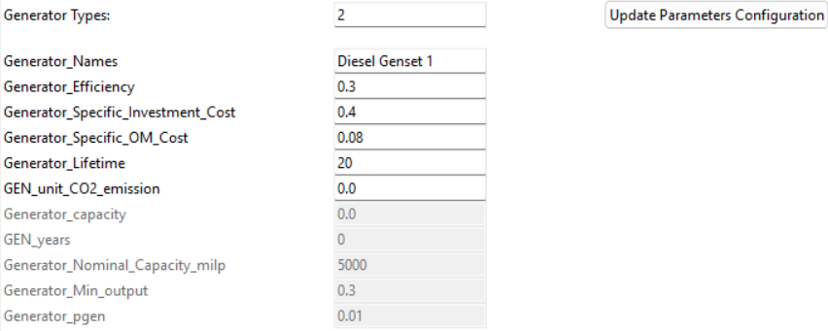
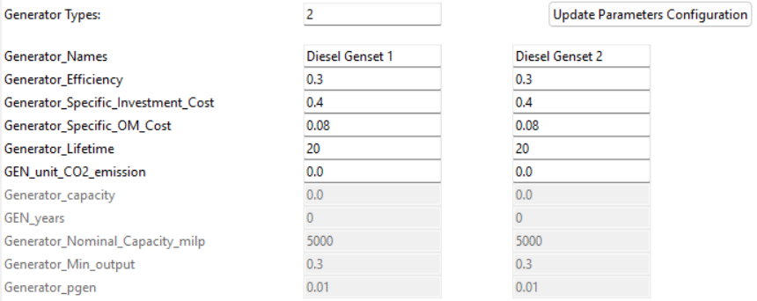
Generator Parameters
The interface includes an "Update Parameters Configuration" button for applying new settings to generator parameters. In particular:
Set the number of generators in Generator Types
Press the button to update the entries for each parameter
Visualize the new set of default values for each parameter
Edit the values as preferred
Notes:
The MicroGridsPy interface includes an "Update Parameters Configuration" button for applying new settings to generator parameters. This process involves four steps:
Set the number of generators in the "Generator Types" field.
Press the "Update Parameters Configuration" button to update the entries for each parameter.
Visualize the new set of default values for each parameter.
Edit the values as preferred to match the specific details of your generator technologies.

Slide 11

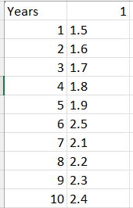

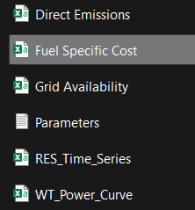


Exogenous Fuel Specific Cost
Numbered columns equal to the number of fuel types
1 2 …
1
2
3
4
5
6
7
8
9
10
11
12
13
….
Yearly price of each type of fuel
Years in the time horizon
Code/Inputs/Fuel Specific Cost.csv
Notes:
MicroGridsPy allows for the inclusion of variable fuel prices through the "Exogenous Fuel Specific Cost" feature. This is particularly useful for accurately modeling fuel price fluctuations over time. The interface includes an option to activate the fuel-specific cost calculation.
Users can input the yearly price of each type of fuel in a CSV file. The file should have columns corresponding to the number of fuel types and rows representing the yearly prices over the simulation period.

Slide 12
References
[1] Zebra et al., A review of hybrid renewable energy systems in mini-grids for off-grid electrification in developing countries, Renewable and Sustainable Energy Reviews, https://doi.org/10.1016/j.rser.2021.111036
[2] Fuel Prices in Africa - Petrol and Diesel Pump Prices in Africa, Statistics and Averages (rhinocarhire.com)

