Slide 1

DATA FOR RENEWABLE ENERGY SYSTEMS
Lesson 2:
Data Collection Strategies

Slide 2
Lesson 2 Outline:
Sampling techniques for different contexts
Quantitative and qualitative data collection methods
Primary and Secondary data collection overview
Data quality control and assurance practices.
Tools and technologies for data collection
Identifying data needs and defining research questions and objectives.

Slide 3
Lesson 2 Learning Outcomes :
Formulate clear and concise research questions and objectives based on identified data needs.
Select appropriate sampling techniques for different research contexts.
Design and implement quantitative and qualitative data collection instruments (surveys, interview guides, observation protocols, etc.).
Access and utilize relevant secondary data sources.
Apply different tools and technologies for data collection (mobile apps, sensors, etc.) following ethical guidelines.
Clean and validate collected data to ensure accuracy and reliability.

Slide 4
Data needs
Define your research question or objective:
What are you trying to learn or achieve with your project?
Consider the context:
What is the background or existing knowledge around your research question?
Are there any relevant policies, trends, or challenges in the field?
Identify stakeholders and their information needs:
Considering stakeholder needs ensures your data collection is relevant and impactful.
Who will be interested in the results of your research?
What information would be most useful to them?
Conduct a literature review:
Reviewing existing literature helps identify existing data and potential gaps that your project can fill.
What research has already been done in your area?
What data sets have been used in similar studies?
Consider feasibility and limitations:
Be realistic about what data you can realistically collect and analyse within your constraints.
What resources (time, budget, personnel) are available for data collection?
What are the ethical and logistical limitations to consider?

Slide 5




Tools for identifying data needs
Mind mapping
Individual brainstorming
Team brainstorming
SWOT analysis
Cost-benefit analysis

Slide 6
Defining research questions
Research questions guide your inquiry and frame the specific problem or phenomenon you want to investigate.
Start with question words like "what," "why," "how," or "when."
Should be clear, concise, and focused on a single issue.
May be open-ended, prompting exploration and discovery.
Example: "What are the factors that influence the adoption of renewable energy sources in developing countries?"

Slide 7
Defining research objectives
Research objectives outline the specific goals you aim to achieve by answering your research question.
Start with verbs like "to identify," "to analyze," "to compare," or "to evaluate."
Should be measurable and attainable within the scope of your project.
Example: “To identify the key economic, social, and technological barriers to renewable energy adoption in developing countries.”

Slide 8
Tips for Effective Research Questions and Objectives
Specific
Measurable
Attainable/Achievable
Relevant
Time-bound
Define a specific timeframe for achieving your objectives. This creates a sense of urgency and helps you stay on track with your research project.
Your objectives should be directly related to your research question and contribute to the overall project goals. Don't set objectives that veer off track from your main focus.
While you want your objectives to be challenging, they should also be realistic within the constraints of your project (time, resources, budget).
You should be able to quantify your objectives in some way. This allows you to track progress and determine if you've achieved your goals.
Your objectives should be clear, concise, and well-defined. They should leave no room for misinterpretation about what you aim to achieve.
Note: Your research question and objectives are not set in stone. As you conduct your research, you may need to refine them based on new information or insights. The key is to have a clear starting point that guides your data collection and analysis efforts.

Slide 9

Sampling techniques
A sample is a subset of a larger population; a smaller group used to represent the larger one.
A population refers to the entire group you're interested in studying. Residents in a minigrid, a set of substations with reliability issues, schools in a particular area, etc
Depending on the locale of your study population different techniques are used to obtain the sample

Slide 10
Sampling techniques in urban areas
Simple Random Sampling
Stratified Random Sampling
Each member of the population has an equal chance of being selected. This is ideal if you have a well-defined urban population list and limited resources. However, it can be challenging in practice due to difficulty reaching everyone.
The population is divided into subgroups (strata) based on relevant characteristics (e.g., age, income level, neighborhood). You then randomly select a sample from each stratum proportionally to its size in the population. This ensures representation from diverse urban sub-populations.
Cluster Sampling
The population is divided into geographic clusters (e.g., city blocks, neighborhoods). You then randomly select a few clusters and survey everyone within those clusters. This can be efficient in densely populated areas, but it might not capture the full diversity within clusters.

Slide 11
Sampling techniques in rural areas
Systematic Sampling:
Stratified Random Sampling with Cluster Sampling:
Snowball Sampling:
You start at a random point in a list of the population and then select every nth individual on the list. This is efficient in rural areas where populations are often spread out and may not have a well-defined list. However, it can be biased if there's a pattern in the list.
Similar to the urban approach, you can first divide the rural population into strata (e.g., villages, geographical regions). Then, within each stratum, randomly select clusters (villages) and survey everyone within those clusters. This ensures representation from diverse rural areas.
You start by identifying a few initial participants who meet your criteria. You then ask them to refer you to others in their network who also meet the criteria. This is useful in rural areas where social networks are tight-knit, but it can lead to biased samples if the initial participants don't represent the broader population.

Slide 12
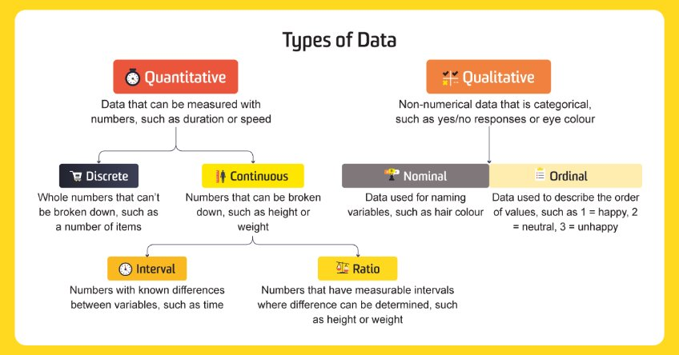
Types of Data

Slide 13
Types of Data
Qualitative Data
Strengths
Weaknesses
Quantitative Data
Strengths
Weaknesses
Allows researchers to explore complex phenomena in-depth.
Can be time-consuming and resource-intensive to analyze data.
Allows researchers to test hypotheses and make causal inferences.
May oversimplify or ignore complex phenomena.
Provides rich and detailed data that captures personal experiences and perspectives.
May uncover unexpected findings and generate new hypotheses
Data may be subjective and difficult to generalize
Data may suffer from researcher bias or interpretation
Provides objective and standardized data that can be easily compared
Can be analyzed using statistical techniques to identify patterns and relationships
May suffer from measurement error or response bias
May be limited in scope or fail to capture nuances of personal experiences

Slide 14


Types of data sources
Primary data refers to data collected firsthand by the researcher specifically for the research project at hand.
This type of data is original and directly relevant to the research question or objectives
Secondary data refers to data that has been collected by someone else for a different purpose but can be repurposed or analysed for a new research project.
This type of data is readily available and can be accessed from various sources, including published literature, databases, government reports, and organizational records.

Slide 15
Types of data sources
PRIMARY DATA COLLECTION
Strengths
Weaknesses
SECONDARY DATA COLLECTION
Strengths
Data may not be tailored to the specific research objectives.
Allows researchers to tailor questions to specific research objectives.
Can be time-consuming and expensive to collect data.
Can be cost-effective and efficient
Weaknesses
Provides first-hand data that is original and unique to the research study
Offers greater control over the research process and data quality.
May suffer from response bias or sample selection bias
May be limited in sample size and scope
May cover a broader geographic area or longer time span than primary data
May provide comparative data for analysis.
Data may be incomplete or inaccurate
Data may be outdated or irrelevant to the current research question

Slide 16
Types of data sources
PRIMARY DATA COLLECTION
Strengths
Weaknesses
SECONDARY DATA COLLECTION
Strengths
Data may not be tailored to the specific research objectives.
Allows researchers to tailor questions to specific research objectives.
Can be time-consuming and expensive to collect data.
Can be cost-effective and efficient
Weaknesses
Provides first-hand data that is original and unique to the research study
Offers greater control over the research process and data quality.
May suffer from response bias or sample selection bias
May be limited in sample size and scope
May cover a broader geographic area or longer time span than primary data
May provide comparative data for analysis.
Data may be incomplete or inaccurate
Data may be outdated or irrelevant to the current research question

Slide 17




Tools and technologies for data collection
There are now a plethora of tools that have made data collection easier.
Apps like Kobotoolbox, Google forms, Microsoft forms, etc enable researchers to collect data from people via in person interviews or remotely through surveys.
This data is stored in a CSV or XLS format which can then be analysed to gain insights
With the aid of development boards like the Raspberry Pi and Arduino, you can deploy sensors to monitor various physical phenomena remotely.

Slide 18
Data quality control and assurance practices.
Data Cleaning
Identifying and correcting errors
Data validation
Data Coding
Categorizing data
Ensuring coding consistency
Data Verification
Double entry
Logical checks
Verifying if the data falls within expected ranges and adheres to pre-defined rules.
Assigning numerical codes to represent different categories within your data (e.g., income levels, education levels). This allows for easier analysis.
This can involve checking for typos, inconsistencies in formatting, missing values, and outliers (extreme values that might skew your results).
Develop coding guidelines and have multiple researchers code a sample of data to identify and resolve any discrepancies.
Entering data twice by different individuals to catch errors during data entry.
Checking for logical inconsistencies within the data (e.g., someone reporting an age of 150).

Slide 19
Data quality control and assurance practices.
Documentation
Record data collection procedures
Documenting how and when data was collected, by whom, and any specific tools or technologies used.
Data cleaning and coding logs
Keeping track of the changes made to the data during cleaning and coding processes for transparency and auditability.
Statistical Methods
Descriptive statistics:
Calculating measures like mean, median, and standard deviation to assess the overall distribution of your data.
Data visualization:
Creating charts and graphs to identify patterns, trends, or outliers that might require further investigation.
Data Security:
Implementing security measures: Protecting sensitive data with encryption, password protection, and access controls.
Data backup and storage
Having secure backup procedures to prevent data loss and ensuring proper storage solutions to meet data security and privacy regulations

Slide 20
Recommended readings and tools:
Books/Papers:
  Measurement and Evaluation Series, Data collection: Planning For and Collecting All Types of Data by Patricia Pulliam Phillips and Cathy A. Stawarski
  Best Practices in Data Cleaning: A Complete Guide to Everything You Need to Do Before and After Collecting Your Data by Jason W. Osborne
  Guidelines for Demand Data Collection for Rural Access to Electricity Projects by Stevanato, N., Sangiorgio, I., Baldelli, G., Farah, A., Mereu, R., Colombo, E., Banda, S., Wacera, A., Oribo, N., Silva, I., Tomas Fillol, L., & Pinomaa, A
Tools:
  Kobotoolbox
  Google forms
  Python
  R
  MS Suite

