Slide 1

Introduction to the Components of a Solar System

Slide 2
Learning Outcomes :
After completing this lesson, you will understand the basic components of an Off-Grid Solar system.

Slide 3
Basic Components of an Off-Grid Solar System
Off-grid Solar Systems – often referred to as Stand-alone power systems (SAPS) – work by generating electricity from solar panels and using it to charge a solar battery via a charger controller. That electricity is then converted using an inverter so that it can power your home or business, even at night or during times when there is less than optimal sun exposure.
Components of an Off Grid Solar System
A simple off-grid solar power system requires the following components:
Solar panels;
Charge controller
Batteries;
Inverter
Notes:
Ref. : https://greenmagazine.com.au/information/solar-calculator/a-guide-to-off-grid-solar/

Slide 4
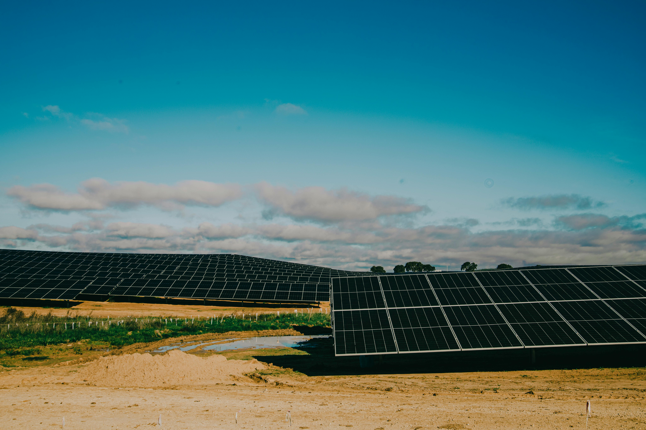
Solar Panels
Solar panels are obviously the first component. The precise size and production capabilities the solar panel array will depend on many factors as the amount of available sunlight in your region, the usable space of your roof, and your energy consumption needs.
Currently, the most cost-effective solar panels are those made up of 60, 72, 120, 132, or 144 cells. Solar cells are the small squares that make up the entirety of the panel itself.
Notes:
Ref. : https://greenmagazine.com.au/information/solar-calculator/a-guide-to-off-grid-solar/
Pic : https://www.pexels.com/photo/solar-panels-on-a-desert-19205947/

Slide 5
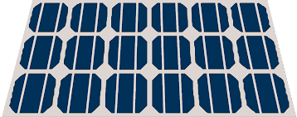
Solar Panels
A solar cell or photovoltaic cell (PV cell) is an electronic device that converts the energy of light directly into electricity by means of the photovoltaic effect. It is a form of photoelectric cell, a device whose electrical characteristics (such as current, voltage, or resistance) vary when it is exposed to light.
These days, monocrystalline panels are the industry standard in most systems.
A typical 60 cell monocrystalline solar panel will be around 68” x 40” in size and output in the range of 300-375 watts, whereas a 72 or 144 cell panel will measure 80” x 40” usually and output around 375 watts and above.
Notes:
Ref. : https://iopscience.iop.org/article/10.1088/1742-6596/1378/2/022031/pdf
Pic : https://commons.wikimedia.org/wiki/File:Solar_panel_color_icon.png

Slide 6
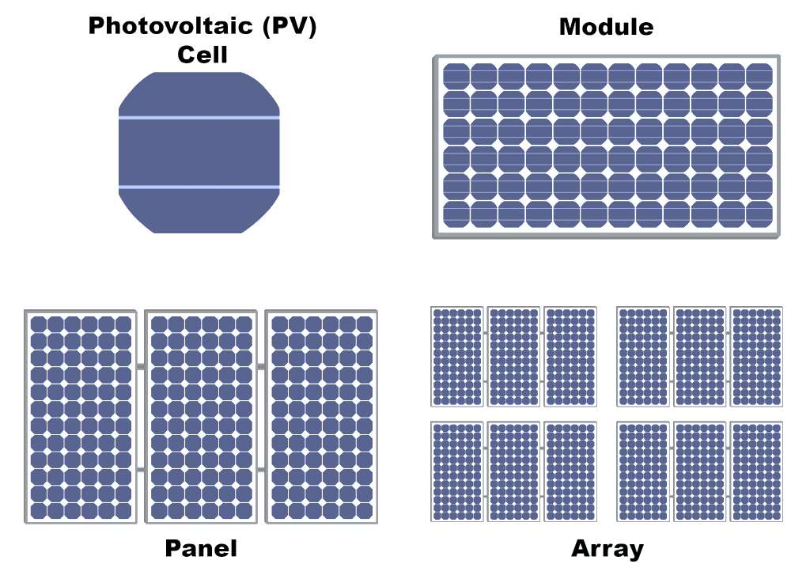
Solar Panels
Determining the size of the solar array is one of the most significant calculations in Off-Grid system design.
After determining the appropriate array configuration, the solar panels are connected in series strings (limited by the max input voltage), then the various strings of solar panels can be connected in parallel to create a substantial array (limited by power or current). This method simplifies the solar array output down to as few conductors as possible.
Notes:
Ref. : https://iopscience.iop.org/article/10.1088/1742-6596/1378/2/022031/pdf
Pic : https://energyresearch.ucf.edu/consumer/solar-technologies/solar-electricity-basics/cells-modules-panels-and-arrays/

Slide 7
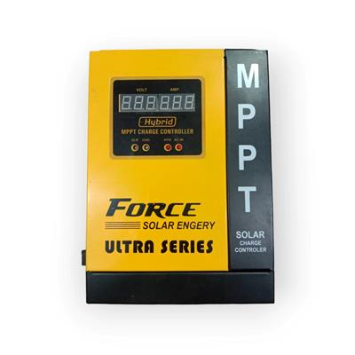
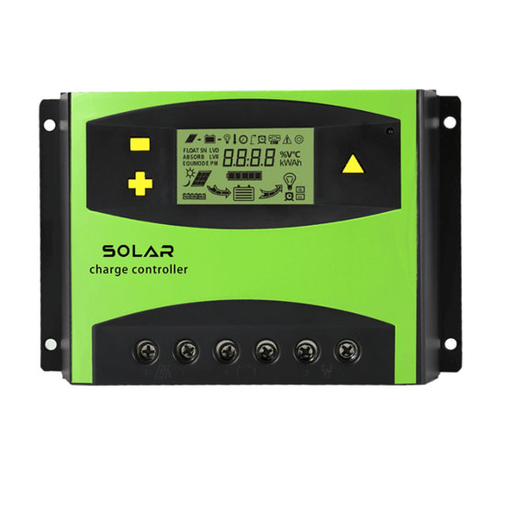
Charge Controller
Another component is the charge controller that plays a crucial role in managing energy flow from solar panels to the battery bank, ensuring proper charging without overcharging, which is vital for battery longevity. There are two main types of charge controllers:
MPPT (Maximum Power Point Tracking) and
PWM (Pulse Width Modulation).
Notes:
Ref. : https://www.solar-electric.com/learning-center/what-components-typically-used-off-grid-solar-power-system/#:~:text=For%20most%20DC-coupled%20off,inverter%20and%20the%20battery%20bank.Pic : https://www.zamzamstore.com.pk/products/force-mppt-solar-charge-controller-60amp
Pic : https://www.inverter.com/60a-pwm-solar-charge-controller
Pic : https://www.inverter.com/60a-pwm-solar-charge-controller

Slide 8
MPPT Charge Controller
MPPT charge controllers are distinguished by their ability to accept higher input voltages from solar panels, typically up to 30% higher than the battery voltage (within controller limits). This flexibility allows them to efficiently convert solar panel power into optimal battery charging power.
MPPT controllers track the maximum power point of the solar array and adjust the voltage and current to deliver the maximum power to the batteries. This capability makes them highly efficient, especially important when batteries approach full charge and need precise power management. MPPT controllers are preferred for their ability to capture the maximum available power from the solar array at any given time.
Notes:
Ref. : https://www.solar-electric.com/learning-center/what-components-typically-used-off-grid-solar-power-system/#:~:text=For%20most%20DC-coupled%20off,inverter%20and%20the%20battery%20bank.Pic : https://www.zamzamstore.com.pk/products/force-mppt-solar-charge-controller-60amp
Pic : https://www.inverter.com/60a-pwm-solar-charge-controller
Pic : https://www.inverter.com/60a-pwm-solar-charge-controller

Slide 9
PWM Charge Controller
PWM charge controllers regulate energy flow by switching on and off, controlling the rate at which energy from solar panels charges the batteries. They require the solar panel's nominal voltage to match that of the battery bank (e.g., 12 volts panels for a 12-volt battery system). PWM controllers provide limited control over power management compared to MPPT controllers, simply directing solar power into the batteries without optimizing for maximum efficiency.
In solar system designs, MPPT controllers are typically favored due to their superior ability to maximize solar energy capture and optimize battery charging, making them the standard choice for most applications.
Notes:
Ref. : https://www.solar-electric.com/learning-center/what-components-typically-used-off-grid-solar-power-system/#:~:text=For%20most%20DC-coupled%20off,inverter%20and%20the%20battery%20bank.Pic : https://www.zamzamstore.com.pk/products/force-mppt-solar-charge-controller-60amp
Pic : https://www.inverter.com/60a-pwm-solar-charge-controller
Pic : https://www.inverter.com/60a-pwm-solar-charge-controller

Slide 10
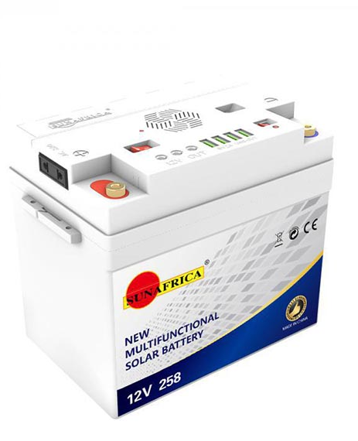
Batteries
A battery will be necessary, to allow the appliances to continue to run after the sun goes down. Throughout the day, the solar storage device will charge as your panels generate excess electricity. Rather than simply losing out on all of that available solar power, a battery enables keeping it for use at a later time. Depending on the energy needs, a single battery can be needed, or even a battery bank.
Batteries are the most expensive component. In the solar power industry.
There are two common battery chemistries – lead acid and lithium.
Notes:
Ref. : https://iopscience.iop.org/article/10.1088/1742-6596/1378/2/022031/pdf
Pic : https://www.alabastore.com/product/sun-africa-12v258-solar-battery-system/

Slide 11
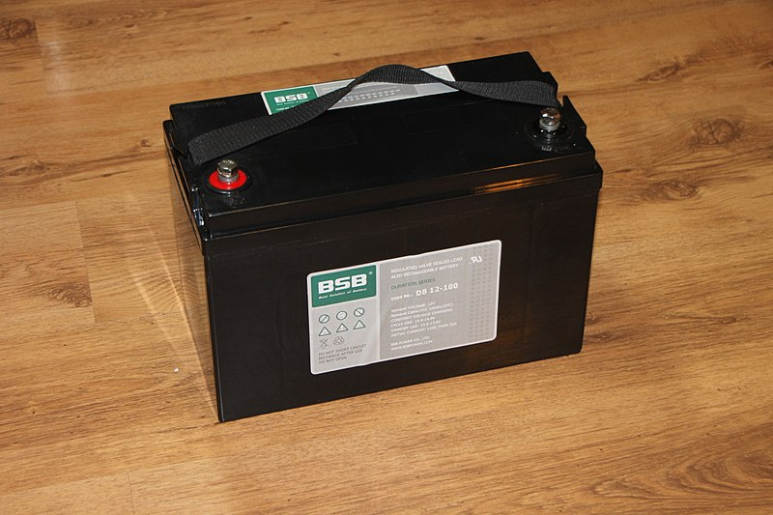
Lead Acid Batteries : Flooded lead-acid batteries
The two main types of lead acid batteries used in solar are flooded lead acid batteries and sealed AGM batteries.
Flooded lead-acid batteries
Flooded lead-acid batteries produce hydrogen gas during charging, which necessitates proper ventilation to avoid dangerous situations. Despite their low cost, lack of maintenance or excessive usage often leads to premature failure. For those seeking a cost-effective and maintenance-free option, AGM batteries may be a suitable alternative.
Notes:
Ref. : https://www.solar-electric.com/learning-center/what-components-typically-used-off-grid-solar-power-system/#:~:text=For%20most%20DC%2Dcoupled%20off,inverter%20and%20the%20battery%20bank.Pic : https://www.alabastore.com/product/sun-africa-12v258-solar-battery-system/
Pic : https://commons.wikimedia.org/wiki/File:VRLA_Valve-Regulated-Lead-Acid-Batteries_82645.jpg

Slide 12
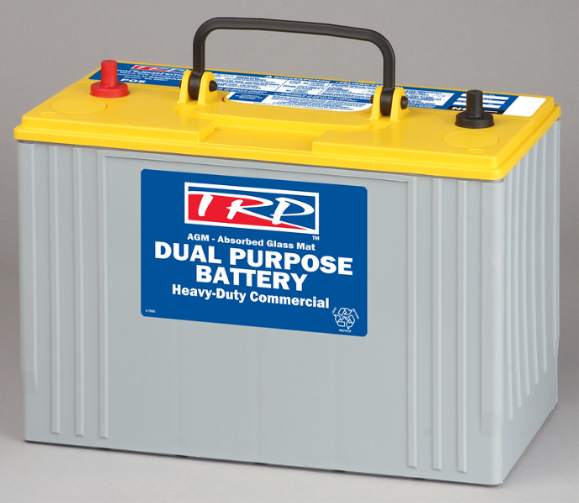
Lead Acid Batteries: AGM batteries
AGM (Absorbed Glass Mat) batteries feature fiberglass mats between the plates that absorb the electrolyte, making them completely sealed and virtually maintenance-free. Their life expectancy, charge cycles, and size/weight are similar to those of flooded lead-acid batteries.
While AGM batteries are more expensive than flooded batteries due to the lack of required maintenance, they eliminate the risk of damage from poor upkeep.
However, if an AGM battery is damaged through abuse, it is difficult to revive. Although AGM and flooded batteries are initially cheaper than lithium batteries, their lifespans are significantly shorter.
Notes:
Ref. : https://www.solar-electric.com/learning-center/what-components-typically-used-off-grid-solar-power-system/#:~:text=For%20most%20DC%2Dcoupled%20off,inverter%20and%20the%20battery%20bank.Pic : https://www.alabastore.com/product/sun-africa-12v258-solar-battery-system/
Pic : https://www.flickr.com/photos/truckpr/4246836079

Slide 13
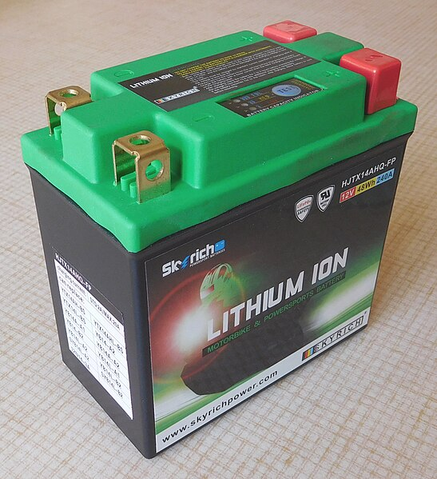
Lithium Batteries
Lithium Iron Phosphate (LiFePO4) batteries, commonly used in the solar power industry, offer several advantages over flooded lead-acid and AGM batteries. They are safer, do not off-gas, and require no ventilation or maintenance. Unlike lead-acid batteries, they do not need to be fully charged and are designed for a significant number of charging cycles, making them ideal for off-grid solar applications. LiFePO4 batteries feature a built-in Battery Management System (BMS) that monitors and protects the battery from over-discharging and extreme temperatures. They can be expanded without affecting the lifespan of the existing battery bank, unlike lead-acid batteries, which fail prematurely when expanded.
Notes:
Ref. : https://www.solar-electric.com/learning-center/what-components-typically-used-off-grid-solar-power-system/#:~:text=For%20most%20DC%2Dcoupled%20off,inverter%20and%20the%20battery%20bank.Pic : https://www.alabastore.com/product/sun-africa-12v258-solar-battery-system/
Pic : https://commons.wikimedia.org/wiki/File:Lithium_iron_phosphate_battery,_12_V,_48_Wh,_240_A.jpg

Slide 14
Lithium Batteries
Available in 12v, 24v, and 48v variations, lithium batteries can be easily paralleled with conventional system voltages. They offer superior depth of discharge, a higher number of charge cycles, faster charging, and continuous power delivery without damage. Additionally, lithium batteries are lighter, more compact, and come with warranties of around 10 years, far exceeding those of lead-acid batteries.
Notes:
Ref. : https://www.solar-electric.com/learning-center/what-components-typically-used-off-grid-solar-power-system/#:~:text=For%20most%20DC%2Dcoupled%20off,inverter%20and%20the%20battery%20bank.Pic : https://www.alabastore.com/product/sun-africa-12v258-solar-battery-system/

Slide 15
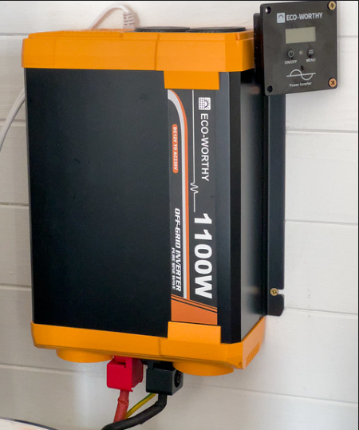
Inverter
The next component in an off-grid solar system design would be an inverter.
In off-grid solar systems, the inverter is a crucial component, typically a battery-based inverter, responsible for converting DC power stored in the battery bank into usable AC power for household appliances. Inverters come in various sizes to accommodate different load requirements, ranging from smaller to larger loads.
It's essential to size the inverter according to the total sum of all loads in the off-grid system to ensure it can handle simultaneous usage. Matching the inverter's voltage to that of the battery bank is critical; for example, a 12-volt inverter should be used with a 12-volt battery bank. Unlike charge controllers, an inverter's voltage is fixed and must align with the system's battery voltage
Notes:
Ref. : https://www.solar-electric.com/learning-center/what-components-typically-used-off-grid-solar-power-system/#:~:text=For%20most%20DC%2Dcoupled%20off,inverter%20and%20the%20battery%20bank.
Pic : https://www.flickr.com/photos/andydavy/53427356157/

Slide 16
Inverter
Choosing an inverter charger, which combines the functions of an inverter and a charger, is common in off-grid systems. An inverter charger not only provides AC power output but also accepts AC input to charge the battery bank, enabling the use of external power sources like generators. This feature ensures system redundancy, crucial during periods of low solar output when additional charging may be necessary.
Selecting the right inverter is a pivotal decision during system design, especially when future expansion is anticipated. Understanding load calculations and matching voltage requirements are fundamental steps in ensuring an efficient and reliable off-grid solar system.
Notes:
Ref. : https://www.solar-electric.com/learning-center/what-components-typically-used-off-grid-solar-power-system/#:~:text=For%20most%20DC%2Dcoupled%20off,inverter%20and%20the%20battery%20bank.
Pic : https://www.flickr.com/photos/andydavy/53427356157/

Slide 17
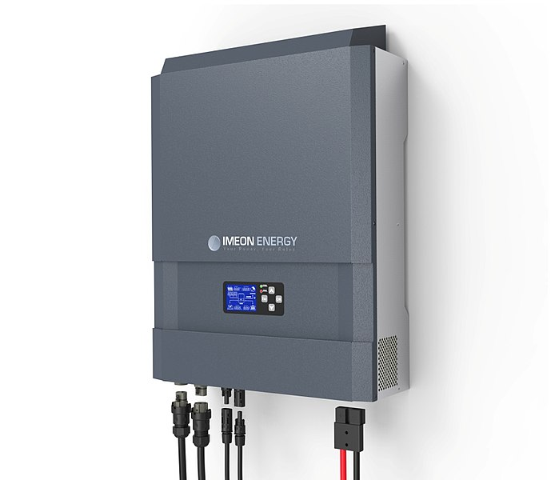
Hybrid Inverter System
Hybrid inverters are comprehensive units that combine inputs for solar, grid, loads, generator, and battery into a single device.
These all-in-one systems integrate the functionalities of MPPT charge controllers and inverter/chargers, offering a versatile and customizable solution known as an Energy Storage System (ESS) or hybrid inverter.
Hybrid inverters are popular for their simplicity and ease of installation, making them ideal for applications where an integrated solution is preferred.
They effectively manage PV production and battery charging similar to a charge controller, while also providing power output from batteries and/or PV like an
off-grid inverter.
Notes:
Ref. : https://www.solar-electric.com/learning-center/what-components-typically-used-off-grid-solar-power-system/#:~:text=For%20most%20DC%2Dcoupled%20off,inverter%20and%20the%20battery%20bank.
Pic : https://commons.wikimedia.org/wiki/File:Onduleur_hybride_1.jpg

