Slide 1

Assessment of Renewable Energy Resources
Lesson 4:
Satellite Applications
Authors: Paula Costa, António Couto, Teresa Simões, Ana Estanqueiro

Slide 2

Lesson 4 Outline:
Main objectives
  Introduction to the Copernicus Database
  Copernicus Services for Solar (CAMS) and Wind (ERA5) data
  What is and the importance of a Reanalysis
https://www.copernicus.eu/en

Slide 3
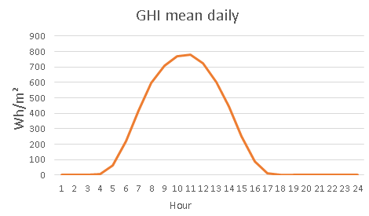
Lesson 4 Learning Outcomes :
  At the end of this lesson, the student will be able to
  Understand what is a Reanalysis database and what are their advantages/disadvantages
  Extract a Solar and Wind Time-Series from Copernicus Databases for a location
  Compute a mean daily and monthly wind and global horizontal irradiation (GHI) profiles for that location

Slide 4
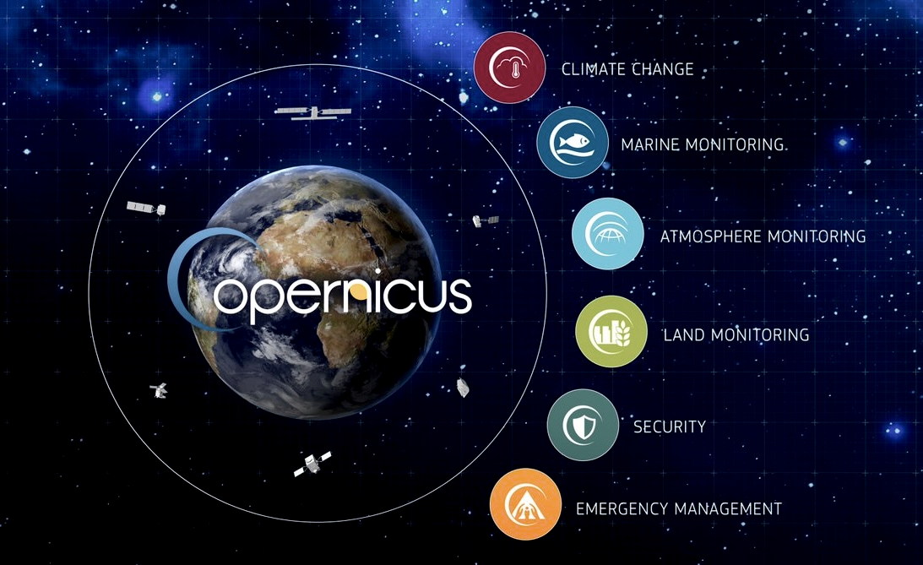
Copernicus Services- Solar and Wind data
What is Copernicus?
  Copernicus is the Earth observation component of the European Union’s Space Programme, looking at our planet and its environment to benefit all European and global citizens.
  Managed by: European Commission
  Join Implementation with:
    EU Member States,
    European Space Agency (ESA)
    European Organisation for the Exploitation of Meteorological Satellites (EUMETSAT)
    European Centre for Medium-Range Weather Forecasts (ECMWF)
    Joint Research Centre (JRC),
    EU Agencies
    Mercator Océan International
https://www.copernicus.eu/en

Slide 5
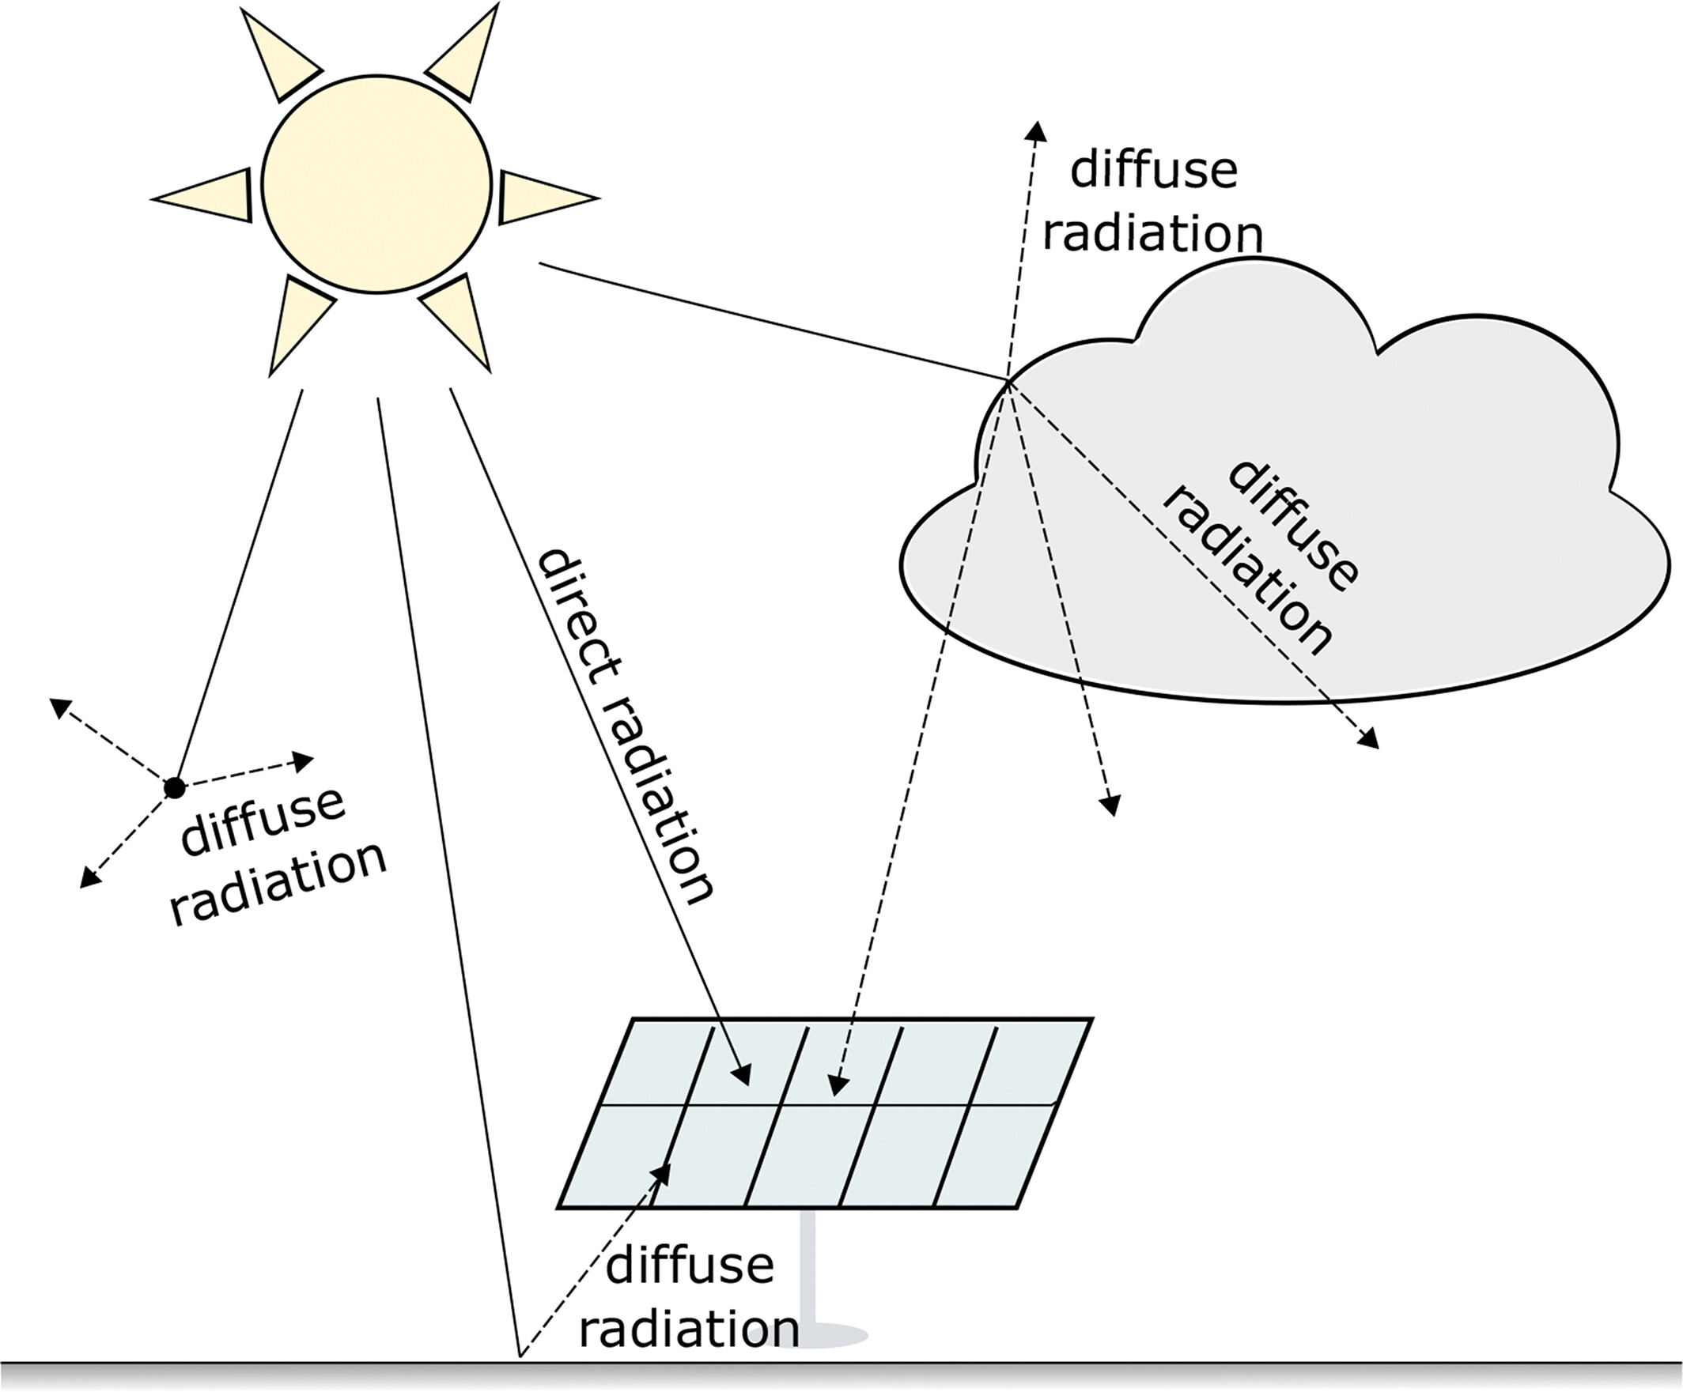
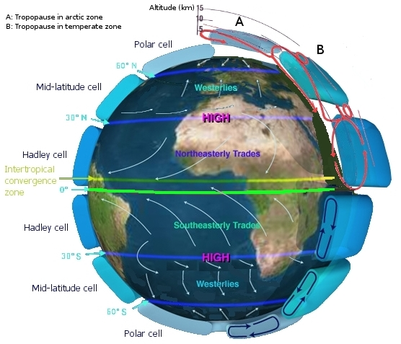
Copernicus Services- Solar and Wind data
Copernicus services provide long-term valuable data in several different sources (satellite and numerical weather models) blending them together to provide continuous spatial-temporal data (1h time step) in a global grid of 27x27km up to 9x9km
In terms of Solar data, Copernicus services provides Solar Irradiance reaching the Earth’s surface, as well as cloud cover. This helps to assess the solar potential of different regions and guiding in solar power plant installations (mini or macro grids)
In terms of Wind data, the mean wind speed and direction are provided by the Copernicus services. This helps in assessing the wind energy potential useful in contribution for small or medium wind turbine layouts and predict long-term energy production.
Doddy Clarke - 2022
Global Atmospheric Circulations

Slide 6
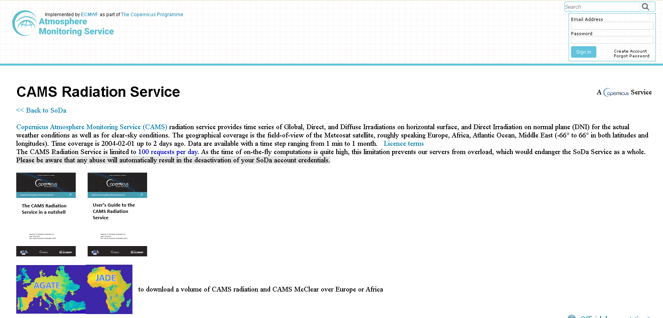
Copernicus Services- CAMS webpage
CAMS is the service that provides
Solar Data.
https://www.soda-pro.com/web-services/radiation/cams-radiation-service?p_p_id=com_liferay_login_web_portlet_LoginPortlet&p_p_lifecycle=0

Slide 7
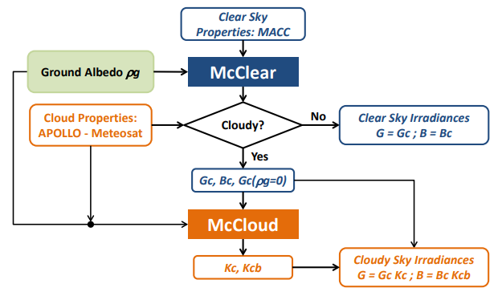
Copernicus Services- CAMS
CAMS radiation service uses information from satellites and its models of the atmosphere to provide climatologies (historical time series) of global and direct irradiance to give the renewable energy sector and policy makers accurate information on solar radiation in accessible, quality metrics.
It is based in the new Heliosat-4 method, integrated into the MACC—RAD service. Heliosat-4 method was created to process Meteosat Second Generation data capable to treat separately the clear sky
radiation (McClear method) and the effects of clouds (McCloud method) derived from SEVIRI instrument APOLLO – multispectral cloud properties) and ground
albedo (derived from MODIS)
Data is spectrally-integrated at a 15-minute for GHI and DNI time-series values or maps with a spatial resolution of 0.2º (approx. 22x22km)
Hoyer-Klick C. et all, 2015

Slide 8
CAMS Solar Data Extraction
CAMS provides time series of Global (GHI), Direct (BHI), and Diffuse (DHI) Irradiations on horizontal surface, and Direct Irradiation on normal plane (DNI) for the actual weather conditions as well as for clear-sky conditions. Global
Time coverage is 2004-02-01 (MSG*) or 2016-02-01 (HIMAWARI**) up to 2 days ago. Data are available with a time step ranging from 1 min to 1 month.
The CAMS Radiation Service is limited to 100 requests per day.
Doddy Clarke - 2022
(Global) GHI = (direct) BHI + (diffuse) DHI
*MSG (Meteosat Second Generation Satellite)
**HIMAWARI (Japanese Global Geostationary Satellite Series)

Slide 9
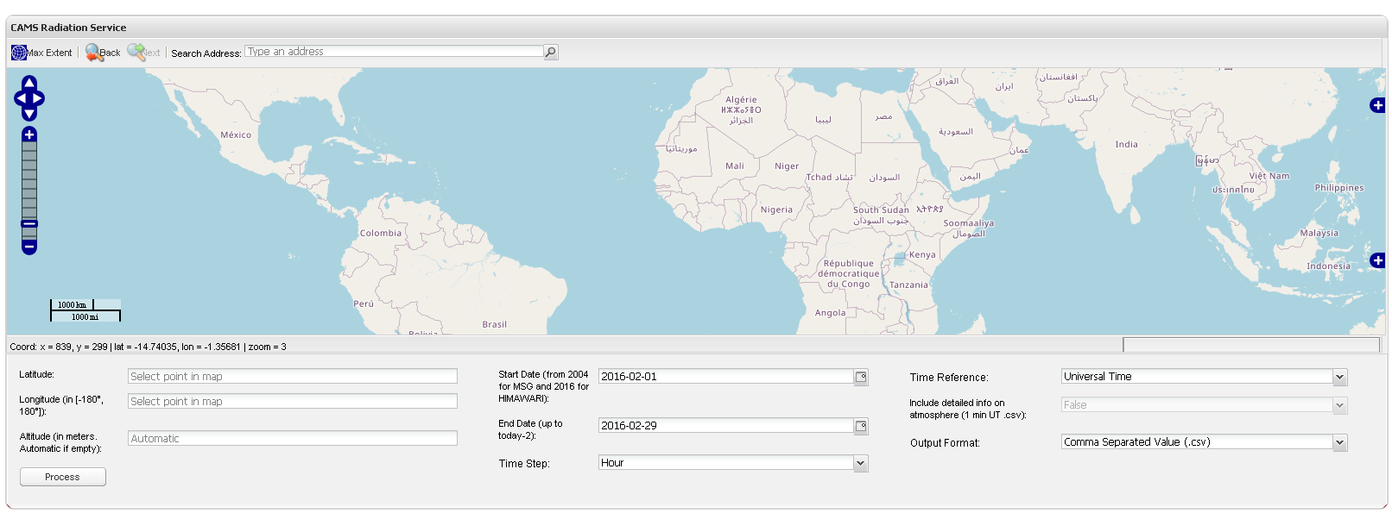
CAMS Solar Data Extraction
Web extraction data menu (define: latitude, longitude, start and end of data extraction and output format)

Slide 10
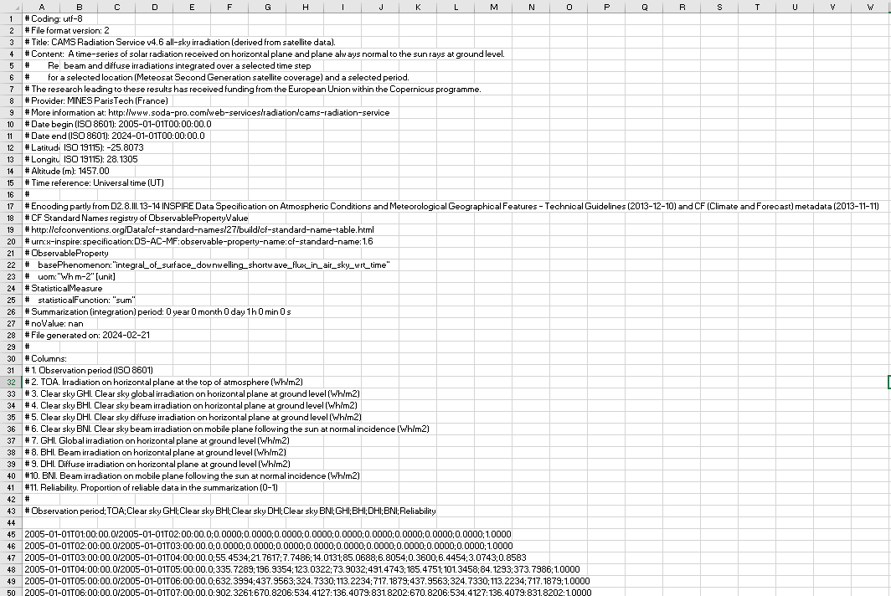
CAMS Solar Data Extraction
Contents of an example extracted time-series of data:
The first 44 rows are metadata
Row 43 contains the header name of column data.
Data starts at Row 45

Slide 11
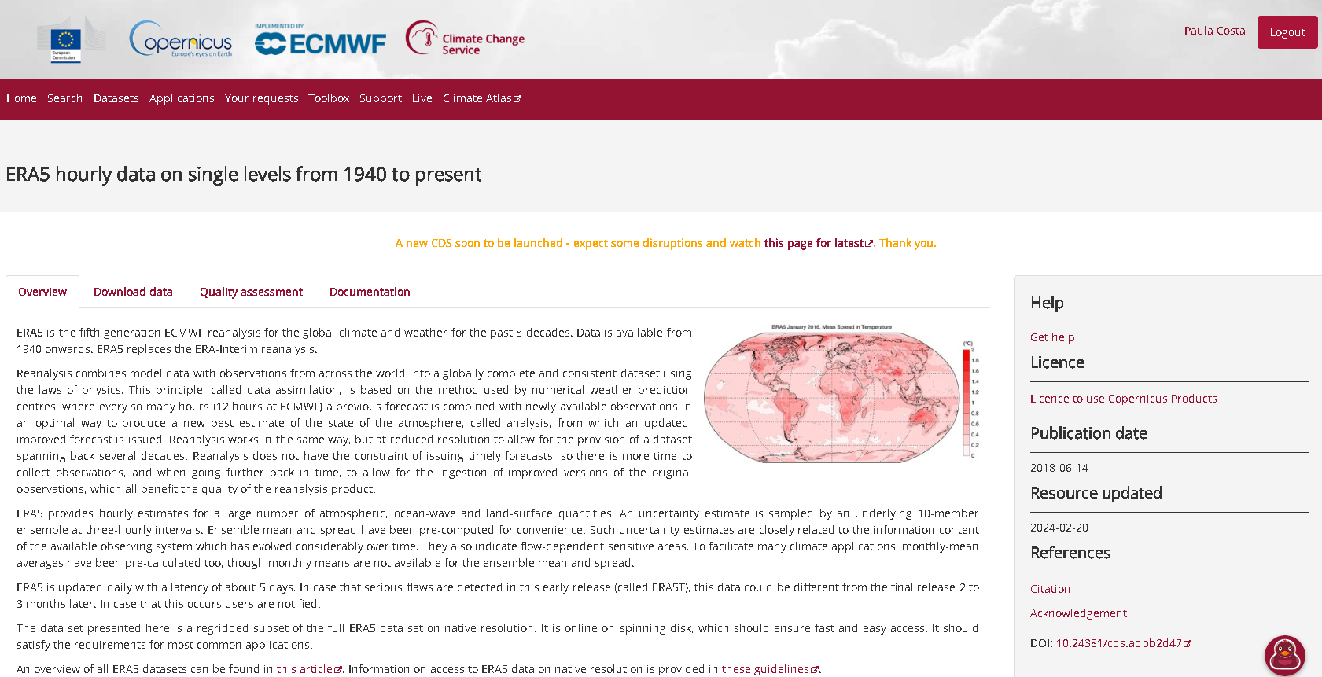
Copernicus Services- ERA5 webpage
ERA5 is the service that provides
Wind Data.
https://cds.climate.copernicus.eu/cdsapp#!/dataset/reanalysis-era5-single-levels?tab=overview

Slide 12
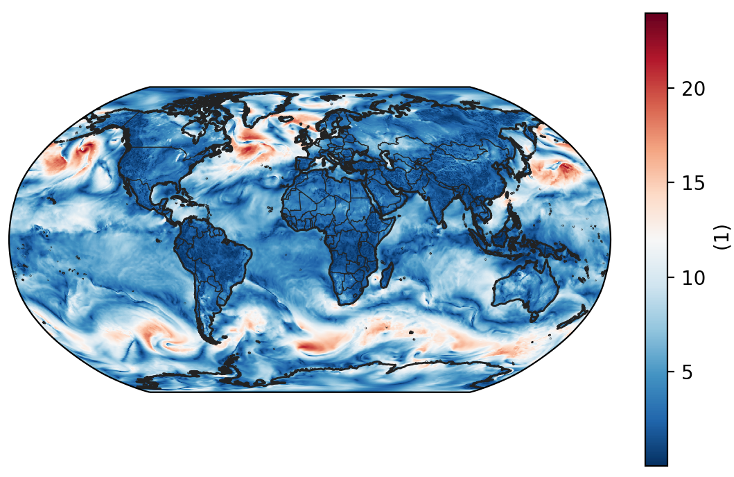
Copernicus Services- ERA5
ERA5 is the fifth generation ECMWF atmospheric reanalysis of the global climate covering the period from January 1940 to present. It provides hourly estimates of wind and other meteorological variables.
The data cover the Earth on a 25 km grid and resolve the atmosphere using 137 levels from the surface up to a height of 80km
ERA5 Mean wind speed at 00:00 2024/01/01
[m/s]

Slide 13
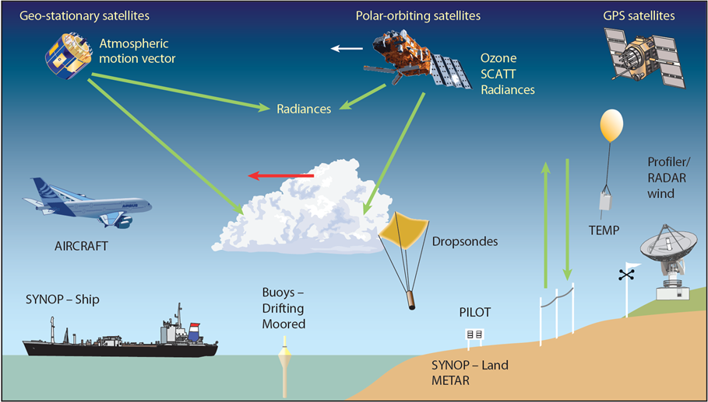
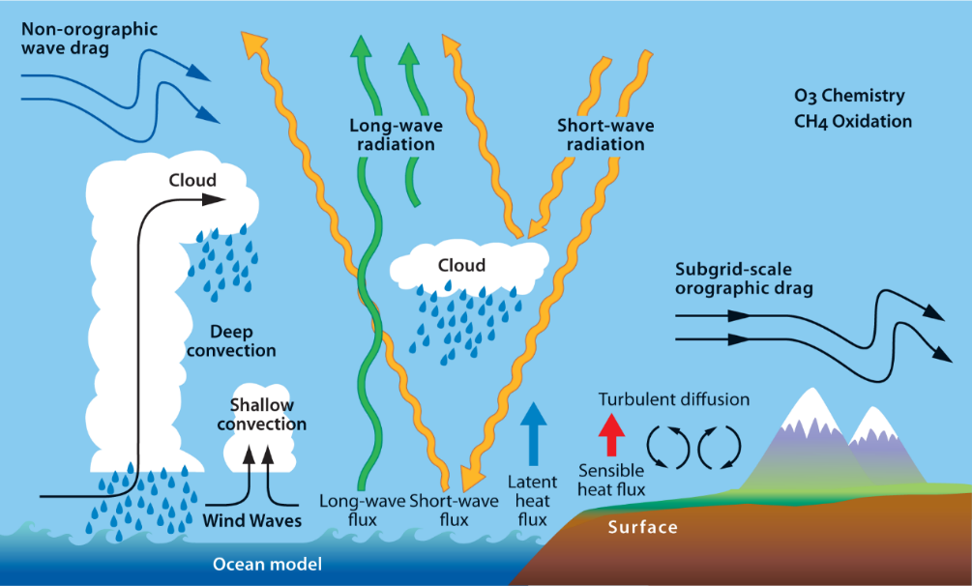
What is a Reanalysis?
A reanalysis is a complex mathematical process that blends different type of observations with numerical weather models to create a consistent 3D “portrait” of the atmosphere at a certain time and date.
Numerical weather models are generally known as Global atmospheric models and they are capable to simulate all thermal, moist and radiation processes occurring in the atmosphere, such as, precipitation, clouds, radiation, turbulence, boundary layer effects, including sub-grid processes derived from orography and non-orography drag processes.
Global Network Observations
Observations | ECMWF
Global Atmospheric model
simulates the majority of the atmospheric processes
Atmospheric physics | ECMWF

Slide 14

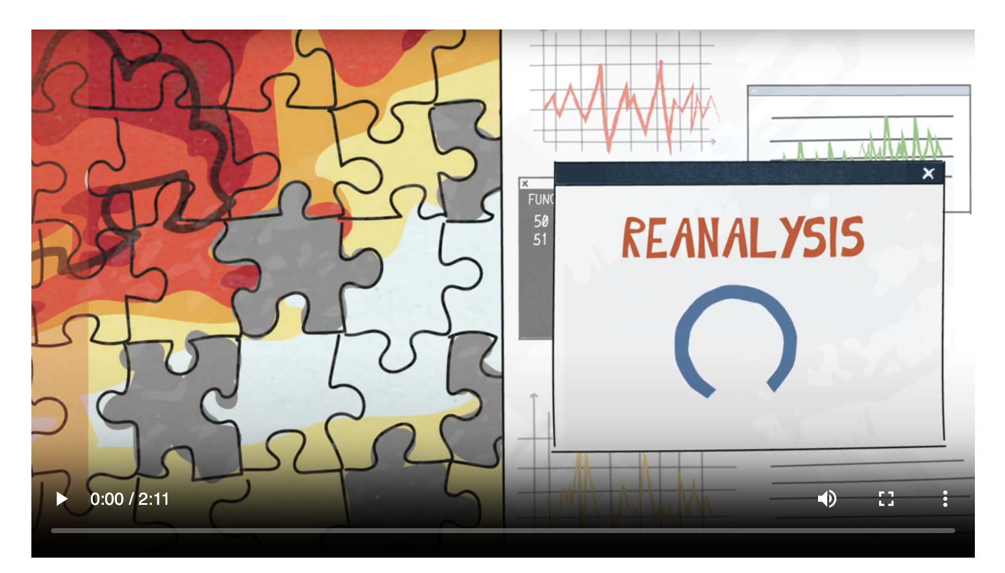
What is Reanalysis? (Movie Courtesy)
What is Reanalysis? ​
​
Please watch the 2-minute video at the following link on the
Climate Copernicus website
to see ​a short, animated explanation.​
https://climate.copernicus.eu/climate-reanalysis

Slide 15
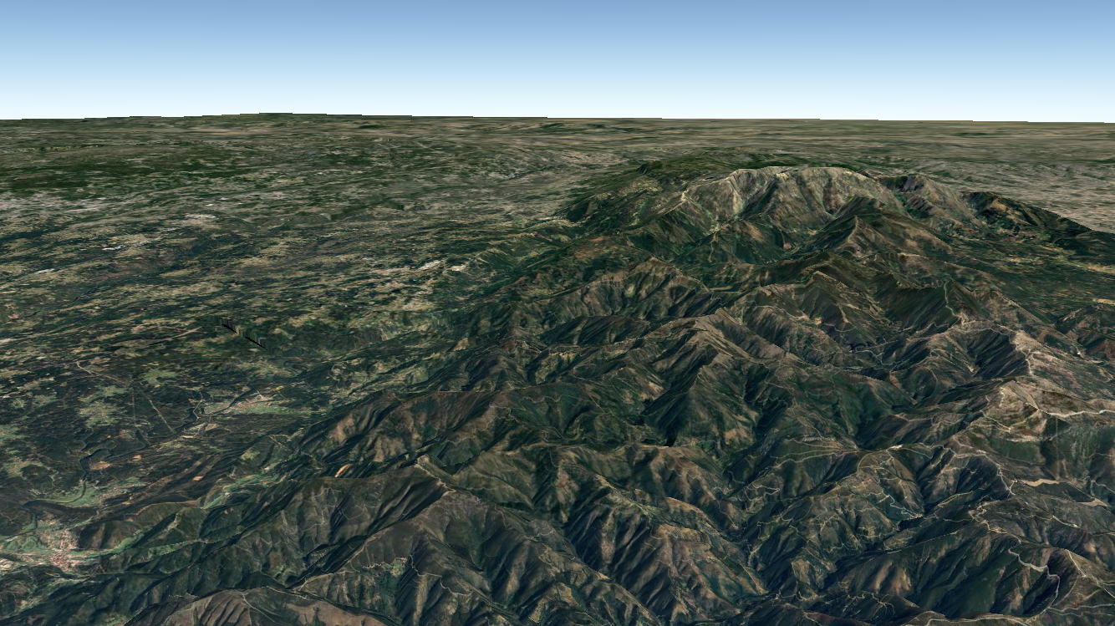
Advantage/disadvantage of a Reanalysis
Reanalysis can provide a kind of “true” 3D state of the atmosphere at each hour but they are conditioned by their spatial resolution grid :
    25 x 25 km spatial grid before 2017
    9 x 9 km spatial grid after 2017
So, localities dominated by mountainous or irregular terrain areas shall be avoided due to deviations in the wind estimates.
In particularly, localities dominated by complex terrain are still a challenge to be well represented by atmospheric models at the current available spatial resolutions.

Slide 16
ERA5 Wind Data Extraction
Wind data can be immediately extracted from a WebAPI service (via browser as https://)
data is provided at only two levels: 10m and 100m height and wind speed and direction comes immediately. Also, the data is extracted for the most near grid point
https://archive-api.open-meteo.com/v1/archive?latitude=-30.17&longitude=35.25&
start_date=1990-01-01&
end_date=2019-12-31&
hourly=wind_speed_10m,wind_speed_100m,wind_direction_10m,wind_direction_100m&
wind_speed_unit=ms&timezone=GMT&format=csv
Example extraction: time series of 30 years, 1hour interval, wind speed and direction for 10m and 100m, for a local w/coordinates Latitude -30.17 and Longitude 35.25 (both in WGS84 coordinate system)

Slide 17
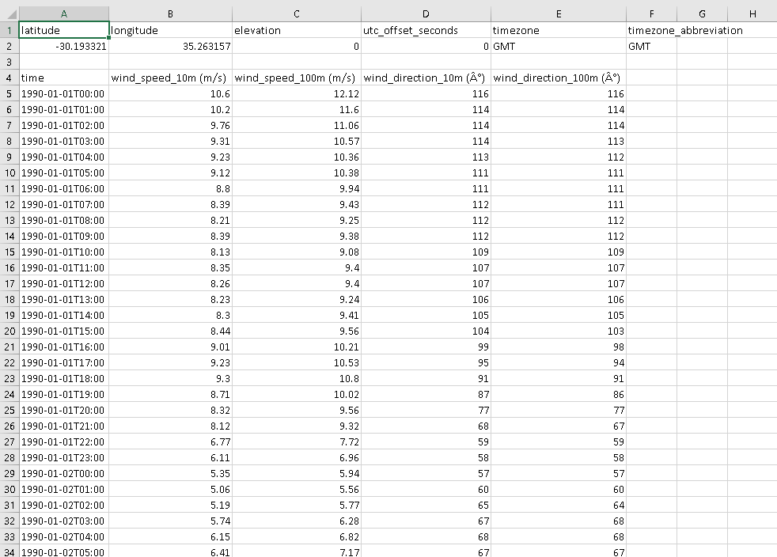
ERA5 Wind Data Extraction
Example of extraction file from the WebAPI command
(in previous slide)
https://archive-api.open-meteo.com/v1/archive?latitude=-30.17&longitude=35.25&
start_date=1990-01-01&
end_date=2019-12-31&
hourly=wind_speed_10m,wind_speed_100m,wind_direction_10m,wind_direction_100m&
wind_speed_unit=ms&
timezone=GMT&
format=csv
Data is quickly provided in a file at the download area of your computer.

Slide 18
Remarks
Copernicus Services ERA5 and CAMS provide global 2D and 3D data for several atmospheric processes such as the Wind and Solar.
Data is generated via Reanalysis Method. It blends observations and computer simulations of the 3D state of the atmosphere. Nowadays Reanalysis has about 9x9km but still delivered mostly of the times at 27x27km (before 2017 year).
Although Reanalysis is a consistent and robust database providing high-quality meteorological data, particular attention for the possible deviations in the wind estimates if the data is extracted for localities dominated by complex terrain . This kind of locals are still a challenge to be well represented by atmospheric models due to their spatial resolution limitation.

Slide 19
Lesson 4: Exercises with solutions
Now follow two exercises, with solutions provided, for you to practice your new skills.
Exercise 1: Solar Task, Solution provided
Exercise 2: Wind Task, Solution provided

Slide 20
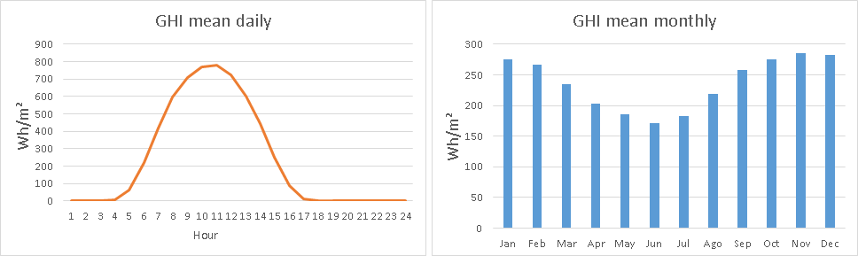
Exercise 1: Solar Task
Extract a time-series with the Global Horizontal Irradiation (GHI) from CAMS Copernicus Service and process the solar radiation data to plot a mean daily and a mean monthly GHI profile for a chosen location in any part of the globe, including your own.
Please note:
it will take
20 to 30 minutes
to complete this exercise.
Find the Guidelines for the Solar Task as well as the data and the solutions here:
https://drive.google.com/drive/folders/1iwglSR4sFfSQfNH8iOJXTqnDVLMULZ6F?usp=sharing

Slide 21
Lesson 4 Exercise 2: Wind Task
Extract a time-series with wind speed and direction from ERA5 Copernicus Service and process the data to plot a mean daily and a mean monthly wind profile for a chosen location in any part of the globe, including your own. Please note: this task will take 20 to 30 minutes to complete.
Find the Guidelines for the Wind Task as well as the data and the solutions here:
https://drive.google.com/drive/folders/1iwglSR4sFfSQfNH8iOJXTqnDVLMULZ6F?usp=sharing

Slide 22
Recommended readings:
PDF files:
https://www.ecmwf.int/sites/default/files/2023-08/Fact%20sheet%20-%20Reanalysis%20-v3_1.pdf
https://climate.copernicus.eu/sites/default/files/2021-12/09-c3s-uls-data-resources-reanalysis.pdf
https://atmosphere.copernicus.eu/sites/default/files/repository/MACCIII_RAD_DEL_D57.5_final_0.pdf
Websites:
https://www.soda-pro.com/web-services/radiation/cams-radiation-service
https://www.soda-pro.com/web-services/radiation/cams-radiation-service
https://www.ecmwf.int/en/forecasts/dataset/ecmwf-reanalysis-v5
https://reanalyses.org/

Slide 23
References
This unit was developed by: Paula Costa, António Couto, Teresa Simões and Ana Estanqueiro, all from LNEG, and is based on the following resources:
The ERA5 Climate Reanalysis: https://climate.copernicus.eu/climate-reanalysis
Data assimilation: https://research.reading.ac.uk/met-darc/aboutus/what-is-data-assimilation/
The CAMS Radiation Service: https://www.soda-pro.com/web-services/radiation/cams-radiation-service

