Slide 1

Assessment of Renewable Energy Resources
Lesson 3: Wind Resource Assessment
Authors: T. Simões, P. Costa, A. Couto, A. Estanqueiro

Slide 2
Lesson 3: Learning Outcomes
At the end of this unit, the student will be able to:
Understand how to estimate the wind potential in a certain site and which are the most relevant parameters to that procedure;
Perform a quality control of the wind data series following the guidelines/protocol available on the slides;
Perform a wind energy production estimate with a power curve;

Slide 3
Lesson 3 Outline
You will learn about:
  Wind as an Energy Resource
  Experimental campaigns – Sensors and data quality check
  Methods for wind resource assessment
  How to estimate wind energy production from a wind turbine
You will also perform two exercises:
Exercise 1: Perform a quality control of the wind data series following the guidelines that we will give you on the slides
Exercise 2: Perform an annual wind energy production using the power curve and remaining information related with the wind behavior that we will provide

Slide 4
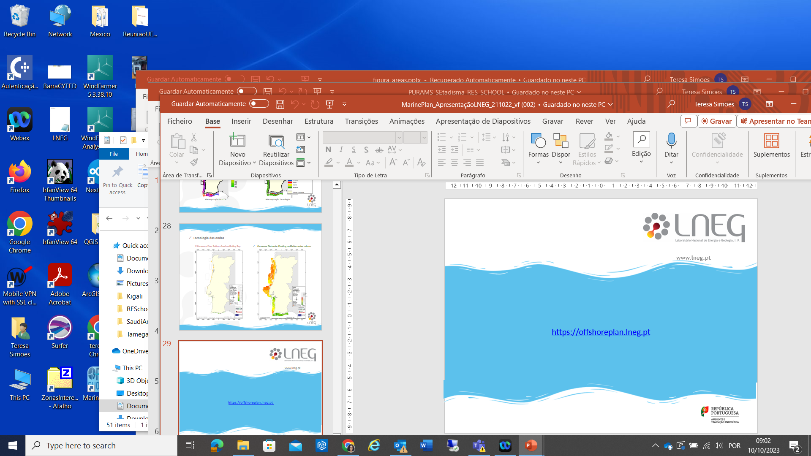
The Wind as an Energy Resource
The wind speed is a vectorial quantity, strongly three-dimensional, whose horizontal component (and not only!) Undergoes great variations in time and space
Horizontal wind direction – 1 month
Wind speed – 1 month

Slide 5
The Wind as an Energy Resource
Spatial and Temporal variability
  Wind speed field associated with the site topology

Slide 6
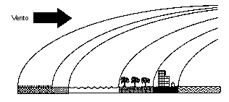
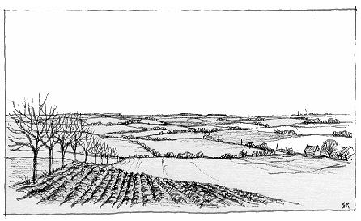
Roughness
Roughness: Joint effect of the surface of the terrain and the existent obstacles that cause a decrease in the wind speed close to the ground.
Type of Terrain
Ice (or similar)
Open sea
Snow
Grass
Mown grass
Very low vegetation
Agriculture field
Sparse trees, isolated huses,
Suburbs
Forest
Urban áreas
Cities
Examples:
- Houses
large / small trees with sparse / dense distribution
vineyards
agricultural land (eg wheat)
- etc.
Fonte – Simiu and Scanlan

Slide 7
Wind as an Energy Resource
Several quantities need to be assessed for a precise wind characterization at a certain site.
Some indicators are “mandatory”:
  the average wind speed and its diurnal and seasonal variations;
  the distribution of wind speed classes;
  calculation of extreme values ​​and their return time;
  the variation with the altitude of the wind speed, i.e. the profile of the atmospheric boundary layer;
  the angular distribution of the wind direction;
  diurnal and seasonal variations in air density and its variation with altitude

Slide 8
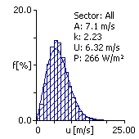
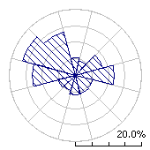
Wind Parameters
Wind speed vertical profile
Wind speed daily profile
Wind speed annual profile
Weibull distribution
Wind rose
“Division” of the wind speed values ​​by speed classes and determination of the frequency of occurrence of each class (histogram). Adjustment of the Weibull distribution curve.
Sectoral distribution (e.g. 12 direction sectors) of wind direction.

Slide 9
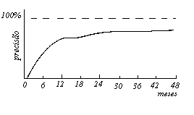
Experimental Campaigns
Wind measurements campaign:
  Equipment selection
  Tower height and corresponding configuration (onshore or coastal)
  Measurement for a minimum period of 12 months, ideally over 3/4 years (data from Portugal and onshore case).
  Inter-annual variability of the wind flow

Slide 10
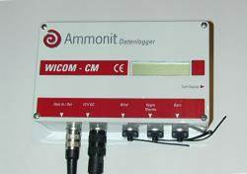
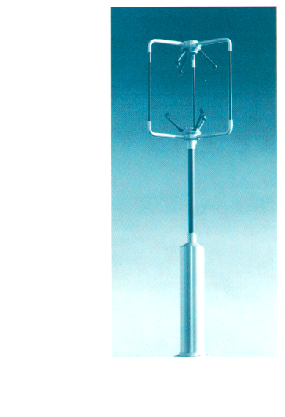
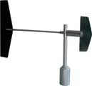
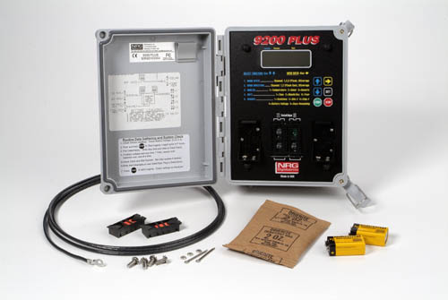
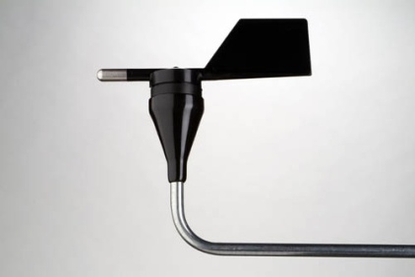
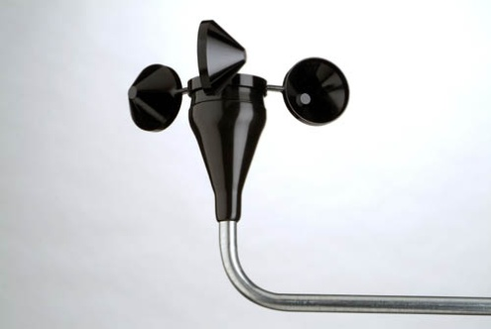
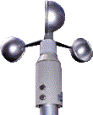
Experimental Campaigns - Sensors
For Standard Methods
For Spectral Methods and Very Complex environments

Slide 11
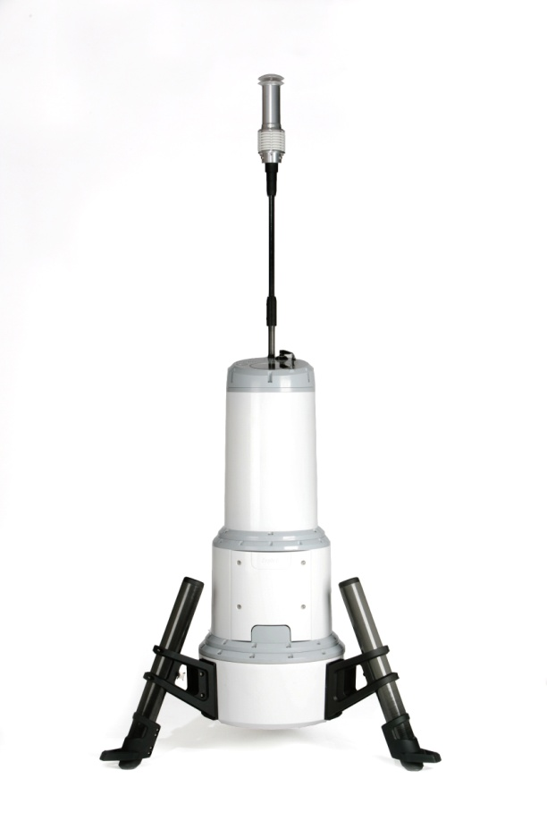
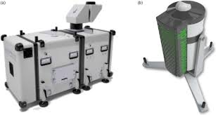
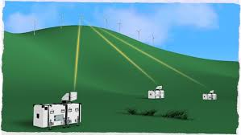
Experimental Campaigns - Sensors
Other sensors for special applications, e.g. Complex terrains, offshore:
LIDAR, SODAR, etc..

Slide 12
Data Quality control
During the realization of the experimental measurement campaign, and after collected and stored, the wind data goes through a set of control processes which validate the further processing and characterization of the wind potential.
The occurrence of failures and errors in data records is more frequent than desirable:
Faulty sensors; Deficient registration system; Damaged cables and/or bad contact; Problems with the registration or reading software; Atmospheric discharges; Ice; others.

Slide 13
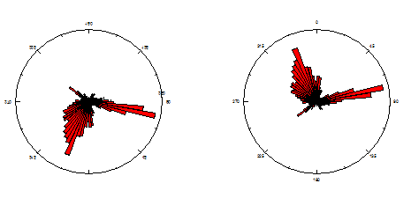
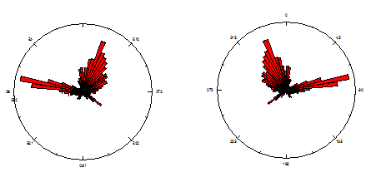
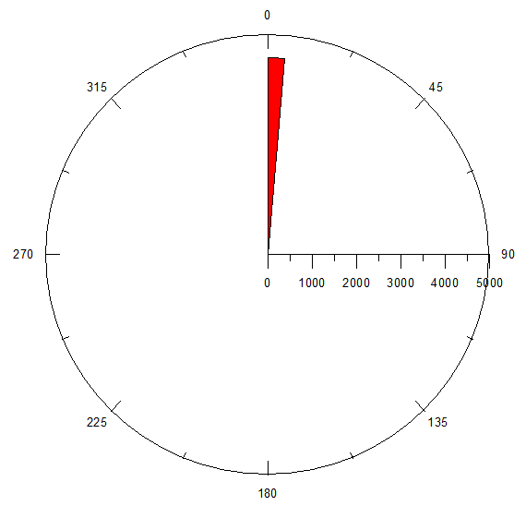
Data Quality Control
Wind direction;
Fixed values in one sector
“Mirrored values”
Deviations from identified directions

Slide 14
Data Quality Control
The detection and correction of these failures necessarily involves inspecting the data, before using it for any purpose. It can be done automatically and / or manually.
  Automatic: Consists of using statistical alphanumeric and graphic data processing software, determining the parameters that allow automatic detection of errors in data files
  Manual: It consists of the inspection and visualization of data in conventional text and graphic editors, which allow the detection of small faults that are often “filtered” and imperceptible by the automatic quality control process.
However sophisticated the automatic control model may be, correct data validation necessarily involves manual inspection of the data.

Slide 15
Data Quality Control
In the specific case of wind speed and direction data, automatic inspection is usually done by filtering the data and visualizing it graphically:
  Wind rose: Detects possible faults in the direction sensors;
  Histogram: It allows detecting anomalous speed values ​​(very low or very high);
  Daily wind speed profiles for all installed sensors: allows detecting any abnormal variations in altitude of the wind speed, or values ​​corresponding to anomalous regimes of atmospheric flow;
  Others: graphics that allow to detect flaws in the temporal sequentiallity of the records.

Slide 16
Data Quality Control
  When failures, anomalies or errors are detected in the collected data, they are recovered - whenever possible - using statistical tools:
    Correlation coefficients;
    Regression functions based on data available for nearby stations in locations with the same type of terrain and wind regime.
  The data sets are subsequently validated by repeating the automatic and / or manual inspection process.
  Wind direction failures are only “corrected” in very short periods and based on similar data series

Slide 17
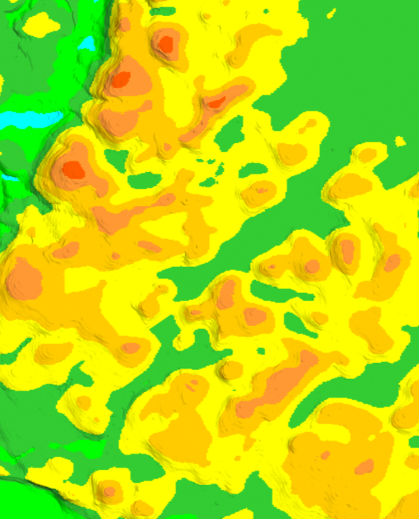
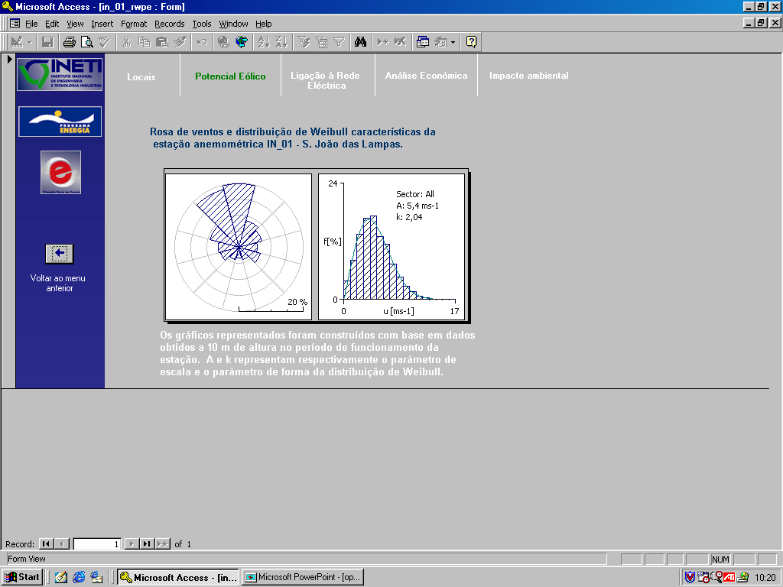
Wind Resource Assessment
Classical Methodology:
Determination of a wind speed distribution function (in this case Weibull)
Estimation of the incident power flow in each location.
Energy resource maps obtained from the local wind atlas
PE configuration and consequent estimation of energy production
Data used: Wind speed and direction obtained experimentally
Need to have description of the terrain and soil occupation

Slide 18
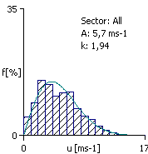
Wind Resource Assessment
Knowledge of a wind distribution law is essential for the characterization of the wind resource.
One of the distribution functions that best fits this purpose is the Weibull distribution, which is:
  strongly asymmetric
  a particular case of the generalized Gamma distribution and presents some advantages in its application;
  a distribution to 2 parameters, A (scale parameter [m / s] and k (shape parameter);
Once parameters A and k are known at a certain time, they can easily be adjusted to another height.
There are several commercial models that use this approach for wind resource assessment.

Slide 19
Wind Energy Annual Estimate
∫
P_{med} =
(
x
)
dv
Wind speed distribution
Power curve
Energy (annual) = P_{average annual} x nº hours (annual);

Slide 20
Exercises
Now follow two exercises for you to practice your new skills.
Exercise 1: Perform a quality control of the wind data series following the guidelines on the slides and a data file that is provided via a link.
Solution provided
Exercise 2: Perform an annual wind energy production using the power curve and provided wind speed distribution.
Solution provided

Slide 21
Test yourself: Lesson 3 Exercise 1 – Wind task
Exercise 1: Perform a quality control of the wind data series using the following steps:
1 – Open the file: Lesson 3 Exercise 1 Wind data
https://drive.google.com/drive/folders/1iwglSR4sFfSQfNH8iOJXTqnDVLMULZ6F?usp=sharing
2 – Identify the columns:
  Spd1 SD1 Dir1 Spd2 SD2 Dir2 Anlg Time Date
  Spd1 – 1st wind speed channel: average wind speed (10 min) anemometer installed at 80m
  SD1 – Standard deviation (10 min) anemometer at 80m
  Dir1 – 1st direction channel: h=80m
  Spd2 – 2nd wind speed channel: average wind speed (10 min) anemometer installed at 40m
  SD2 – Standard deviation (10 min) anemometer at 40m
  Dir2 – 2nd direction channel
  Anlg –
  Time – hour
  Date – day (mmddyy or ddmmyy)

Slide 22
Exercise 1 – Wind Resource Assessment
3 – Build the graphs with wind speed data from 40m and 80m. The graphical view enables to find potential anomalous values. You will find values that are not standard wind speeds.
4 – Build the graph with wind direction.
5 – Look at the values on rows 806, 1158 and 1590. What kind of errors can you find?
6 – Anemometers are normally calibrated prior to their installation in anemometric towers. The calibration curves of the anemometers installed in the tower that corresponds to the data series studied are shown in the table. Apply them to the data and save the file with the name Exercise1_C.xls.
7 – Delete the graphs and save as Exercise1_c.txt. Your file is ready to use in most wind resource assessment models.
Anemometers installed in your Met. Mast | Calibration expression to apply to the data
Anem. 40m | Calib. Velocity = 1.003 x Velociity (in the file) + 0.004
Anem. 80m | Calib. Velocity = 1.007 x Velociity (in the file) + 0.006

Slide 23
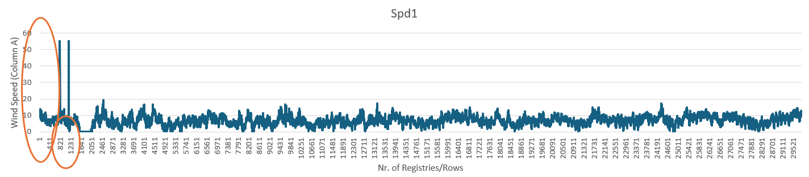
Exercise 1 – Wind Resource Assessment
Discussion
3 – Build the graphs with wind speed data from 40m and 80m. The graphical view enable to find potential anomalous values. You will find values that are not standard wind speeds.
Example for column A (Spd1 – wind speed 80m). Ovals represent the values you should take a look more carefully. First Oval represents abnormally high values, and the second oval represents null values

Slide 24
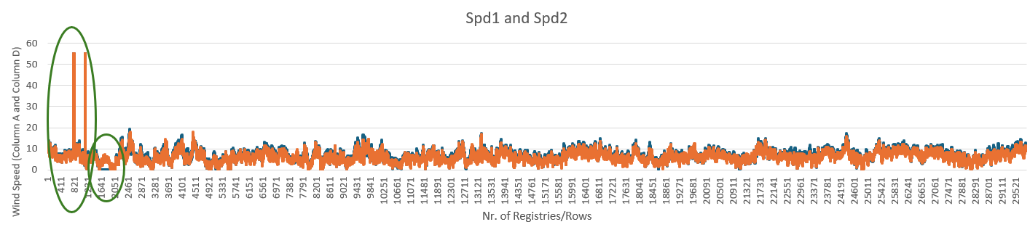
Exercise 1 – Wind Resource Assessment
Discussion
3 – Build the graphs with wind speed data from 40m and 80m. The graphical view enables to find potential anomalous values. You will find values that are not standard wind speeds.
Example: after adding column D referred to wind speed at 40m, you obtain the graph below. (Spd1 – wind speed 80m, Spd2 – 40m). Similar errors are found in column D.

Slide 25
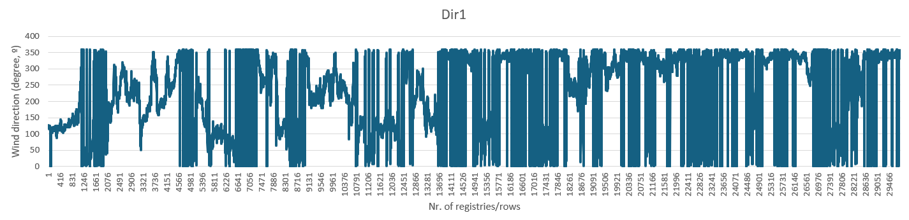
Exercise 1 – Wind Resource Assessment
Discussion
4 – Build the graph with wind direction.
The picture below shows what you will obtain:
While looking at the file in what concerns wind direction column, it is expected that when the wind speed is null, wind direction is also null. In this file, you will not find many of those situations.
If you remove wind speed values form the file, you also need to remove the direction values, i.e., remove the whole row because you should always use pairs (wind speed, wind direction at the same time – same day, time of the day).

Slide 26
Exercise 1 – Wind Resource Assessment
Discussion
5 – Look at the values on rows 806, 1158 and 1590. What kind of errors can you find?
You will find values for wind speed out of the ordinary, with values in the order of 55m/s, and null values that usually indicate a failure on the anemometer, or the absence of wind.
6 – Anemometers are normally calibrated prior to their installation in anemometric towers. The calibration curves of the anemometers installed in the tower that corresponds to the data series studied are shown in the table. Apply them to the data and save the file with the name Lesson 3Exercise1.xls.
The solutions to 5 and 6 are on the next slides.
Are you ready to check your answers? ​
If so, continue

Slide 27
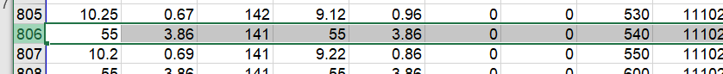
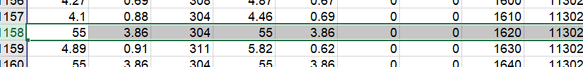
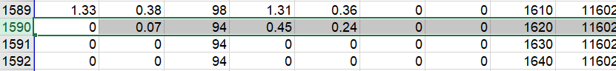
Exercise 1 - Solution
Solution - 5
Row 806
Row 1158
Row 1590

Slide 28
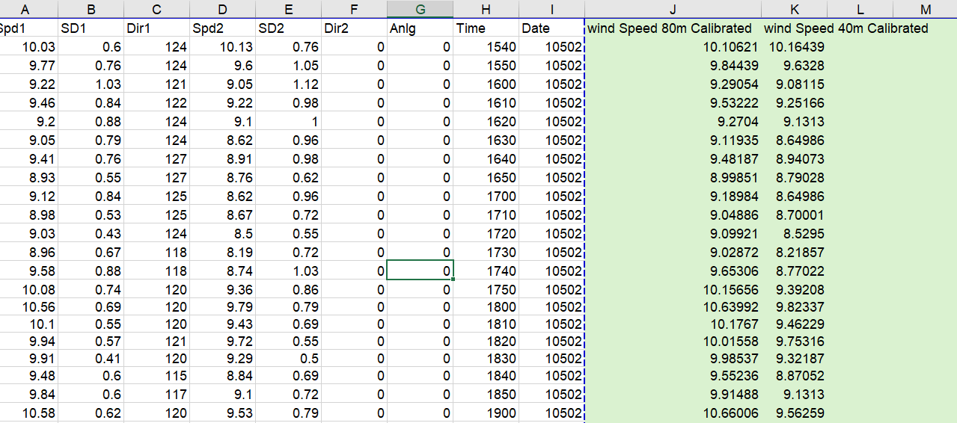
Exercise 1 - Solution
Solution - 6
Columns highlighted representing the calibrated values.

Slide 29
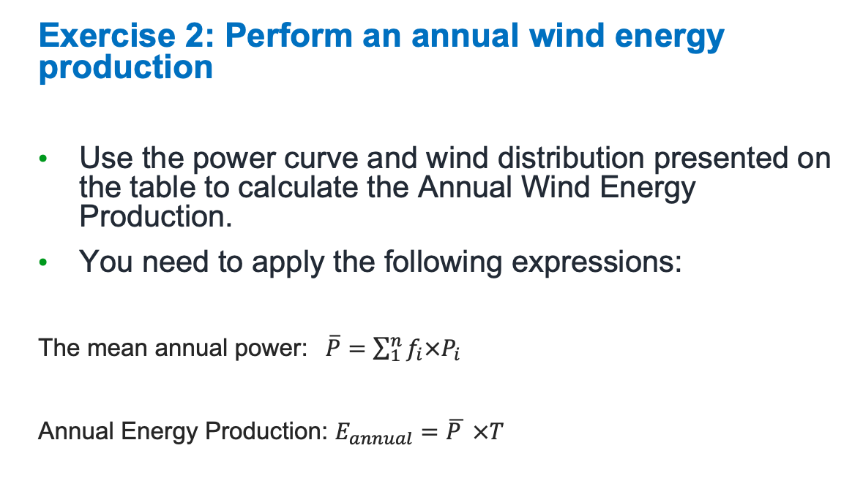
Lesson 3 Exercise 2
Exercise 2: Perform an annual wind energy production
Use the power curve and wind distribution presented on the table to calculate the Annual Wind Energy Production.
You need to apply the following expressions:
The mean annual power: $\overline{P}=\sum_{1}^{n}{f_{i}×P_{i}}$
Annual Energy Production: $E_{annual}=\overline{P } ×T$
Velocity (m/s) | f (%) | P(kW)
3 | 7.82 | 16
4 | 8.88 | 38
5 | 10.03 | 120
6 | 12.66 | 231
7 | 11.55 | 360
8 | 11.24 | 586
9 | 9.44 | 857
10 | 8.61 | 1157
11 | 5.99 | 1425
12 | 4.24 | 1615
13 | 2.95 | 1783
14 | 2.16 | 1922
15 | 1.47 | 1938
16 | 1.08 | 1978
17 | 0.67 | 1988
18 | 0.52 | 1974
19 | 0.28 | 1972
20 | 0.18 | 1982
21 | 0.07 | 1988
22 | 0.18 | 2000
The solution to Exercise 2 is on the next slide.
Are you ready to check your answer? ​
If so, continue

Slide 30
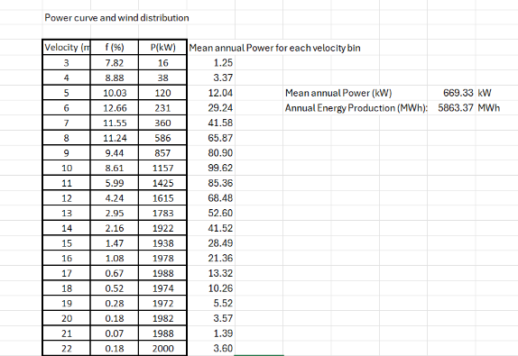
Wind Resource Assessment - Exercise 2: Solution
:
Congratulations if your result is the same!

Slide 31
Recommended readings:
Hau, E., 2000. Wind turbines, fundamentals, technologies, application, economics. Springer.
Manwell, J., McGowan, J., Rogers, A., 2002. Wind Energy Explained - Theory, design and application. West Sussex: John Wiley & Sons Ltd.
Sathyajith, M., 2006. Wind Energy, Fundamentals, Analysis and Economics. Springer-Verlag Berlin Heidelberg
Simiu, E., Scanlan, R.H., 1986. Wind effects on structures. John Wiley and Sons, USA. ISBN: 0-471-86613-X. 589pp.

Slide 32
References
This unit was developed by T. Simões, P. Costa, A. Couto, A. Estanqueiro, from LNEG and is based on the following resources:
Estanqueiro, A., Simões, T., Costa, P. e Couto, A. ; Notes from the Integrated Master degree course in Energy and Environment Engineeringfrom Lisbon University – Faculty of Sciences
Hau, E., 2000. Wind turbines, fundamentals, technologies, application, economics. Springer.
Manwell, J., McGowan, J., Rogers, A., 2002. Wind Energy Explained - Theory, design and application. West Sussex: John Wiley & Sons Ltd.
Sathyajith, M., 2006. Wind Energy, Fundamentals, Analysis and Economics. Springer-Verlag Berlin Heidelberg
Simiu, E., Scanlan, R.H., 1986. Wind effects on structures. John Wiley and Sons, USA. ISBN: 0-471-86613-X. 589pp.

