Slide 1

DATA FOR RENEWABLE ENERGY SYSTEMS
Lesson 3: Data Analysis
Techniques, Part A

Slide 2
Lesson 3 Outline:
Introduction to Statistical Software (Python)
2. Descriptive and Inferential Statistics in Python
3. Data Cleaning and Preparation
4. Introduction to Data Visualization using Matplotlib/ Seaborn

Slide 3
Lesson 3 Learning Outcomes
At the end of this unit, the student will be able to:
set up Python for data analysis and understand the basics of data analysis using Python.
clean and prepare data for analysis.
understand data visualization methods in Python.
understand descriptive and inferential statistics.

Slide 4

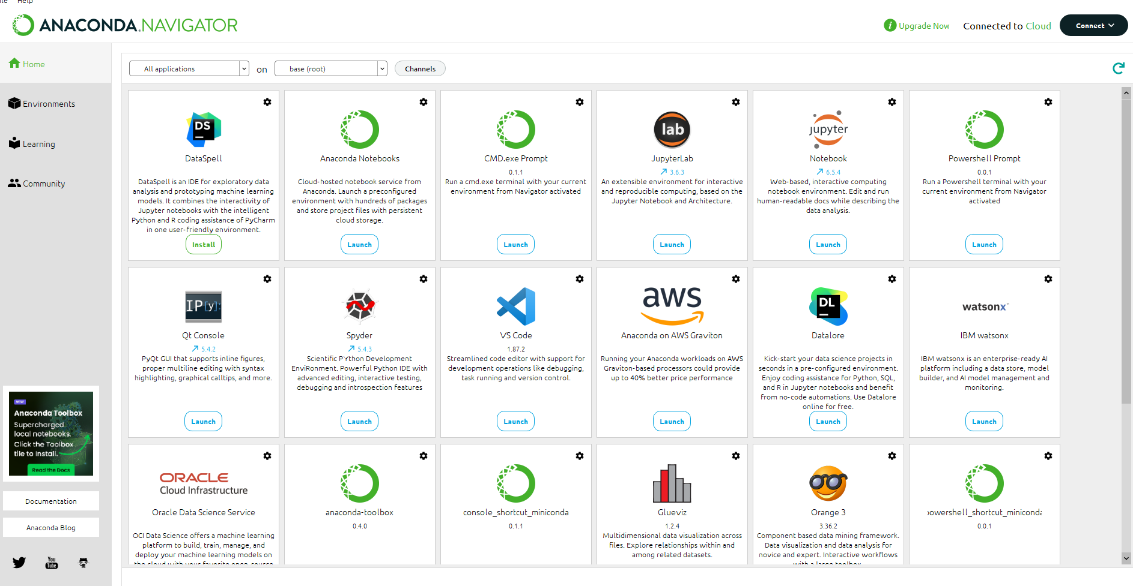
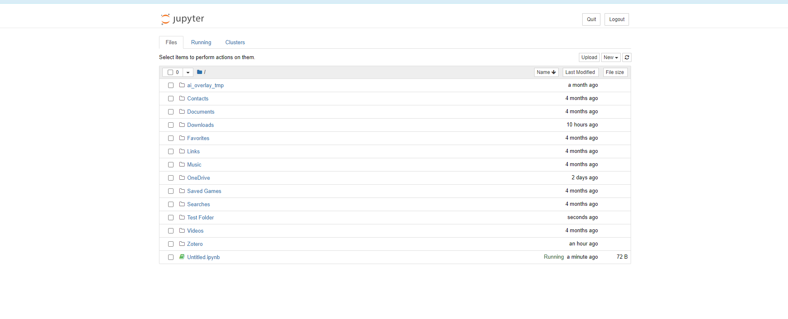
Introduction to Statistical Software (Python)
To install Python, install Anaconda in your computer by visiting the anaconda distribution download website via this link. (Python 3.11 for Windows, Mac or Linux)
Install Jupyter notebooks – an interactive coding environment.
Notes:
Talking Points:
Why Python for data analysis.
Anaconda distribution and its advantages.
Introduce Jupyter Notebooks and their interactive features.
Highlight the basic concepts and libraries essential for data analysis.

Slide 5





Introduction to Statistical Software: Basic Concepts
Variables and Data Types
Integers – whole numbers without a decimal ii. Float – number with a decimal
String – basic text
Notes:
Special characters of strings i.e. ‘\n’ is for a new line and ‘\t’ is for tab

Slide 6
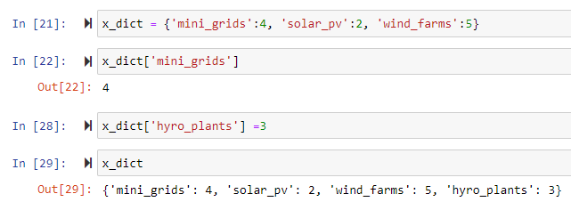




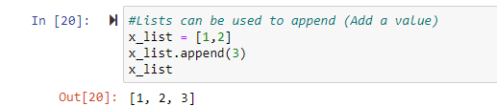
Introduction to Statistical Software: Data Structures
iv. List – allows one to store elements of different data types in one enclosure. The enclosure are square brackets.
v. Dictionary – they have unique set of keys which contain elements with key-value pairs
vI. Tuples – similar to lists but can’t be changed (immutable). Written with parenthesis instead of square brackets
Notes:
You can convert a list to a tuple: tuple(x_list) and vice versa a tuple can be converted to a list: list(x_tuple)

Slide 7
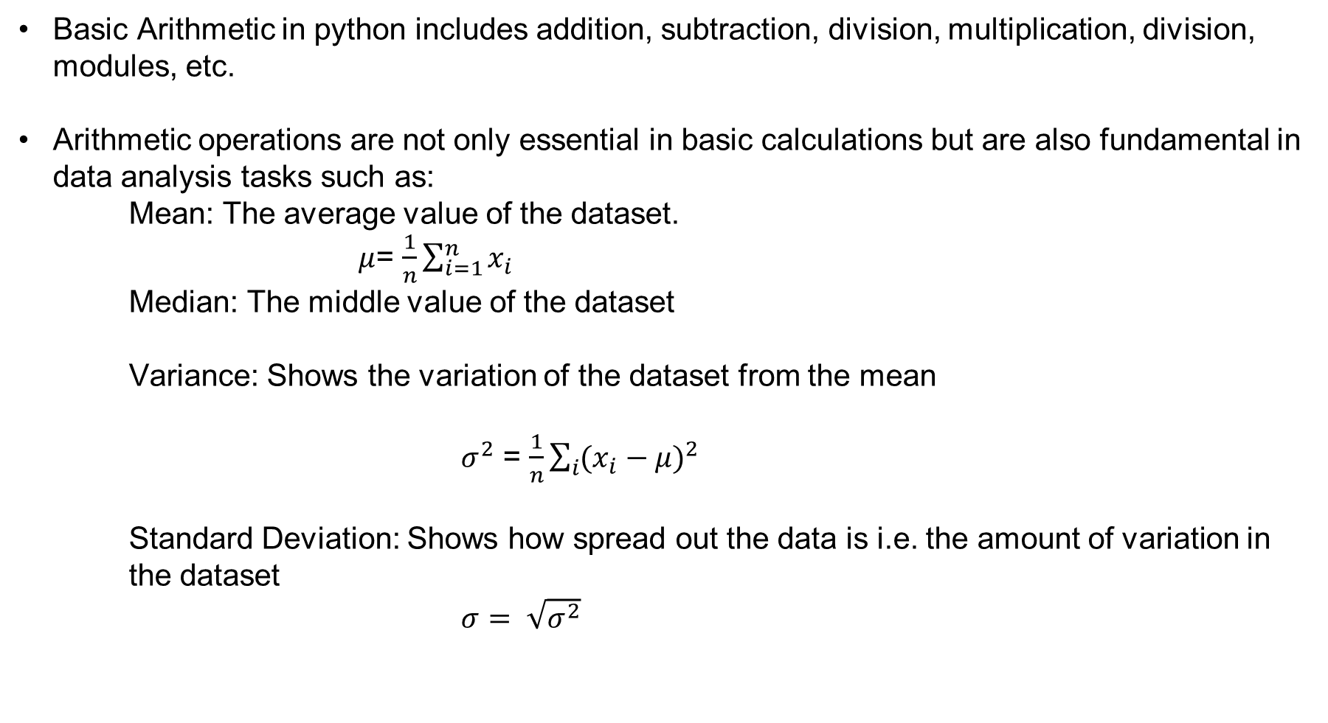
Introduction to Statistical Software: Basic Arithmetic
Basic Arithmetic in python includes addition, subtraction, division, multiplication, division, modules, etc.
Arithmetic operations are not only essential in basic calculations but are also fundamental in data analysis tasks such as:
Mean: The average value of the dataset.
$μ$= $\frac{1}{n}\sum_{i=1}^{n}{x_{i}}$
Median: The middle value of the dataset
Variance: Shows the variation of the dataset from the mean
$σ^{2}$ = $\frac{1}{n}\sum_{i}{({x_{i}−μ)}^{2}}$
Standard Deviation: Shows how spread out the data is i.e. the amount of variation in the dataset
$σ= \sqrt{σ^{2}}$

Slide 8
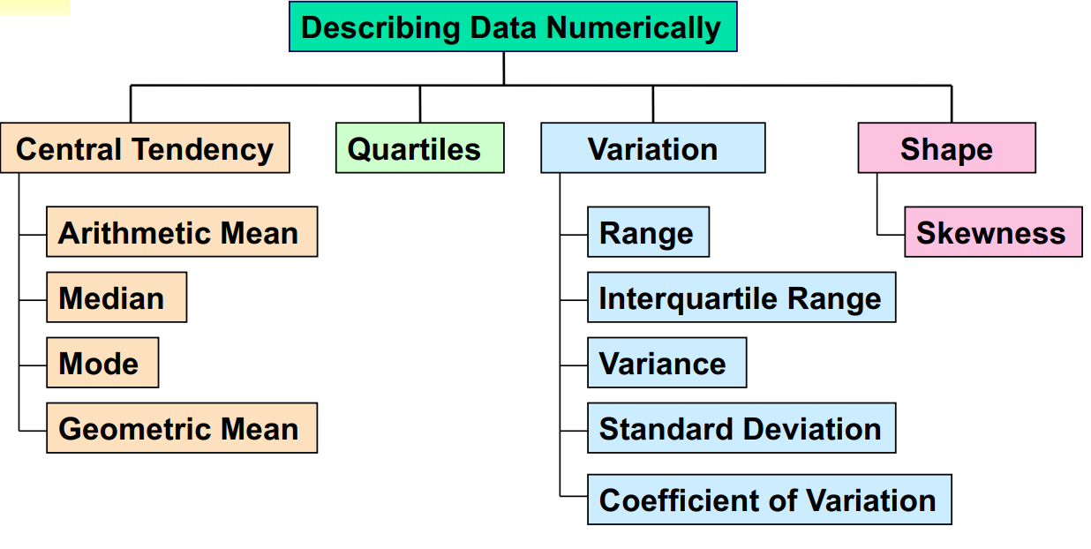
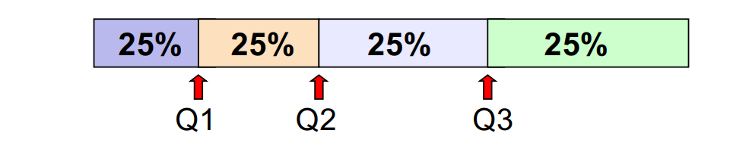
4. Descriptive and Inferential Statistics in Python
Statistics is the measure of:
Measures of :
central tendency,
variation,
shape
When looking at Population summary measures, one looks at
Mean,
Variance,
Standard deviation
Notes:
The first quartile, Q1, is the value for which 25% of the observations are smaller and 75% are larger n Q2 is the same as the median (50% are smaller, 50% are larger) n Only 25% of the observations are greater than the third quartile

Slide 9
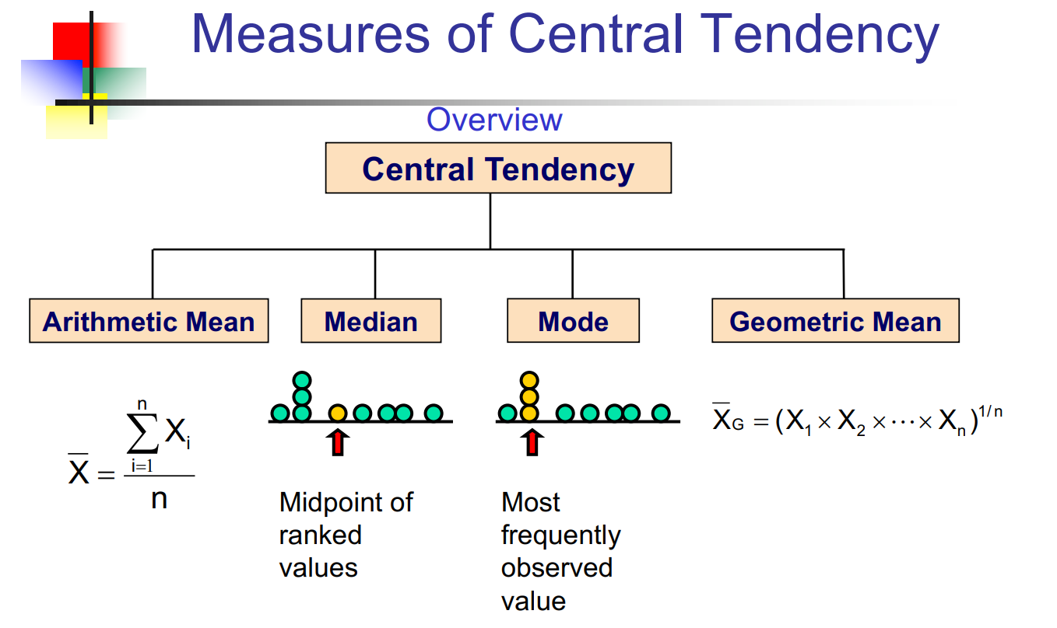
4. Descriptive and Inferential Statistics in Python
9

Slide 10
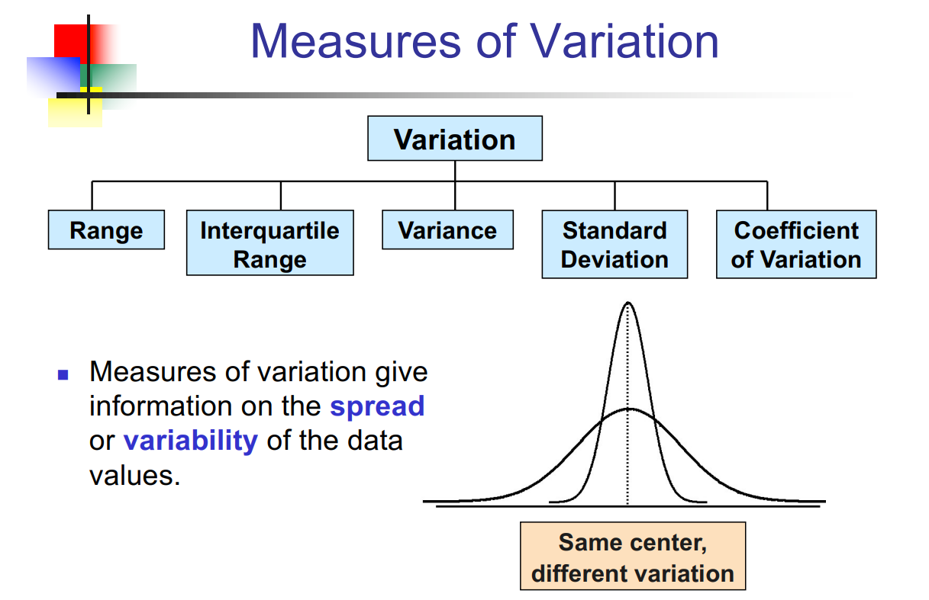
4. Descriptive and Inferential Statistics in Python
10

Slide 11
4. Descriptive and Inferential Statistics in Python
Drawbacks in Numerical Descriptive Measures
Since data analysis is objective, the summary measures that most closely align with the data set's presumptions should be reported.
Since the interpretation of data is subjective, it should be done in a fair, impartial, and understandable way.
Ethical considerations in Numerical Descriptive Measures
Numerical descriptive measurements should:
      Record both successful and unsuccessful outcomes
      Be presented in an impartial, fair, and objective way
      Avoid using unsuitable summary measures to misrepresent the facts.
11

Slide 12
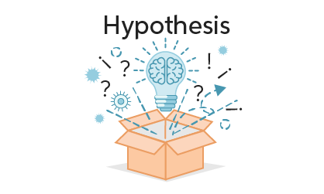
Inferential Statistics
Hypothesis Testing
A hypothesis is a claim (assumption) about a population parameter.
- 66% of the Kenyan population cook with biomass (wood, crop waste) as their primary fuel.
- An urban household in Kenya spends on average Kshs 4,000 monthly for their electricity bill.
The Null Hypothesis, H_{0:}
- It states the assumption to be tested. It tests on the population parameter and not the sample statistic.
The Alternative Hypothesis H₁:
- Is the opposite of the null hypothesis.
12

Slide 13
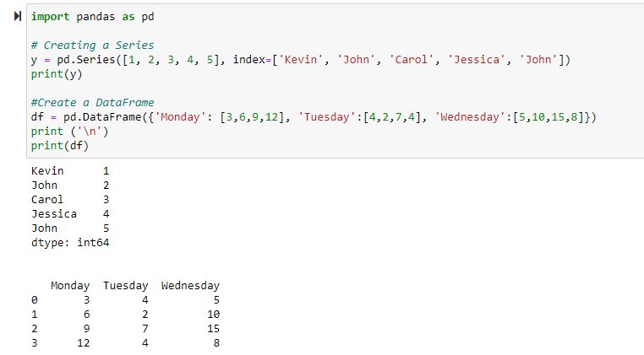
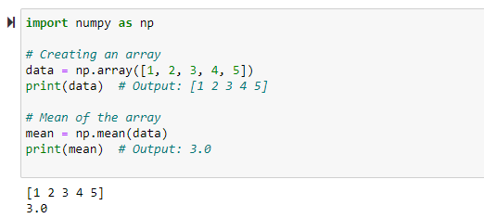
Introduction to Statistical Software: Essential Libraries
NumPy (NUMerical PYthon)
Created in 2005 by Travis Oliphant .
The three main features of NumPy are: less memory requirement, faster processing and conveniency.
Run pip install numpy on jupyter notebook to install.
Provides support for mathematical functions to operate on large multi-dimensional arrays and matrices.
2. Pandas
Created in 2008 by Wes McKinney.
Most used python library for performing data operations.
Run pip install pandas on jupyter notebook to install.
Is versatile in its use and can be used to:
  Create a 1D array
  Create a 2D dataframe
  Data manipulation and handling
13
Notes:
Arrays:
Numpy provides for data structures known as arrays.
An array is a collection (multiple) of variables
Each variable in the collection is of the same data type[that means that the size (number of bytes) of each variable is the same]
The variables are placed (stored) consecutively in memory
Pandas and Numpy are libraries that can be used to perform exploratory data analysis (EDA) that involves data preparation and cleaning and data wrangling

Slide 14





Data Cleaning and Preparation
Involves numerical and visual analysis.
Investigating the statistical properties of the dataset.
Simple data plots using pandas, seaborn etc.
Information about the dataset. i.e the dimensions, data types, missing values and statistical properties.
DATA CLEANING AND PROCESSING
VISUALIZATION AND REPORTING
LOADING/READING DATA
STEP 1
STEP 2
STEP 3
STEP 4
STEP 5
Takes up 25%-90% of the time.
Includes removing irrelevant data, dealing with missing values and duplicates
UNDERSTANDING DATA STRUCTURE
Exploring more plots for analysis.
Could be a .csv, .xlsx or sql
Pandas library
UNDERSTANDING DATA STRUCTURE
EXPLORATORY DATA ANALYSIS
14

Slide 15
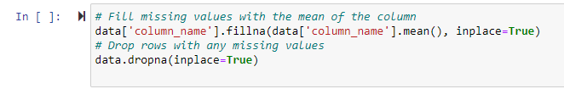

Data Cleaning and Preparation
Common Data Cleaning and Preparation Steps Used:
1. Handling missing values/data
    - Done to ensure data completeness
    - Common techniques used; filling, dropping or imputing missing values.
    2. Removing Duplicate Values
    3. Correcting Data Types
15
Notes:
Why?
To ensure the dataset is accurate and is of quality for analysis
Informs the reliability of the decisions made from the dataset.
Reduces errors and inconsistencies in data analysis.

Slide 16
Introduction to Data Visualization using Matplotlib/Seaborn
Data Visualization is the graphical representation of data that makes complex data more accessible, understandable and usable. They are meant to reveal patterns, trends and insights.
Matplotlib is the original base-level plotting packages in Python. Best applied for basic plotting like line plots, bar charts, histograms, scatter plots etc.
Seaborn is used for plotting more complex plots like time series, when combining multiple subplots, bar plots, box plots, count plots and violin plots.
16
Notes:
Matplotlib is a Python library that helps with data visualization. It’s a 2D plotting library which produces different types of figures. It can be used with Python scripts, Jupyter notebooks, application servers, etc
To install matplotlib, run ‘pip install matplotlib’
When using matplotlib for visualization, the library used is matplotlib.pyplot

Slide 17
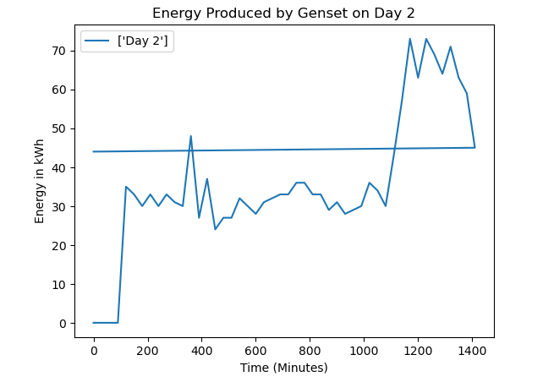
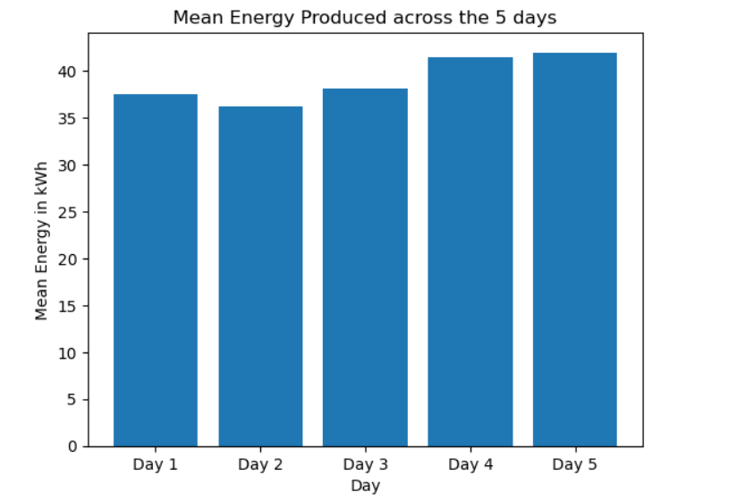
Introduction to Data Visualization using Matplotlib/Seaborn
Bar plots – for categorical plots
Histograms – for the distribution of continuous values
Line charts/plots – for time series
Scatter plots – for relationships between two continuous variables
Heatmaps – for relationships between two continuous variables and correlations
17

Slide 18
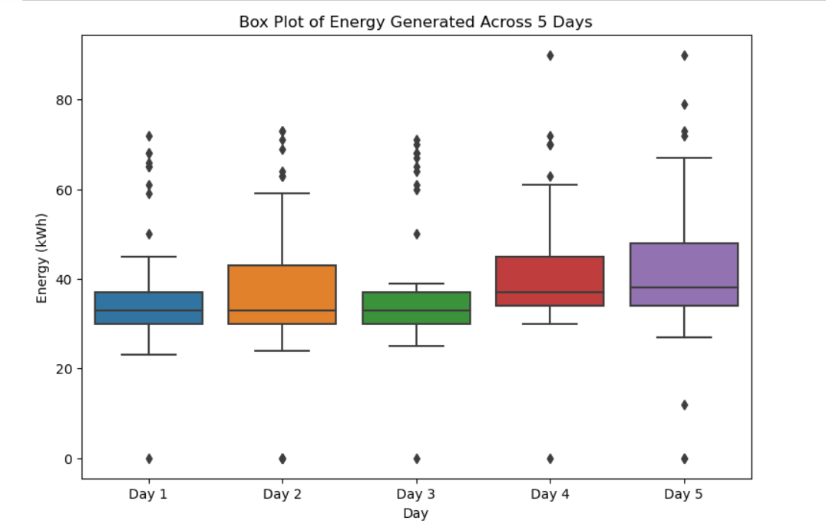
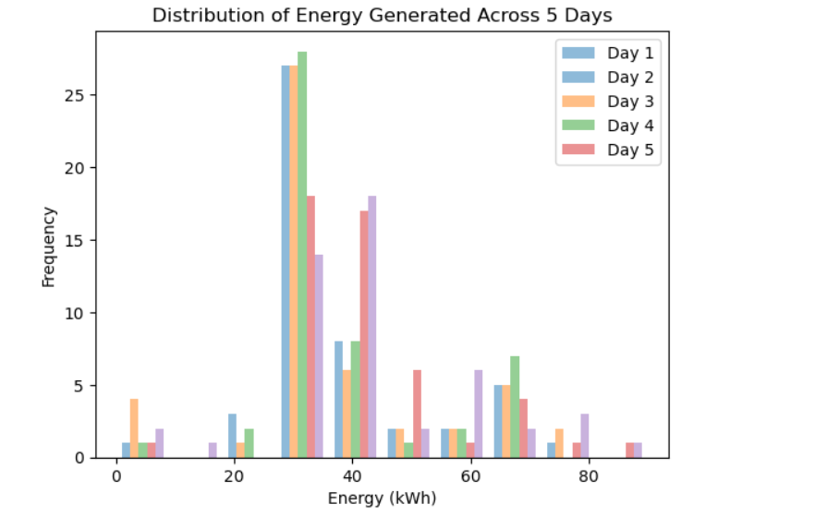
Introduction to Data Visualization using Matplotlib/Seaborn
18
Notes:
Box Plot: The horizontal line in the center of the box is the median, also known as the 50th percentile or 2nd quartile (Q2). This is the middle data point in our data set when observed from smallest to greatest. The bottom and top of the box are the first and third quartiles (Q1 and Q3). These quartiles are formed when we break up a dataset into four equal pieces by ascending or descending values. So, 25% of the data lies at or below Q1, and 25% above Q3. Q1 can be considered as the middle data point between the minimum and the median.

Slide 19
Data Cleaning Exercise – Instructions
Go to this Google Drive Folder https://drive.google.com/drive/folders/16W5TTIiIHfZ4nY8xw8PlWoKz5zWqT2A7?usp=sharing
Download the pictures of the data sheet in the “Data Sheets/ Pictures of Data Sheets” folder and compare it to the converted excel files in the “Data Sheets/Converted Sheets” folder
Once done, compare the converted excel file to the cleaned excel data file. “AUGUST-2018” in the root folder
Ordinarily, you would have to go row by row to clean the data but in this case, it has already been done for you so you may proceed to the next step
Once done, extract the “Units” column from the first 15 days of the AUGUST 2018 file and input it into the blank excel file titled “KWh Data Template”. Rename it “KWh Data 1”
You will use the KWh Data 1 for the exercise in the next module so make sure this is done and downloaded to your computer’s local drive

Slide 20
Data Cleaning Exercise for Faza Case study Scenario
Pre-assessment of the existing data (Faza)
Data (log sheets) transport
Data (log sheets) scanning
Conversion to excel sheets
Data cleaning
Coding (use 2022 log sheets as benchmark)
19

Slide 21
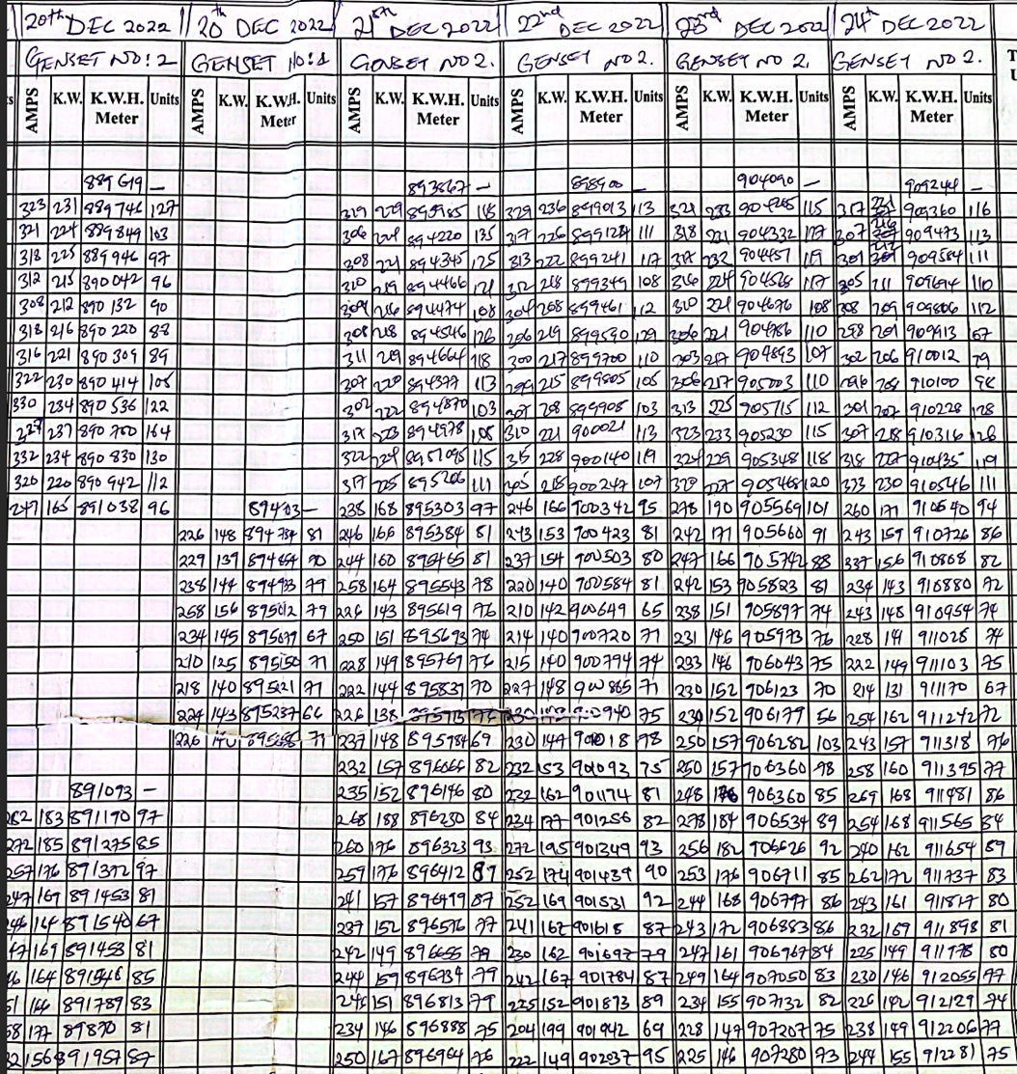
Data Cleaning Exercise
20
Notes:
This is what the data cleaning exercise looked like

Slide 22
Recommended readings:
Igual, L., & Seguí, S. (2017). Introduction to Data Science. A Python Approach to Concepts Techniques and Applications—Laura Ig—Undergraduate Topics in Computer Sc Laura Igual · | Course Hero. https://www.coursehero.com/file/75390110/Introduction-to-Data-Science-A-Python-Approach-to-Concepts-Techniques-and-Applications-Laura-Ig/
George, N. (2021). Practical Data Science with Python [Book]. https://www.oreilly.com/library/view/practical-data-science/9781801071970/
21

Slide 23
Credits and acknowledgment
This unit was developed by Sandra Banda and Augusta Njogo, Strathmore University and is based on the following resources:
  Igual, L., & Seguí, S. (2017). Introduction to Data Science. A Python Approach to Concepts Techniques and Applications—Laura Ig—Undergraduate Topics in Computer Sc Laura Igual · | Course Hero. https://www.coursehero.com/file/75390110/Introduction-to-Data-Science-A-Python-Approach-to-Concepts-Techniques-and-Applications-Laura-Ig/
  George, N. (2021). Practical Data Science with Python [Book]. https://www.oreilly.com/library/view/practical-data-science/9781801071970/
The research and results presented in this unit was supported within the framework of the LEAP-RE programme.
22

