Slide 1

DATA FOR RENEWABLE ENERGY SYSTEMS
Lesson 5: Communicating
Findings for Impact

Slide 2
Lesson 5 Learning Outcomes :
By the end of this unit, the learner should be able to:
Create effective data stories and presentations.
Choose the right data visualizations for their audience and purpose.
Deliver presentations with confidence and clarity.
Communicate effectively with diverse audiences.

Slide 3
Lesson 5 Outline:
Creating effective data interpretations and presentations:
Types of Data Visualisation
Rules for Actionable Visuals.
Data storytelling and data visualization:
Data Storytelling vs Data Visualisation;
Principles of Data Visualisation
Communicating with diverse audiences (policymakers, communities, etc.).

Slide 4
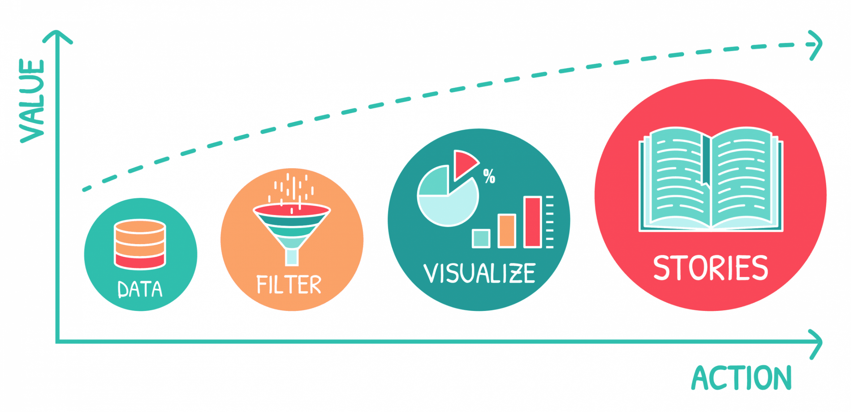
Storytelling through data
This is the most effective way to share business information and drive outcomes.
Data storytelling is a structured approach for communicating data insights, and it involves a combination of three key elements: data, visuals, and narrative.

Slide 5
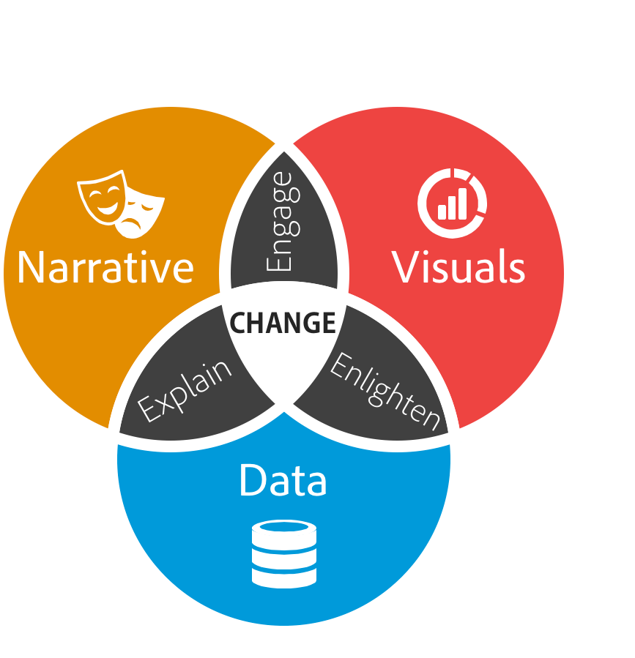
Why Data Storytelling?
Data storytelling requires a careful balance of the following elements:
Narrative: Craft a compelling story that connects the data to a larger context.
Visuals: Use visuals to enhance the storytelling process and make the data easier to understand.
Data: Select and present the data in a way that supports the story.
We are looking to CHANGE people’s mindsets if they are based on misinformation.
This requires that the content being presented is engaging, enlightening and actively explains complex topics in a simple manner.

Slide 6
How to build a Narrative
Set the Context. Explain what the data story is about and why your audience should care.
Describe the Charts. What measures and dimensions are being shown? How should the chart be interpreted?
Guide the Flow. What should the reader look at next? What should they do to proceed in the story?
Highlight Insights and Actions. What's most valuable to take away from the data story? What should the reader do about it?

Slide 7
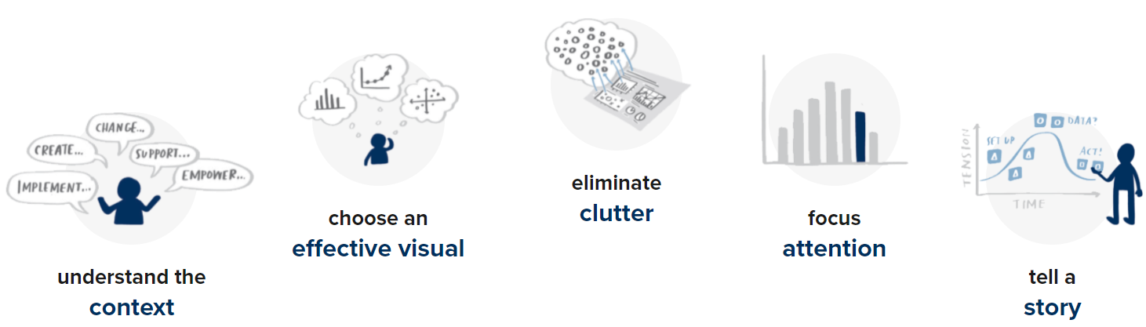
Creating a good data story

Slide 8

Data Visualisation

Slide 9
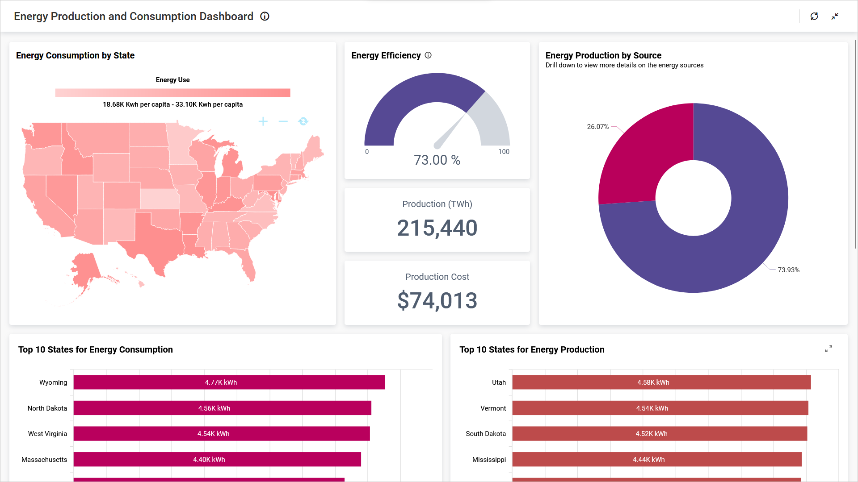
Why Data Visualization?
Helps identify the 3 key points in data analytics – correlations, outliers, trends
Better way of analyzing data
Makes sense of complicated data
Identify errors and inconsistency in data
Easy exploration of data
Better way of presenting insights
Interactive visualisations allow for further analysis
Obtained From: https://samples.boldbi.com/solutions/energy/consumption-and-monitoring-dashboard

Slide 10

Principles of Data Visualization
The following principles determine how people naturally perceive visual elements. If you understand them, you understand how to create a better User Experience (UX).
Gestalt Principles are in the Mind, Not the Eye.
By understanding how people perceive charts and layouts, you can build psychologically-stable visuals that communicate information effectively.
Know your Audience
Usually, problems arise when how a visual is perceived differs significantly from the intent of the conveyer. Consequently, it is important to identify, as early as possible in the design process, the audience and the message the visual is to convey.
The graphical design of the visual should be informed by this intent.

Slide 11
Principles of Data Visualization
Identify your message
A figure is meant to express an idea or introduce some facts or a result that would be too long (or nearly impossible) to explain only with words, be it for an article or during a time-limited oral presentation. In this context, it is important to clearly identify the role of the figure, i.e., what is the underlying message and how can a figure best express this message?
Only after identifying the message will it be worth the time to develop your figure, just as you would take the time to craft your words and sentences when writing an article only after deciding on the main points of the text.

Slide 12
Principles of Data Visualization
Visual Appeal
During an oral presentation, a figure will be displayed for a limited time
It is important to keep in mind that during oral presentations, figures will be video-projected and will be seen from a distance, and figure elements must consequently be made thicker (lines) or bigger (points, text), colors should have strong contrast, and vertical text should be avoided.

Slide 13
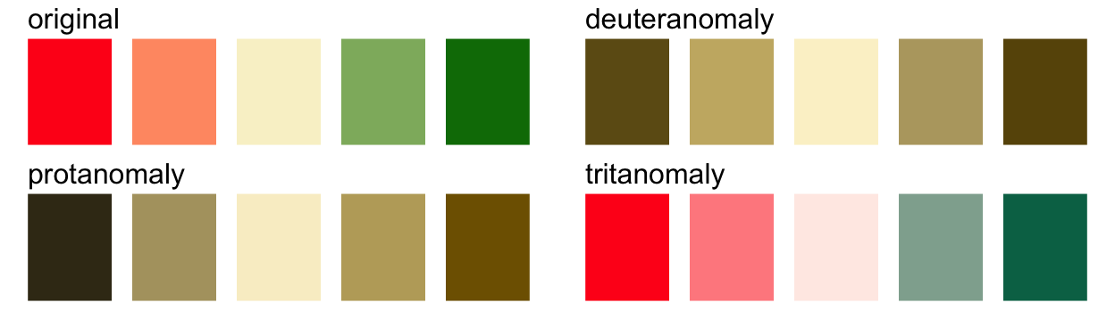
Principles of Data Visualisation
Use Colors Effectively
Color is an important dimension in human vision and is consequently equally important in the design of a scientific figure. Color can be either your greatest ally or your worst enemy if not used properly.
Beware of Color Blindness
13

Slide 14
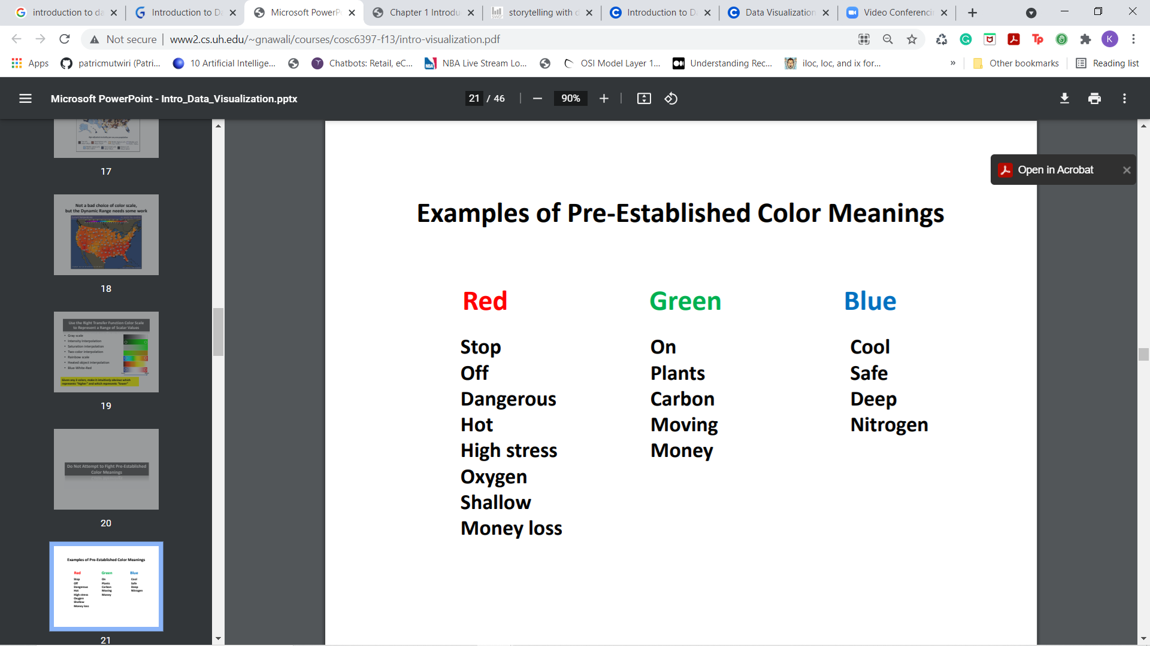
Colors
Colours have the power to evoke specific feelings, influence our decision-making, and even impact our physical health.
Don’t fight pre-established color meanings. For example:

Slide 15
Principles of Data Visualisation
5. Captions are not optional
Whether describing an experimental setup, introducing a new model, or presenting new results, you cannot explain everything within the figure itself—a figure should be accompanied by a caption.
The caption explains how to read the figure and provides additional precision for what cannot be graphically represented.
Don’t mislead the reader
A scientific figure is, by definition, tied to the data and if you loosen this tie, you may unintentionally project a different message than intended.
Items that can be used to mislead the reader:
      Title
      Color
      Axis

Slide 16
Principles of Data Visualisation
Avoid Chart Junk
Chart junk refers to all the unnecessary or confusing visual elements found in a figure that do not improve the message (in the best case) or add confusion (in the worst case). For example, chart junk may include the use of too many colors, too many labels, gratuitously colored backgrounds, useless grid lines

Slide 17
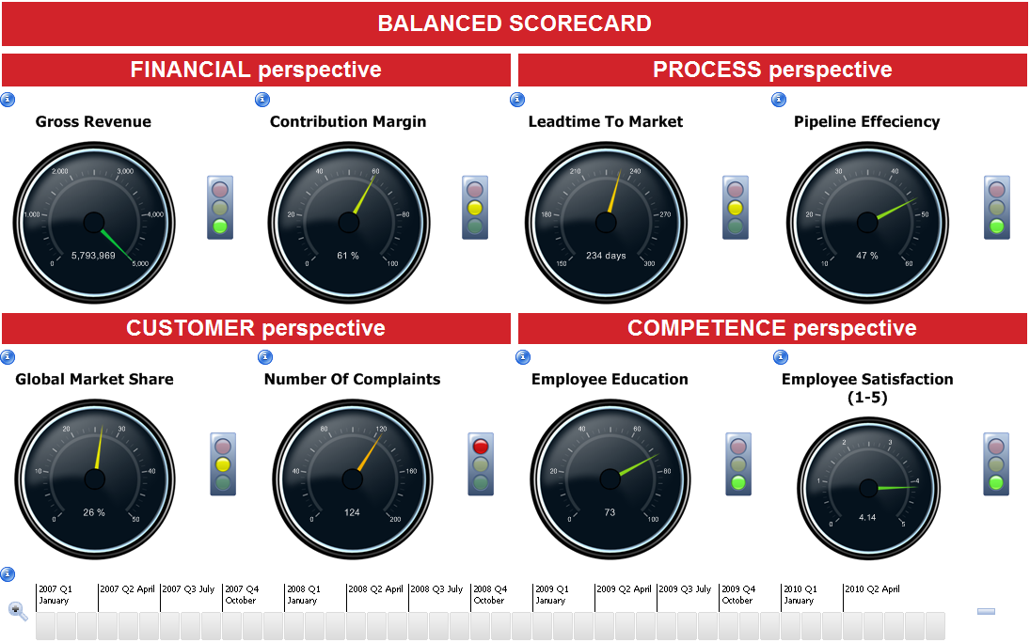
Example of Chart Junk
Source: Targit BI Balanced Scorecard from https://www.youtube.com/watch?v=4vuoQgYPdAw

Slide 18
Principles of Data Visualisation
Message Trumps Beauty
Message and readability of the figure is the most important aspect while beauty is only an option.
Get the right tool
Depending on the type of visual you're trying to create, there is generally a dedicated tool that will do what you're trying to achieve. You can always export data in order to use it in another tool. Whether drawing a graph, designing a schema of your experiment, or plotting some data, there are open-source tools for you

Slide 19
The 4 C’s of Data visualization (Shaffer )
Clear - easily seen; sharply defined
  who's the audience? what's the message?
  clarity more important than aesthetics
Clean - thorough; complete; unadulterated
  labels, axis, gridlines, formatting, right chart type, color choice, etc.
Concise - brief but comprehensive
  not minimalist but not verbose
Captivating - to attract and hold by beauty or excellence
  does it capture attention? is it interesting? does it tell the story?

Slide 20
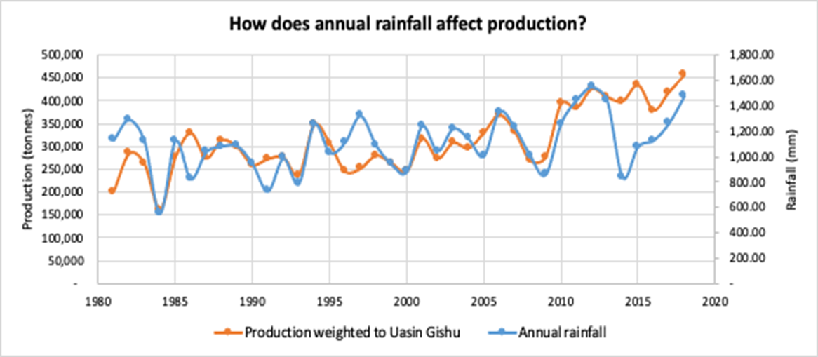
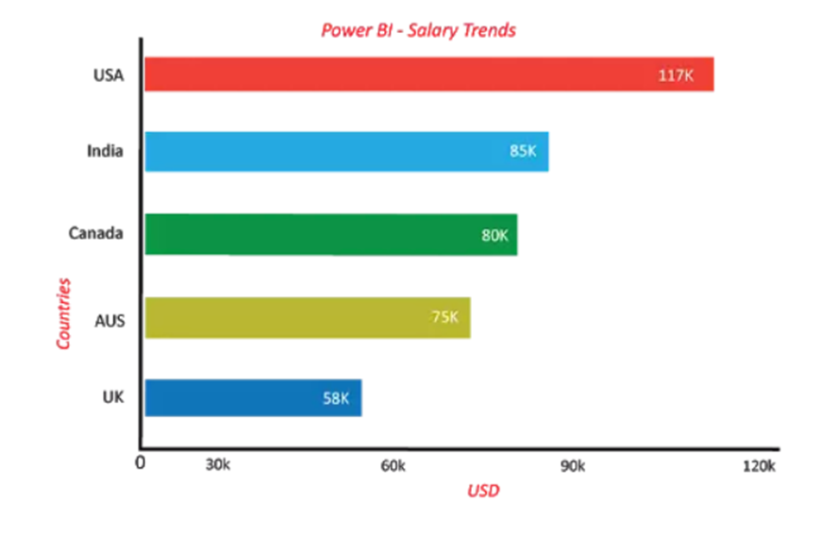
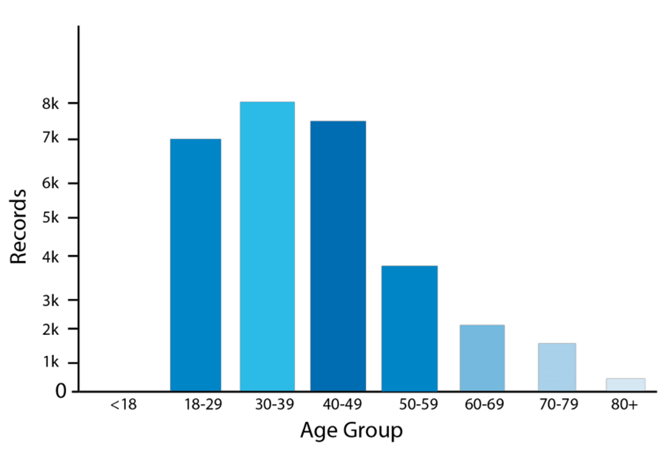
Types of Visualisations
Bar Graph – Mainly horizontal, they are useful to display the data that includes negative values because it is possible to position the bars above and below the x-axis
Line plots - Helps in spotting trends and forecasting time variables
Column Charts – Similar to Bar Graph with a strict vertical orientation and can also be stacked

Slide 21
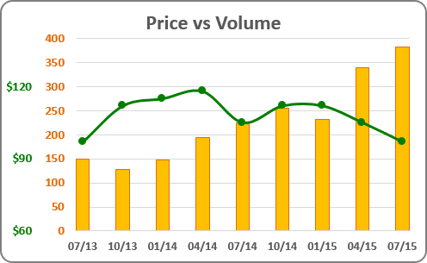
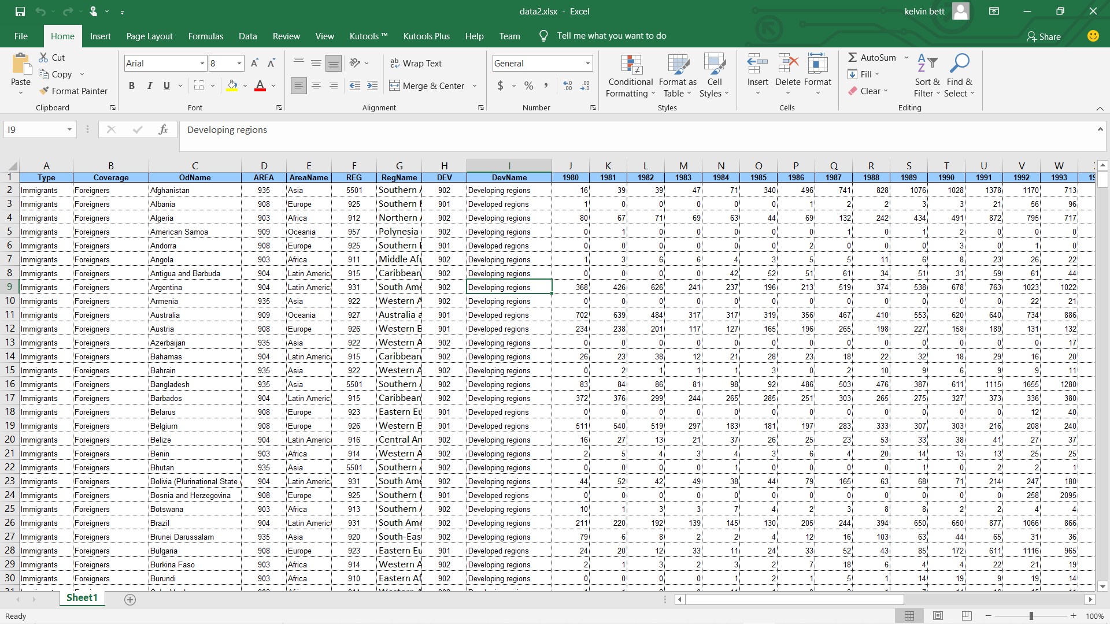
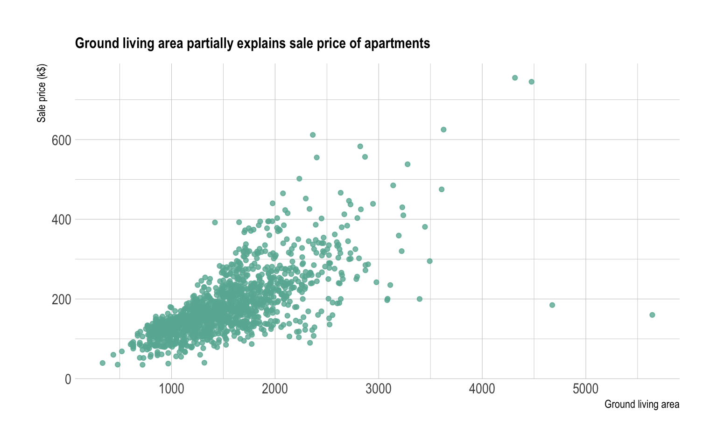
Types of Visualisations
Tables - Great for comparison across categorize but becomes less effective when too large
Combo Chart–. A combo chart is a combination of both the column charts and line charts that help you to make a quicker comparison of the data.
Scatter Plots - Best for continuous variables to discover potential relationships

Slide 22
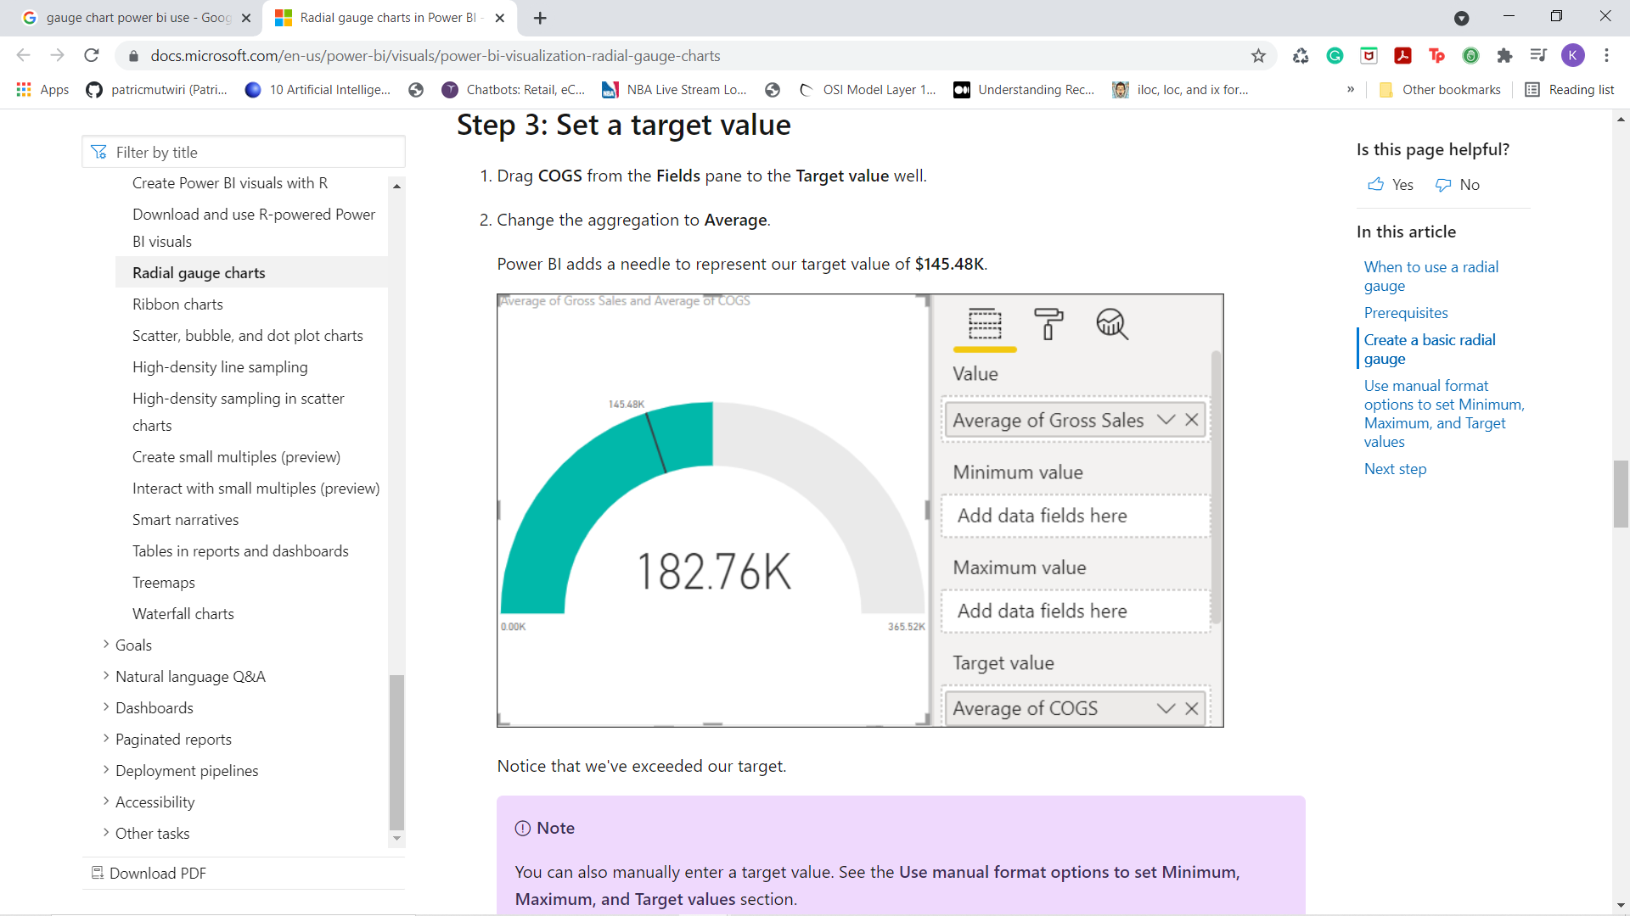
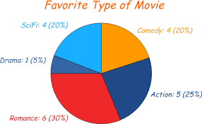
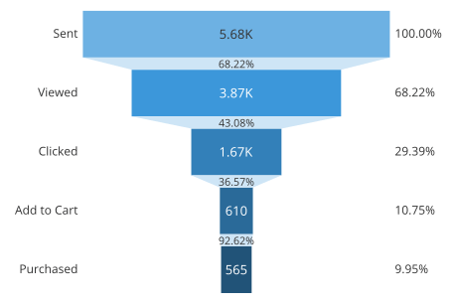
Types of Visualisations
Gauge Chart– It uses the needle to read the data, and it shows the information on a dial. In the gauge chart, it represents the value of each needle as it reads the data according to the axis or colored data
Pie Chart– mostly used to represent the same category of data. It helps users to understand the data quickly.
Funnel Chart– Visualize data meant to flow from one phase to another

Slide 23
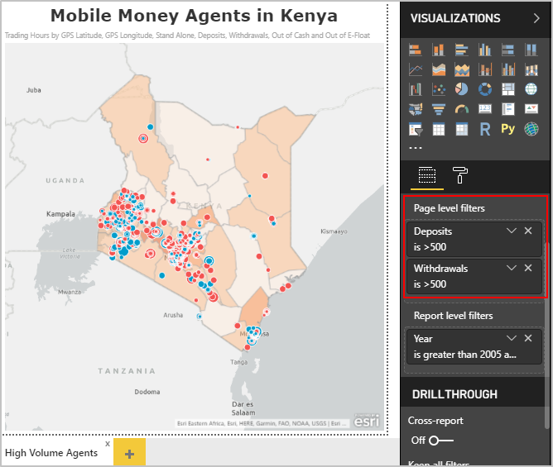
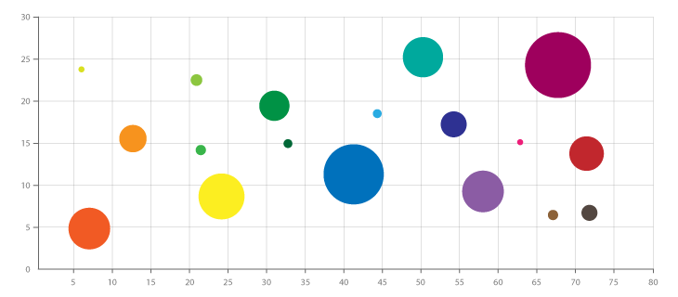
Types of Visualisations
Bubble Chart– Similar to Scatter plots with an added dimension representing size
Maps– Used for spatial data

Slide 24
Emphasis Guidelines for Visualisation
Most emphasis
Neutral
Dominance of the neutral quadrants may change based on content.
Neutral
Least emphasis

Slide 25
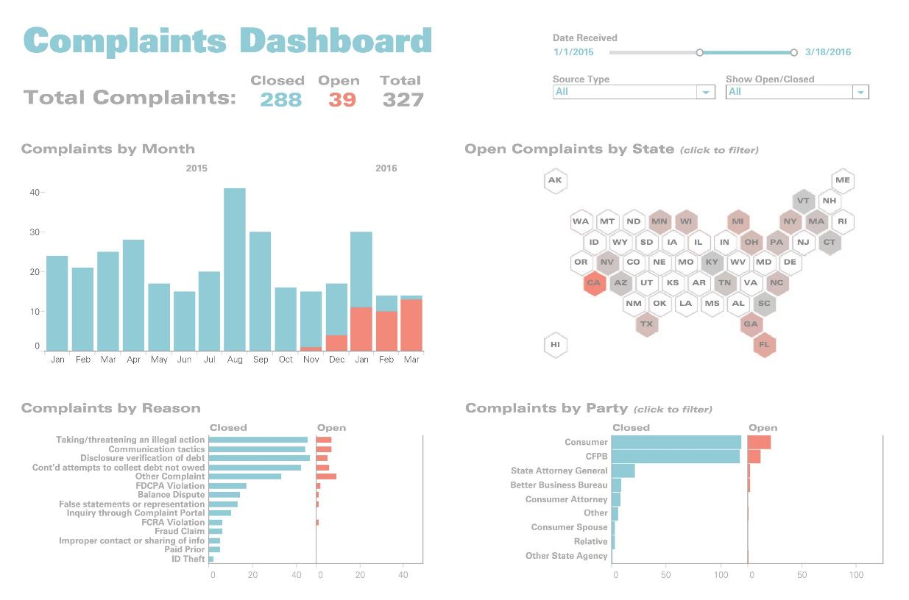
Most emphasis
Neutral
Neutral
Least emphasis

Slide 26
Recommended readings:
https://github.com/Financial-Times/chart-doctor/tree/main/visual-vocabulary
Practice makes perfect: Practice by remaking previous visualisations
  https://public.tableau.com/app/discover/viz-of-the-day
  https://public.tableau.com/app/discover
  https://community.powerbi.com/t5/Data-Stories-Gallery/bd-p/DataStoriesGallery
Join a community/ participate in events/ competitions
  https://www.tableau.com/blog/introducing-2021-tableau-zen-masters
  https://community.powerbi.com/t5/Events/ct-p/Events
  https://www.tableau.com/community/iron-viz

Slide 27
Credits and acknowledgment
This lesson was developed by Strathmore University and is based on the following resources:
Source: Targit BI Balanced Scorecard from https://www.youtube.com/watch?v=4vuoQgYPdAw
https://github.com/Financial-Times/chart-doctor/tree/main/visual-vocabulary
The research and results presented in this lesson was supported within the framework of the LEAP-RE programme.

