Slide 1

Off-Grid Energy Systems Modelling with MicroGridsPy
Lesson 10:
Case Study,
Kalobeyei Village, Kenya

Slide 2

Lesson 10: Contents
Comprehensive Understanding of MicroGridsPy Usage
Participants will gain detailed knowledge on how to utilize MicroGridsPy from start to finish in a sample project, including basic features and functionalities
Insight into Result Variability Based on Input
Learners will understand how different inputs can significantly alter the outcomes of the MicroGridsPy model, highlighting the importance of accurate and context-specific data
Awareness of the Model's Limitations and Potentials
Participants will comprehend the strengths and limitations of MicroGridsPy in modelling off-grid energy systems, providing a realistic perspective on its applicability in various scenarios
Notes:
In this concluding session, we will be applying all the concepts and techniques we've discussed throughout the course to a comprehensive case study. This hands-on project will illustrate the practical application of MicroGridsPy, showcasing its utility and potential in real-world scenarios. By the end of this lecture, you will have a detailed understanding of how to utilize MicroGridsPy from start to finish within a sample project, learning how various inputs can significantly affect the results and discussing the strengths and limitations of MicroGridsPy in modeling off-grid energy systems.

Slide 3
Lesson 10: Learning Outcomes
At the end of this lesson, the student will be able to:
Utilise MicroGridsPy in a sample project
Understand Result Variability Based on Inputs
Understand the Model's Limitations and Potentials
Notes:
In this concluding session, we will be applying all the concepts and techniques we've discussed throughout the course to a comprehensive case study. This hands-on project will illustrate the practical application of MicroGridsPy, showcasing its utility and potential in real-world scenarios. By the end of this lecture, you will have a detailed understanding of how to utilize MicroGridsPy from start to finish within a sample project, learning how various inputs can significantly affect the results and discussing the strengths and limitations of MicroGridsPy in modeling off-grid energy systems.

Slide 4

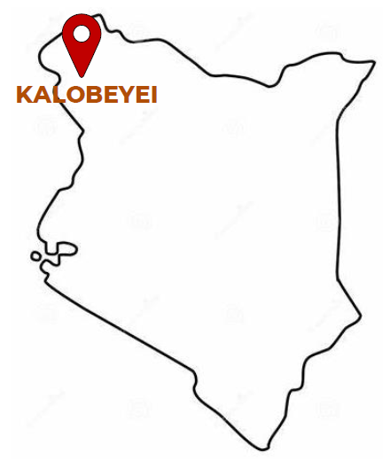
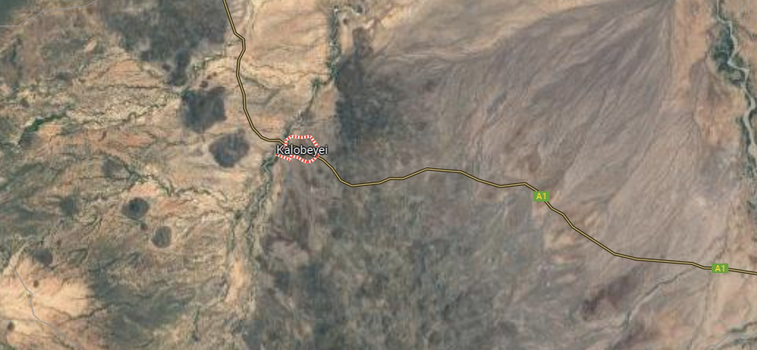
Call for proposals for electrification solutions for Kalobeyei settlement
The call for proposal from the UNESCO Chair in Energy for Sustainable Development seeks innovative off-grid rural electrification solutions for Kalobeyei settlement (Kenya), focusing on hybrid systems that combine renewable and non-renewable technologies. It underscores the importance of energy in local development and environmental preservation in line with global sustainable development goals, particularly SDG7.
Coordinates
Lon: 3°46’7.644’’
Lat: 34°37’ 14.458’’
Satellite location picture from Google Maps
Notes:
The selected case study is Kalobeyei, an off-grid and remote village located in Kenya. The goal of this project is to design and implement a hybrid energy system that combines renewable and non-renewable technologies. This approach will ensure a stable and sustainable power supply, fostering local development and environmental preservation.
By addressing the energy needs of Kalobeyei, we aim to contribute to the global sustainable development goals, particularly SDG7, which seeks to provide affordable, reliable, and modern energy for all. This case study will illustrate the practical application of MicroGridsPy, demonstrating how it can be used to develop tailored solutions that meet the specific needs of rural communities.

Slide 5
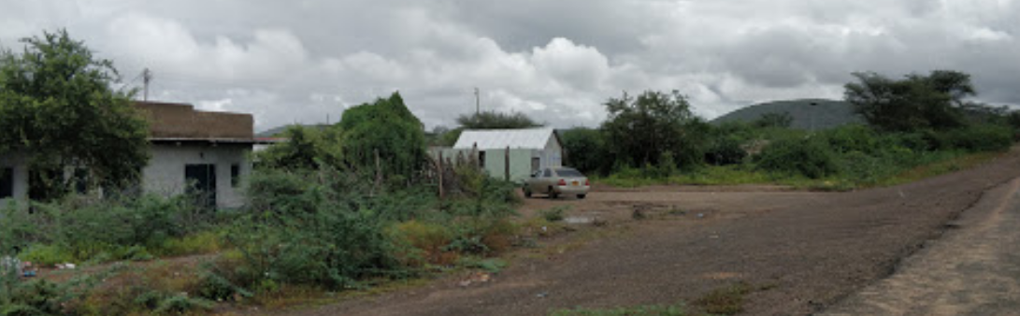

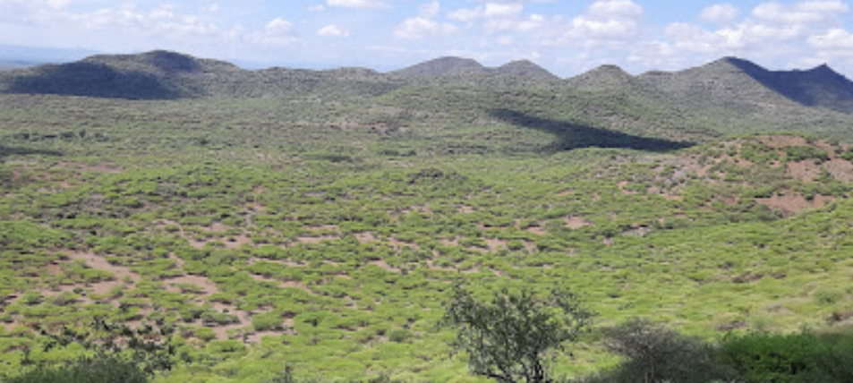
Kalobeyei Village
Kalobeyei, located in northern Kenya, is a remote village not serviced by the national grid and inhabited by around 700 families. The residents predominantly use traditional energy sources such as kerosene, diesel, and biomass for their daily needs. The village presents a unique case for developing a sustainable, off-grid, hybrid energy solution to meet its residential and communal energy requirements.
700 Households divided into 3 groups based on their existing appliances and on the appliances which are expected to be installed in the near future.
2 Primary schools with around 30 lights are installed; some external lights are also considered
1 dispensary having 3 rooms and 7 beds in total
Productive activities: tailor workshop, bars, garages.
Location pictures from Google Maps
Notes:
Inhabited by around 700 families, the residents primarily rely on traditional energy sources such as kerosene, diesel, and biomass for their daily needs. This village represents a unique case for developing a sustainable, off-grid, hybrid energy solution to meet its residential and communal energy requirements.
The socio-economic composition of Kalobeyei is characterized by several key elements:
Households: There are approximately 700 households in Kalobeyei, divided into three groups based on their existing appliances and those expected to be installed in the near future.
Education: The village has two primary schools equipped with around 30 lights each, and some external lighting is also considered for safety and security.
Healthcare: There is one dispensary with three rooms and seven beds, providing essential medical services to the community.
Productive Activities: The village engages in various productive activities, including a tailor workshop, bars, and garages, which contribute to the local economy and require reliable energy sources.
Conducting a socio-economic analysis is crucial not only for estimating the load demand but also for strategizing the approach and identifying any potential opportunities or challenges in the implementation of the mini-grid and its management within the community.

Slide 6
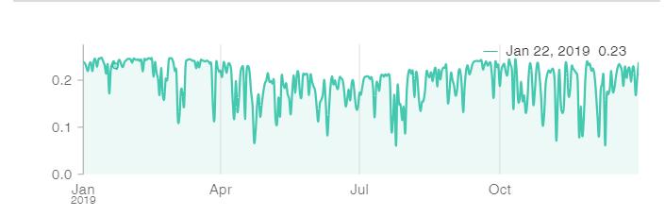
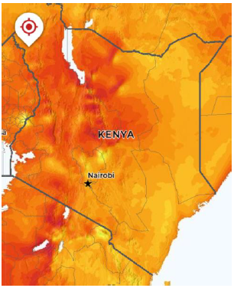
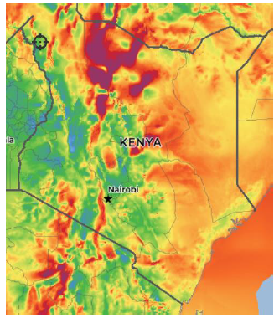
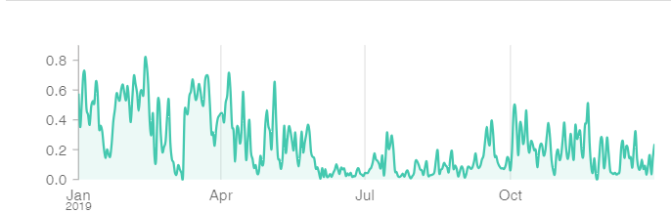
Resource Assessment
The most important resource available in the intervention area is certainly solar radiation, which is particularly high as it is throughout the country. Regarding the presence of winds that can be suitable for electricity production, despite the proximity to the equator would suggest good availability, the village region does not have large amounts of wind due to the morphology of the territory.
Daily average PV capacity factor
Solar Atlas
Wind Atlas
Daily average Wind capacity factor
Solar and Wind Atlas of the Kalobeyei Village [1]
Daily average capacity factor for PV and Wind generated for Kalobeyei village [2]
Sources for images: [1] Global Solar Atlas, Global Wind Atlas, [2] Renewables.ninja
Notes:
Next, let's move on to the resource assessment for Kalobeyei Village, which is a critical step in designing our hybrid energy system.
The most important resource available in the intervention area is certainly solar radiation. Kalobeyei, like much of Kenya, benefits from high levels of solar radiation throughout the year, making solar energy a highly viable option for electricity production. In contrast, while the region's proximity to the equator might suggest good wind availability, the specific morphology of the territory around Kalobeyei means it does not have large amounts of wind. Therefore, wind energy is less promising compared to solar energy in this context.
To visualize this, we can refer to the Solar Atlas and Wind Atlas of the area. The Solar Atlas indicates strong and consistent solar radiation, while the Wind Atlas shows lower wind speeds and capacity. The graphs on the right further illustrate this point. The daily average PV capacity factor is relatively stable and high, indicating good potential for solar power generation. On the other hand, the daily average wind capacity factor is much lower and more variable, reinforcing the limited potential for wind energy in Kalobeyei.

Slide 7
Technology Characterization
Presented below is a simplified dataset of all available energy technologies in the Kalobeyei, Kenya area. It encompasses renewable sources like solar and wind, alongside non-renewable options such as diesel generator as well as two different types of battery bank and a biogas generator option.
 | PV | Wind generator | Diesel generator | Biogas generator + ICE | Battery type 1 (Lead-Acid) | Battery type 2 (Li-Ion) | Electronics
Capital cost [$/W] | 1.2 | 3 | 0.4 | 1.05 | 0.2 ($/Wh) | 0.3 ($/Wh) | 0.15 ($/Wh) for Li-ion 0.1 for Lead-Acid
O&M cost [%investment] | 1.8% | 2% | 4.5% | 4.5% | 2% | 2%
Lifetime [y] | 20 | 20 | 20 | 20 | 4000 cycles | 5500 cycles
Other info | System loss: 0.05 | NPS100c-21 | Diesel cost: 1.3 $/L Genset eff.: 34% | Crop residues price: 90 $/t ICE eff.: 30% | Eff. (round-trip): 0.86 DOD: 50% Ch./disch. time: 6 h | Eff. (ch&disch): 0.93 DOD: 20% Ch./disch. time: 4 h | Efficiency (inverter and rectifier) 96%
Discount Rate: 7.4%
Notes:
Before opening the MicroGridsPy interface and start configuring our optimization problem, let's examine the complete dataset of all available energy technologies for the Kalobeyei area. This dataset encompasses renewable sources like solar and wind, alongside non-renewable options such as diesel generators, as well as two different types of battery banks and a biogas generator option.
We have PV systems with moderate capital and low operational costs, and wind generators with higher capital costs but a long lifespan. Diesel generators offer low capital costs but higher operational expenses and CO2 emissions, while biogas generators provide a renewable alternative with moderate costs. The two battery options include lead-acid, which is cheaper with fewer cycles, and lithium-ion, which is more expensive but offers greater efficiency and longevity. Electronics costs involve inverters and rectifiers essential for system integration.
Key parameters include capital cost, operational costs, lifetime, efficiency, depth of discharge, and charge/discharge times for batteries. For generators, fuel costs and efficiency are the most relevant.

Slide 8
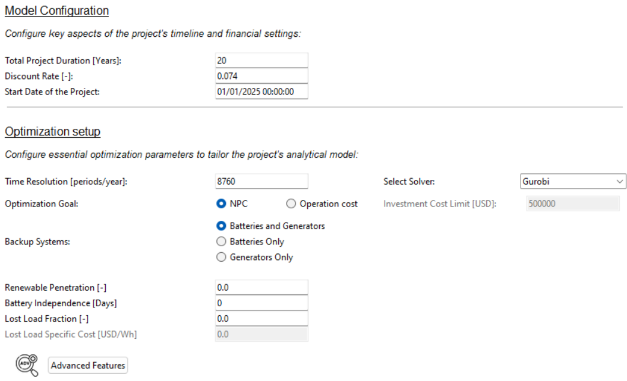
Model Configuration
The configuration for the mini-grid project in Kalobeyei involves a 20-year project duration, with a discount rate of 7.4%, starting on January 1, 2025
The mini-grid in Kalobeyei would be designed to deliver electricity at the lowest possible cost. It integrates storage and backup systems strategically, ensuring an economical supply of power without stringent restrictions on technology choices.
Notes:
To start in MicroGridsPy, we initially set the basic project configuration, including a 20-year project duration with a discount rate of 7.4%. These parameters help plan the financial aspects and long-term sustainability of the mini-grid system. In the optimization setup, we configure the time resolution to 8760 periods per year, representing hourly intervals for detailed analysis. Our optimization goal is to minimize the Net Present Cost (NPC) to ensure economic viability. The backup systems include various options such as batteries and generators, providing flexibility for different scenarios. No additional constraints are implemented in this case for the sake of simplicity, but it is possible to set parameters like renewable penetration or battery independence for more advanced configurations, tailoring the system to specific needs and ensuring optimal performance under varying conditions.

Slide 9
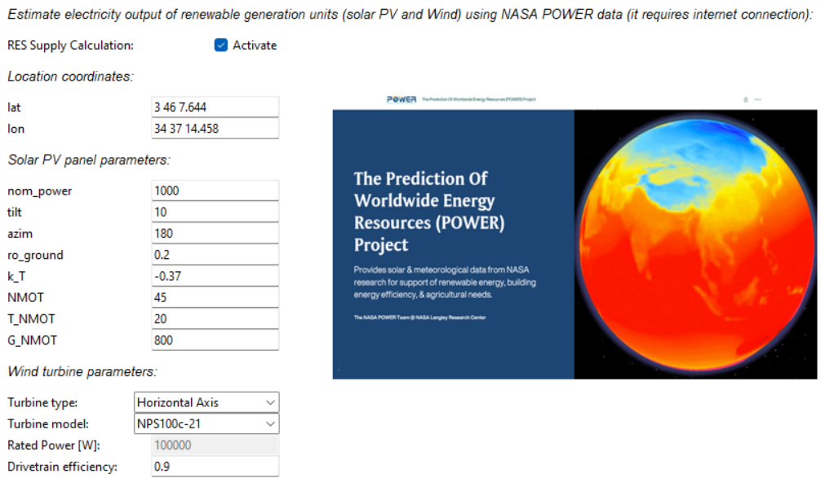
RES Time Series Estimation
In assessing the renewables resources for the caste study area, the project will utilize NASA POWER project datasets to evaluate the availability of solar and wind energy, ensuring a data-driven approach to harnessing local renewable resources for Kalobeyei.
7
Notes:
To accurately assess the renewable resources for the case study area, we will utilize NASA POWER project datasets within MicroGridsPy. On the RES Time Series Estimation page, we start by entering the location coordinates for Kalobeyei. For the solar PV panels, we configure general parameters such as power capacity, tilt and azimuth angles, and efficiency factors. Similarly, for the wind turbine, we select an appropriate turbine model and set key parameters like rated power and efficiency.
Using these configurations, the NASA POWER project datasets provide us with accurate and reliable data on the availability of solar and wind energy.

Slide 10

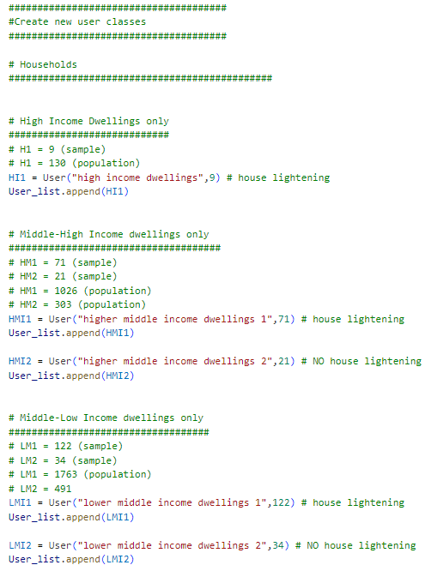
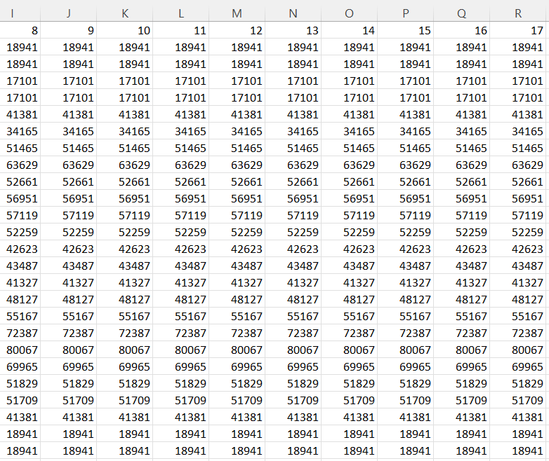
Exogenous Load Demand
Load Demand is estimated using advanced stochastic approach to have a reliable and on-minute basis load curve. The software used is RAMP, an open-source model for the generation of high-resolution multi-energy profiles
80 kW Peak Power at evening (around 19:30)
65 kW Secondary Peak at morning (around 8:30)
Baseload during the day: 40 kW
RAMP inputs file and exemplative load demand data in Excel
Notes:
Load demand is estimated using RAMP, an open-source model for the generation of high-resolution multi-energy profiles based on basic parameters about users’ appliances and functioning windows. From the analysis, we observe that Kalobeyei has an evening peak power demand of 80 kW, a secondary morning peak of 65 kW, and a baseload of approximately 40 kW throughout the day. With this detailed demand profile, we can now move forward to optimize our system design, ensuring that it is both robust and cost-effective, tailored to the specific needs of the Kalobeyei community.

Slide 11
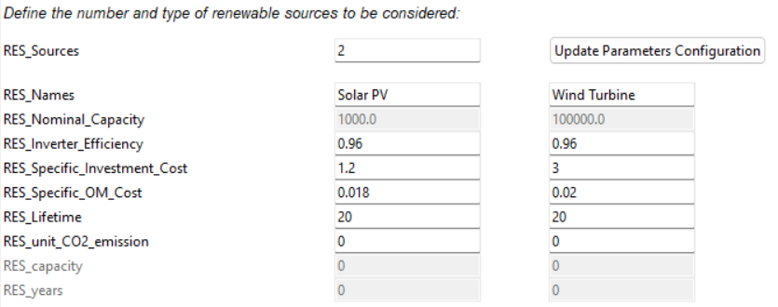
Renewable Parameters
The available renewable generation technologies for the project include photovoltaic (PV) panels and wind turbines. Comparatively, PV systems offer a suitable solution for consistent energy generation with lower specific investment costs. In contrast, wind turbines, while having a higher upfront cost, can be more efficient in areas with strong, consistent wind conditions. The model would operate a selection between these technologies based on their relative costs, performance efficiencies, and local resource assessment.
Notes:
Next, let's discuss the configuration of renewable technologies in MicroGridsPy for our project in Kalobeyei.
The available renewable generation technologies for the project include photovoltaic (PV) panels and wind turbines. Each technology has distinct characteristics and cost implications, which are crucial for optimizing our energy system.
PV systems offer a reliable solution for consistent energy generation with lower specific investment costs. They are particularly well-suited for Kalobeyei, given the high solar radiation in the region. We configure the parameters for PV systems, including their nominal capacity, inverter efficiency, specific investment cost, and operational and maintenance costs.
On the other hand, wind turbines, while having a higher upfront cost, can be more efficient in areas with strong, consistent wind conditions. However, given Kalobeyei's limited wind resources, as previously assessed, the use of wind turbines might be less favorable. Nonetheless, we still configure their parameters, including nominal capacity, efficiency, investment cost, and maintenance costs, to allow for a comprehensive comparison.
The model will select between these technologies based on their relative costs, performance efficiencies, and local resource availability. This selection process ensures that the chosen solution provides the most cost-effective and reliable energy supply for Kalobeyei.

Slide 12
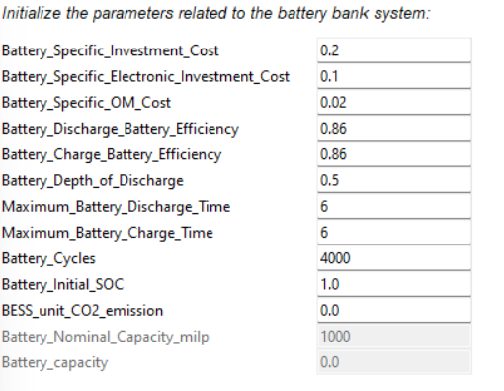
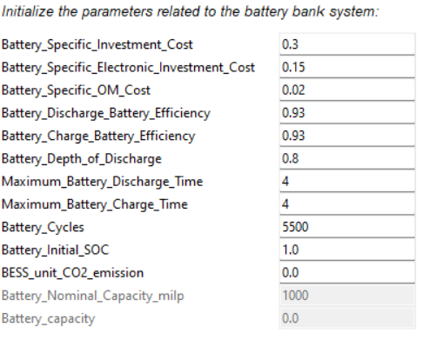
Battery Parameters
For the mini-grid project, two different scenarios using lead-acid and lithium-ion batteries will be compared to determine which is more cost-effective for the Kalobeyei area. Lead-acid batteries have lower specific investment costs and are robust, but offer fewer cycles and lower efficiency than lithium-ion batteries. Lithium-ion batteries, while more expensive initially, provide higher efficiency and a greater number of cycles.
Lead-Acid Battery
Lithium-Ion Battery
Notes:
Moving on to the battery configuration for our mini-grid project, we will compare two different scenarios using lead-acid and lithium-ion batteries to determine which is more cost-effective.
Lead-acid batteries are known for their lower specific investment costs and robustness. However, they offer fewer cycles and lower efficiency compared to lithium-ion batteries. In our configuration, we set parameters such as specific investment cost, electronic investment cost, operational and maintenance costs, efficiency, depth of discharge, charge and discharge times, and the total number of cycles.
On the other hand, lithium-ion batteries, although more expensive initially, provide higher efficiency and a greater number of cycles. Their configuration also includes parameters like specific investment cost, electronic investment cost, operational and maintenance costs, efficiency, depth of discharge, charge and discharge times, and the total number of cycles. By performing a sensitivity analysis on these two battery technologies, we can evaluate their performance under the same conditions and determine the most cost-effective solution for Kalobeyei.

Slide 13
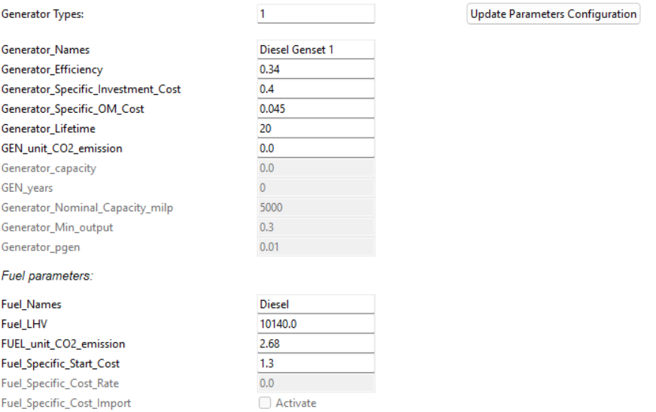
Diesel Generator Parameters
As a backup system for the mini-grid project, a diesel generator will be considered, chosen for its established reliability and known operational parameters. It is characterized by relatively low specific investment costs and offers a balance between efficiency and operational expenditure.
While diesel generators are not the most environmentally friendly due to CO2 emissions, they are often used in energy systems for their dependability and ease of integration, making them a practical choice in scenarios where renewable sources may be intermittent.
Notes:
As a backup system for the mini-grid project, a diesel generator will be considered. Diesel generators are chosen for their established reliability and well-known operational parameters. They are characterized by relatively low specific investment costs and offer a balance between efficiency and operational expenditure.
In our configuration, we set parameters such as generator efficiency, specific investment cost, operational and maintenance costs, and generator lifetime. Additionally, we configure fuel parameters, including lower heating value (LHV), unit CO2 emissions, and specific fuel cost (constant). With all these configurations in place, we are now ready to run the optimization and finalize the design of the hybrid energy system for Kalobeyei.

Slide 14
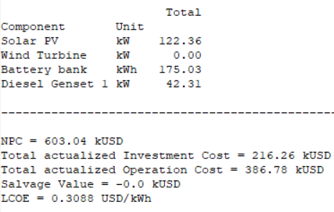
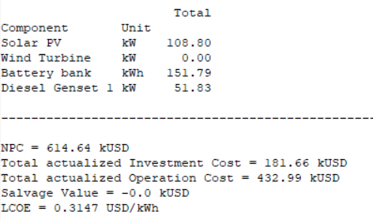
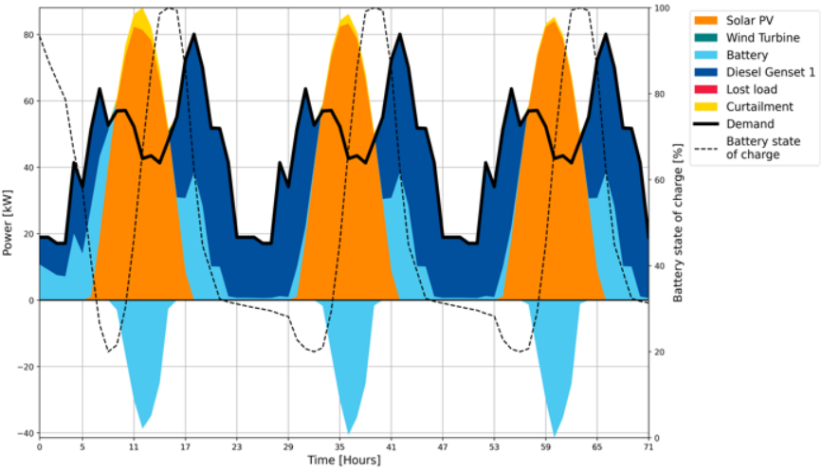
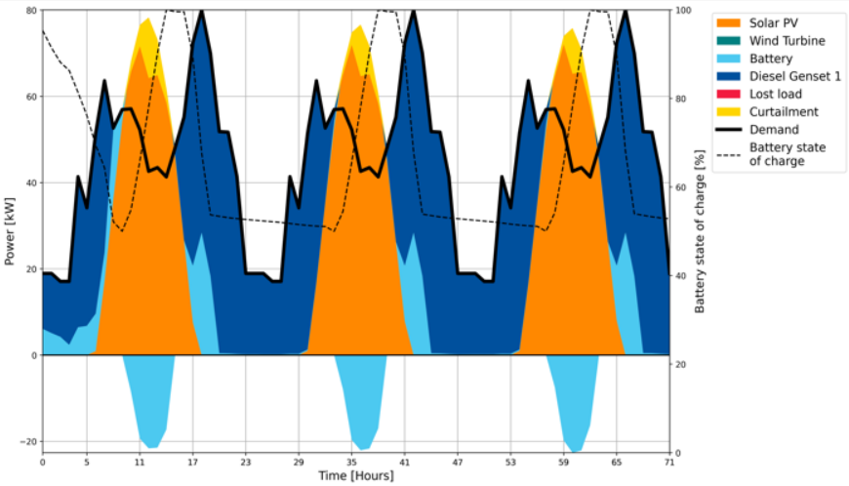
Results Comparison
Lithium-Ion
Lead-Acid
Notes:
Now, let's compare the results of the two scenarios using lead-acid and lithium-ion batteries, obtained from running the MicroGridsPy optimization. Both configurations are visually represented in the graphs, showing the power contributions from solar PV, the diesel generator, and the battery state of charge over time.
Comparing these results, we see that while the lithium-ion setup has a higher initial investment, it offers a lower operation cost and a slightly lower LCOE, making it a more cost-effective solution in the long run. On the other hand, the lead-acid setup has a lower initial investment but higher operational costs and a higher LCOE.
This comparison highlights the trade-offs between the two battery technologies, with lithium-ion batteries offering better performance and cost efficiency over time despite their higher upfront costs.

Slide 15
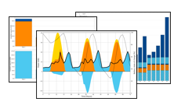
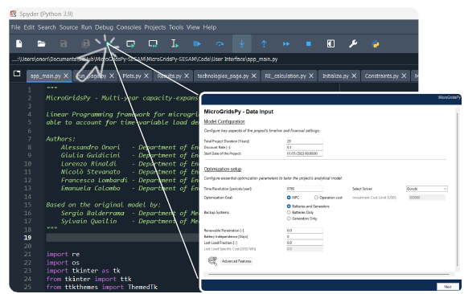
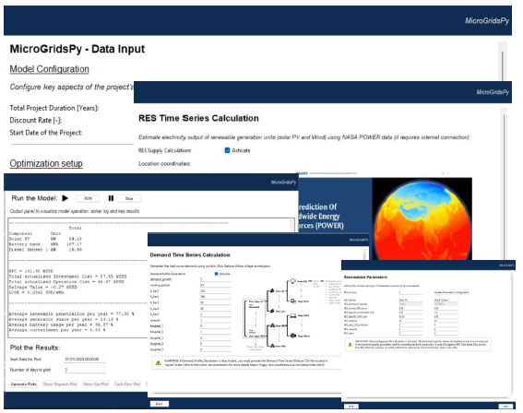
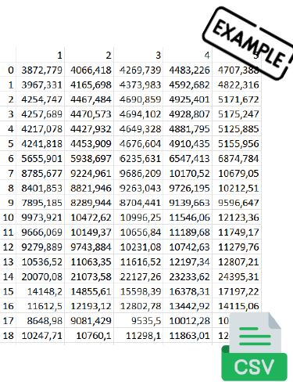
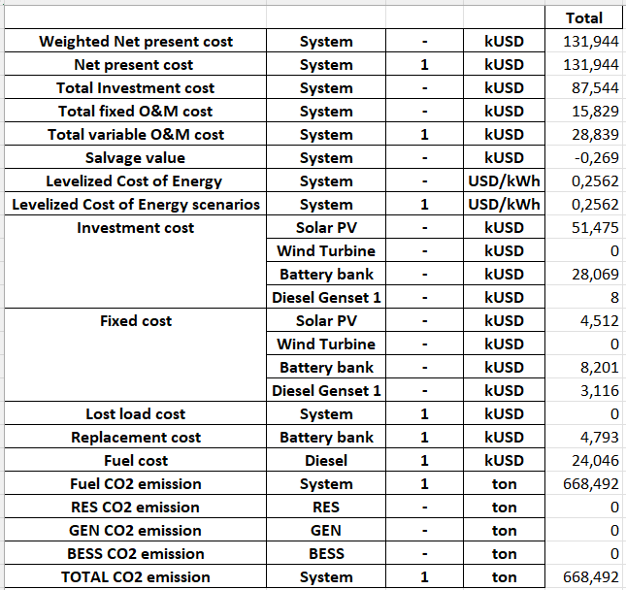
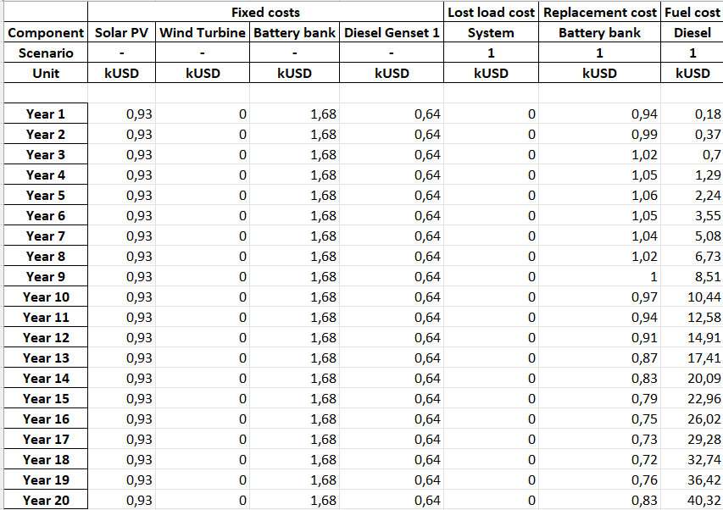
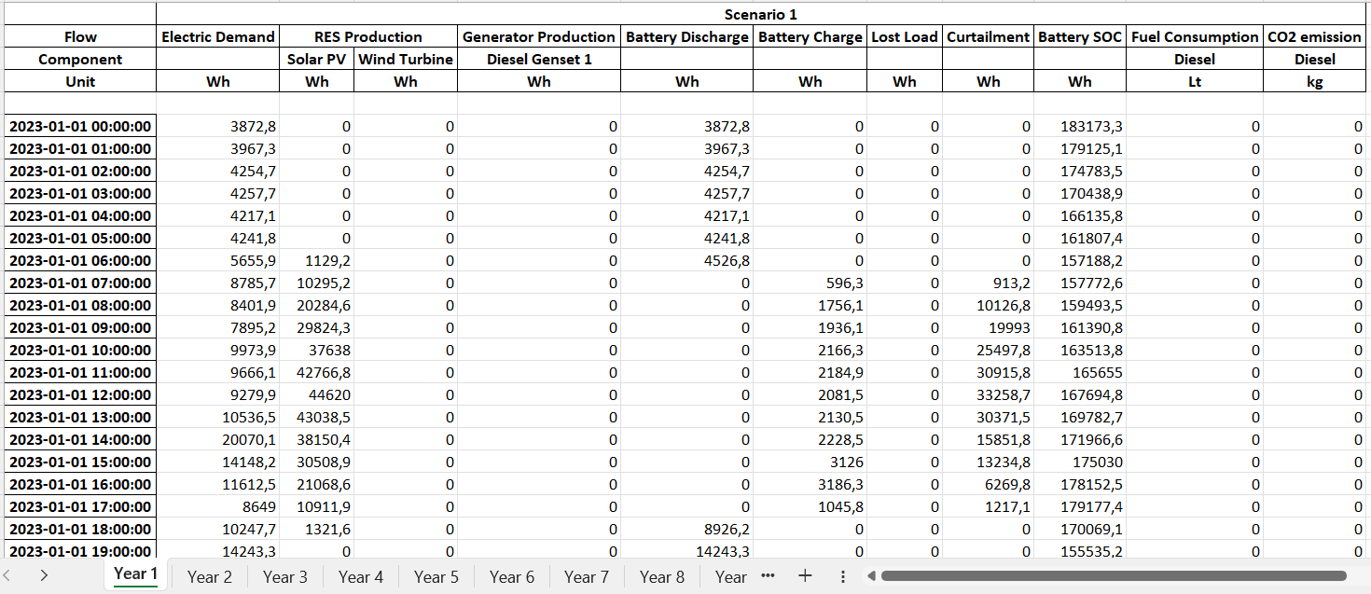
Let’s Practice!
Participants are encouraged to apply the knowledge and skills they've acquired by replicating the analysis presented:
Generate and provide Time Series Data (Demand and Resource Availability) as input in MicroGridsPy
Input techno-economic parameters for mini-grid components (Technology Characterization)
Running and compare different scenarios
As you embark on this task, we wish you the best of luck in successfully completing it!
Notes:
Now that we've completed the design and optimization process for Kalobeyei's hybrid energy system, it's your turn to apply these skills. Participants should generate and input Time Series Data in MicroGridsPy and enter the techno-economic parameters for mini-grid components. You will then run and compare different scenarios. We wish you the best of luck in this exercise, which will reinforce your understanding and prepare you for real-world applications. Thank you for your participation and dedication!

