Slide 1

Off-Grid Energy Systems Modelling with MicroGridsPy
Lesson 9: Understanding the Results

Slide 2

Lesson 9: Contents
Interpretation of MicroGridsPy Visual Outputs
Develop the ability to interpret and analyse the integrated suite of visual plots provided by MicroGridsPy, which include energy dispatch, component sizing, and cost analysis, to understand the operational and financial performance of mini-grid systems
Analysis of Detailed Results Spreadsheets
Acquire skills to navigate and extract valuable insights from the detailed spreadsheets generated by MicroGridsPy, which present grid component capacities, project costs, yearly cash flows, and key energy metrics for comprehensive system efficiency and economic evaluations
Navigating and Utilizing the MicroGridsPy Interface
Learn to navigate the MicroGridsPy interface effectively, including real-time output panel to monitor the solver's log and the mini-grid's operational actions during the simulation as well as generating and displaying plots
Notes:
In this lecture, we will focus on understanding and analyzing the results generated by MicroGridsPy. By the end of this lesson, you will be able to interpret and analyze the integrated suite of visual plots provided by MicroGridsPy. These plots include energy dispatch, component sizing, and cost analysis, which are crucial for understanding the operational and financial performance of mini-grid systems.
You will also acquire skills to navigate and extract valuable insights from the detailed spreadsheets generated by MicroGridsPy. These spreadsheets present grid component capacities, project costs, yearly cash flows, and key energy metrics, allowing for comprehensive system efficiency and economic evaluations.
Lastly, you will learn to navigate the MicroGridsPy interface effectively, including the real-time output panel to monitor the solver's log and the mini-grid's operational actions during the simulation. You will also learn how to generate and display plots to visualize and interpret the results.

Slide 3
Lesson 9: Learning Outcomes
At the end of this unit, participants will be able to :
Interpret of MicroGridsPy Visual Outputs
Develop the ability to interpret and analyse the integrated suite of visual plots provided by MicroGridsPy, which include energy dispatch, component sizing, and cost analysis, to understand the operational and financial performance of mini-grid systems
Analyse of Detailed Results Spreadsheets
Acquire skills to navigate and extract valuable insights from the detailed spreadsheets generated by MicroGridsPy, which present grid component capacities, project costs, yearly cash flows, and key energy metrics for comprehensive system efficiency and economic evaluations
Navigate and Utilize the MicroGridsPy Interface
Learn to navigate the MicroGridsPy interface effectively, including real-time output panel to monitor the solver's log and the mini-grid's operational actions during the simulation as well as generating and displaying plots
Notes:
In this lecture, we will focus on understanding and analyzing the results generated by MicroGridsPy. By the end of this lesson, you will be able to interpret and analyze the integrated suite of visual plots provided by MicroGridsPy. These plots include energy dispatch, component sizing, and cost analysis, which are crucial for understanding the operational and financial performance of mini-grid systems.
You will also acquire skills to navigate and extract valuable insights from the detailed spreadsheets generated by MicroGridsPy. These spreadsheets present grid component capacities, project costs, yearly cash flows, and key energy metrics, allowing for comprehensive system efficiency and economic evaluations.
Lastly, you will learn to navigate the MicroGridsPy interface effectively, including the real-time output panel to monitor the solver's log and the mini-grid's operational actions during the simulation. You will also learn how to generate and display plots to visualize and interpret the results.

Slide 4
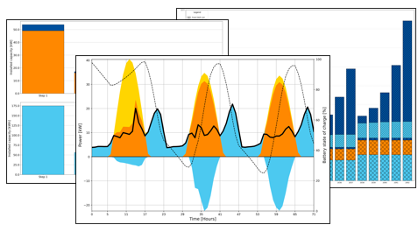
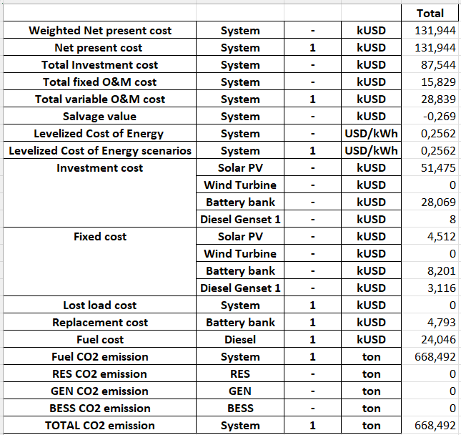
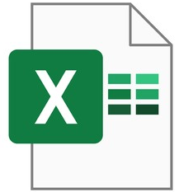
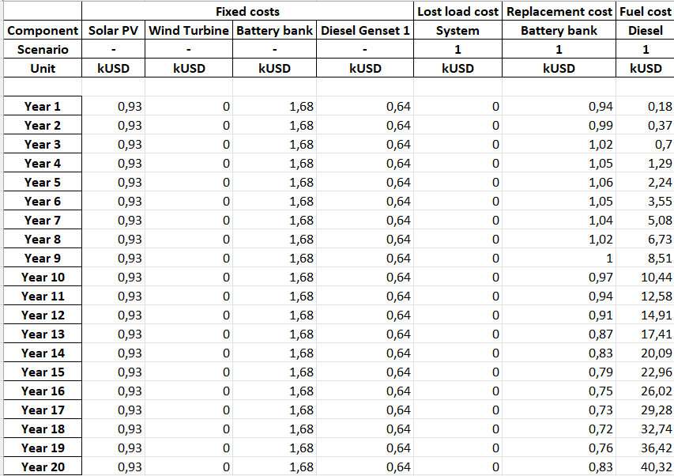
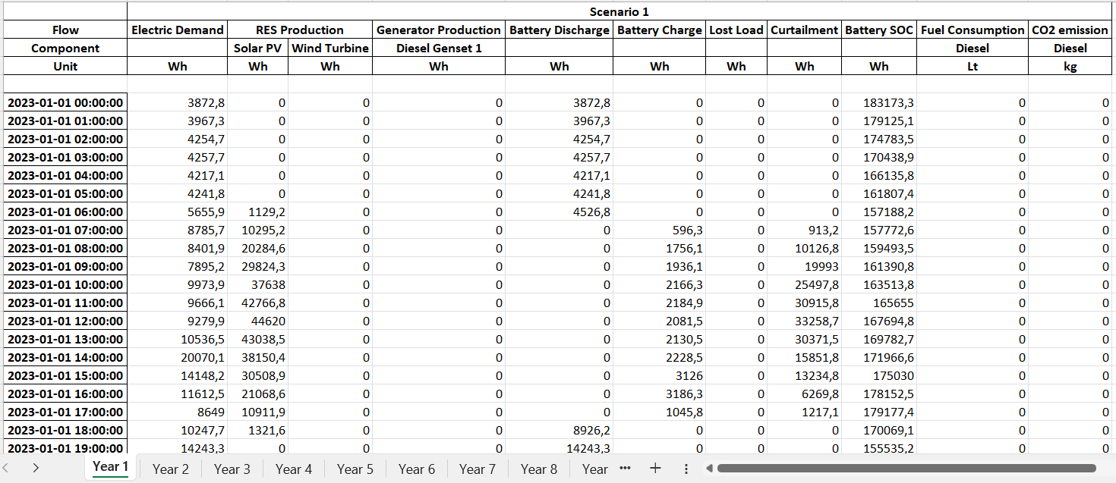

MicroGridsPy Results
MicroGridsPy results are delivered through an integrated suite of visual plots and detailed spreadsheets, enabling a thorough analysis of the mini grid overall performance.
Plots
Visual plots depict energy dispatch, component sizing, and cost analysis, offering intuitive insights into the system’s operational and financial performance.
Detailed Results Spreadsheets
Spreadsheets provide an in-depth look at grid component capacities, project costs, yearly cash flows, and key energy metrics, facilitating a thorough examination of the system's efficiency and economics across various scenarios.
Code/Results/Plots
Code/Results
Notes:
MicroGridsPy results are delivered through an integrated suite of visual plots and detailed spreadsheets, enabling a thorough analysis of the mini-grid's overall performance.
Visual plots depict energy dispatch, component sizing, and cost analysis. These plots offer intuitive insights into the system's operational and financial performance, allowing users to quickly grasp key dynamics and trends within the microgrid.
Detailed results spreadsheets provide an in-depth look at grid component capacities, project costs, yearly cash flows, and key energy metrics. These spreadsheets facilitate a thorough examination of the system's efficiency and economics across various scenarios, helping users to make informed decisions based on comprehensive data.

Slide 5
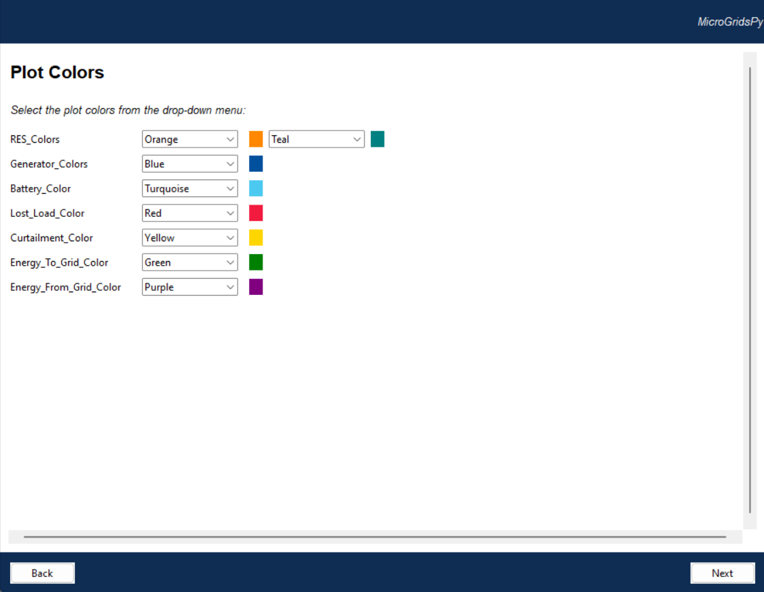

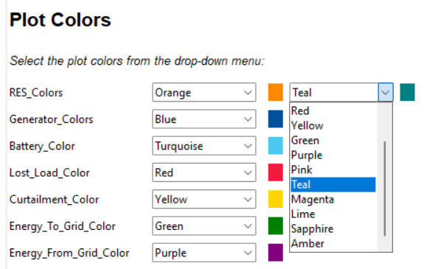
Plots layout
Users can select colors from a dropdown menu to represent different components such as renewable energy sources (RES), generators, batteries, lost load, curtailment, and energy exchanged with the grid, enhancing the clarity and distinction of various data sets in graphical representations
Notes:
Once you have correctly set configurations, load demand, resource, and technology characterization in MicroGridsPy, you can proceed to obtain and analyze the results through the user interface. Users can customize the visualization of results by selecting colors from a dropdown menu. This feature allows you to represent different components, such as renewable energy sources (RES), generators, batteries, lost load, curtailment, and energy exchanged with the grid, with distinct colors.

Slide 6
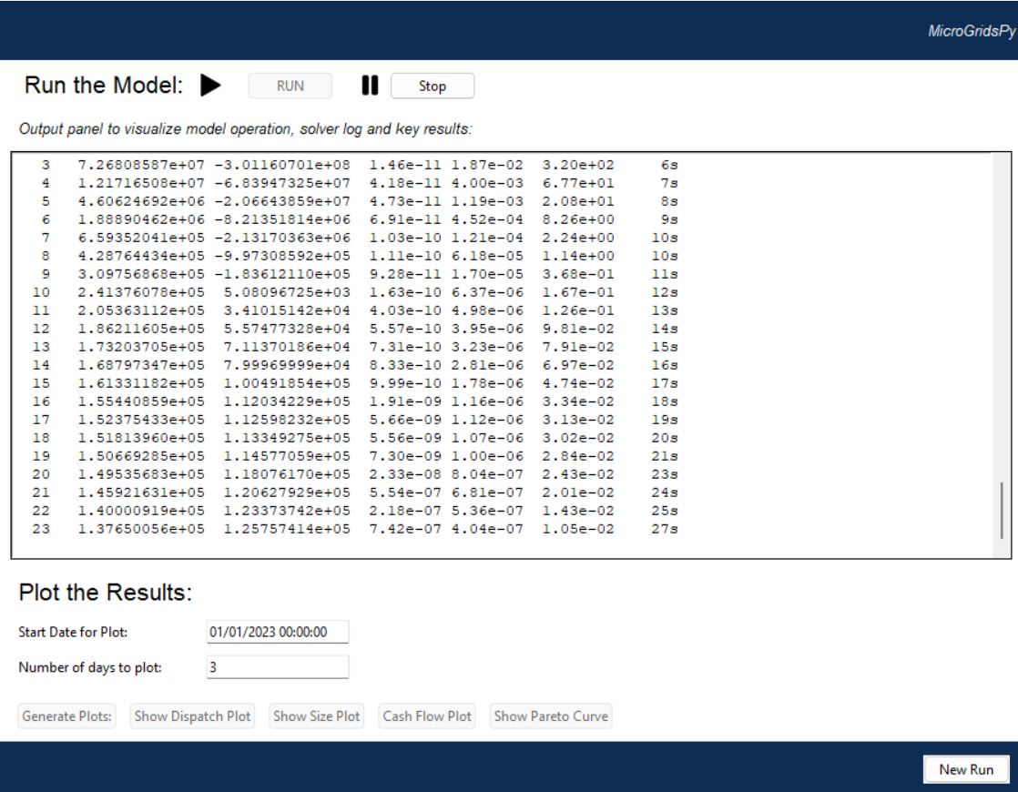
Running the model
Upon initiating the model with the 'Run' button, users can monitor the solver's log and the system's operational actions in real-time. This output panel provides a live feed of the model's processing data displaying also potential errors messages.
Notes:
After configuring all necessary parameters and setting up your system, you can initiate the model by clicking the 'Run' button. Once the model is running, you can monitor the solver's log and the system's operational actions in real-time. This output panel provides a live feed of the model's processing data, including potential error messages.
The real-time solver's log is crucial for tracking the model's progress and identifying any issues that may arise during the simulation. Additionally, you can plot the results by selecting the start date and the number of days to plot. This feature enables you to generate visual plots, such as dispatch plots, size plots, cash flow plots, and Pareto curves (if multi-objective optimization), for detailed analysis and interpretation of the mini-grid's performance.

Slide 7
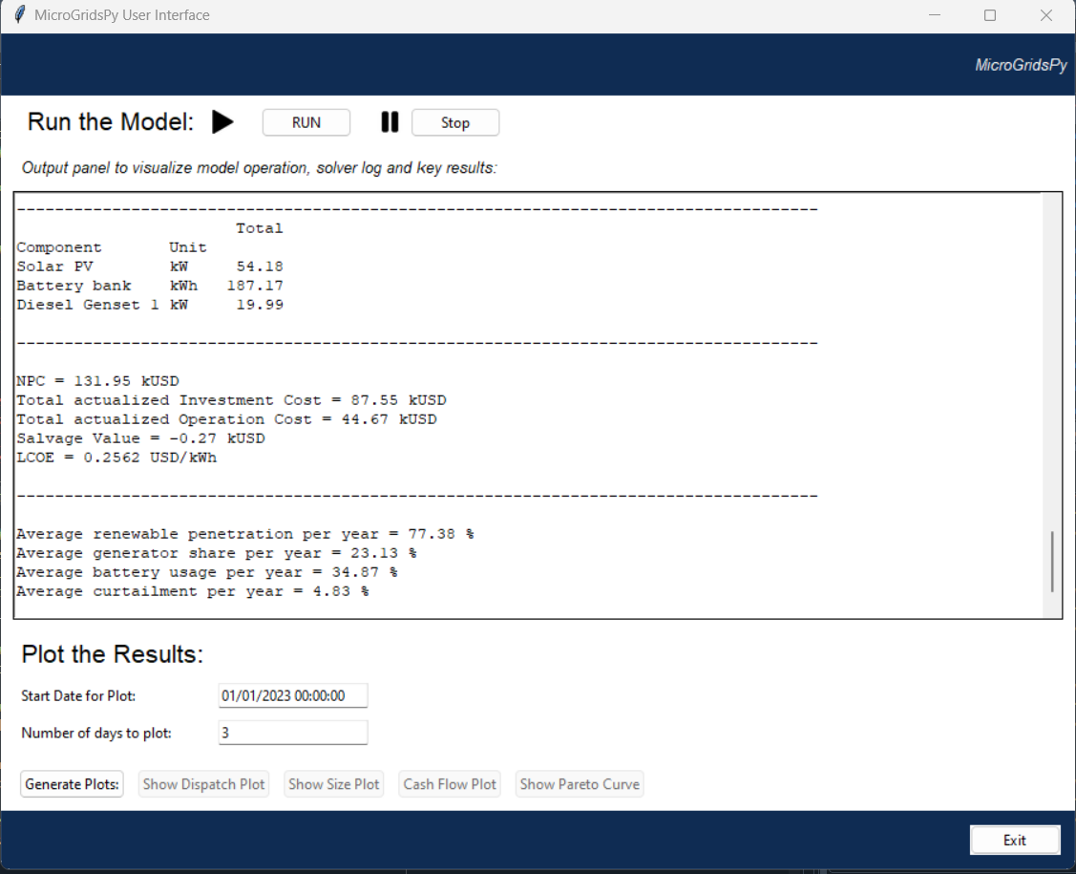
Key Results
Sizing of the mini-grid
Optimal capacity installed each investment steps divided by technology
NPC (Net Present Cost) [k$]
This is the total cost of the mini-grid system over its lifetime, discounted to present value
Total actualized Investment and Operation Cost [k$]
The upfront investment and operation costs for the mini-grid, actualized to the present.
Salvage Value [k$]
The estimated residual value of the system's components at the end of the project's life
LCOE (Levelized Cost Of Energy) [$/kWh]
The average cost per unit of electricity generated by the mini-grid, accounting for the total actualized costs over the system's lifetime
Average renewable penetration per year [%]
The percentage of the mini-grid's energy supplied by renewable sources on an annual basis.
Average generator and battery share per year [%]
The proportion of energy contributed by generators and battery each year.
.
Average curtailment per year
The percentage of renewable energy generated that was not used or stored annually.
Notes:
Once the optimization problem is solved, the interface summarizes key results in the run window, following the solver log. For example, sizing details show the optimal capacity installed for each technology. Financial metrics include the Net Present Cost (NPC), representing the total cost over the system's lifetime, and the Levelized Cost of Energy (LCOE), indicating the average cost per unit of electricity generated.
Operational insights cover the average renewable penetration and the share of energy from generators and batteries per year. Additionally, it reports curtailment rates, showing the percentage of renewable energy not used or stored.

Slide 8
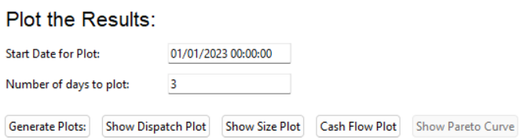
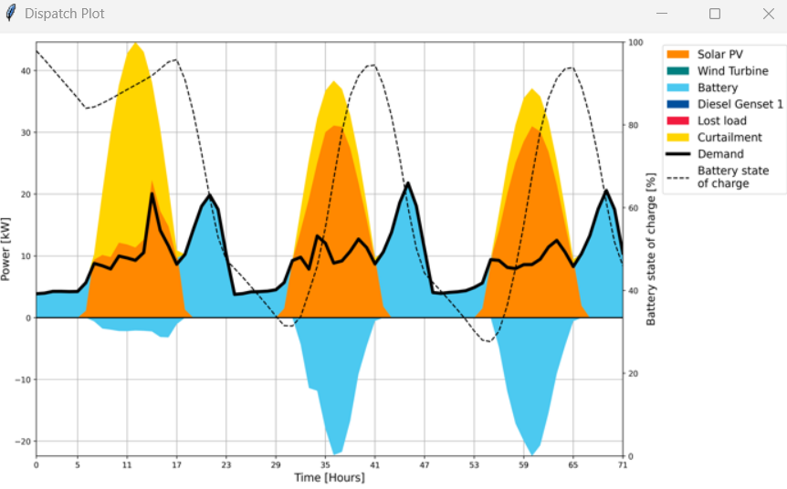
Displaying plots
Users can create visual plots of model outputs by setting a date range and choosing from various plot types. The buttons generate graphs for energy dispatch, system sizing and financial analysis, providing a comprehensive view of the model’s performance over the selected timeframe.
Notes:
After obtaining the key results, users can create visual plots of model outputs by setting a date range and choosing from various plot types. The interface allows generating graphs for energy dispatch, system sizing, and financial analysis. These plots provide a comprehensive view of the model's performance over the selected timeframe, enhancing the understanding of system operations and financial metrics.

Slide 9

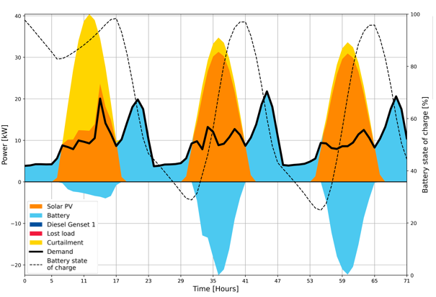
Dispatch Plot
A dispatch plot is a graphical representation that displays how energy is generated and used within a mini-grid over a specific time frame, showing when and how much energy each source is contributing to the overall demand.
Load Demand
Energy demand profile compared with the supply from different sources
Curtailment
Excess of RES energy generated that is not used or stored
Battery Discharge
Energy release from the battery to supply the demand
Solar PV energy
Contribution of solar PV energy used to meet the demand or stored. In case of solar it peaks during daylight hours and tapers off with the availability of sunlight.
Battery Charge
Negative energy stored within the battery using RES excess energy
3 days plot
Notes:
Let's have a closer look at the different types of plots generated by MicroGridsPy, starting with the dispatch plot. A dispatch plot is a graphical representation that displays how energy is generated and used within a mini-grid over a specific timeframe. This plot shows when and how much energy each source is contributing to the overall demand. For instance, the plot highlights solar PV energy peaks during daylight hours, with the batteries charging during these times and discharging to supply demand when solar energy is unavailable. In this specific example, there is no use of the generator, and curtailment is observed only on the first day due to the batteries already being full.

Slide 10
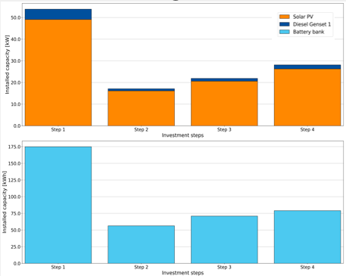

Size Plot
A size plot graphically presents the installed capacities of different energy components in a mini-grid across various investment steps. Each bar represents a specific technology—such as Solar PV, diesel generators, or battery banks—showing how their individual capacities contribute to the total system size.
Solar PV Sizing
Optimal capacity of PV [kW] installed during the time horizon of the project at each investment step.
Generator Sizing
Optimal capacity of the generator [kW] installed during the time horizon of the project at each investment step
In the example, the advanced feature of capacity expansion has been implemented to show the progressive increase in installed capacity across successive investment steps. By default, when capacity expansion is not enabled, the system assumes a single investment step occurring at the start of the time horizon.
20 years, 4 investment steps
Battery Sizing
Optimal capacity of the battery bank [kWh] installed during the time horizon of the project at each investment step
Notes:
Next, let's look at the size plot. This plot graphically presents the installed capacities of different energy components in a mini-grid across various investment steps. Each bar represents a specific technology, such as Solar PV, diesel generators, or battery banks, showing how their individual capacities contribute to the total system size.
In the provided example, the advanced feature of capacity expansion has been implemented to show the progressive increase in installed capacity across successive investment steps over 20 years. For instance, we can see the optimal capacity of solar PV, battery bank, and generator increasing at each investment step. By default, when capacity expansion is not enabled, the system assumes a single investment step occurring at the start of the time horizon.

Slide 11
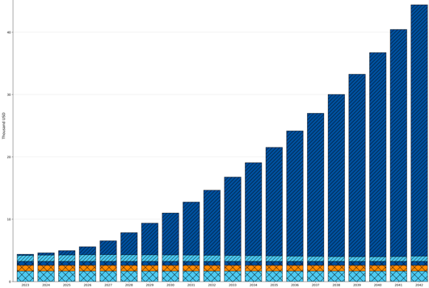
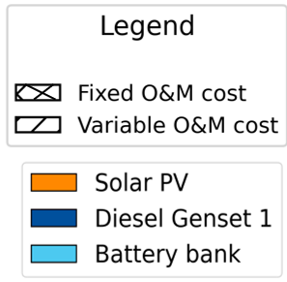
Cash Flow Plot
The cash flow plot displays the financial performance of a mini-grid over time, segmented by different cost categories. The bars represent total operation costs, with each colour indicating a specific type of cost, such as fixed and variable operations and maintenance (O&M) divided by type of technology
Variable O&M costs
Variable operation costs fluctuate with the level of production or usage of the system. They include costs for fuel and maintenance that scales with the amount of energy produced or the wear and tear on equipment during operation.
In the example: the increasing load demand across the years lead to an increased usage of generator and so an increased costs for diesel,
20 years, increasing load demand
Fixed O&M costs
It refer to the regular, ongoing expenses required to operate and maintain energy infrastructure regardless of the system's output. These typically include routine maintenance, annual inspections, long-term service agreements, and fixed staffing costs.
Notes:
Let's move on to the cash flow plot. This plot displays the financial performance of a mini-grid over time, segmented by different cost categories. The bars represent total operation costs, with each color indicating a specific type of cost, such as fixed and variable operations and maintenance (O&M) divided by the type of technology.
Variable O&M costs fluctuate with the level of production or usage of the system. They include costs for fuel and maintenance that scale with the amount of energy produced or the wear and tear on equipment during operation. For example, in the plot, the increasing load demand over the years leads to increased usage of the generator and, consequently, higher costs for diesel.
Fixed O&M costs, on the other hand, refer to regular, ongoing expenses required to operate and maintain energy infrastructure regardless of the system's output. These typically include routine maintenance, annual inspections, long-term service agreements, and fixed staffing costs.
In the example, the plot shows how costs evolve over a 20-year period with increasing load demand, giving a comprehensive view of the mini-grid's financial sustainability.

Slide 12
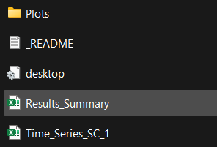
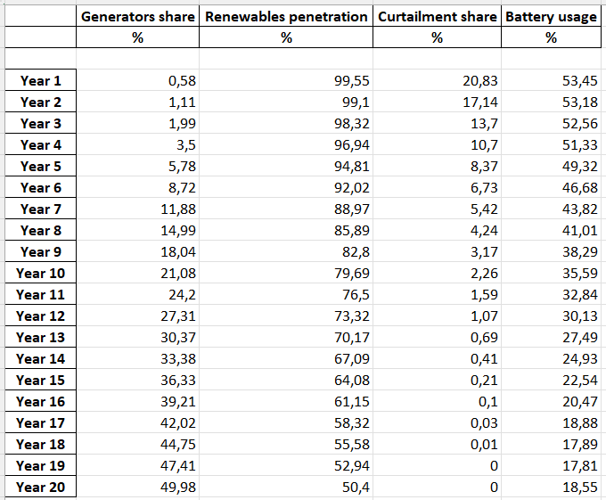
Results Folder
Code/Results/Results_Summary.xlsx
The Results_Summary spreadsheet details grid capacities, project costs, and annual cash flows. It also quantifies energy distribution across generators, renewables, batteries, and grid usage, with scenario comparisons.
Notes:
In addition to visual plots, MicroGridsPy provides detailed results in the results folder. The Results Summary spreadsheet is a key file located here. This detailed document outlines grid capacities, project costs, and annual cash flows. It also quantifies energy distribution across generators, renewables, batteries, and grid usage, offering a thorough scenario comparison.
By examining the Results Summary, users can gain insights into critical metrics such as the net present cost, total investment and operational costs, fixed and variable O&M costs, salvage value, and the levelized cost of energy. Additionally, it provides a breakdown of how energy is shared among different sources, the extent of renewable energy penetration, curtailment rates, and battery usage over the project's time horizon.

Slide 13
Result Summary
Cost sheet
It presents a financial and environmental summary of the optimal solution, detailing, for each scenario simulated and broken down by component.
Key points
Aggregated Costs, including the net present and total investment costs, as well as fixed and variable O&M expenses
The levelized cost of energy, alongside specific investment and ongoing fixed costs for technologies like Solar PV and Diesel Generators
Environmental impact, reflected in CO2 emissions from various system components, with a total emissions figure.
Code/Results/Results_Summary - Cost
Notes:
Continuing with the detailed analysis provided by the Results Summary file, let's explore the Cost sheet. This sheet presents a comprehensive financial and environmental summary of the optimal solution, detailing costs and emissions for each scenario simulated and broken down by component. The key points include aggregated costs, which encompass the net present cost, total investment cost, and fixed and variable O&M expenses. The levelized cost of energy (LCOE) is highlighted, detailing specific investment and ongoing fixed costs for technologies like Solar PV and Diesel Generators. Additionally, the environmental impact is summarized through CO2 emissions from various system components, providing a comprehensive view of the project's financial and environmental performance.

Slide 14
Result Summary
Yearly cash flows sheet
It details annual fixed, lost load, replacement, and fuel costs for different components of the optimal solution each year of the time horizon.
Key points
Yearly Fixed costs for each technology component such as Solar PV, Wind Turbine, Battery Bank, and Diesel Generator
Yearly Lost load costs, representing the economic impact of energy demand not met by the system
Yearly Replacement costs specific to the Battery Bank and Diesel Generator components, indicating the expected frequency and cost of component replacements over time
Yearly Fuel costs associated with the operation of the Diesel Generator, reflecting the operational expense of fuel consumption.
Code/Results/Results_Summary – Yearly cash flows
Notes:
The yearly cash flows sheet in the Result Summary details annual fixed, lost load, replacement, and fuel costs for different components of the optimal solution each year of the time horizon. Key points include yearly fixed costs for components like Solar PV, Wind Turbine, Battery Bank, and Diesel Generator; yearly lost load costs indicating the economic impact of unmet energy demand; yearly replacement costs specific to Battery Bank and Diesel Generator components, indicating the expected frequency and cost of replacements over time; and yearly fuel costs associated with the Diesel Generator, reflecting operational fuel expenses.

Slide 15
Result Summary
Yearly energy parameters sheet
It provides annual percentages for key performance indicators of a mini-grid over the time horizon years.
Key points
Generators Share: Yearly percentage of total energy supplied by generators
Renewables Penetration: Annual percentage of total energy provided by renewable sources
Curtailment Share: Yearly percentage of renewable energy generated that was not utilized
Battery Usage: Annual percentage of total energy demand met by discharging the batteries.
Code/Results/Results_Summary – Yearly energy parameters
Notes:
The yearly energy parameters sheet provides annual percentages for key performance indicators of a mini-grid over the time horizon years. Key points include the yearly percentage of total energy supplied by generators (Generators Share), the annual percentage of total energy provided by renewable sources (Renewables Penetration), the yearly percentage of renewable energy generated but not utilized (Curtailment Share), and the annual percentage of total energy demand met by discharging the batteries (Battery Usage).

Slide 16
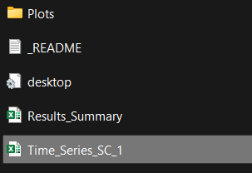
Results Folder
The Time_Series spreadsheet contains hourly data of the system’s energy balance, including technology energy production, battery energy flows, demand, lost load, and curtailment. Additionally, it tracks the state of charge of the batteries and the fuel consumed by the generators. Each year of the time horizon is reported on a different sheet.
Code/Results/Time_Series_SC_1.xlsx
Notes:
Finally, The Time Series spreadsheet contains hourly data of the system's energy balance, including technology energy production, battery energy flows, demand, lost load, and curtailment. Additionally, it tracks the state of charge of the batteries and the fuel consumed by the generators. Each year of the time horizon is reported on a different sheet, providing a detailed temporal resolution of the system's performance over time.

