Slide 1

Off-Grid Energy Systems Modelling with MicroGridsPy
Lesson 6:
Resource Assessment

Slide 2

Lesson 6: Contents
Understanding Renewable Resource Assessment
Comprehend the methods for assessing the availability and variability of local renewable resources such as solar, wind, and hydro, and how this information informs the design of sustainable off-grid energy systems
Renewables Potential Analysis
Learn to analyse the potential of renewable energy sources in different regions, with a focus on the socio-economic and environmental benefits they can provide to rural communities
Renewable Estimation Techniques
Acquire knowledge of different renewables estimation methods, both on-field and desktops analysis
Resource Assessment within MicroGridsPy
Master the use of the MicroGridsPy interface page and features, learning to input and analyse field data
Notes:
This lecture will introduce learners to the critical aspects of renewable resource assessment for off-grid energy systems. We'll explore methods for assessing local renewable resources like solar, wind, and hydro, and how this information informs sustainable system design. You'll learn to analyze the potential of renewable energy sources, focusing on their socio-economic and environmental benefits for rural communities. We'll cover different estimation techniques, including on-field and desktop analyses. Finally, we'll dive into using MicroGridsPy for resource assessment, focusing on inputting and analyzing field data. By the end, you'll have a solid foundation for assessing and optimizing renewable resources in off-grid energy systems.

Slide 3
Lesson 6: Learning Outcomes
At the end of this unit, participants will be able to :
Comprehend the methods for assessing the availability and variability of local renewable resources
Learn to analyse the potential of renewable energy sources
Acquire knowledge of different renewables estimation methods
Master the use of the MicroGridsPy interface page and features
Notes:
This lecture will introduce learners to the critical aspects of renewable resource assessment for off-grid energy systems. We'll explore methods for assessing local renewable resources like solar, wind, and hydro, and how this information informs sustainable system design. You'll learn to analyze the potential of renewable energy sources, focusing on their socio-economic and environmental benefits for rural communities. We'll cover different estimation techniques, including on-field and desktop analyses. Finally, we'll dive into using MicroGridsPy for resource assessment, focusing on inputting and analyzing field data. By the end, you'll have a solid foundation for assessing and optimizing renewable resources in off-grid energy systems.

Slide 4
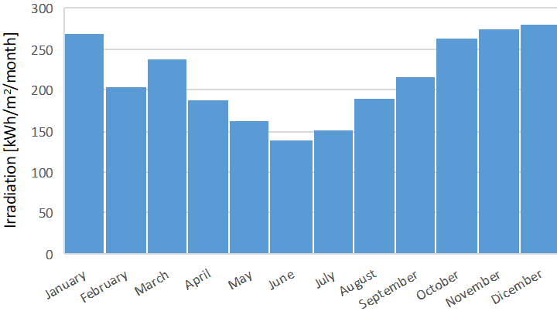

Resource Assessment
Resource Assessment aims at assessing the availability of local resources to better exploit local renewable energy and ground the technological solutions in the context
Resource Optimization
Careful evaluation of local renewable sources is key to ensuring that the mini-grid system taps into the maximum available energy without exceeding the region's potential, which prevents both energy deficits and oversupply
Energy Stability
Assessing the intermittency of renewables like solar and wind is vital for designing a system that can handle fluctuations and deliver a stable and reliable energy supply, even with variable resource availability
Sustainability
Resource assessments help in creating a sustainable energy system that leverages local renewables efficiently, reducing environmental impacts and ensuring the system's viability in the long term
Community-Centric Energy Solutions
Incorporating local resource data into mini-grid development ensures that solutions are tailored to the specific geographic and climatic conditions of the community, enhancing acceptance and participation
Monthly Average Solar Irradiation in Rural Village of Toconao, Chile
Inaccurate or incomplete data regarding local renewable energy availability can lead to flawed system sizing and performance, as the resource assessment critically informs both the technical and economic feasibility of the mini-grid.
Notes:
Resource assessment evaluates the availability of local renewable resources to optimize energy use in mini-grids. By accurately assessing resources like solar and wind, we can prevent energy deficits and oversupply, ensure stable and reliable energy supply, and support sustainable system design. Incorporating local data ensures solutions are tailored to community needs, enhancing acceptance and participation. On the other hand, incomplete data can lead to flawed system sizing and performance, impacting both technical and economic feasibility.

Slide 5
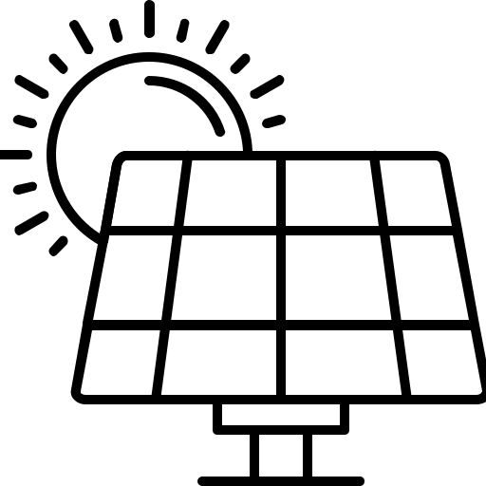
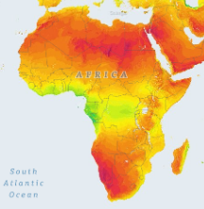

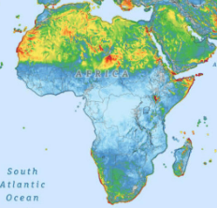

Renewable sources
In rural villages, access to conventional energy grids is often limited, leading to a reliance on locally available renewable energy sources. These sources not only offer a sustainable supply of energy but also play a crucial role in the social and economic development of these communities. Here are the typical renewable sources:
Solar Energy
Abundant and widely available, solar panels capture sunlight, making it a popular choice for electrification in remote locations
Wind Energy
In areas with favourable wind conditions, small wind turbines can provide supplementary power, especially effective in higher altitude villages or coastal regions
Micro-Hydro Power
Villages near streams or rivers can harness water flow to generate electricity, providing a consistent and reliable power source
Solar and Wind Atlas of Africa
Sources for images: Global Solar Atlas and Global Wind Atlas
Notes:
In rural villages, access to conventional energy grids is often limited, leading to reliance on locally available renewable energy sources. These sources provide a sustainable supply of energy and support the social and economic development of these communities.
Solar Energy: Abundant and widely available, solar panels capture sunlight, making them a popular choice for electrification in remote locations.
Wind Energy: In areas with favorable wind conditions, small wind turbines provide supplementary power, especially effective in higher altitude villages or coastal regions.
Micro-Hydro Power: Villages near streams or rivers can harness water flow to generate electricity, providing a consistent and reliable power source.

Slide 6
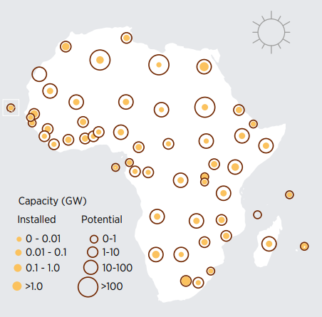
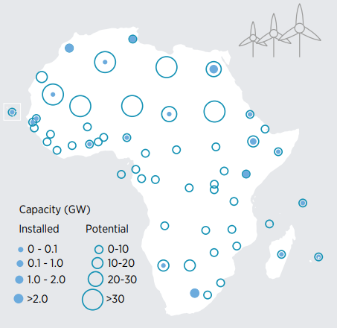
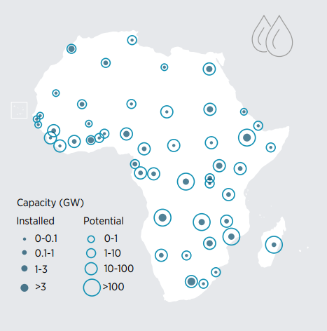
Renewables Potential in Africa
Africa holds an immense and diverse potential for renewable energy development. The illustrated data captures the continent's current installations and expansive future potential in solar, wind, and hydroelectric power. These figures, represented in varying capacities from less than 0.01 GW to greater than 100 GW, provide a clear indication of the vast opportunities for harnessing sustainable energy resources across different African regions
Solar
Wind
Hydro
Solar, Wind and Hydro potential with installed capacity, Africa. Source: [1]
Notes:
Africa holds immense and diverse potential for renewable energy development. This slide illustrates the continent's current installations and expansive future potential in solar, wind, and hydroelectric power. The data captures varying capacities, from less than 0.01 GW to over 100 GW. Solar energy potential is highest in Northern and Southern Africa, wind energy is particularly promising in coastal and high-altitude regions, while hydroelectric power has significant potential in Central and East Africa. These figures highlight the vast opportunities for harnessing sustainable energy resources across different African regions.

Slide 7
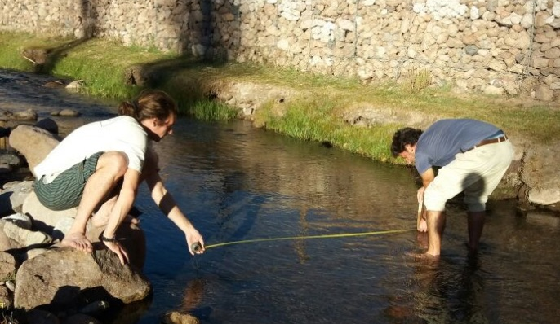
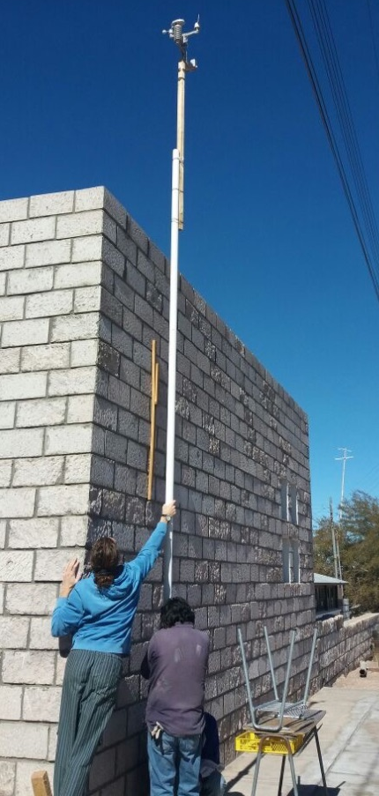
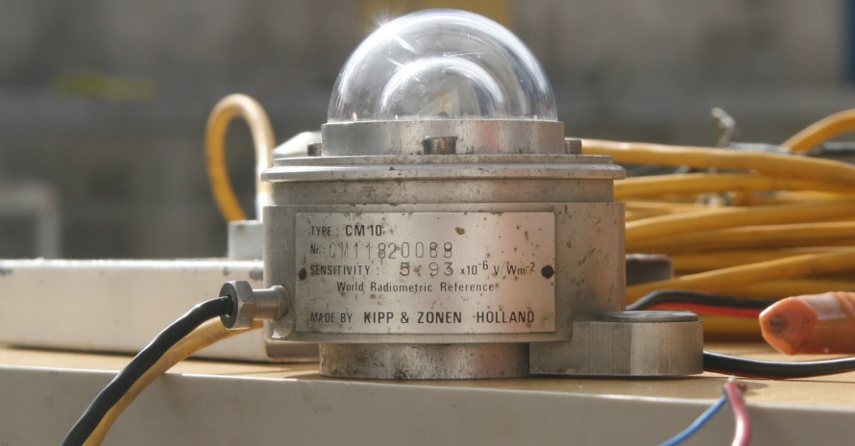
Locally Available Resource
Assessment
On-field resource assessment stands as a primary option for evaluating the potential of renewable energy sources in mini-grid development. By conducting direct on-field measurements and collecting historical climate data, it is possible to accurately predict energy yields and design a system that aligns with the local environment.
Resource Identification
Catalog local renewable energy sources, including solar irradiation, wind patterns, water flow rates for micro-hydro, geothermal heat sources, and biomass.
Data Collection
Gather historical climate data, topographical maps
Direct on-field measurements (e.g. solar radiometers, wind anemometers etc.)
Community Engagement
Collaborate with local populations to understand resource management practices and socio-economic factors.
On-Field pictures of data collection
Notes:
How to collect data about resources availability? On-field resource assessment is, of course, a primary option for evaluating renewable energy potential in mini-grid development. By conducting direct on-field measurements and collecting historical climate data, we can accurately predict energy yields and design systems that align with the local environment.
Resource Identification: Catalog local renewable energy sources, including solar irradiation, wind patterns, water flow rates for micro-hydro, geothermal heat sources, and biomass.
Data Collection: Gather historical climate data, topographical maps, and perform direct on-field measurements such as using solar radiometers and wind anemometers.
Community Engagement: Collaborate with local populations to understand resource management practices and socio-economic factors.

Slide 8
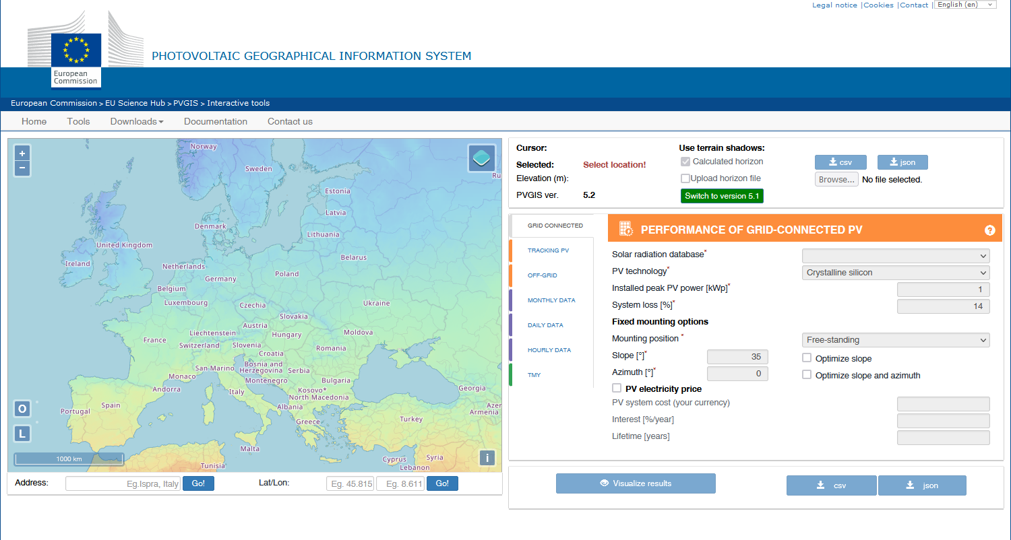
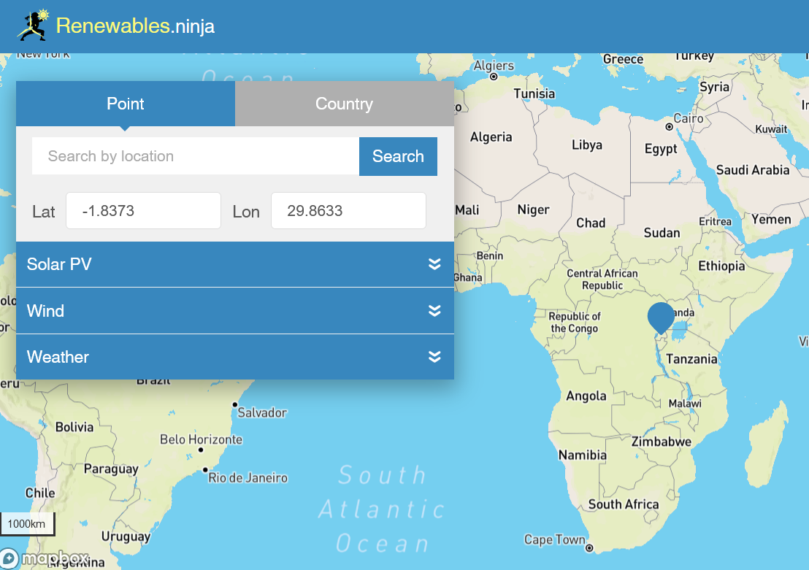
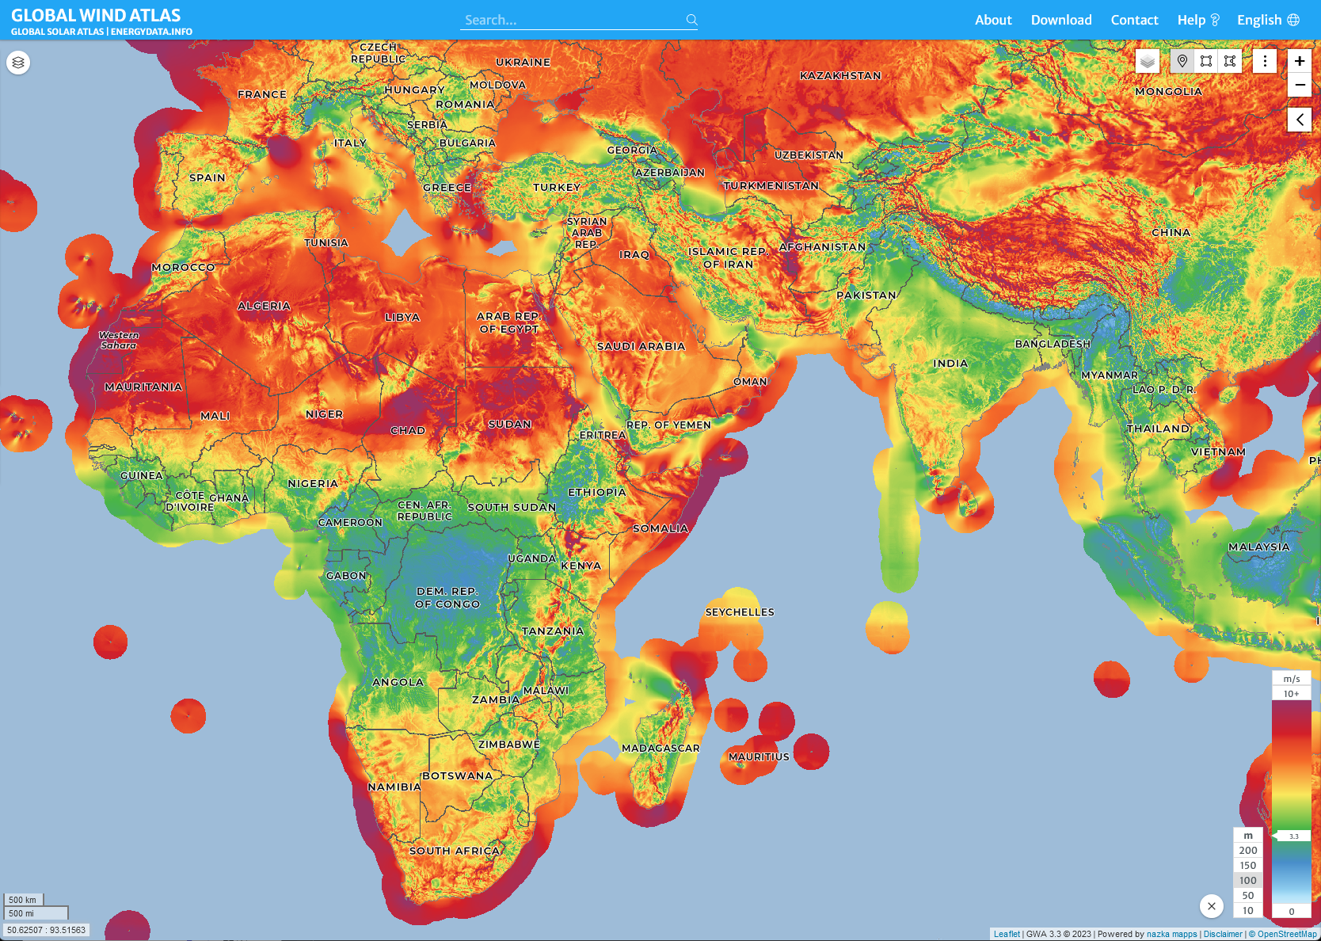
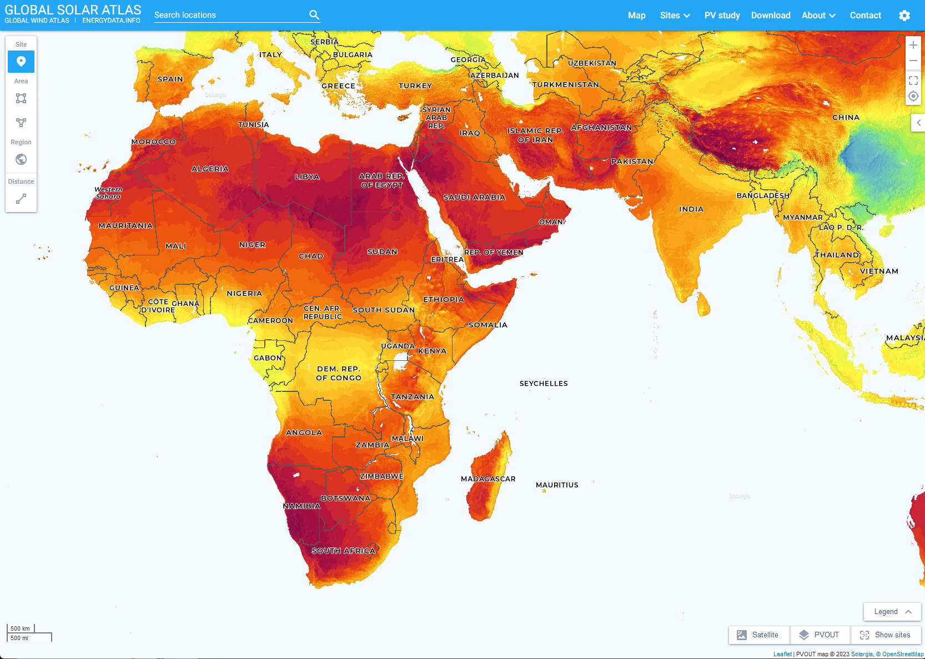
Online Renewables Databases
When direct on-site resource measurement is not feasible, online databases like Renewables.ninja, PVGIS, Solar and Wind Atlases provide alternative solutions. These digital platforms offer detailed renewable energy potential assessments, reducing costs and overcoming the barriers of physical site surveys. They enable accurate, remote analysis for mini-grid planning, leveraging high-quality data and advanced modelling to inform sustainable energy projects.
Sources for images: Global Solar Atlas , Global Wind Atlas , Renewables.ninja and PVGIS websites
Notes:
However, local on-field data campaigns are often very expensive. When direct on-site resource measurement is not feasible, online databases like Renewables.ninja, PVGIS, and Solar and Wind Atlases provide alternative solutions. These digital platforms offer detailed renewable energy potential assessments, reducing costs and overcoming the barriers of physical site surveys. They enable accurate, remote analysis for mini-grid planning, leveraging high-quality data and advanced modeling to inform sustainable energy projects.

Slide 9
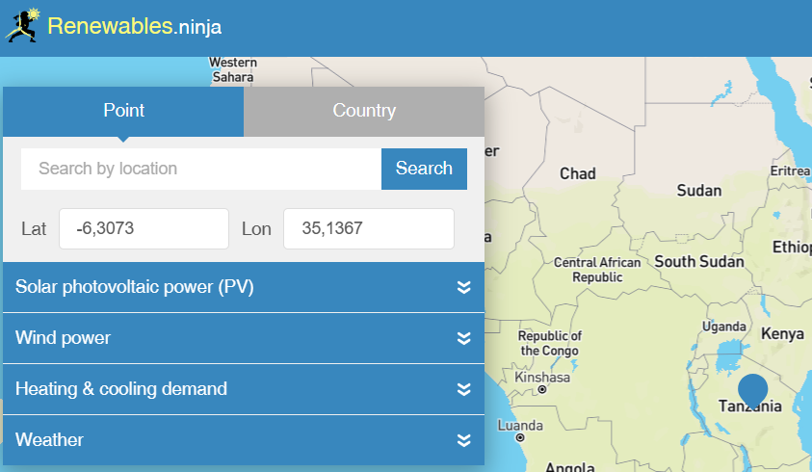
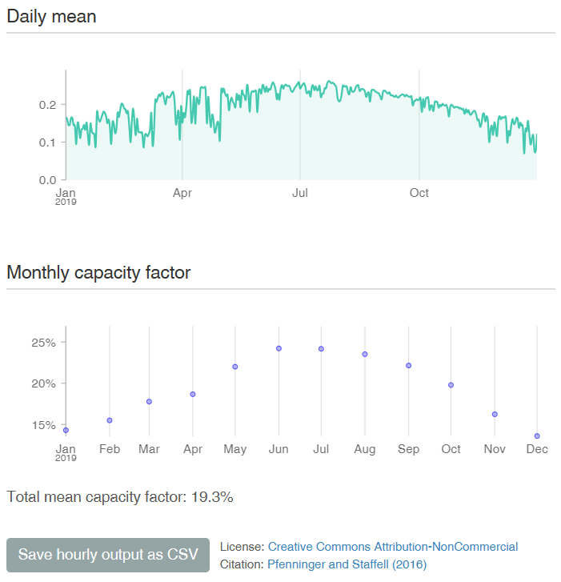
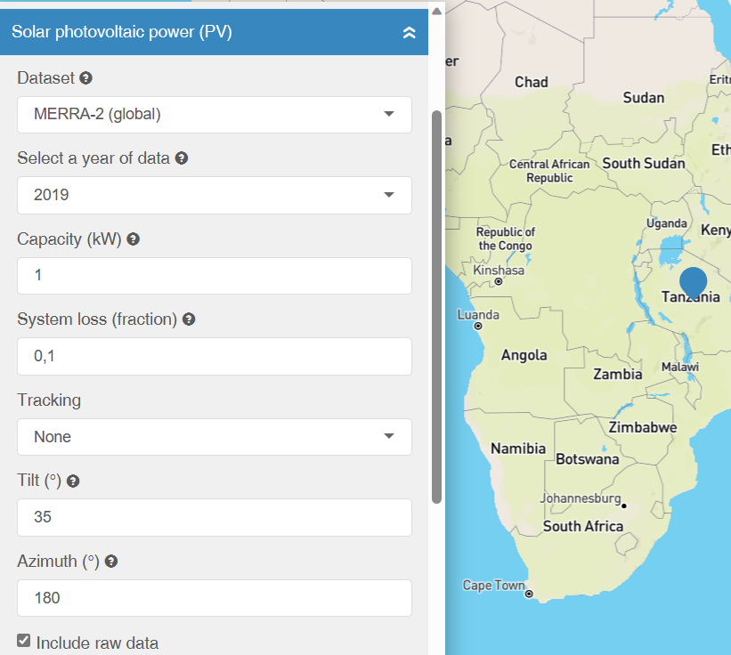
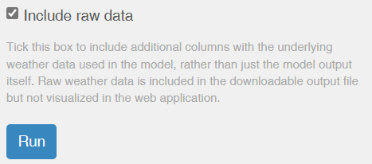
Online Renewables Databases
Renewables.ninja is an online platform designed to model and simulate power generation of photovoltaic (PV) solar panels and wind turbines at different locations around the world.
The outputs displayed show the variation in solar energy production over the year and the monthly capacity factor indicating the efficiency of the solar PV system, with an overall average provided.
Location
PV panel parameters
Press to simulate the expected energy output of the PV system based on historical weather and solar irradiation data specific to the chosen location.
Sources for images: Renewables.ninja website
7
Notes:
Renewables.ninja is an online platform designed to model and simulate the power generation of photovoltaic (PV) solar panels and wind turbines at different locations worldwide. To use this tool, start by selecting your location on the map.
Next, input the PV panel parameters, including the dataset, year of data, system loss percentage, and tracking type. You can choose to include raw data if needed.
Press the "Run" button to simulate the expected energy output of the PV system. The output displays the variation in solar energy production over the year and the monthly capacity factor, indicating the system's efficiency. Historical weather and solar irradiation data specific to the chosen location are used for this simulation. You can save the hourly output as a CSV file for further analysis.

Slide 10
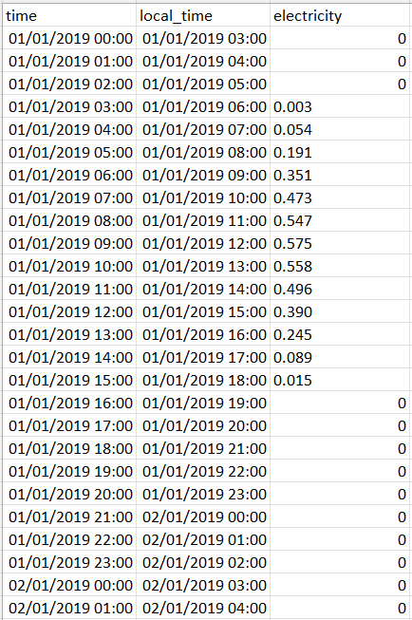
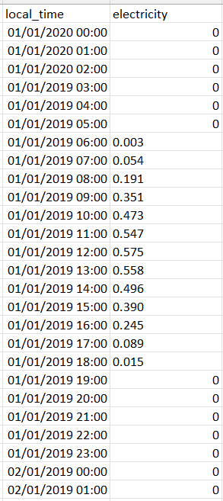
Online Renewables Databases
The results are provided in a CSV file showing the hourly electricity output in local time. For compatibility with MicroGridsPy, which operates on UTC time, an adjustment or shift of these values may be required to align with the universal time standard.
Press to download the hourly output of the PV panel in a comma-separated values (CSV) file. If raw data included, the csv file would provide time, local time, electricity, irradiance and temperature data
Sources for images: Renewables.ninja website
Input data for MicroGridsPy
Notes:
The results from Renewables.ninja are provided in a CSV file showing the hourly electricity output in local time. For compatibility with MicroGridsPy, which operates on UTC time, an adjustment or shift of these values may be required to align with the universal time standard.
Press the "Save hourly output as CSV" button to download the data. The CSV file includes columns for time, local time, and electricity output. If raw data is included, additional columns for irradiance and temperature will also be available. This detailed data enables accurate input for energy simulations and analysis within MicroGridsPy.

Slide 11

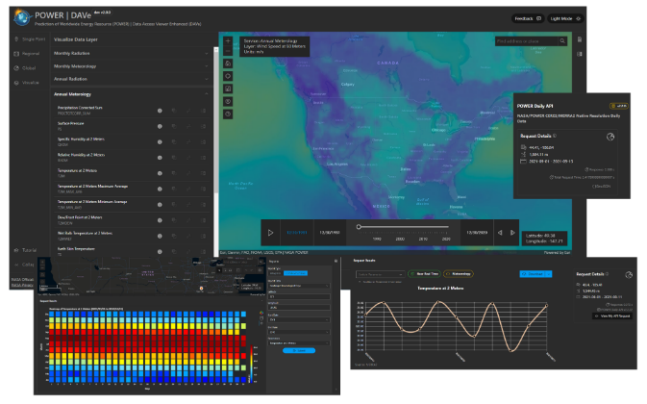
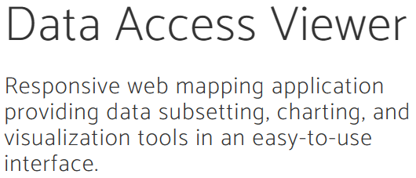
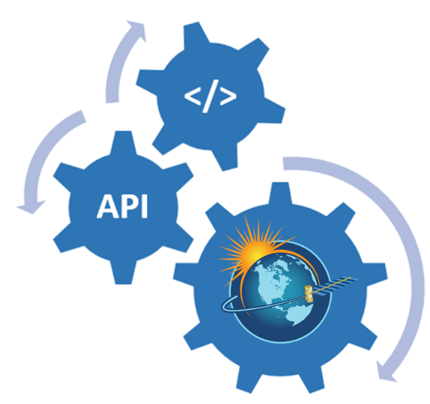
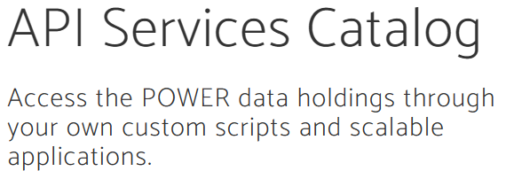

The NASA Power Project
The NASA POWER project (Prediction Of Worldwide Energy Resources) offers a comprehensive collection of solar and meteorological data beneficial for renewable energy, building efficiency, and agriculture. It provides easy access to data from Earth observation satellites and models, supporting a wide range of applications with up-to-date and historical data.
Built-In Feature in MicroGridsPy:
Endogenous Solar and Wind time series data estimation with the NASA Power Project API
Sources for images: The NASA POWER project website
Notes:
Another way of accessing renewable energy data is through the NASA POWER project, which MicroGridsPy supports via its API for automatic data download and processing. The NASA POWER project (Prediction Of Worldwide Energy Resources) offers a comprehensive collection of solar and meteorological data, essential for renewable energy applications. It provides access to data from Earth observation satellites and models, with both up-to-date and historical information. The platform includes a Data Access Viewer for easy data visualization and an API Services Catalog for accessing data through custom scripts. This integration in MicroGridsPy enables precise solar and wind time series data estimation, facilitating efficient resource assessment and planning.

Slide 12
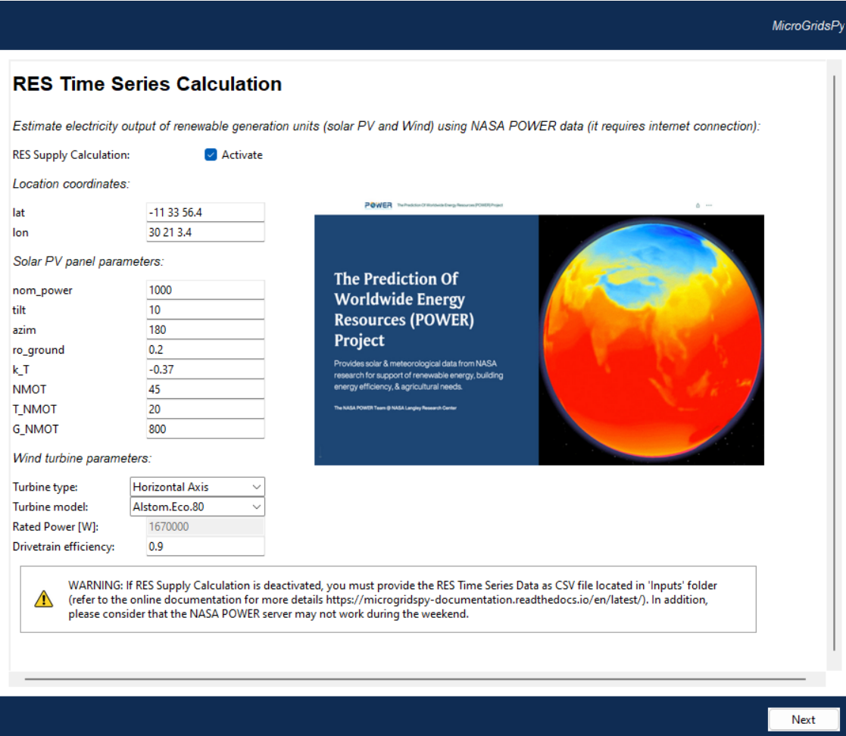



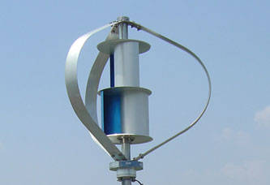

Endogenous RES Time Series
Estimation
Location Coordinates
Input latitude and longitude in DMS system (degrees, minutes and seconds)
Solar PV parameters
Specifications for solar panel module, including nominal power, tilt angle, azimuth, and efficiency-related coefficients to calculate solar generation potential accurately
Wind turbine parameters
Select the turbine type and model, see the associated rated power and input drivetrain efficiency to estimate wind energy generation
Models available:
Horizontal Axis: Alstom.Eco.80 and NPS100c-21
Vertical Axis: Hi-VAWT.DS1500 and Hi-VAWT.DS700
Internet Connection required
Code/Inputs/WT_Power_Curve.csv
Notes:
Within the MicroGridsPy user interface, there is a specific section dedicated to endogenous renewable energy source (RES) time series estimation, utilizing the NASA POWER data. This section allows users to accurately estimate the electricity output of renewable generation units, including solar PV and wind turbines, based on specific location coordinates and system parameters.
To start, input the latitude and longitude in the DMS system (degrees, minutes, and seconds). For solar PV parameters, specify details such as nominal power, tilt angle, azimuth, and efficiency-related coefficients to calculate the solar generation potential accurately. For wind turbine parameters, select the turbine type and model, and input the drivetrain efficiency to estimate wind energy generation. Available models include both horizontal axis (e.g., Alstom.Eco.80 and NPS100c-21) and vertical axis (e.g., Hi-VAWT.DS1500 and Hi-VAWT.DS700) turbines.

Slide 13

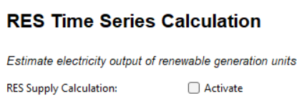
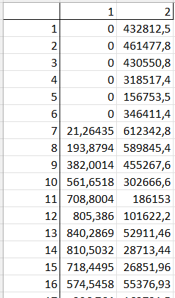

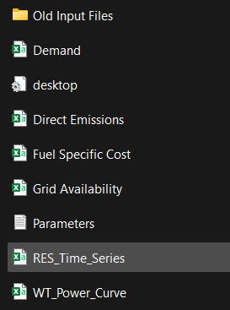

Exogenous RES Time Series
Numbered columns equal to the number of renewables
1 2 …
1
2
3
4
5
6
7
8
9
10
11
12
13
….
Hourly electricity output in W for each renewable sources unit
Hours in a year
Code/Inputs/RES_Time_Series.csv
Notes:
In addition, there is a section dedicated to exogenous RES time series estimation. This allows users to upload their own renewable energy data if they prefer to use custom datasets.
To enable this, navigate to the "RES Time Series" section and activate the RES supply calculation. Users can upload a CSV file containing the hourly electricity output for each renewable energy unit. The file should have columns corresponding to each renewable source and rows representing each hour of the year.
This flexibility allows for precise customization of input data, ensuring that the simulation closely matches the specific conditions and resources of the project site.

Slide 14
References
[1] IRENA, Renewable Energy Market Analysis: Africa and its Regions, 2022

