Slide 1

LESSON 4:
TariffS and financial viability of microgrids
BUSINESS AND SOCIO-ECONOMIC CONTEXTS OF MINI-GRID DEVELOPMENT

Slide 2
Lesson 4 Outline
This lesson will cover the following topics:
Electrification and socio-economic sustainability
Tariff structure in microgrids
The demand curve: effect of price
The demand curve: the revenue
The supply curve: costs of the microgrid
Profit to the developer vs a balance between profitability and socio-economic safeguards of the community

Slide 3
Lesson 4 Learning Outcomes
At the end of this lesson, the participant should be able to:
Understand the basic relationship between tariff and demand
Understand a methodology for setting tariffs with a balance between profitability and socio-economic safeguards of the community

Slide 4

Electrification and socio-economic sustainability
Mini-Grid Developers encounter the following tradeoff:
The higher the number of consumers,
the higher the (potential) revenue
The higher the number of consumers,
the higher the costs
To ensure financial sustainability, revenue must exceeds costs.
Therefore a balance between the demand to meet and generation costs is required

Slide 5
Profit to the developer (and operator)
Assuming an entity develops and operates a microgrid, its profit consists of
Goal of the operator: maximize Profits
To increase profits, a balance between revenues and costs is required, as later described
Profit = Revenue - Cost

Slide 6
Electrification and socio-economic sustainability
In the following, we give insights on how to strike a balance between:
Revenue to the microgrid, which relates to demand and the tariff structure
Costs of the microgrid, which relate to the technical design or supply

Slide 7

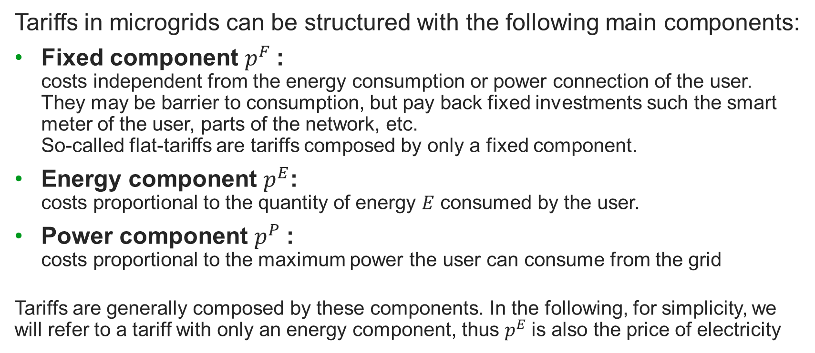
Tariff structure in microgrids
Tariffs in microgrids can be structured with the following main components:
Fixed component $p^{F}$:
costs independent from the energy consumption or power connection of the user.
They may be barrier to consumption, but pay back fixed investments such the smart meter of the user, parts of the network, etc.
So-called flat-tariffs are tariffs composed by only a fixed component.
Energy component $p^{E}$:
costs proportional to the quantity of energy $E$ consumed by the user.
Power component $p^{P}$:
costs proportional to the maximum power the user can consume from the grid
Tariffs are generally composed by these components. In the following, for simplicity, we will refer to a tariff with only an energy component, thus $p^{E}$is also the price of electricity
$$Tariff≈p^{F}+p^{E}E+p^{P}P$$

Slide 8


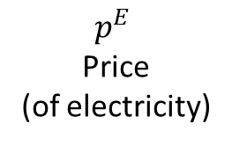



The demand curve: effect of price
Consumption of a good, including electricity, depends on price
The higher the price, the lower the demand,
all else being equal*
When additional conditions change
(e.g. salaries, prices of alternative goods, etc),
the curve is not the same
Generally, the higher the electricity tariff, the lower the energy demand
$$p^{E}$$
Price
(of electricity)
Demand curve*
$$π^{N}$$
N
$$π^{O}$$
O
$$q^{N}$$
$$q^{O}$$
$q$ quantity consumed
$π^{O}$ is lower than $π^{N}$, its demand $q^{O}$ is higher than $q^{N}$
*all else being equal, including salaries

Slide 9

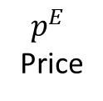
The demand curve: effect of price
$$p^{E}$$
Price
People in rural areas are subject to high price per unit of service for lighting or mobile charging
High-price activity are of high social relevance
e.g. lighting and mobile
Lower prices are aligned to higher consumption of the basic appliances and/or productive uses
Lighting
Productive uses
$q$ quantity
Mobile charging
Mini-grid policy toolkit, Ren21 - https://www.ren21.net/2014-mini-grid-policy-toolkit/

Slide 10



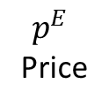


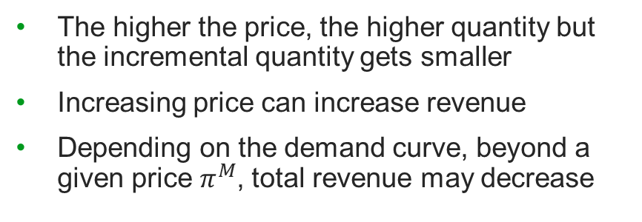


The demand curve: the revenue
Revenue = quantity x price
M
$$R^{O}=q^{O}π^{O}$$
The higher the price, the higher quantity but the incremental quantity gets smaller
Increasing price can increase revenue
Depending on the demand curve, beyond a given price $π^{M}$, total revenue may decrease
$$p^{E}$$
Price
$$R^{N}=q^{N}π^{N}$$
Revenue
$$π^{N}$$
N
M
$$π^{O}$$
O
Demand curve
$$q^{N}$$
$$q^{O}$$
$q$ quantity consumed
Note: the orange box corresponds to the value of $R^{N}$: it is a rectangle with sides $π^{N}$ and $q^{N}$, hence with area $π^{N}$ $q^{N}$

Slide 11
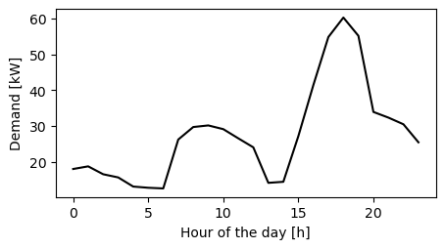
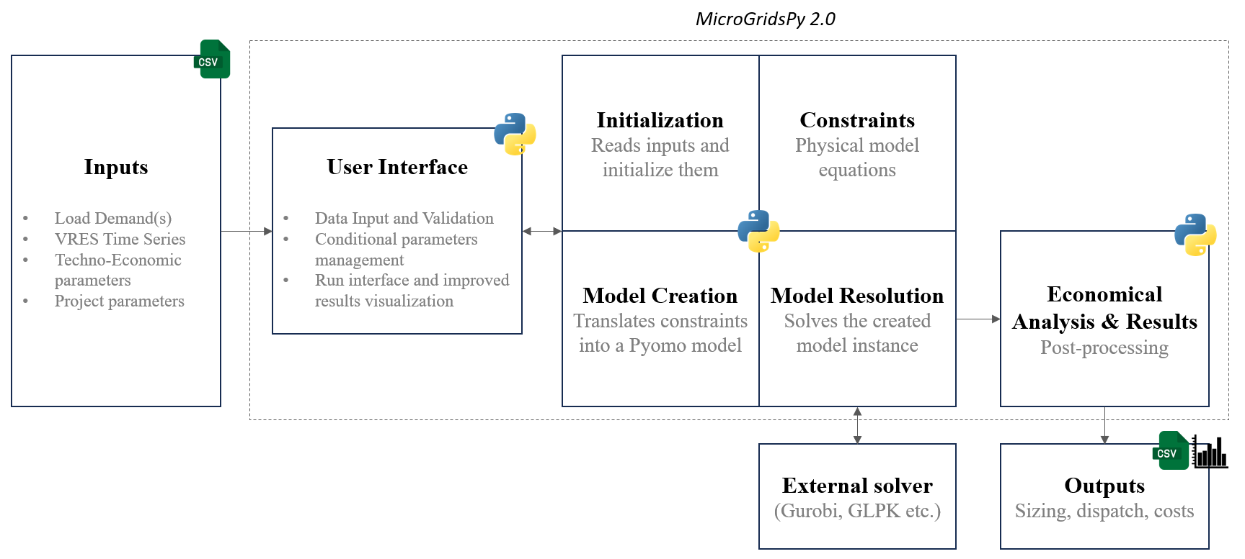
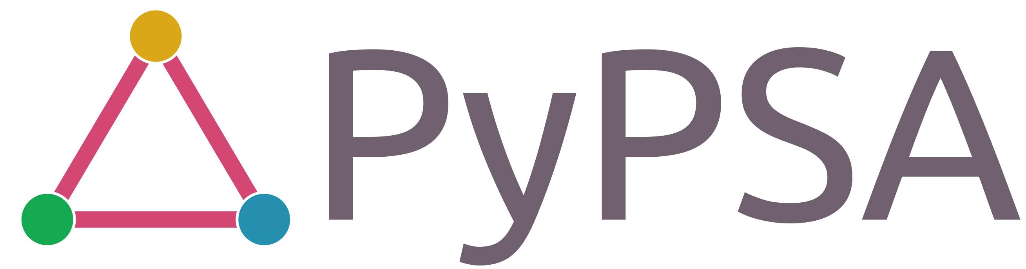



The supply curve: costs of the microgrid
To estimate the costs for every point of the demand, it is possible to use an Energy System Modelling tool
To do so, there is the need to estimate the demand profile for every point of the curve, which is fed into the tool
Demand curve
Estimate profile
Estimate techno-economic design
$$p^{E}$$
Price
Energy System Modelling
Results:
costs
MicrogridsPy
$q$ quantity

Slide 12
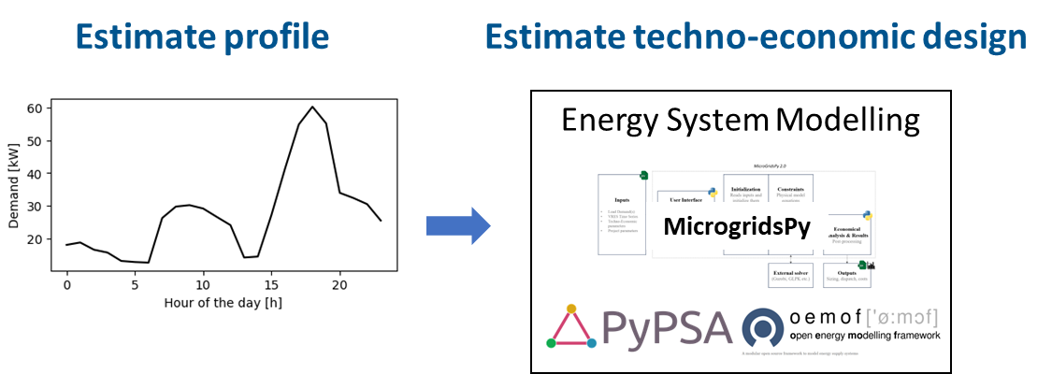




The supply curve: costs of the microgrid
To calculate the cost of the curve, we iterate the process of techno-economic estimation through the demand curve
Demand curve
Cost curve
$$p^{E}$$
Price
$$€$$
$q$ quantity
$q$ quantity
Each colored point in the left hand side corresponds to the point on the right hand side

Slide 13


Profit to the operator
Profit = Revenue - Cost
Profitability, if exists,
lays within a given window (A-C in the example)
A profitability maximum (B) may exists
The goal for the operator is to fall into the profitability range
Note that this is in the interest of users as well, as otherwise the project fails and the developer can no longer serve the users
$$€$$
Cost curve
Revenue curve
B
A
C
$q$ quantity
Profitability

Slide 14
Profit to the developer: Can price be freely chosen?
Electricity price is highly sensitive, socially and politically responsive
Regulations affect the price setting
The following options apply:
  Price is set by law: in this case, the developer has limited freedom to adjust the price, sometimes limited to connection tariffs or alike
  Price can be negotiated: depending on the size of the microgrid, the developer has freedom to propose and negotiate a tariff

Slide 15







Profit to the developer: no tariff negotiation
With no regulation, profitability depends on the tariff proposed by the authority
If tariff is too low (E) and all users are fed, demand is too large and profitability can compromised. As a result, either a subset of users is electrified or the company is not going to invest in the project
If tariff is in the profitability range (D), the company may invest
However, it is complex to setup a tariff profitable throughout a large country, geographies and social composition
Profitability curve
$$€$$
Cost curve
D
Revenue curve
Demand cuve
E
$$p^{E}$$
Price
B
D
A
$$q^{D}$$
C
$$q^{E}$$
$$q$$
E
$$q^{D}$$
$q$ quantity
$$q^{E}$$
Profitability

Slide 16
Profit to the developer: tariff negotiation
With negotiation, the developer has the opportunity to propose the price that maximizes its profit
However, that reduces the potential users and the productive uses they may perform
Appropriate negotiation with the authority and/or regulation rules can strike a balance between profitability and socio-economic safeguards of the community
Profitability curve
$$€$$
Cost curve
Revenue curve
Demand cuve
$$p^{E}$$
Price
B
B
A
C
$$q$$
$q$ quantity
Profitability

