Slide 1

ENTREPRENEURSHIP IN THE OFF-GRID SOLAR ENERGY SECTOR
Lesson 2 : Market Analysis and Opportunity Identification in the
Off-Grid Solar Sector
Author: A. Dib

Slide 2
Lesson 2 Learning Outcomes :
After completing this lesson, you will be able to:
Understand the dynamics of the Off-Grid Solar Market in Africa
Identify emerging trends and technological advancements that could impact the off-grid solar market
Identify and Evaluate Business Opportunities

Slide 3
Off-Grid Solar Systems - Stand-alone power systems (SAPS)
Stand-alone power systems (SAPS) – work by generating electricity from solar panels and using it to charge a solar battery via a charger controller. That electricity is then converted using an inverter so that it can power your home or business appliances.
By storing the electricity in a solar battery, it is possible to run your home exclusively from solar energy, even at night or during times when there is less than optimal sun exposure.
Notes:
Ref. : https://greenmagazine.com.au/information/solar-calculator/a-guide-to-off-grid-solar/

Slide 4

Off-Grid Technology Basics: Solar Panels
Currently, the most cost-effective solar panels are those made up of 60, 72, 120, 132, or 144 cells. Solar cells are the small squares that make up the entirety of the panel itself.
A solar cell or photovoltaic cell (PV cell) is an electronic device that converts the energy of light directly into electricity by means of the photovoltaic effect. It is a form of photoelectric cell, a device whose electrical characteristics (such as current, voltage, or resistance) vary when it is exposed to light.
These days, monocrystalline panels are the industry standard in most systems. Determining the size of the solar array is one of the most significant calculations in Off-Grid system design.
Notes:
Ref. : https://iopscience.iop.org/article/10.1088/1742-6596/1378/2/022031/pdf
Pic : https://commons.wikimedia.org/wiki/File:Solar_panel_color_icon.png

Slide 5
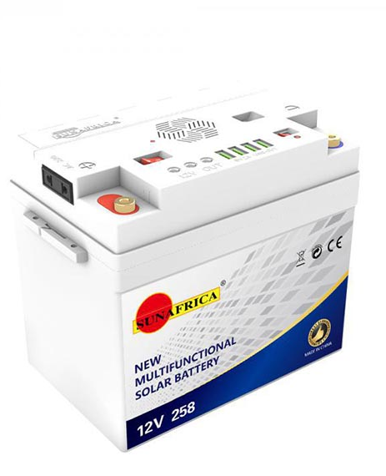
Off-Grid Technology Basics: Batteries
A battery will be necessary, to allow the appliances to continue to run after the sun goes down. Throughout the day, the solar storage device will charge as your panels generate excess electricity. Rather than simply losing out on all of that available solar power, a battery enables keeping it for use at a later time. Depending on the energy needs, a single battery can be needed, or even a battery bank.
Batteries are the most expensive component. In the solar power industry.
There are two common battery chemistries – lead acid and lithium.
Notes:
Ref. : https://iopscience.iop.org/article/10.1088/1742-6596/1378/2/022031/pdf
Pic : https://www.alabastore.com/product/sun-africa-12v258-solar-battery-system/

Slide 6
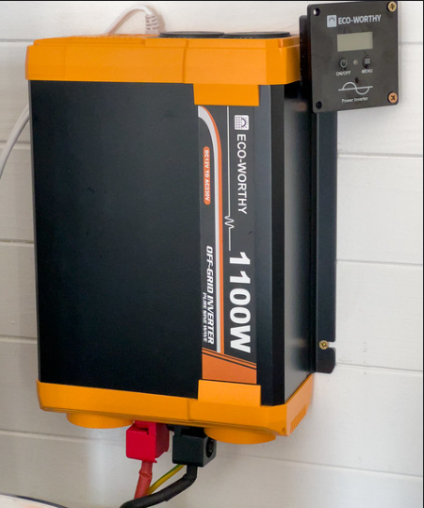
Off-Grid Technology Basics: Inverter
The next component in an off-grid solar system design would be an inverter.
In off-grid solar systems, the inverter is a crucial component, typically a battery-based inverter, responsible for converting DC power stored in the battery bank into usable AC power for household appliances. Inverters come in various sizes to accommodate different load requirements, ranging from smaller to larger loads.
It is essential to size the inverter according to the total sum of all loads in the off-grid system to ensure it can handle simultaneous usage.
Hybrid inverters are popular for their simplicity and ease of installation, making them ideal for applications where an integrated solution is preferred.
Notes:
Ref. : https://www.solar-electric.com/learning-center/what-components-typically-used-off-grid-solar-power-system/#:~:text=For%20most%20DC%2Dcoupled%20off,inverter%20and%20the%20battery%20bank.
Pic : https://www.flickr.com/photos/andydavy/53427356157/

Slide 7
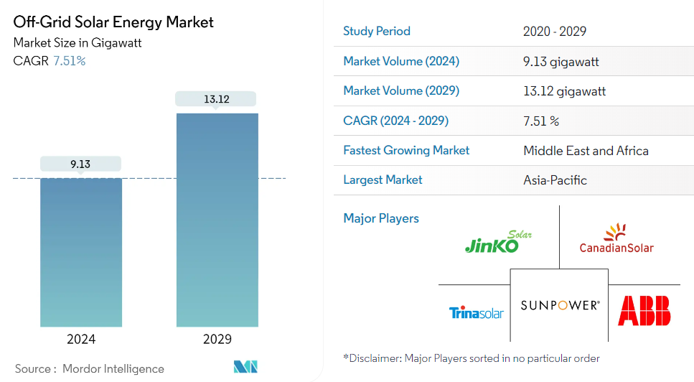
Off-Grid Solar Market Landscape
The Off-Grid Solar Energy Market size is estimated at 9.13 gigawatt in 2024, and is expected to reach 13.12 gigawatt by 2029, growing at a compound annual growth rate of 7.51% during the forecast period
(2024-2029).
COVID-19 negatively impacted the market in 2020. Presently the market is likely to reach pre-pandemic levels.
Notes:
Ref. : Source: https://www.mordorintelligence.com/industry-reports/off-grid-solar-energy-market/market-size

Slide 8
Off-Grid Solar Energy Market Analysis
Over the long term, factors like decreasing the price of solar panels and batteries are expected to drive the market. On the other hand, high installation costs and poor maintenance practices hinder the market's growth.
Nevertheless, nations like the United States, the United Kingdom, Germany, China, India, and others have set up ambitious targets to increase the renewable share in their energy mix.
Governments across these nations have also planned to increase the renewable energy share by deploying residential and off-grid solar PV systems in the coming years. These are expected to create enormous opportunities for the off-grid solar energy market.
Notes:
Ref. : Source: https://www.mordorintelligence.com/industry-reports/off-grid-solar-energy-market/market-size

Slide 9
Off-Grid Solar Market Analysis
Middle-East and Africa region is expected to dominate the market growth primarily due to the increasing demand for electricity due to the lack of a central grid and reliable electricity supply, mainly in the African region.
Notes:
Ref. : Source: https://www.mordorintelligence.com/industry-reports/off-grid-solar-energy-market/market-size

Slide 10
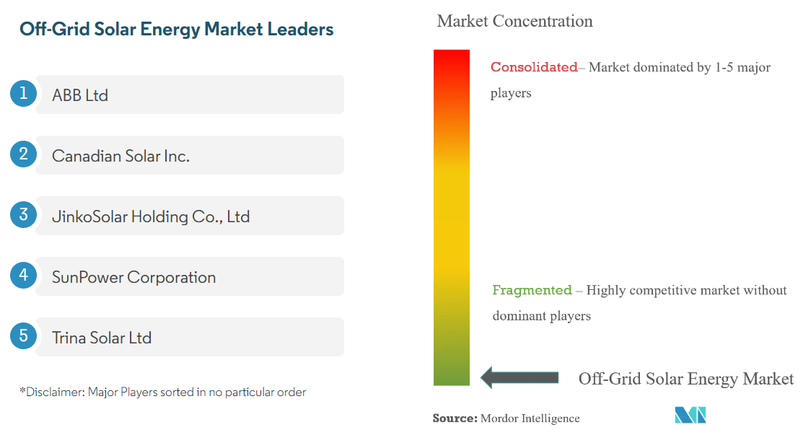
Market Share of Off-Grid Solar Energy Industry
The Off-Grid solar energy market is very fragmented.
Notes:
Ref. : Source: https://www.mordorintelligence.com/industry-reports/off-grid-solar-energy-market/market-size

Slide 11
Market Trends of Off-Grid Solar Energy Industry
Residential Segment Expected to Dominate the Market
The off-grid solar system has been gaining popularity in recent years for the residential sector as it is self-sustaining. Although installing off-grid systems and associated parts is relatively expensive, the consumer becomes more self-reliant and is unaffected by power shortages due to grid failures and shutdowns.
As of 2021, the global off-grid installed capacity was at 5.51 GW compared to 5.13 GW in 2020, registering a growth rate of almost 7.5%.
Notes:
Ref. : Source: https://www.mordorintelligence.com/industry-reports/off-grid-solar-energy-market/market-size

Slide 12
Market Trends of Off-Grid Solar Energy Industry
Residential Segment Expected to Dominate the Market
Moreover, the off-grid system provides power solutions to remote areas where grid connectivity is a major restraint in the region's electrification. Mainly end-users from residential sectors are present in those areas. Off-grid solar systems can facilitate independent and sustainable electricity generation.
The demand for off-grid solar systems is expected to increase on account of decreasing solar PV costs, supportive government policies for residential solar PV, FIT programs and incentives, and targets set by various governments for solar energy.
Notes:
Ref. : Source: https://www.mordorintelligence.com/industry-reports/off-grid-solar-energy-market/market-size

Slide 13
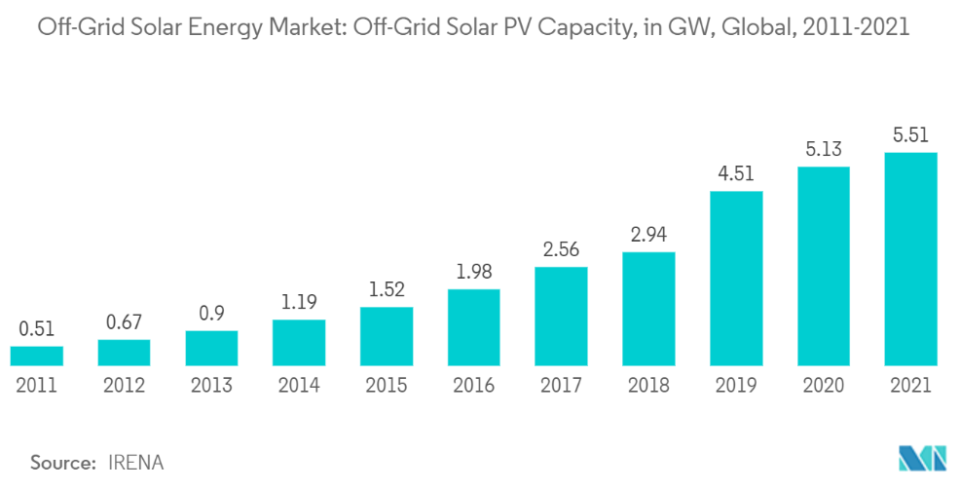
Off-Grid Solar Market Landscape
The cost reductions are driven by continuous technological improvements, including higher solar PV module efficiencies. The industrialization of these highly modular technologies has yielded impressive benefits, from economies of scale and greater competition to improved manufacturing processes and competitive supply chains.
Residential Segment Expected to Dominate the Market
Notes:
Ref. : Source: https://www.mordorintelligence.com/industry-reports/off-grid-solar-energy-market/market-size

Slide 14
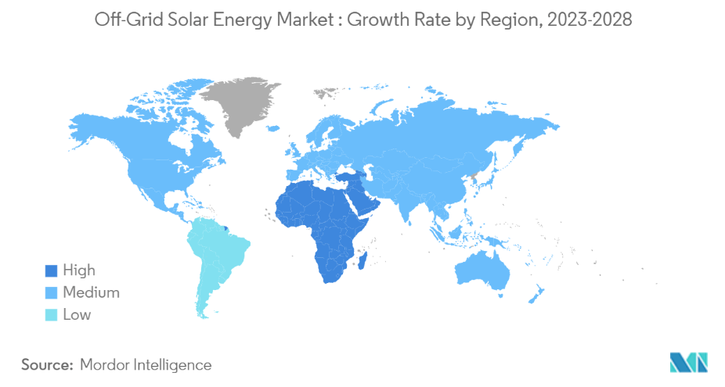
Market Trends of Off-Grid Solar Energy Industry
Between 2012 and 2021, the off-grid solar sector has raised $2.3 billion in capital through debt, equity and grants. From 2016 to 2020, the industry saw yearly investment volumes plateauing between $300 million and $350 million, before reaching $457 million in 2021.
In 2022, the largest share of funding was to East Africa (49%), as larger, scale-up companies are attracting debt in their most established markets. Companies that are in their seed or start-up phases have attracted significantly less capital.
Notes:
Ref. : Source: https://www.mordorintelligence.com/industry-reports/off-grid-solar-energy-market/market-size

Slide 15
Market Trends of Off-Grid Solar Energy Industry
Middle-East and Africa Expected to Dominate the Market Growth
The demand for off-grid solar systems is expected to witness significant growth in the Middle East and Africa, mainly because these countries primarily generate electricity from fossil fuels. These fossil fuels generate carbon emissions that pollute the environment.
The increasing pressure of reducing carbon emissions and the high solar energy potential in most of the countries in these regions is expected to make way for the off-grid solar energy system. The unreliable power distribution system in many countries has increased the demand for off-grid solar systems.
Notes:
Ref. : Source: https://www.mordorintelligence.com/industry-reports/off-grid-solar-energy-market/market-size

Slide 16
Market Trends of Off-Grid Solar Energy Industry
Middle-East and Africa Expected to Dominate the Market Growth
Historically, the region has relied on diesel generators for electricity supply. Still, recently there has been a significant shift towards solar energy mainly due to declining prices of solar panels and solar inverters in recent years. According to the World Bank, an estimated 600 million Africans have no access to electricity. Given the high cost of extending transmission lines into remote areas, off-grid solar has witnessed a significant rise in the region.
In September 2022, German sustainability energy service provider, Kowry Energy, announced the successful commissioning of decentralized solar systems in three countries of West Africa. Kowry Energy has designed and commissioned four off-grid solar energy systems in Senegal, Nigeria, and Mali. The recently installed projects are the first of several forming portfolios in these countries that will be completed within three years.
Notes:
Ref. : Source: https://www.mordorintelligence.com/industry-reports/off-grid-solar-energy-market/market-size

Slide 17
Insights from the Affiliate Off-Grid Solar Market
East Africa
East Africa, particularly Kenya, has been central to key developments for the off-grid solar industry, including PAYGo solutions and modern SHS. Since 2018, East Africa has been the largest market by volume for affiliates, ahead of South Asia. With proportionally higher PAYGo and Solar Home Systes SHS sales, East Africa represents an important market in terms of total value.
While the OGS industry in the region returned to growth in 2021, this growth has been fragile and unevenly distributed. In Kenya, sales were stable in 2020 compared to 2019, but reported sales are lower in 2021 as companies weather the protracted effects of the COVID-19 pandemic
Notes:
Ref. : Off-Grid Solar Market Trends Report 2022: State of the Sector

Slide 18
Market Trends of Off-Grid Solar Energy Industry
East Africa
In Ethiopia, COVID-19, conflict and unresolved foreign exchange restrictions have led sales to decline continuously since the end of 2019. On the other hand, younger markets such as Malawi, Mozambique and Madagascar are seeing strong growth in sales of off-grid lighting products. In the case of Mozambique and Madagascar, support from intervention programs has been a key driver.
Growth in East Africa in 2021 was largely driven by lanterns and multi-light systems, notably through increased sales of PAYGo solar lanterns. PAYGo sales in East Africa recorded their highest level yet with 1.87 million units sold in 2021.
Notes:
Ref. : Off-Grid Solar Market Trends Report 2022: State of the Sector

Slide 19
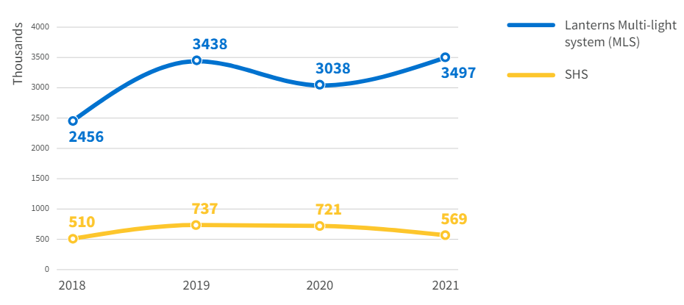
Market Trends of Off-Grid Solar Energy Industry
East Africa
However, SHS sales have yet to return to growth and recorded substantially lower sales in 2021 than in 2020.
Affiliates sales volumes of solar energy kits in East Africa (2018-2021)
Notes:
Ref. : Off-Grid Solar Market Trends Report 2022: State of the Sector

Slide 20
Market Trends of Off-Grid Solar Energy Industry
West Africa
West Africa, especially Nigeria, has become a new growth driver for the industry since 2019, particularly in sales of SHS. Prior to 2019, West Africa was still perceived as a relatively new market for off-grid solar, with companies operating in East Africa progressively exploring market entry. Since 2018, affiliate sales, both cash and PAYGo, have shown strong growth in West Africa with cash sales growing 31% and PAYGo recording a staggering 178% growth.
Lanterns and multi-light systems sales, which declined between 2016 and 2018, have rebounded above their 2016 level, while SHS sales were multiplied by 1.87 between 2018 and 2021 Overall, when compared to East Africa, SHS represent a much larger share of affiliate sales in West Africa.
Notes:
Ref. : Off-Grid Solar Market Trends Report 2022: State of the Sector

Slide 21
Market Trends of Off-Grid Solar Energy Industry
West Africa
Nigeria represents more than half of affiliates’ sales in West Africa in 2021, and affiliate sales reported in Nigeria were particularly high in 2021. Strong growth in Nigeria is linked to multiple factors including a large untapped potential market, increasing diesel prices in a market where generators are often used as a back-up to a weak grid. The implementation of the Nigeria Electrification Program has also contributed, which includes RBF for offgrid solar and is implemented by the Rural Electrification Agency with funding from the World Bank and the African Development Bank
Notes:
Ref. : Off-Grid Solar Market Trends Report 2022: State of the Sector

Slide 22
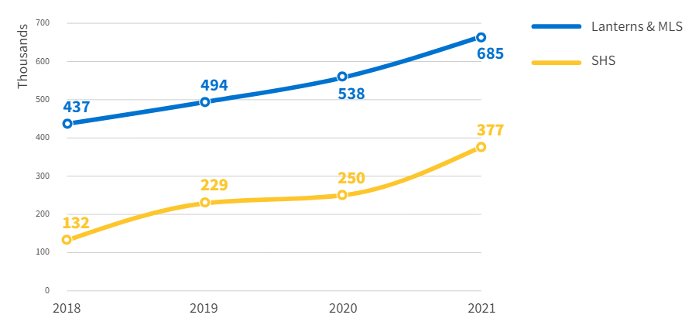
Market Trends of Off-Grid Solar Energy Industry
West Africa
Trends in most other West African markets have been less consistent, with the majority of markets yet to show a solid return to growth as of 2021.
Affiliates sales volumes of solar energy kits in West Africa (2018-2021)
Notes:
Ref. : Off-Grid Solar Market Trends Report 2022: State of the Sector

Slide 23
Market Trends of Off-Grid Solar Energy Industry
Central Africa
Sales data from affiliates for the region remains far lower than sales recorded in East or West Africa. However, recent data highlights potential for growth. Key markets for SEKs in the region are the DRC and Cameroon.
Between 2018 and 2021, cash sales grew by 103% to close to 300,000 units, while PAYGo sales grew by 178% reaching 115,000 units. During the same period, lanterns and MLS sales grew 98%,74 and SHS sales grew by 450%.75 Further data collection will clarify if the high volume of smaller products sold in 2021 is a peak or indicative of a more significant trend.
Notes:
Ref. : Off-Grid Solar Market Trends Report 2022: State of the Sector

Slide 24
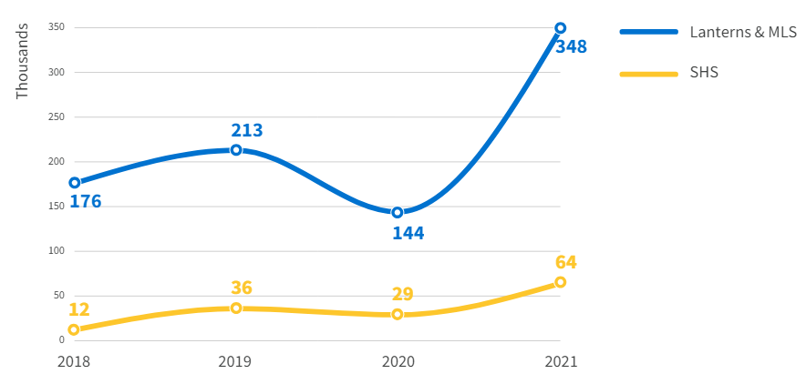
Market Trends of Off-Grid Solar Energy Industry
Central Africa
Affiliates sales volumes of solar energy kits in Central Africa (2018-2021)
Notes:
Ref. : Off-Grid Solar Market Trends Report 2022: State of the Sector

Slide 25
Conclusion :
The off-grid solar sector in Africa presents a significant and dynamic market with immense potential for growth and development. Key drivers such as increasing energy demand, decreasing costs of solar technologies, and supportive government policies have created a favorable environment for solar energy solutions.
The adoption of advanced battery technologies, smart grid integration, and innovative financing models are pivotal in addressing the unique challenges of energy access across the continent.

Slide 26
Conclusion :
The rise of hybrid energy systems and local manufacturing initiatives are transforming the market landscape. These advancements not only enhance system efficiency and reliability but also foster local economic growth and job creation.
Identifying and capitalizing on opportunities within this sector requires a comprehensive understanding of regional energy needs, consumer behavior, and technological advancements.
The off-grid solar market in Africa is poised for significant expansion, driven by technological innovations and strategic market interventions.

