Slide 1

Assessment of Renewable Energy Resources
Lesson 2:Solar Resource Assessment

Slide 2
Lesson 2: Outline
Basic Principles of Solar Radiation
Solar Resource Assessment
  Why?
  What?
  How?
  Ground Measured Data
  Satellite Derived Data
  Numerical Weather Prediction Models’ Data
  Platforms and tools
Quality Control

Slide 3
lesson 2: Learning Outcomes
Understand the basic principles of solar radiation required to perform solar resource assessments and use solar irradiance data
Understand what is a solar resource assessment and its relevance in the context of the development of solar energy projects
Identify solar irradiance data sources (open databases)
Understand the basic principles of quality control approaches
Notes:
By the end of this presentation you should be able to:

Slide 4
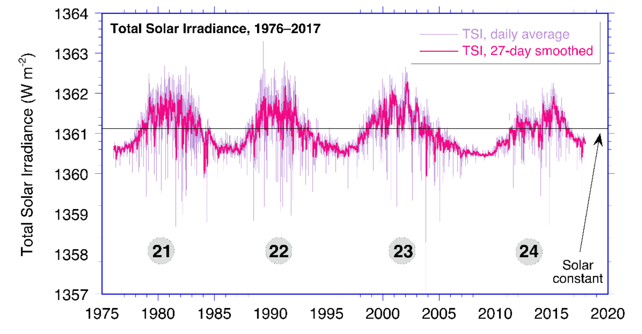

Basic principles of solar radiation
Extraterrestrial solar irradiance
  Solar constant, G₀ (or G_{SC}): power density of solar radiation outside the Earth’s atmosphere received on a unit area of surface perpendicular to the direction of propagation of the radiation at mean earth-sun distance (149,5 x 10⁶ km)
$G_{0}=1361,1 ±0,5$ $W m^{−2}$
Source: Sengupta et al., NREL, 2017
Source: Koop & Lean, 2011
Notes:
With an effective surface temperature of ≈5777 K (energy – 6300 K for same wavelength of maximum radiaton), the Sun behaves like a quasi-static blackbody and emits radiation over a wide range of wavelengths, with a distribution that is close to that predicted by Planck’s law
Varia ~0,2% devido à variação da actividade solar – desprezável para aplicações práticas

Slide 5
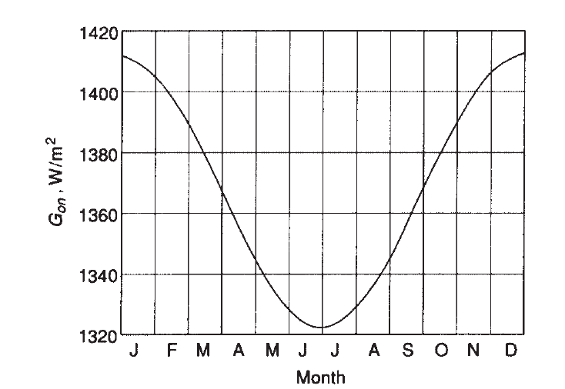
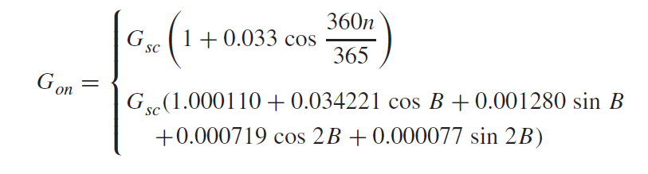

Basic principles of solar radiation
Extraterrestrial solar irradiance
  Seasonal variation on the Sun-Earth distance impact the extraterrestrial solar irradiance: ~1409 W/m2 (+3.5%) near January 3rd to ~1315 W/m2 (–3.3%) near July 4th
Source: Solar Engineering of Thermal Processes, 2020
Notes:
Simple equation
More accurate equation - +/- 0,01%

Slide 6
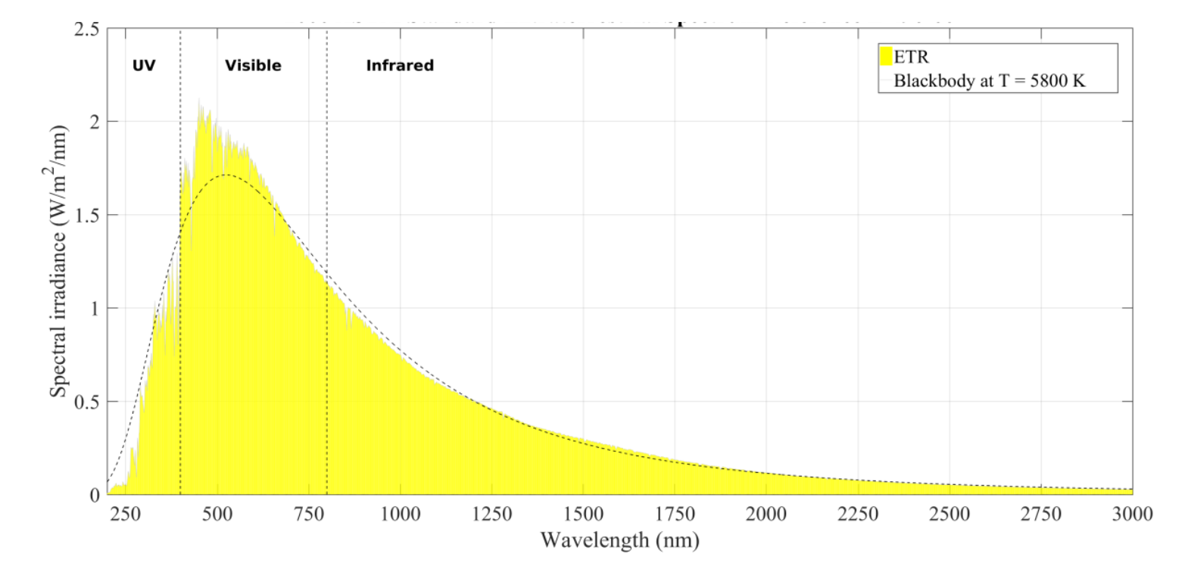
Basic principles of solar radiation
Extraterrestrial solar irradiance
  Solar spectral power distribution
Source: Sengupta et al., NREL, 2017
Notes:
With an effective surface temperature of ≈5777 K (energy – 6300 K for same wavelength of maximum radiaton), the Sun behaves like a quasi-static blackbody and emits radiation over a wide range of wavelengths, with a distribution that is close to that predicted by Planck’s law
the solar spectral power distribution, or solar spectrum. For terrestrial applications, the useful solar spectrum (98,5%), also called the shortwave
spectrum (≈290–4000 nm), includes the spectral regions called ultraviolet (UV), visible, and near-infrared (NIR) (Figure 2-1). The latter is the part of the infrared spectrum that is below 4000 nm in the solar spectrum.

Slide 7
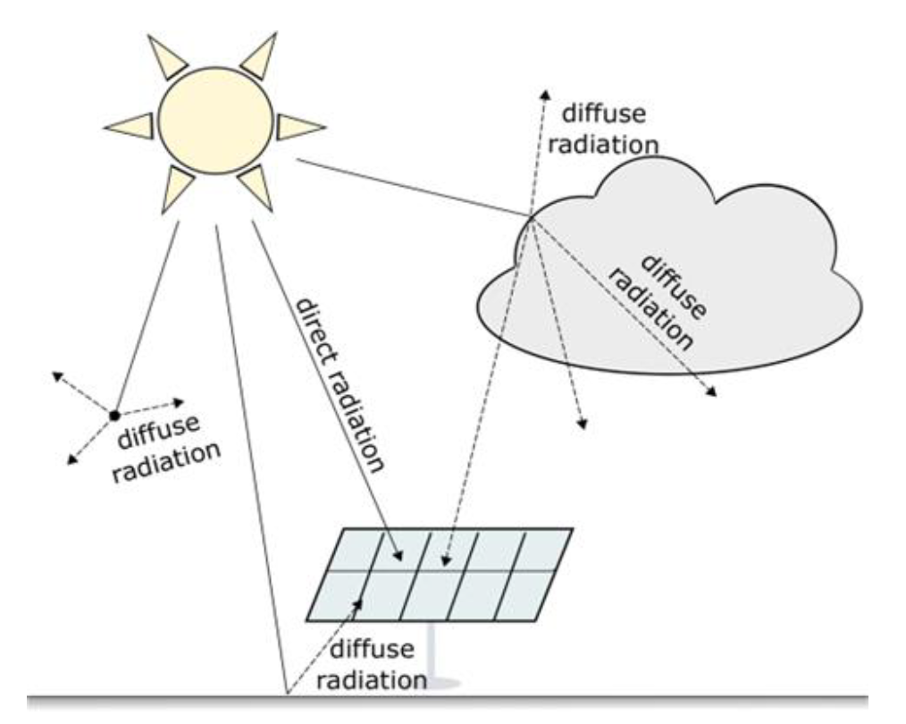
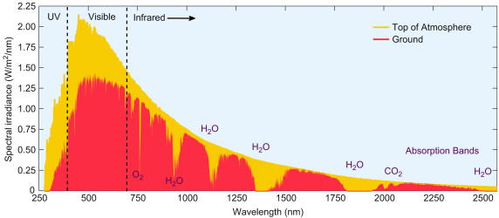
Basic principles of solar radiation
Solar irradiance at ground level
Source: Handbook of Energy, 2013
Source: Doddy Clarke & Sweeney, 2022
Notes:
Attenuation due to Raleigh scattering and radiation absorption
Scattering of radiation as it passes through the atmosphere is caused by interaction
of the radiation with air molecules, water (vapor and droplets), and dust. The degree to
which scattering occurs is a function of the number of particles through which the radiation
must pass and the size of the particles relative to λ, the wavelength of the radiation
For air particles the main process is Raleigh scattering

Slide 8
Basic principles of solar radiation
Solar radiation components
Direct (or beam): solar radiation emanating from the solar disk and the circumsolar region.
Diffuse: solar radiation scattered and reflected by the air, clouds and other particles in the atmosphere
Global: The sum of the direct and diffuse components of solar radiation.
Source: Doddy Clarke & Sweeney, 2022

Slide 9
Basic principles of solar radiation
Solar radiation components
Classification in relation to surfaces
  Horizontal: received on a horizontal surface
  Normal: received on a surface perpendicular to the sun’s rays
  Tilted: on a tilted surface
Source: Doddy Clarke & Sweeney, 2022

Slide 10
Basic principles of solar radiation
Solar radiation components
Global horizontal irradiance (GHI): the power density of the solar radiation received on a horizontal surface (includes direct and diffuse components).
Direct normal irradiance (DNI): the power density of solar radiation incident on a surface perpendicular to the sun’s rays emanating from the solar disk and the circumsolar region.
Diffuse horizontal irradiance (DHI): the power density of solar radiation scattered and reflected by the air, clouds and other particles in the atmosphere, incident on a horizontal surface.
Global tilted irradiance (GTI): the power density of solar radiation incident on a tilted surface (including direct and diffuse components).
Source: Doddy Clarke & Sweeney, 2022

Slide 11
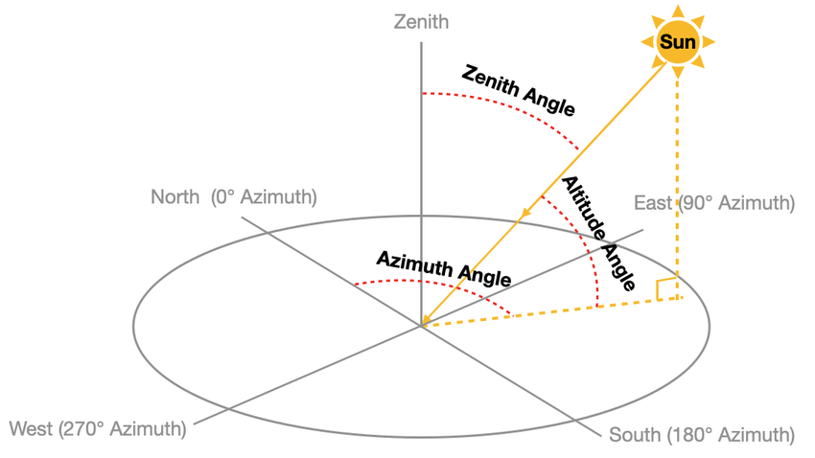

Basic principles of solar radiation
Solar radiation components
Fundamental relationships between GHI, DNI and DHI
$$GHI=DNI ×\cos\left(θ_{z}\right)+DHI$$
Source: Doddy Clarke & Sweeney, 2022
Source: Zhang et al, 2021

Slide 12
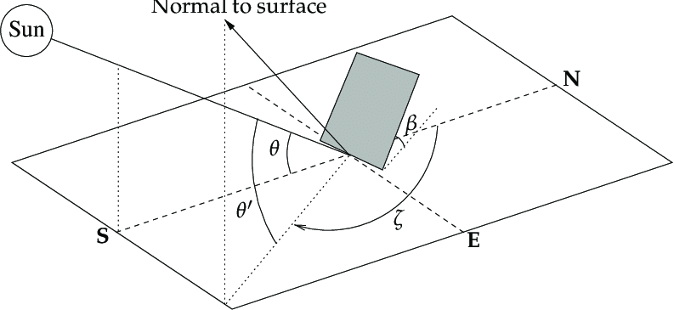
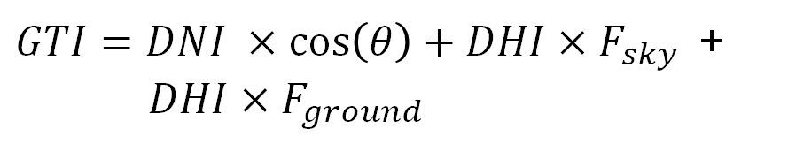
Basic principles of solar radiation
Solar radiation components
Fundamental relationships between GHI, DNI and DHI
$GTI=DNI ×\cos\left(θ\right)+DHI×F_{sky }$ + $DHI×F_{ground }$
Source: Doddy Clarke & Sweeney, 2022
Source: Herrería-Alonso et al, 2020

Slide 13
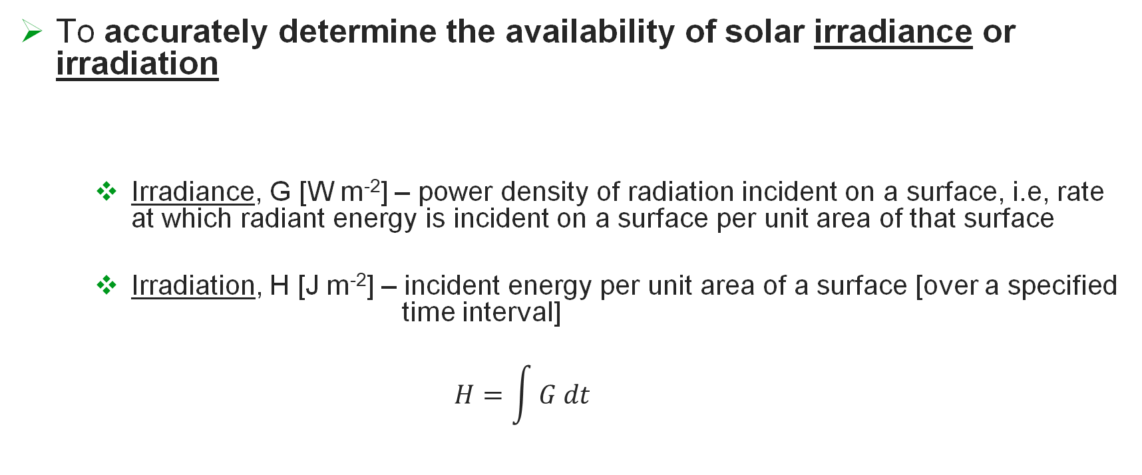
Solar Resource Assessment – Why?
To accurately determine the availability of solar irradiance or irradiation
  Irradiance, G [W m⁻²] – power density of radiation incident on a surface, i.e, rate at which radiant energy is incident on a surface per unit area of that surface
  Irradiation, H [J m⁻²] – incident energy per unit area of a surface [over a specified time interval]
  $$H=\int{G dt}$$
Notes:
For any generation source, knowledge of the quality and future reliability of the fuel is essential for accurate analyses of system performance and to determine the financial viability of a project. For solar energy systems, the variability of the supply of sunlight probably represents the single greatest uncertainty in a solar power plant’s predicted performance.

Slide 14
Solar Resource Assessment – Why?
To accurately determine the availability of solar irradiance or irradiation for developing, deploying, and operating solar energy systems
Notes:
For any generation source, knowledge of the quality and future reliability of the fuel is essential for accurate analyses of system performance and to determine the financial viability of a project. For solar energy systems, the variability of the supply of sunlight probably represents the single greatest uncertainty in a solar power plant’s predicted performance.
Also, to make energy policy decisions – determination of potential

Slide 15
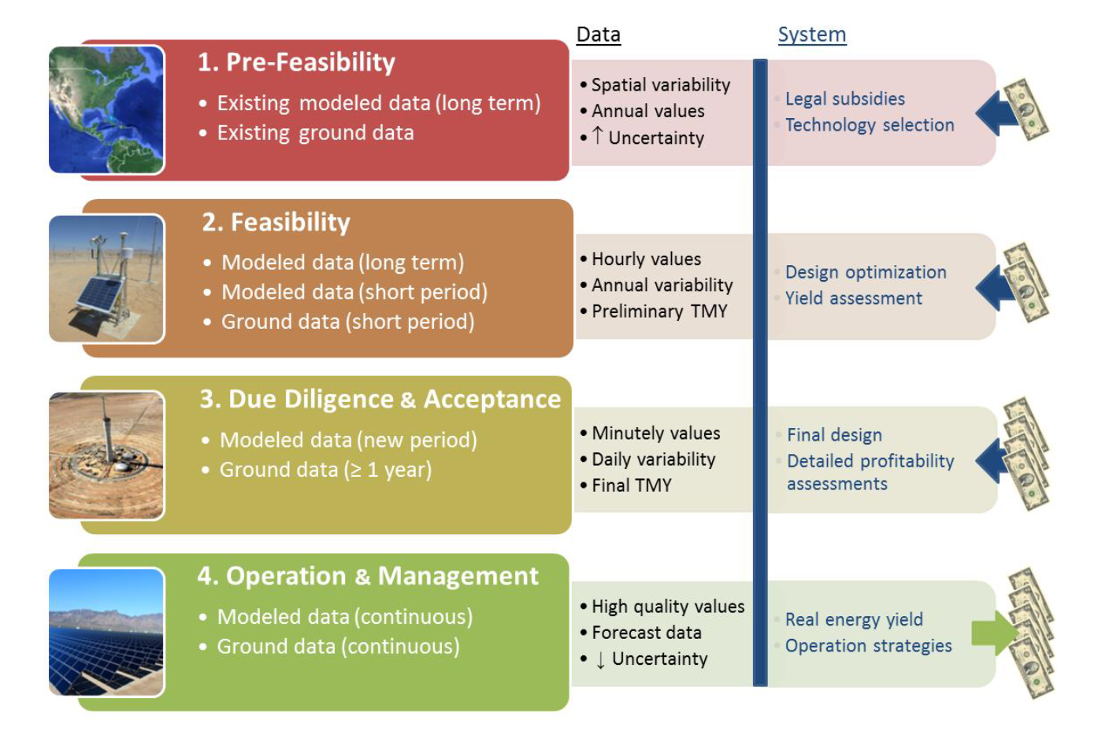
Solar Resource Assessment – Why?
To accurately determine the availability of solar irradiance or irradiation for developing, deploying, and operating solar energy systems
Time span / Resolution / Accuracy
Uncertainty
Source: Sengupta et al., NREL, 2017
LEAP-RE 2nd RESchool, Kigali, October 10th 2023
Notes:
For any generation source, knowledge of the quality and future reliability of the fuel is essential for accurate analyses of system performance and to determine the financial viability of a project. For solar energy systems, the variability of the supply of sunlight probably represents the single greatest uncertainty in a solar power plant’s predicted performance.
Also, to make energy policy decisions – determination of potential

Slide 16
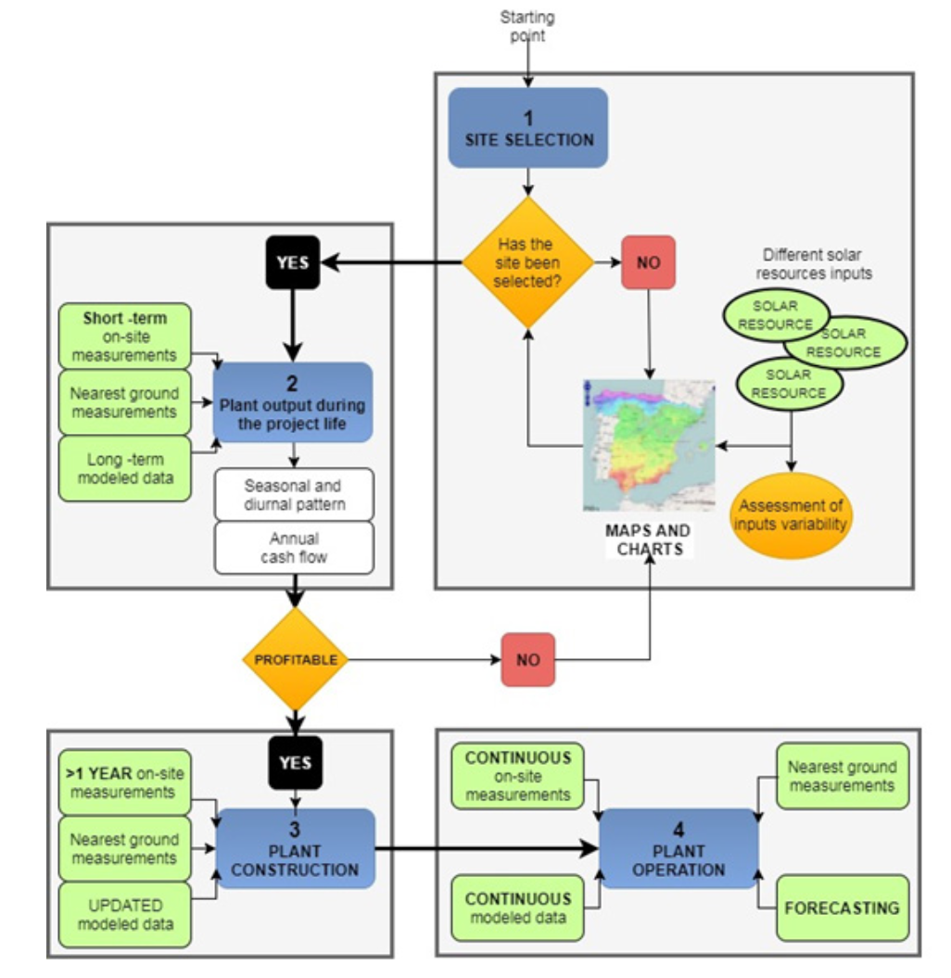
Solar Resource Assessment in the solar project life cycle
Source: Sengupta et al., NREL, 2017
Notes:
Generalized view of solar radiation data requirements throughout various conceptual stages of a project’s life cycle

Slide 17
Solar Resource Assessment – What?
Characterization of the solar irradiance that is available for energy conversion at a specific location or region over a period of interest
Must ensure:
  Reliability - quality of the used approach
  Low uncertainty
  Accounting for intra and inter annual patterns and trends – high temporal resolution and long-term data

Slide 18
Solar Resource Assessment – How?
By identifying reliable data for solar irradiance and processing it to be used in the desired analysis
For each application, the data source must be selected considering:
  Temporal resolution
  Spatial resolution
  Spatial coverage
  Data uncertainty
  Parameters of interest (GHI, DNI, etc.)

Slide 19
Solar Resource Assessment – How?
Sources of data:
  Ground-measured data
  Satellite derived data
  Numerical weather prediction (NWP) models

Slide 20
Ground measured data
Data collected for a specific location using ground stations equipped with pyrheliometers (DNI) and pyranometers (GHI, DHI, GTI)
Direct Normal Irradiance
Global Horizontal Irradiance
Diffuse Horizontal Irradiance

Slide 21
Ground measured data
Advantages:
  High degree of accuracy
  High temporal resolution
Disadvantages:
  Spatial resolution is very limited - data is only representative for the station location
  High maintenance requirements
  Expensive

Slide 22
Ground measured data
Special care should be taken when using measured data since not all databases perform data quality assessments of their records (more on this later)
Ground measured data is required for validation of reanalysis or satellite derived datasets

Slide 23
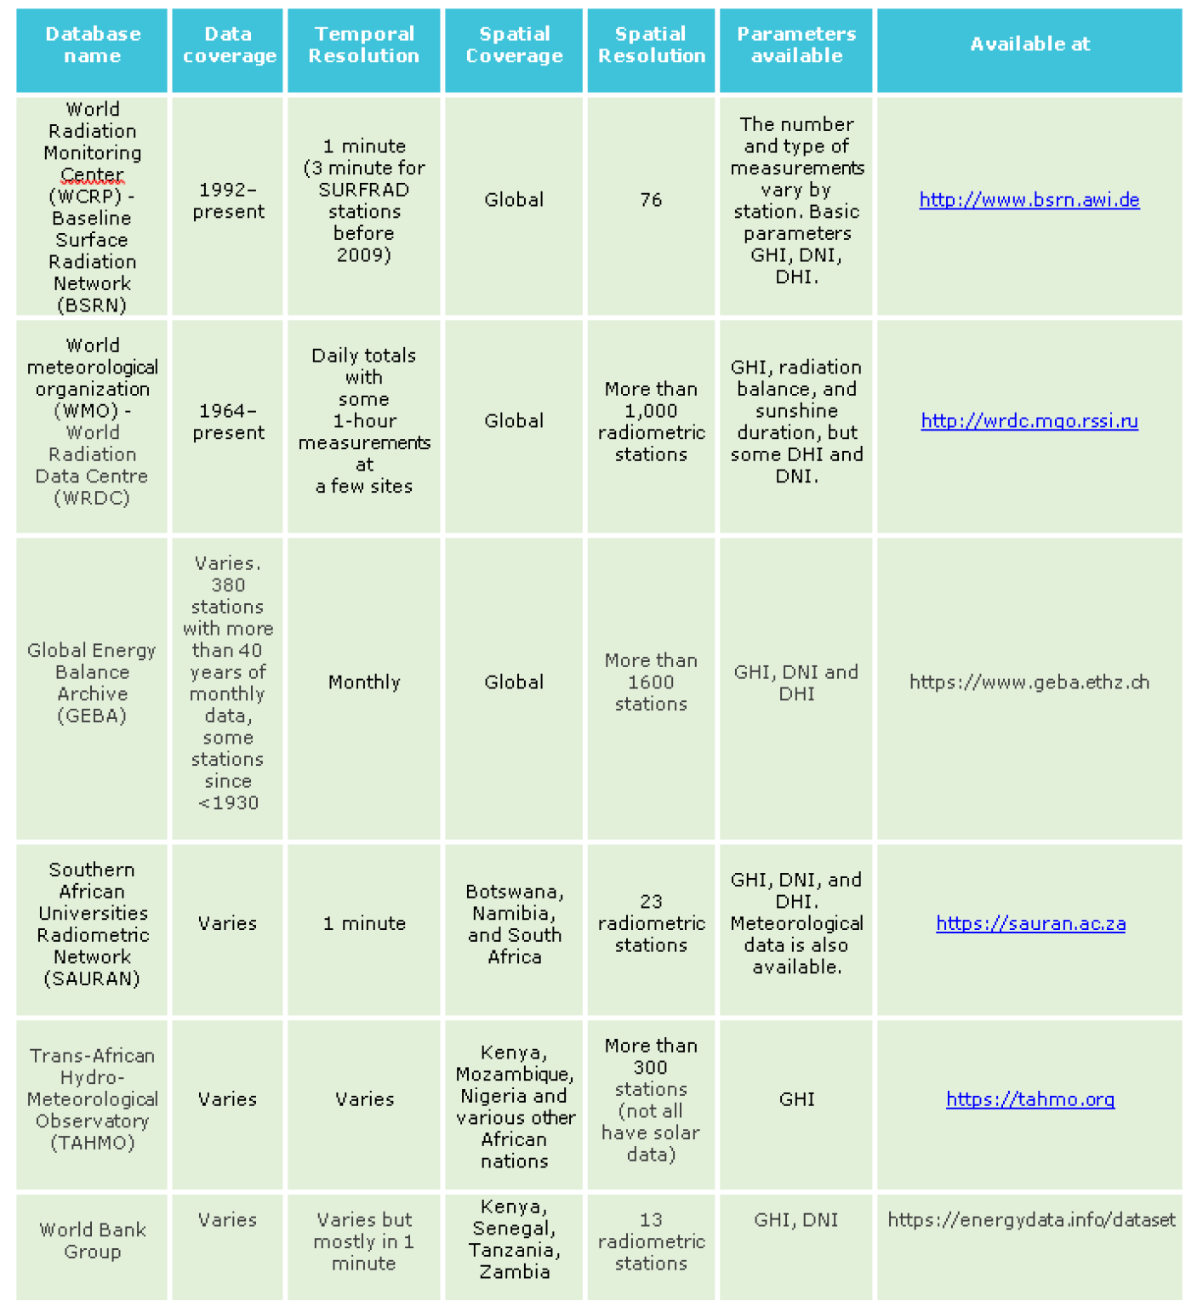
Ground measured data

Slide 24
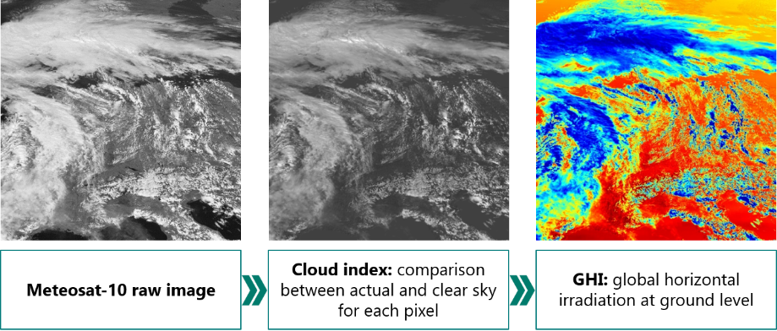
Satellite derived data
Solar irradiance components derived from remote sensing data provided by satellite imaging / radiometric sensors according to atmosphere radiative models
Source: Reuniwatt, 2015
Notes:
high quality local observations of the solar resource are only available in a few locations, generally, far from locations of interest for energy exploitation (through heat or energy conversion). Additionally, the time series present short monitoring periods, preventing the assessment of the solar radiation interannual variability, which is crucial to quantify the uncertainty associated with solar resource availability.

Slide 25
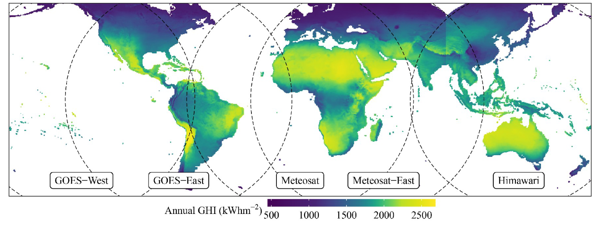
Satellite derived data
Solar irradiance components derived from remote sensing data provided by satellite imaging / radiometric sensors according to atmosphere radiative models
Main datasets cover all locations on Earth between latitude 60ºN and 60ºS
Source: Yang et al, 2022

Slide 26
Satellite derived data
Solar irradiance components derived from remote sensing data provided by satellite imaging / radiometric sensors according to atmosphere radiative models
Main datasets cover all locations on Earth between latitude 60ºN and 60ºS
Data available for higher latitude locations but with lower temporal resolution (polar orbit satelittes – 100 min)
Accuracy also varies greatly across products, and across locations, time periods, and sky conditions

Slide 27
Satellite derived data
Advantages:
  High temporal resolutions (sub-hourly)
  High spatial resolution (pixels’ sides with 1-10 km)
  Datasets available for most regions of the world
  Long-term data is available

Slide 28
Satellite derived data
Disadvantages:
  Higher uncertainties
  Solar variability cannot be well captured, especially, under highly fragmented clouds
    Not all spatial points are collected at the same time

Slide 29
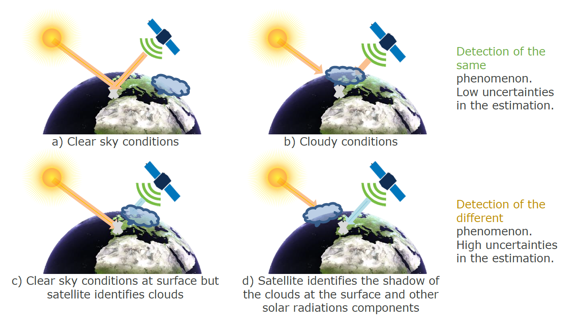
Satellite derived data
Disadvantages:
  Model performance is affected by the solar and viewing geometry

Slide 30
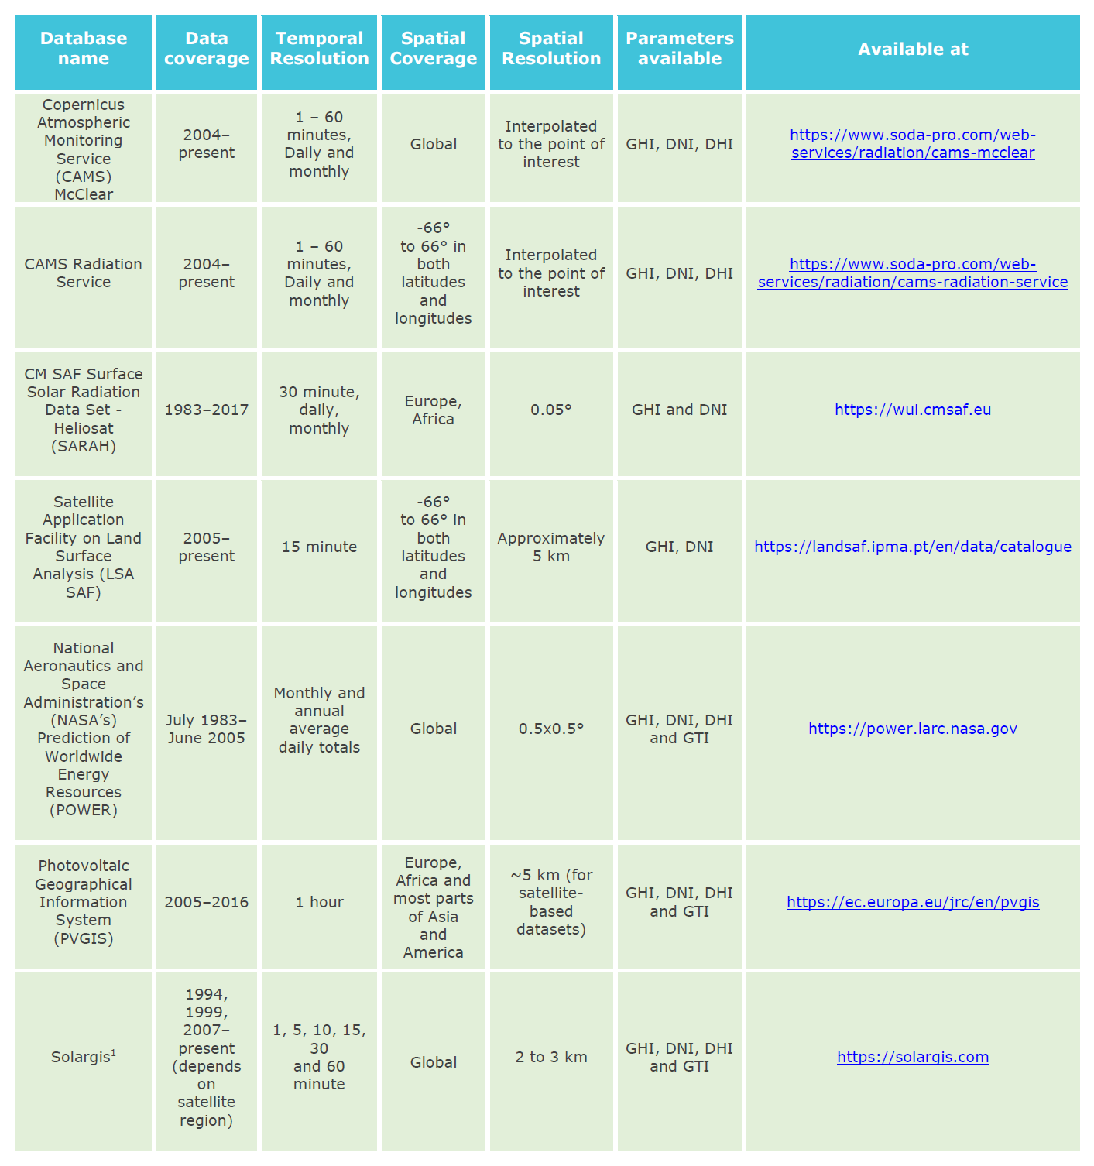
Satellite derived data

Slide 31
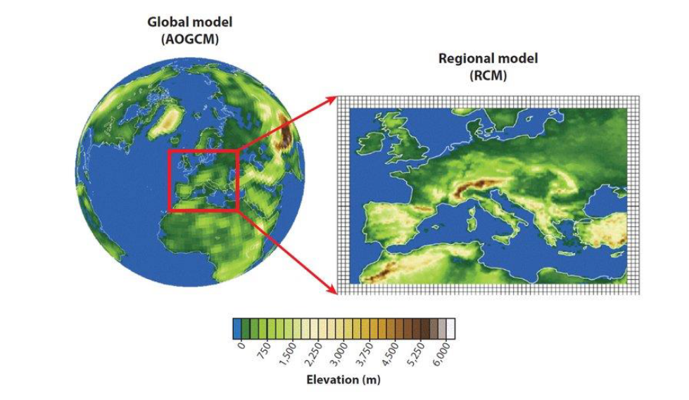
NWP models’ data
Combine meteorological observations and numerical weather prediction models to obtain a long-term retrospective estimation of many atmospheric and climatic variables, including solar irradiation – aka reanalysis
Two types: global models and mesoscale/regional models

Slide 32
NWP models’ data
Advantages:
  Uniform grid data for the entire world
  Temporally consistent without missing data
  Long-term period (can go back up to 30 years)

Slide 33
NWP models’ data
Disadvantages:
  Low spatial resolution: highest from ERA5 (ECMWF) with a grid of 0.28º x 0.28º
  High temporal resolution is unavailable (typical 1h to 6h)
  Predict well clear sky conditions but, only a small amount (<60%) of the observed variability in irradiation is well captured
  Cannot account for the effect of aerosols – very relevant for concentrating applications

Slide 34
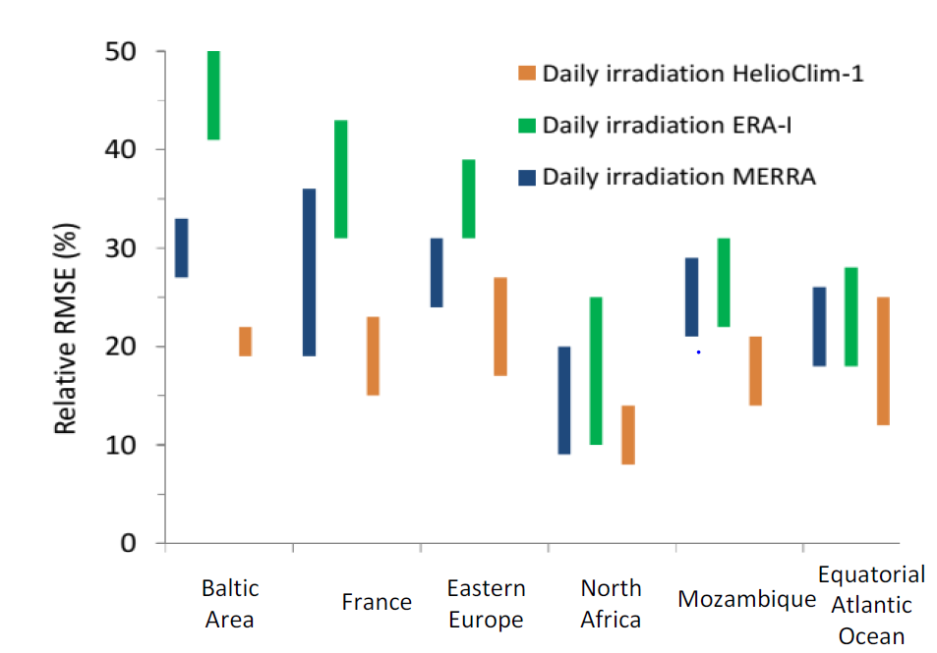
NWP models’ data
Disadvantages:
  Predict well clear sky conditions but, only a small amount (<60%) of the observed variability in irradiation is well captured.

Slide 35
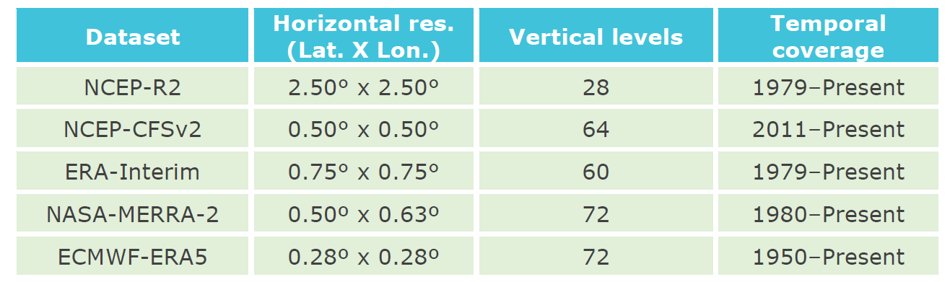
NWP models’ data

Slide 36
Platforms and tools
Some web platforms and tools provide data considering hybrid solutions (e.g., combining satellite and reanalysis data, combining satellite data with interpolation of data from ground stations) or even additional processing in relation to the original data source
Examples of free platforms with data for the African continent:
  NASA POWER - https://power.larc.nasa.gov/
  Renewables.ninja - https://www.renewables.ninja
  Photovoltaic Geographical Information System (PVGIS) - https://re.jrc.ec.europa.eu/pvg_tools/en

Slide 37
Quality control
Measuring solar irradiance comes with uncertainty and error sources
Main sources:
  Equipment characteristics and associated uncertainty
  Operation errors

Slide 38
Quality control
Several quality control procedures are available in the literature:
  NREL (1993)
  CIE (1994)
  Long and Dutton (2002)
  Muneer and Fairooz (2002)
  Yournes et al. (2005)
  Shi and Long (2008)
  Journée and Bertrand (2011)
  IEC (2017)

Slide 39
Quality control
Measurement coherence control is performed in 3 stages:
  1st : Physical feasibility of the measurement
  2nd : Rare occurrence values
  3rd : Internal coherence of irradiance values

Slide 40
Quality control
Physical feasibility (examples)
Notes:
The first stage identifies values in the data that are not physically possible, therefore filtering large measurement errors. Each of the 3 irradiance variables are tested to check of they are within the limits listed in Table 3.

Slide 41
Quality control
Extremely rare values (examples)
Notes:
The second stage identifies extremely rare values in the data, further restricting the interval of accepted values. It is physically possible for the irradiance to be outside this interval for very short periods of time or extremely rare situations. However, it is advisable to filter these values when building representative data sets or for calculations.
This step was added to the CIE method by Muneer and Fairood (2002) and compares the diffuse and global horizontal irradiances to the values of the extreme conditions calculated with Page’s models for very clear and heavily overcast skies. For the clear-sky, the same values of the respective series were used.

Slide 42
Quality control
Internal coherence evaluation (examples)
Notes:
The three irradiance values under consideration (Gh, Gd,h and Gb,n) are physically related to each other, thus, the third step of the procedure checks for deviations to the physical relationships between the irradiance measurements. In the table r = Gh / (Gd,h + Gb,h).

Slide 43
Recommended readings
Sengupta et al. (2021) Best Practices Handbook for the Collection and Use of Solar Resource Data for Solar Energy Applications: Third Edition. Golden, CO: National Renewable Energy Laboratory. NREL/TP-5D00-77635. https://www.nrel.gov/docs/fy21osti/77635.pdf
John A. Duffie, William A. Beckman, Nathan Blair. Solar Engineering of Thermal Processes, Photovoltaics and Wind John Wiley & Sons, 2020. doi: 10.1002/9781119540328
Marques, F. et al (2020) Solar Irradiance (Global, Direct and Diffuse) Quality Control Methodologies. Review: Application to Time Series Measured At LES/LNEG, Lisboa, Portugal. In: Proceedings of EuroSun 2020: 13th International Conference on Solar Energy for Buildings and Industry, Virtual Conference,1-3 September, 2020, doi:10.18086/eurosun.2020.09.04

Slide 44
References
This lesson was developed by João P. Cardoso, LNEG and is based on the following resources:
Sengupta et al. (2021) Best Practices Handbook for the Collection and Use of Solar Resource Data for Solar Energy Applications: Third Edition. Golden, CO: National Renewable Energy Laboratory. NREL/TP-5D00-77635. https://www.nrel.gov/docs/fy21osti/77635.pdf
John A. Duffie, William A. Beckman, Nathan Blair. Solar Engineering of Thermal Processes, Photovoltaics and Wind John Wiley & Sons, 2020. doi: 10.1002/9781119540328
Marques, F. et al (2020) Solar Irradiance (Global, Direct and Diffuse) Quality Control Methodologies. Review: Application to Time Series Measured At LES/LNEG, Lisboa, Portugal. In: Proceedings of EuroSun 2020: 13th International Conference on Solar Energy for Buildings and Industry, Virtual Conference,1-3 September, 2020, doi:10.18086/eurosun.2020.09.04

