Slide 1

Off-Grid Energy Systems Modelling with MicroGridsPy
Lesson 3:
Energy System Modelling

Slide 2

Lesson 3: Contents
Understanding Energy System Models
Energy system models, including their purpose and how they function. This will involve grasping the concept that these models are mathematical representations of physical phenomena or collections of processes and acquiring the basic glossary.
General Glossary
Optimization Techniques in Energy Modelling
Optimization techniques, including constrained optimization and linear programming, and their application in energy modelling
Temporal and Geo-Spatial Resolution in Modelling
Temporal and geo-spatial resolutions in energy system modelling, crucial for managing renewable energy variability and understanding local energy dynamics for strategic planning
Introduction to MicroGridsPy
Attributes, characteristics, and features of MicroGridsPy as an energy systems modeling tool
Notes:
This lecture aims to build a solid foundation for understanding the theory behind energy systems modelling. We'll start with an overview of Energy System Models. You'll learn what these models are, their purpose, and how they function, acquiring the basic glossary of energy modelling. The lecture will cover also Optimization Techniques, introducing concepts such as constrained optimization and linear programming, which are critical for making energy systems more efficient. It will be also discuss the importance of Temporal and Geo-Spatial Resolution in energy models, critical issue especially for managing the intermittency of renewable energy and for strategic energy planning. Lastly, we’ll introduce MicroGridsPy software and its modelling attributes. You'll get to know this open-source tool, understanding its capabilities and how it fits into the broader context of energy system modeling. By the end of this lecture, you'll have a clear understanding of these fundamental aspects, setting the stage for more advanced topics in our course. Let's get started.

Slide 3
Lesson 3: Learning Outcomes
At the end of this unit, participants will be able to :
Understand Energy System Models
Appreciate various Optimization Techniques in Energy Modelling
Understand the importance of Temporal and Geo-Spatial Resolution in Modelling
Understand the Attributes of MicroGridsPy
Notes:
This lecture aims to build a solid foundation for understanding the theory behind energy systems modelling. We'll start with an overview of Energy System Models. You'll learn what these models are, their purpose, and how they function, acquiring the basic glossary of energy modelling. The lecture will cover also Optimization Techniques, introducing concepts such as constrained optimization and linear programming, which are critical for making energy systems more efficient. It will be also discuss the importance of Temporal and Geo-Spatial Resolution in energy models, critical issue especially for managing the intermittency of renewable energy and for strategic energy planning. Lastly, we’ll introduce MicroGridsPy software and its modelling attributes. You'll get to know this open-source tool, understanding its capabilities and how it fits into the broader context of energy system modeling. By the end of this lecture, you'll have a clear understanding of these fundamental aspects, setting the stage for more advanced topics in our course. Let's get started.

Slide 4
Energy System Models
Mathematical representation of a physical phenomenon or ensemble of processes, in order to perform analytical experiments by assessing different scenarios and inform with sound scientific data the policy making process.
Definition
Global Energy Transition
Environmental dimension
Social dimension
Social equity
Governance
Challenges
High share of variable sources
Need of flexibility and storage
Cross-Sectorial Linkages
Inter or intra-national connections
Complex energy systems
Notes:
First of all, let’s try to define what energy system models are. At their core, these models are mathematical representations of physical phenomena or ensembles of processes. They allow us to perform analytical experiments, assess various scenarios, and provide sound scientific data that can guide policy-making. As we navigate through the Global Energy Transition, we see the Environmental, Social, and Governance dimensions intertwining, all through the lens of social equity. These elements are pivotal in shaping complex energy systems, which we must understand in depth.
However, these complex systems bring about significant challenges. The high share of variable energy sources demands increased flexibility and innovative storage solutions. Moreover, the cross-sectorial linkages and the necessity of either inter or intra-national connections pose unique challenges that require sophisticated modelling techniques.
Understanding these multifaceted aspects is crucial, as it allows us to model energy systems with greater precision, and in turn, craft more effective strategies for the future of energy.

Slide 5
Brief History of Energy Modelling
Oil Crisis
International Energy Agency (IEA)
1970s
1972
1974
1976
Nowadays
International Institute for Applied System Analysis (IIASA) - MESSAGE
IEA-ETSAP – MARKAL, TIMES
Affordability, resilience and environment
High penetration of renewables
Decentralized generation
New-generation models
High spatial and temporal resolution
High technological detail
Limited complexity of energy systems
Low temporal resolution
Low spatial resolution
High interest in policy/economy feedbacks
Focus on macro-economic interactions
Notes:
Here, we'll take a concise walk through the evolution of energy modeling. The 1970s marked the inception with the oil crisis, catalyzing the energy sector's shift towards more structured analysis. The establishment of the International Energy Agency in 1974 signaled a growing recognition of energy's role in international policy.
Early models like the International Institute for Applied System Analysis's MESSAGE model and the IEA-ETSAP's MARKAL and TIMES models focused on a simpler view of energy systems with lower temporal and spatial resolution, driven by a high interest in how energy policy impacts the economy.
Fast forward to today, and the focus has shifted to affordability, resilience, and environmental sustainability. Current models emphasize the high penetration of renewables, decentralized generation, and boast high spatial and temporal resolution, along with detailed technological insights.

Slide 6




General Glossary
Top-down
Bottom-up
Aim at modelling the economy as a whole at national or regional level (macroeconomic models) and at assessing the aggregated effects of energy and/or climate change policies in monetary units.
Aim at modelling more specific and narrowed energy systems with high-degree of technological detail but usually without taking into account broader macroeconomic aspects.
“How much a given energy price (environmental tax) increase will reduce demand (emissions) and consumption (GDP growth)?”
“How can a given energy demand (emission reduction target) be achieved with minimal (energy systems) costs?”
Application to feedback loops to welfare, employment and economic growth
Give a detailed representation of energy systems and technological options
Low technological characterization
Do not take into consideration complex socio-economical dynamics
Notes:
As we delve deeper into the world of energy modelling, let’s introduce some general glossary, taking this opportunity to introduce some fundamental terms and concepts that characterize energy modelling. Firstly, we encounter the distinction between Top-down and bottom-up models. Top-down frameworks aim at modelling the economy at large scales, such as national or regional levels. They use macroeconomic models to evaluate the cumulative effects of energy and climate policies in monetary terms. Questions they address include the economic repercussions of changes in energy pricing and how these can influence demand, emissions, and GDP growth. They're instrumental in demonstrating how energy policies loop back to impact overall welfare, employment, and economic expansion, despite their typically lower emphasis on technological detail.
In contrast, Bottom-up models focus on specific energy systems with a high degree of technological detail. They prioritize technological specificity and depth, addressing how energy demands or emission reduction targets can be met with minimal system costs. While offering a detailed technical picture, they tend to set aside the broader macroeconomic context.

Slide 7


General Glossary
Simulation
Optimization
Aim to replicate the rules and linkages that describe the interactions among different elements of the analysed system, simulating the behaviour of energy producers and consumers in response to factors like prices, income, and other parameters.
Identify an optimal mix of technologies under certain constraints to achieve specific targets, assuming that real-world decisions align with the objective function to obtain a theoretically ideal solution.
“Mathematical optimization is the selection of a best element (with regard to some criterion) from some set of available alternatives”
“Instead of generating possible futures, focus on predicting the system’s likely evolution”
Realism: Accurately mirrors real-world energy systems, capturing complex interactions
Efficient Decision-Making: Finds the most efficient solutions within set constraints.
Limited Predictive Power: Not as effective for future planning
Over-simplification: May produce impractical solutions due to simplified assumptions
Notes:
Continuing our exploration of the general glossary in energy modelling, let's now introduce two key different approaches: simulation and optimization. Simulation aims to replicate the complex rules and interactions within an energy system. It simulates the behaviour of energy stakeholders responding to various factors like pricing and income. The main advantage of simulation is its realism, providing a model that closely reflects real-world conditions and interactions. However, one of its limitations is limited predictive power, which may not be as effective for long-term planning scenarios.
On the other side, we have optimization, which seeks an ideal mix of technologies to meet certain targets under specified constraints, always aiming to align with a predefined objective function. Optimization is crucial for efficient decision-making, helping to find the most cost-effective and resource-efficient solutions. The drawback here is that it can sometimes result in oversimplification, offering solutions that might be theoretically sound but not always practical in the real world. Both approaches are essential in the toolkit of an energy modeler, offering different lenses through which we can view and solve the challenges in energy systems.

Slide 8





Optimization Modelling Frameworks
Optimization problems require a specific terminology and robust frameworks for modelling and solving complex mathematical challenges.
Basic Terminology
Open-source Python package for formulating and solving various optimization models, compatible with both commercial and open-source solvers, defining general symbolic problems, create specific problem instances, and solve them
PYOMO
Parameter: a fixed and constant value in model equations, often linked to real-world costs, efficiencies, or physical traits of the energy system
Variable: elements of a model that are unknown and changeable, such as decisions or system outcomes. Their values, known as the solution, emerge from the optimization
Set: index used in the algebraic structure of equations, serving to categorize and organize variables and parameters within the model
Constraint: an expression, either equal or inequal, that limits the possible values of one or more variables within the model.
Objective function: mathematical expression that defines the goal of the optimization, such as maximizing profits or minimizing costs. It is formulated in terms of the model's variables and parameters and is the key component the solver aims to optimize given the constraints.
Python-embedded modelling language for convex optimization problems. It provides an intuitive syntax and automatic transformations of complex problems into standard forms
A high-level General Algebraic Modelling Language for mathematical optimization problems. It allows for easy model formulation, management, and solves problems using various solvers
A powerful modelling language and collection of supporting packages for mathematical optimization in Julia. It allows to formulate and solve a range of problem classes, including linear programs, integer programs, conic programs, semidefinite programs, and constrained nonlinear programs.
Notes:
Let’s focus on Optimization problems by introducing the basic terminology and frameworks essential for modelling complex mathematical challenges. In the formulation of a mathematical model, we begin with parameters—these are the quantifiable inputs derived from empirical data or established standards that remain constant throughout the problem-solving process. They provide the model with real-world context and boundaries. We then define the variables, which are the decision points or outcomes that the optimization process seeks to evaluate. Their optimal values are unknown at the outset and are determined as a solution to the optimization problem.
To systematically structure the model, we employ sets, which function as indices to organize the parameters and variables into an algebraic framework. This organization is essential for managing complexity in large-scale models. Constraints, formulated as algebraic inequalities or equalities, delineate the feasible region of operation for the variables. They embody the physical, technological, and policy limitations within which the model must operate. Finally, at the core of the optimization problem is the objective function, a mathematical expression crafted to represent the goal of the optimization, such as cost minimization or efficiency maximization. This function is tied to the model's variables and is the key metric the solver seeks to optimize within the context of the constraints. To tackle these optimization problems, we utilize robust frameworks and languages to define our models. Some examples include PYOMO, an open-source Python package versatile across different solvers; CVXPY, tailored for convex optimization with an intuitive Python-based syntax; GAMS, a high-level algebraic language that simplifies complex model management; and JuMP, a flexible Julia language package for a wide range of optimization problems, including nonlinear formulations.

Slide 9

Constrained Optimization
In energy model constrained optimization, the objective function is bound by constraints that mirror the system's physical behaviour and specific policy or regulatory directives, ensuring solutions are economically sound, technically viable, and policy-compliant.
Objective Function
min [cost/emissions/others...]
Energy Balance
Power Balance
Mass Balance
Economical Constraints
Technological Constraints
Environmental Constraints
Notes:
Having already introduced and established the role of objective functions, parameters, and variables in energy, let’s have a closer look at Constrained Optimization. Constraints are usually multifaceted, starting with the physical—energy, power, and mass balances—that ensure fidelity to conservation principles. Beyond the physical, we might integrate technological constraints, defining what is technically feasible given current or projected technology, economic constraints that account for financial parameters from costs to returns, and environmental constraints that encompass emissions goals and broader ecological factors. This approach ensures that the optimization not only reaches theoretical ideals but also stands up to practical application and policy compliance.

Slide 10
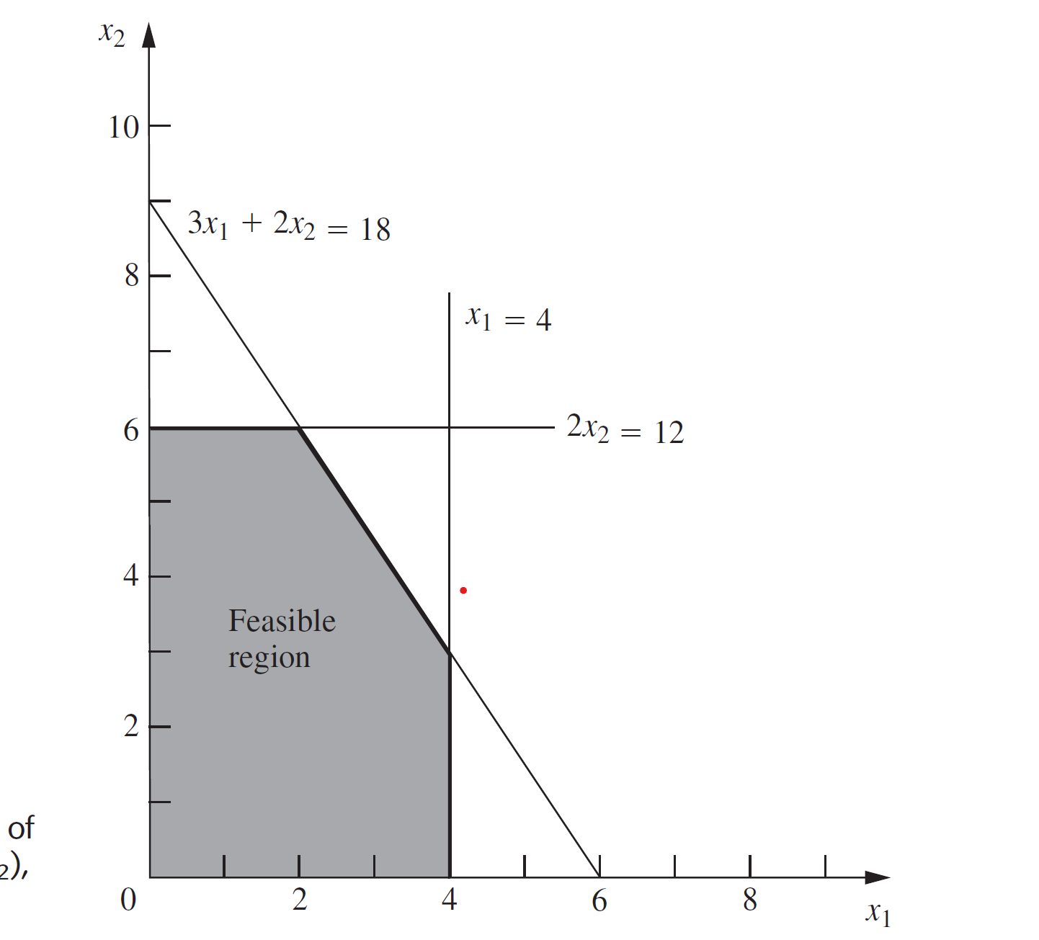
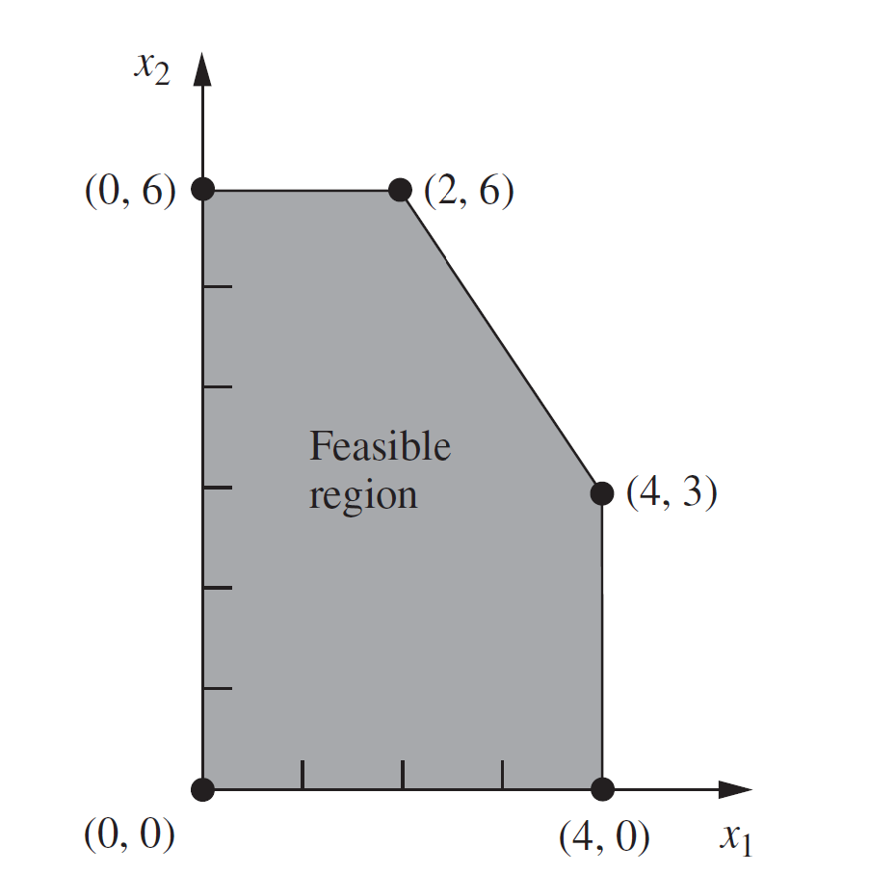
Linear programming (LP) – a method for optimization
LP optimisation is a deterministic optimisation method that allows to find the exact absolute optimum solution within the given domain. The most common type of application involves the general problem of allocating limited resources among competing activities in a best possible (i.e., optimal) way.
Maximize Z=(c₁x₁ + c₂x₂)
Subject to (constraints)
With given
0≤ x₁ ≤ b₁; 0 ≤ 2x₂ ≤ b₂
c ₁= 3; c ₂ = 5
a₁ x₁ + a₂ x₂ ≤ b ₃
b ₁=4; b ₂=12; b₃ =18
a ₁= 3; a₂ = 2
SIMPLEX Method
The simplex method is an algebraic procedure. In linear programming constraints define a polyhedron in n dimensions: if an optimal solution exists, it will be at a corner point feasible solution (vertex) of the latter. Starting from any feasible solution, one can find the optimal solution by following the edges of the polyhedron .
Example of feasible solution domain
Notes:
Once the model and its characteristics have been defined, the solving process begins. Here it’s presented Linear programming technique, a deterministic optimization method renowned for its ability to find the absolute optimum solution within a defined set of parameters. It operates within a framework of linear constraints, which, when graphically represented, form a polyhedron or a feasible region. The objective function, which we aim to maximize or minimize, must be a linear equation as well. The Simplex method, a cornerstone algorithm in LP, navigates through the vertices of the polyhedron to locate the optimal corner point solution. It's an elegant solution that moves from one vertex to another, seeking the point where the objective function has the most favourable value. While LP is a fundamental pillar in optimization, providing clear and precise solutions within its scope, it's worth noting that it does not cover all the possible complexities of energy systems. For scenarios where variables and constraints are not linear, more advanced methodologies come into play, such as Mixed Integer Linear Programming (MILP) and nonlinear programming methods.

Slide 11


General Glossary
Static
Dynamic
Offer an instantaneous snapshot of an energy system at a specific point in time, either present or future. They can depict immediate adjustments to shocks, transitioning from old to new equilibriums without involving time or transition phases.
Explicitly incorporate time, illustrating how system properties evolve. They are recursive, forming a sequence of static equilibria where the output of one time slice becomes the input for the next.
Straightforward, less complex and easier interpretation of results
More comprehensive view of the energy system's evolution over time.
Exclude energy systems dynamics, such as technological evolution, policy impacts over time, or long-term environmental effects
Complex and resource-intensive, requiring detailed data and sophisticated modelling
Notes:
In our general glossary for energy modelling, two critical concepts to understand are Static and Dynamic modelling. Static models offer an instantaneous snapshot of an energy system at a specific point in time, be it present or future. They are adept at depicting immediate adjustments to shocks, showing how a system transitions to a new equilibrium without accounting for the passage of time or the phases of transition. The strength of static models lies in their simplicity and straightforward interpretation. However, they do not capture the dynamics of energy systems, such as technological progress or the long-term impact of policies and environmental changes.
On the other hand, Dynamic models explicitly incorporate the dimension of time, portraying how the properties of a system evolve. They are recursive, forming a sequence where the outcome of one period becomes the input for the next. This approach provides a more comprehensive view of the energy system's evolution over time. While dynamic models offer depth, they are also more complex and resource-intensive, demanding detailed data and sophisticated modelling techniques. Both static and dynamic models are important tools, each with their unique applications and insights into the behavior and future of energy systems.

Slide 12
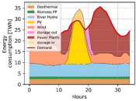

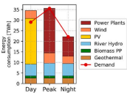
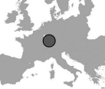
General Glossary
Time Resolution
Geo-Spatial Resolution
Refers to the granularity with which time is represented in the model. It can range from hourly intervals to annual aggregates.
Refers to the geographical detail within the model. This can vary from a single, aggregated national level to a more detailed regional or even local level.
Higher time resolution allows for detailed analysis of fluctuations in energy demand and supply, crucial for modelling systems with significant renewable energy sources
Higher geo-spatial resolution provides insights into local variations in energy demand and supply and environmental impacts, crucial for distributed energy resources like solar and wind power
Lower time resolution may be sufficient for long-term planning and policy assessment as well as modelling fossil fuels systems which are less dependent on time
Lower geo-spatial resolution are useful for national policy-making and strategic decisions as well as centralized systems which are not dependent on location
Notes:
Moving forward, we encounter two more pivotal Time Resolution pertains to the granularity at which time is represented in a model, ranging from granular hourly intervals to broader annual aggregates. A higher time resolution allows for a detailed analysis of fluctuations in energy demand and supply, which is particularly important when modelling systems with a significant share of renewable energy sources. These sources, such as solar and wind, are inherently variable and benefit from a more nuanced temporal analysis. Conversely, lower time resolution may be suitable for long-term planning and policy assessment, especially in models concerning fossil fuel systems where time sensitivity is less critical. Geo-Spatial Resolution refers to the level of geographical detail within the model. It can vary from a broad, aggregated national level to a more finely tuned regional or even local level. A higher geo-spatial resolution yields deeper insights into local variations in energy demand and supply, as well as environmental impacts. This is especially important for distributed energy resources like solar and wind power, where location plays a significant role in their effectiveness. Lower geo-spatial resolutions serve national policy-making and strategic decisions well, particularly for centralized systems where the dependency on location is less pronounced.

Slide 13



Time Resolution
The crucial role of high-resolution temporal data in system modelling cannot be overstated, particularly for the accurate representation of renewable energy sources. It ensures that the intermittent and variable nature of renewables is captured effectively, enabling more reliable and efficient energy system planning
Computational balance
Low Time Resolution
A coarse spatial and temporal resolution is necessary to keep computational effort manageable and useful for situations where temporal fluctuations are not important: fossil fuel-fired or nuclear plants
High Time Resolution
Renewable energy can be highly variable in time. Therefore, with their rising importance, resolving time and space becomes important to accurately answer questions about the energy system.
Notes:
The significance of time resolution in system modelling is crucial, especially when accounting for renewable energy sources. High time resolution captures the intermittent and variable nature of renewables, thus facilitating more accurate and reliable planning in energy systems. On the flip side, a low time resolution may suffice in scenarios with less variability, such as fossil fuel-fired or nuclear plants, helping to manage computational effort while still providing essential insights. Striking a computational balance between these resolutions is key to optimizing the modelling process for different energy systems.

Slide 14
Geo-Spatial Resolution
Correlation between VRE generation and fluctuating demand
Requirements for load-following and storage technologies
Analysis of centralized vs de-centralized energy supply
1
Regional demand variabilities and inflexibilities
Regional consumer preferences
Impact of climate conditions on demand
Supply Side Implications
VRE generation potential
Transmission development
Diversification of Generation
Regional resource endowment
2
Demand Side Implications
Regional environmental issues
Energy consumption habits
Regional consumer affordability
Regional willingness to pay
Region-specific financial incentives
Population demographics
Regional responsibilities
Political acceptability
Local actors & stakeholders
Regional income level & wealth distribution
Need for equitable generation
Trade-offs between environmental impacts and energy security
Social resistance against new installations
3
Socio-economic, environmental
& political motivations
Source for Image: adaptation from [2]
Notes:
Geo-spatial resolution in energy modelling is sometime crucial as well for capturing the complexity of regional energy dynamics. It encompasses various factors, such as the distribution of renewable energy resources, the need for transmission infrastructure to integrate remote generation, and the socio-economic and environmental impacts of energy projects. By accounting for regional variations in resource availability, demand patterns, and stakeholder preferences, geo-spatial resolution facilitates informed decision-making in energy planning and policy formulation. This approach ensures that energy strategies are tailored to the specific needs and characteristics of different geographic regions, optimizing resource utilization and minimizing environmental and social impacts.

Slide 15




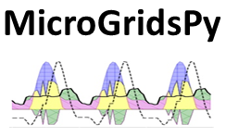

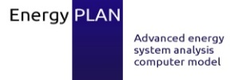

Main Modelling Frameworks
Energy modelling encompasses a range of tools tailored for different scopes, from local to global, with varying temporal detail, supporting decision-making in energy system development and planning.
Global
MESSAGE
Continental
MARKAL
TIMES
Geographical Coverage
PyPSA
National
Regional
URBS
Local
Single Project
Hours
Days
Years
Seconds
Minutes
Decades
Temporal Resolution
Source for Image: adaptation from [2]
Main modelling frameworks in terms of geographical and temporal resolution
Notes:
The main modelling frameworks can be characterized based on their geographical and temporal resolution. For instance, TIMES offers broad geographical coverage, typically continental, but with relatively low time resolution, usually spanning days. Conversely, HOMER, a commercial software, provides high time resolution for optimizing mini-grids but with a narrowed geographical focus. Similar to HOMER, MicroGridsPy, the open-source model at the core of this course, offers detailed temporal resolution while maintaining a flexible and adaptable geographical scope. Let’s start to explore it.

Slide 16
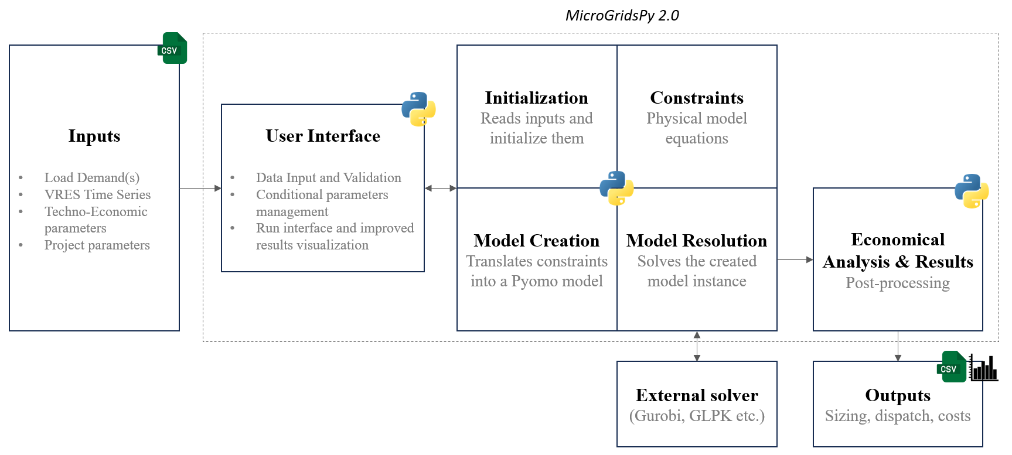


What is MicroGridsPy?
MicroGridsPy is an open-source bottom-up, stochastic optimization model for sizing and dispatching energy in mini-grids, particularly in isolated areas, with high time resolution and time-evolving load demand.
It’s Python-based, running on Pyomo and it relies mainly on linear programming formulation.
MicroGridsPy model scheme visualization
Bottom-up, dynamic, optimization model
High time resolution, Linear programming
Notes:
MicroGridsPy stands out as an open-source bottom-up, stochastic optimization model meticulously designed for sizing and dispatching energy in microgrids, especially in remote or isolated areas. What distinguishes it is its high time resolution, enabling precise modelling of time-evolving load demands within microgrid systems. Built on Python, MicroGridsPy leverages the robust capabilities of Pyomo, a powerful optimization modelling language, and primarily employs linear programming formulations to ensure computational efficiency and accuracy in its solutions. MicroGridsPy is structured into various Python modules that interact seamlessly according to the scheme outlined in the slide. Despite its underlying complexity, the user's interaction is simplified through a user-friendly Graphic User Interface (GUI), as well as input and output files. This design not only enhances the user experience but also ensures the maintainability of the code, allowing for easier troubleshooting and future development.

Slide 17

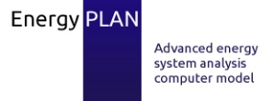
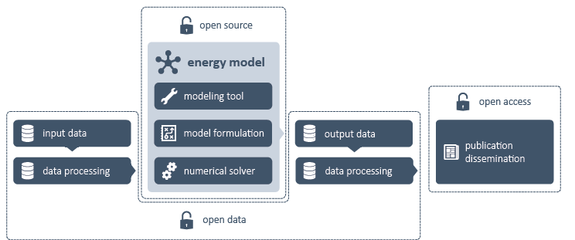

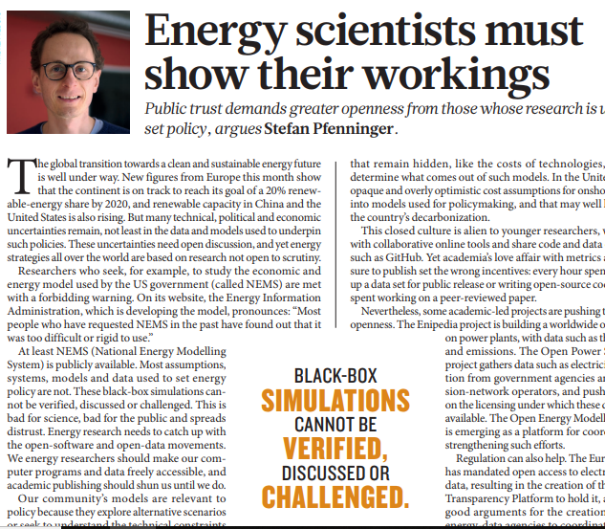
Towards OPEN-SOURCE modelling
Most of the new-generation modelling frameworks arose within the Open Energy Modelling Initiative (OpenMod) in response to the increasing advocacy for openness and transparency of codes and datasets.
PyPSA
URBS
Balderrama et al. (2019)
Howells et al. (2011)
Hilpert et al. (2018)
Pfenninger (2017)
Brown et al. (2018)
Quoilin et al. (2017)
Dorfner et al. (2016)
Lund (2007),
Garegnani et al. (2016)
GitHUB
Notes:
MicroGridspy is part of the broader Open Energy Modeling Initiative (OpenMod), a collective response to the growing demand for openness and transparency in codes and datasets. OpenMod is grass root initiative of modellers from various universities and research institutes across the world aiming at opening up energy models to improve quality, transparency, and credibility, leading to better research and policy advice. Other notable models that have emerged from this initiative include OSeMOSYS, PyPSA, and oemof, each of them primarily hosted on platforms like GitHub and contributing with unique features and functionalities to the open-source ecosystem.

Slide 18
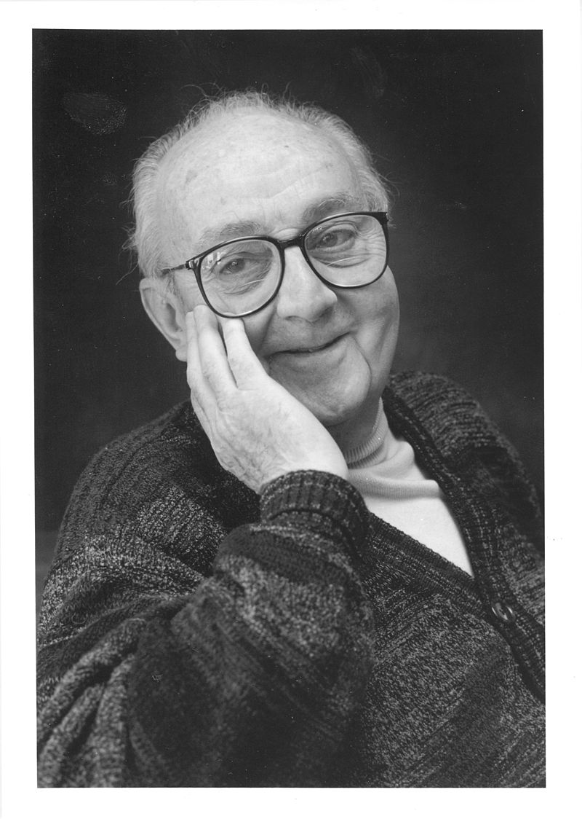
"All models are wrong, but some are useful“
George Box – British Statistician
16
Notes:
To conclude this lecture on Energy system modelling, here's an interesting insight from the British statistician George Box: "All models are wrong, but some are useful." This serves as a reminder that models are built upon assumptions and data, inevitably concealing uncertainties and errors. Our objective is to continually refine these models to maximize their utility and effectiveness.

Slide 19
References
[1] Prina et al., Classification and challenges of bottom-up energy system models - A review, Renewable and Sustainable Energy Reviews 2020, https://doi.org/10.1016/j.rser.2020.109917
[2] Aryanpur et al., A review of spatial resolution and regionalisation in national-scale energy systems optimisation models, Energy Strategy Reviews, https://doi.org/10.1016/j.esr.2021.100702

