Slide 1

Off-Grid Energy Systems Modelling with MicroGridsPy
Lesson 3X (Extra) Energy Frameworks

Slide 2

Learning Outcomes of the Lesson
Definition of modelling frameworks and models
Basics on the process of modelling
Characteristics of frameworks
Notes:
Let’s now focus on the content of this first lecture that aims to explore the synergies between energy systems and sustainable development, examine global disparities in electricity access, and investigate off-grid electricity solutions. You will learn how these components interconnect within the framework of the United Nations' Agenda 2030, understand the critical importance of equitable electricity access and the measures used to evaluate it, and gain an overview of off-grid electricity solutions, assessing their impact and applicability in varied contexts.

Slide 3

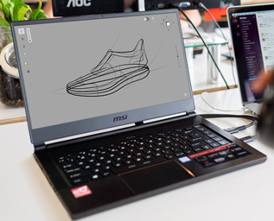
Introduction to modelling
Definitions of «Modelling»:
“The construction of physical, conceptual or mathematical simulations of the real world ”
(OECD/FAO)
“The activity of using mathematical models to make calculations or predict what might happen”
(Cambridge)
Ability to create “virtual or computerized simulation of a building or complex, ...”
(Book IGI Global)
Origins from the latin word “modulus” (measure)
REALITY
Model
Modelling

Slide 4
The process of modelling
Still
Abstraction!
Reality
Abstraction
Model
Stakeholders
Objective/s
Solution of the model!
Framework
Modelling
Constraints
Solution
Real problem
Solver
Data
Expert supervises and validates the solution

Slide 5
Example of (open) frameworks (88)
AMIRIS
ASAM
AnyMOD
Backbone
Balmorel
Breakthrough Energy Model
CAPOW
CESAR-P
Calliope
CapacityExpansion
DESSTinEE
DIETER
Demod
Dispa-SET
DynPP
EA-PSM Electric Arc Flash
EA-PSM Electric Short Circuit
ELMOD
ELTRAMOD
EMLab-Generation
EMMA
EOLES elec
EOLES elecRES
ESO-X
Energy Policy Simulator
Energy Transition Model
EnergyNumbers-Balancing
EnergyRt
EnergyScope
Ficus
FlexiGIS
GAMAMOD
GAMAMOD-DE
GRIMSEL-FLEX
Genesys
GridCal
HighRES
JMM
Lemlab
LoadProfileGenerator
MEDEAS
MOCES
Maon
Medea
MicroGridsPy
Mosaik
MultiMod
NEMO
NEMO (SEI)
OMEGAlpes
OSeMOSYS
Oemof
OnSSET
OpenTUMFlex
PLEXOS Open EU
POMATO
Pandapipes
Pandapower
PowNet
PowerMatcher
PowerSimulations.jl
PowerSimulationsDynamics.jl
PowerSystems.jl
Pvlib python
PyLESA
PyPSA
REopt
Region4FLEX
Renpass
SIREN
SMS++
SciGRID gas
SciGRID power
SimSEE
SimSES
StELMOD
Switch
System Advisor Model (SAM)
TIMES
TIMES Évora
TIMES-PT
Temoa
TransiEnt
URBS
USENSYS
https://wiki.openmod-initiative.org/wiki/Open_Models (03/2024)

Slide 6

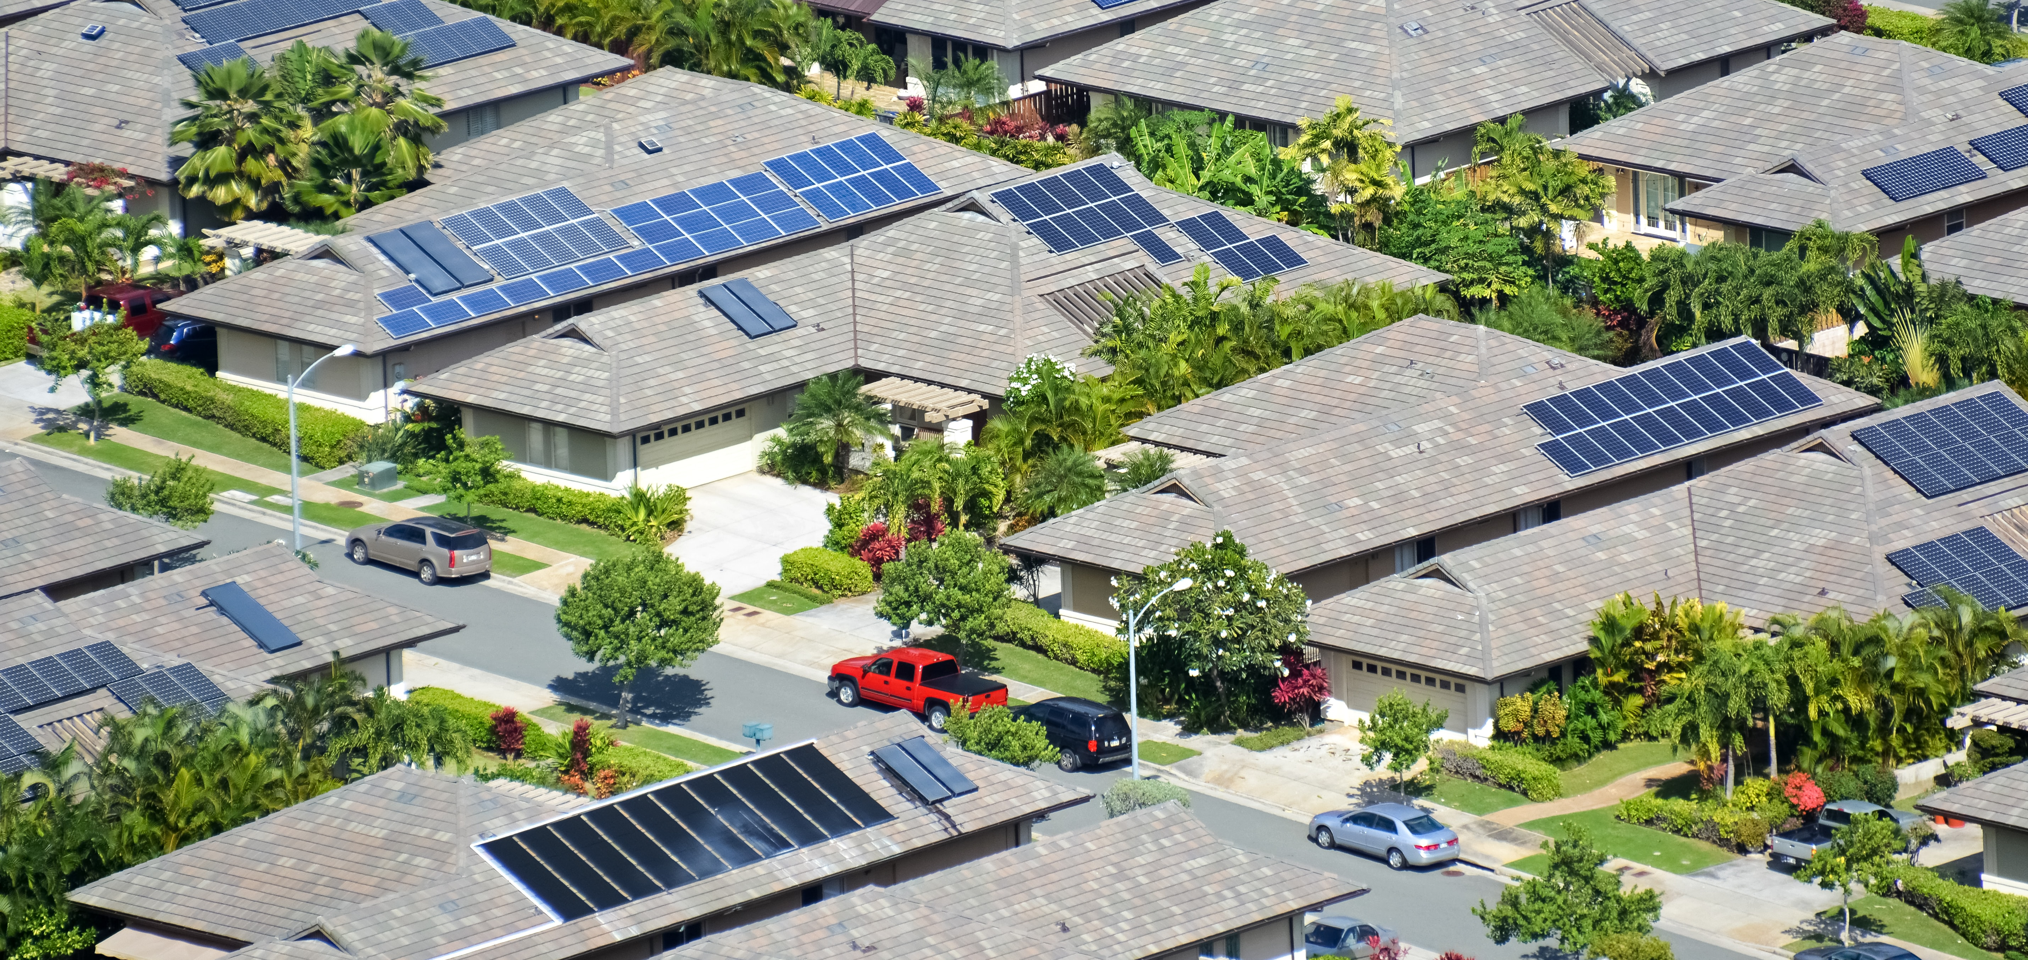
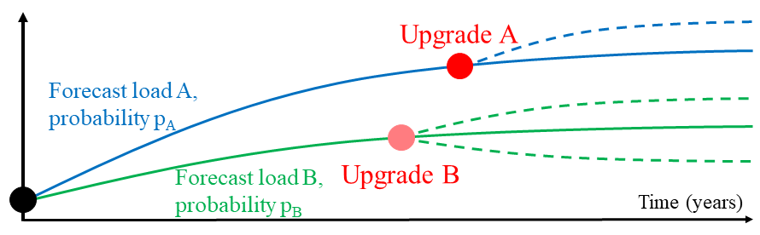
Characteristics of frameworks
1. Definition of the objective/s
2a. Representation of the physical system
Classification of components
Type of constraints
Description of constraints
Energy balances
2b. Temporal characterization
Temporal horizon
Temporal resolution
Representative days
Uncertainties
3. Interfaces to solvers
4. Additional features
(visualization, input-output, etc.)
https://doi.org/10.1016/j.esr.2017.12.002

Slide 7
1. Objective/s
Note: the objective must be clearly defined!
Goal and approximations
Type of objective/s
ECONOMIC
Net Present Value, Internal Rate of Return,
Payback Period, Annuity, …
Environmental
Land use, CO2eq emissions, …
Technical
Conversion efficiency, …
Social
Job creation, «welfare», …
Goal | Variables |  | Approximations
Scopo | Design | Dispatch
Dispatch | No: fixed | Yes | ++
Design | Yes | No (rule-based) | +++
Design and dispatch | Yes | Yes | +++(+) (medium/high)
Dynamics | Limited | Some | + (few)

Slide 8
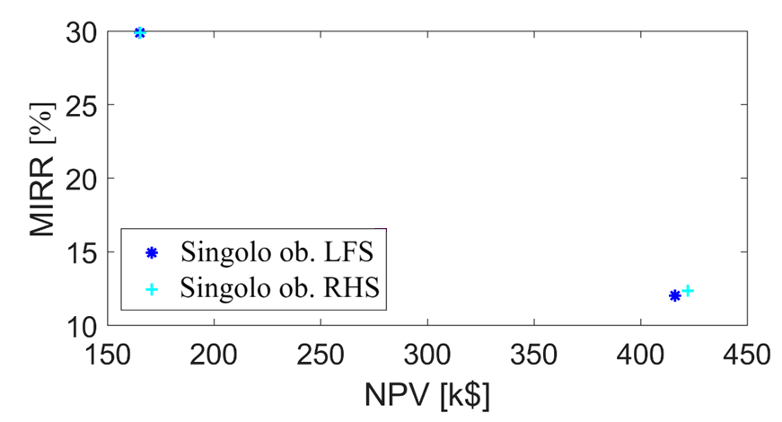
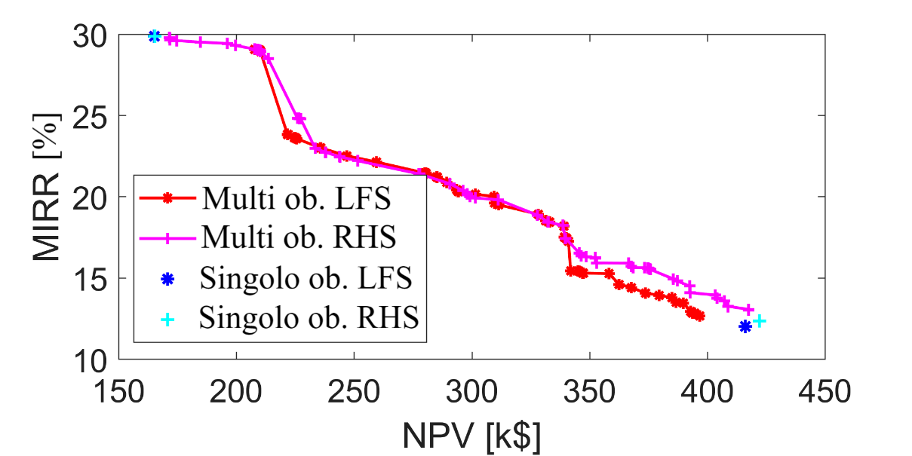
1. Objective/s
Single-Objective problems
min./max. a single indicator
Multi-objective problems
identify the best trade-off among indicators (Pareto frontier)
Max MIRR
Pareto frontier(s)
Max NPV

Slide 9
2a. Represent the physical system
Every framework provides the automatic mathematical description of the physical system, based on:
Characterization of the main phenomena dominating the system:
  Description of the technology(ies)
  Power flow/spatial dimension
Identify the main variables describing the phenomenon
Choose the control and dependent variables
Represent the mathematical relationship between the control and the dependent variables
  Constraints
  Objective function

Slide 10

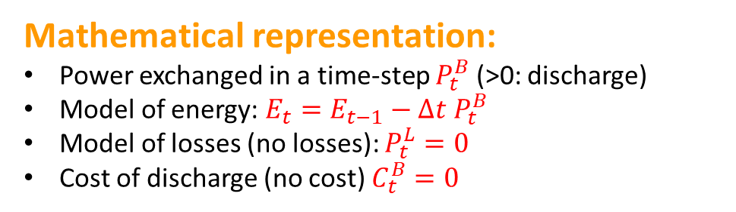
2a. Example: Battery model for dispatching
(high approximation)
Main phenomena:
Electrochemistry:
bidirectional energy flow and energy storage with losses
Joule effect:
energy thermal losses on resistive objects
Conversion losses (elettronics, BMS and converter)
Main variables:
Power exchanged
Energy storage
Losses
Cost of charging/discharging (opportunity cost)
Lithium-ion batteries
Goal:
Purpose: dispatch
Obj. function: economic
Level of approximation: high
Mathematical representation:
Power exchanged in a time-step $P_{t}^{B}$ (>0: discharge)
Model of energy: $E_{t}=E_{t−1}−Δt P_{t}^{B}$
Model of losses (no losses): $P_{t}^{L}=0$
Cost of discharge (no cost) $C_{t}^{B}=0$

Slide 11
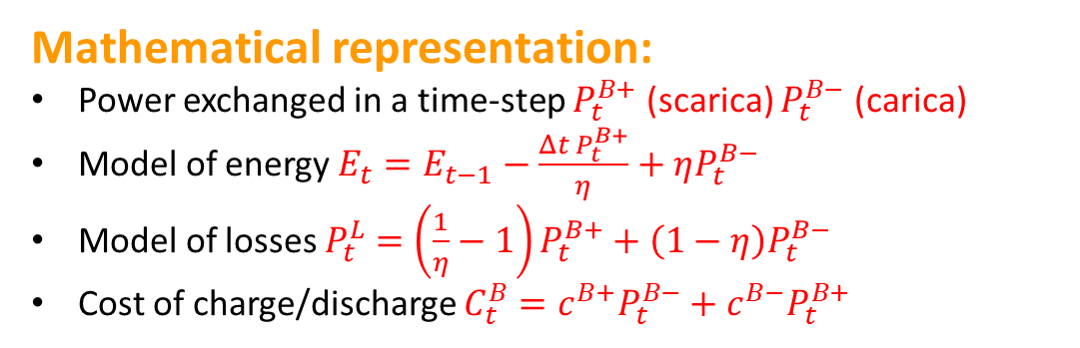
2a. Example: Battery model for dispatching
(medium approximation)
Main phenomena:
Electrochemistry:
bidirectional energy flow and energy storage with losses
Joule effect:
energy thermal losses on resistive objects
Conversion losses (elettronics, BMS and converter)
Main variables:
Power exchanged
Energy storage
Losses
Cost of charging/discharging (opportunity cost)
Lithium-ion batteries
Goal:
Purpose: dispatch
Obj. function: economic
Level of approximation: medium
Mathematical representation:
Power exchanged in a time-step $P_{t}^{B+}$ (scarica) $P_{t}^{B−}$ (carica)
Model of energy $E_{t}=E_{t−1}−\frac{{Δt P}_{t}^{B+}}{η}+ηP_{t}^{B−}$
Model of losses $P_{t}^{L}=$ $\left(\frac{1}{η}−1\right)P_{t}^{B+}+\left(1−η\right)P_{t}^{B−}$
Cost of charge/discharge $C_{t}^{B}=c^{B+}P_{t}^{B−}+c^{B−}P_{t}^{B+}$

Slide 12
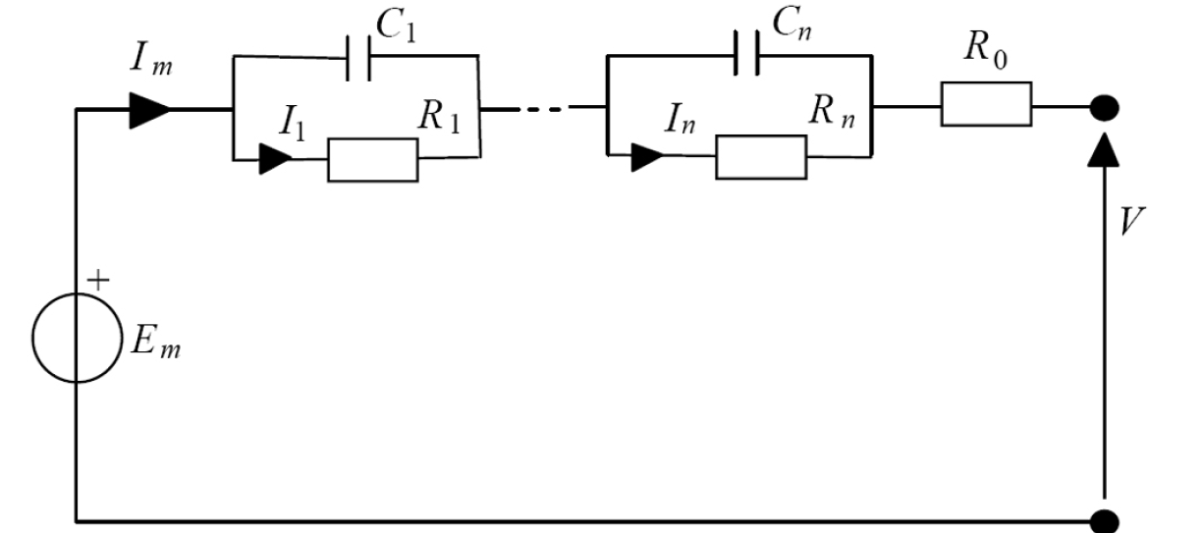
2a. Example: Battery model for dynamics
Main phenomena:
Electrochemistry:
bidirectional energy flow and energy storage with losses
Joule effect:
energy thermal losses on resistive objects
Conversion losses (elettronics, BMS and converter)
Main variables:
Power exchanged
Energy storage
Losses
Cost of charging/discharging (opportunity cost)
Lithium-ion batteries
Goal:
Purpose: dispatch
Obj. function: economic
Level of approximation: high
Mathematical representation:

Slide 13
2a. Represent the physical system: comment
There is no «one-fits-all» framework for all scopes:
multiple scopes are available, each one with advantages and limitations
When no framework addresses your problem, you may integrate your own equations in existing instruments
(Excel – solver addin, Matlab, Python – Pyomo/pulp, Julia – JuMP.jl, Convex.jl)

Slide 14
2b. Temporal characterization
Temporal horizon:
Horizon of the study
Time
1 year
(52 weeks)
Temporal resolution (discrete representation):
Elementary steps the time is subdivided in
Simplify
to dominate
complexity
Representative days (es. simulate 1 week a year)
For long-term problems, a modeler may represent the time horizon (e.g. 20 years) with a fewer number of days,
defined as "typical days," each of which characterizes the behavior of a subperiod (e.g., a month).

Slide 15
2b. Temporal characterization: trade-off resolution/time horizon
Management
Medium-term
Planning
>days
Management
Short-term
hours
Temporal Resolution
minutes
<seconds
<seconds
hours
days
weeks
year
decades
Dynamics
Time horizon

Slide 16
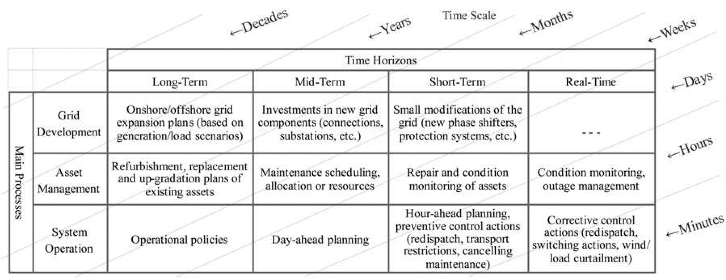
2b. Temporal characterization: focus on the power system
Khuntia, S.R., Tuinema, B.W., Rueda, J.L. and van der Meijden, M.A. (2016), Time-horizons in the planning and operation of transmission networks: an overview. IET Gener. Transm. Distrib., 10: 841-848. https://doi.org/10.1049/iet-gtd.2015.0791

Slide 17
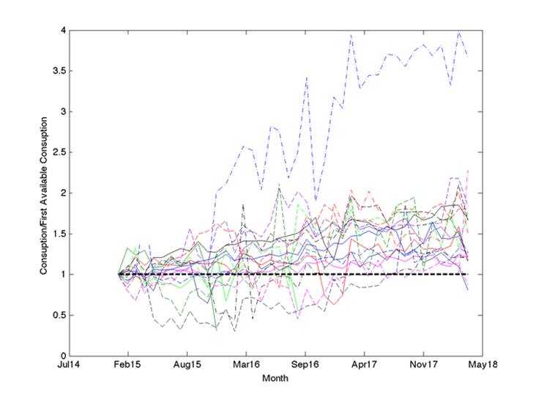
2b. Temporal characterization: uncertainties
Resource estimation can (is likely to) be uncertain!

Slide 18
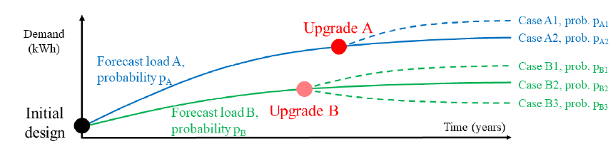
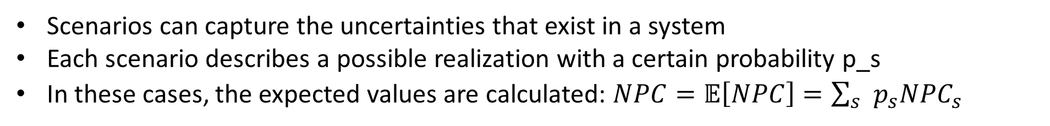
2b. Temporal characterization: scenario representation
Scenarios can capture the uncertainties that exist in a system
Each scenario describes a possible realization with a certain probability p_s
In these cases, the expected values are calculated: $NPC=𝔼\left[NPC\right]=\sum_{s}{p_{s}NPC_{s}}$
For microgrids: -20% Net Present Cost (NPC) and -50% CAPEX
Davide Fioriti, Davide Poli, Pablo Duenas-Martinez, Ignacio Perez-Arriaga, Multi-year stochastic planning of off-grid microgrids subject to significant load growth uncertainty: overcoming single-year methodologies, Electric Power Systems Research, Volume 194, 2021, https://doi.org/10.1016/j.epsr.2021.107053

Slide 19
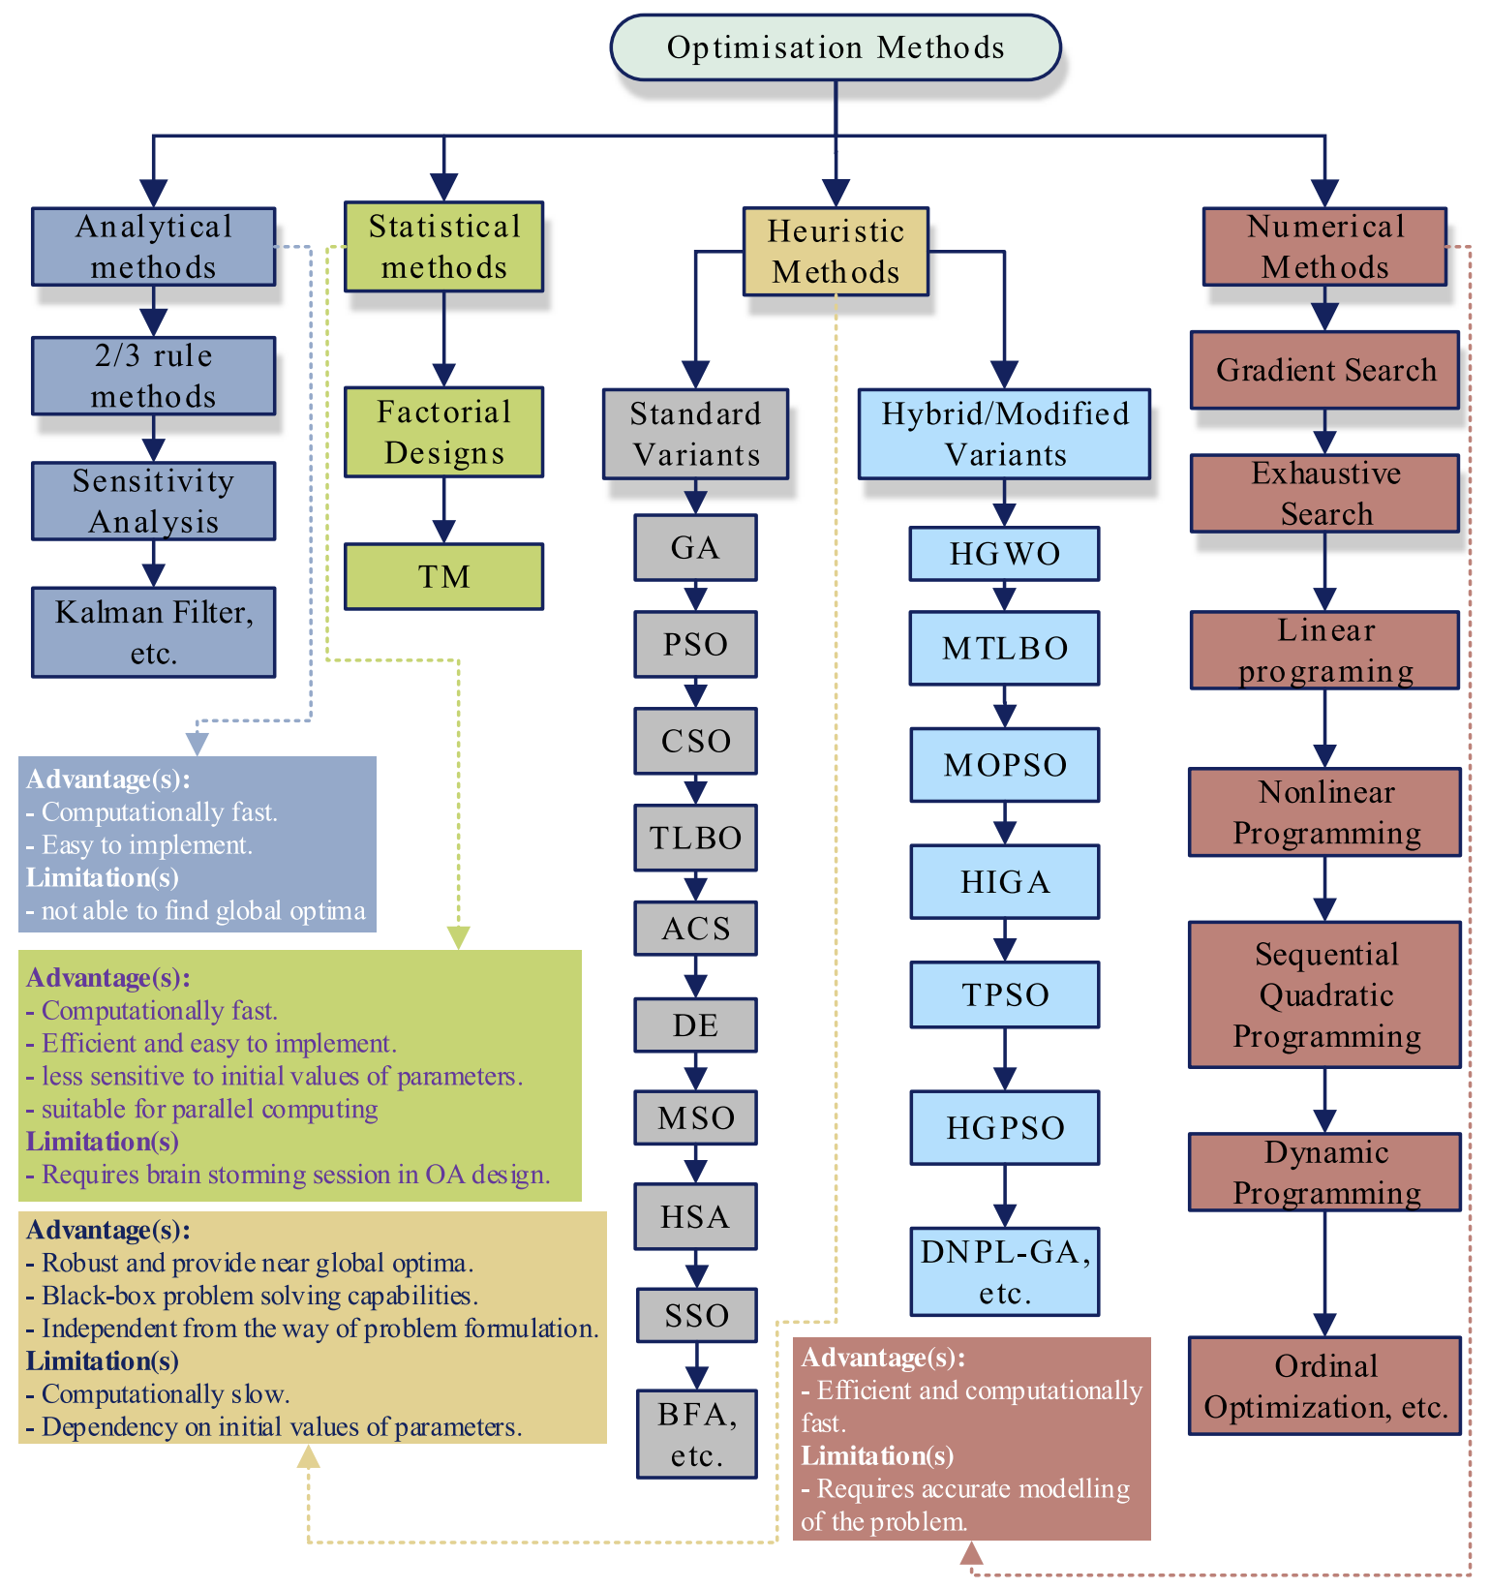
3. Optimization Techniques
Frameworks contain:
a solver or
Interfaces with solvers
e.g. PyPSA, Calliope (Python)
AnyMod.jl GenX.jl (Julia)
P.S. A model can be written
even without Framework

Slide 20
3. Optimization Techniques
Heuristic methods
Simple to implement
Can address arbitrarily complex systems
Limited proof of convergence to global optimum
Scalability/Accuracy issues with large problems
Frameworks contain:
a solver or
Interfaces with solvers
e.g. PyPSA, Calliope (Python)
AnyMod.jl GenX.jl (Julia)
P.S. A model can be written
even without Framework

Slide 21
3. Optimization Techniques
Exhaustive search
Simple to implement
Can address arbitrarily complex systems
Only integer options
Computational complexity explodes with the number of options

Slide 22
3. Optimization Techniques
Mathematical programming
Proven to converge to global optimum, if convex
Can scale with problem size
Model formulation is limited by the formulation
Computational issues can appear for large problems

Slide 23
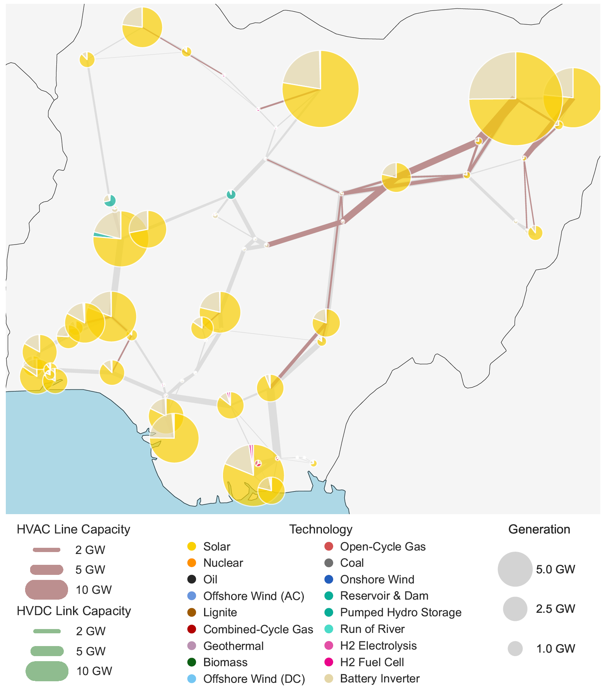
4. Additional features
Import/Export from file
Interfaces to data visualizations
Automatic clustering to dominate complexities
…
Parzen, Maximilian and Abdel-Khalek, Hazem and Fedorova, Ekaterina and Mahmood, Matin and Frysztacki, Martha Maria and Hampp, Johannes and Franken, Lukas and Schumm, Leon and Neumann, Fabian and Poli, Davide and Kiprakis, Aristides and Fioriti, Davide. PyPSA-Earth. A New Global Open Energy System Optimization Model Demonstrated in Africa. Preprint available at https://arxiv.org/abs/2209.04663; https://zenodo.org/record/6857191

Slide 24
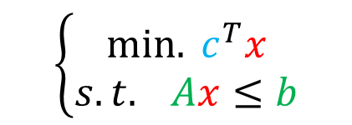
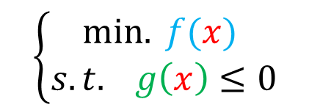
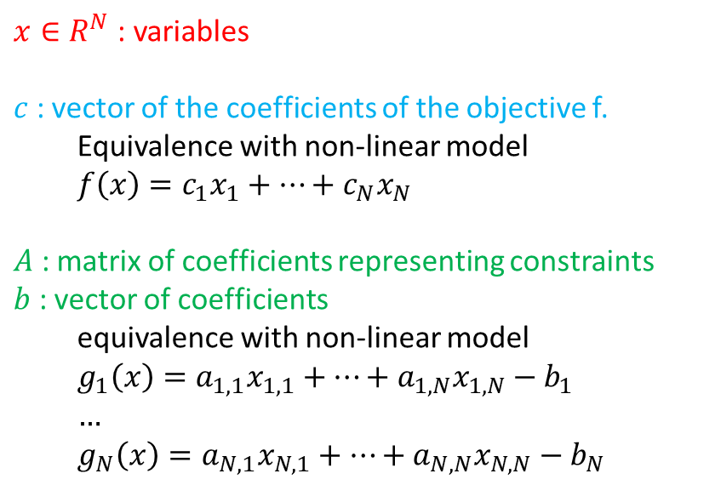
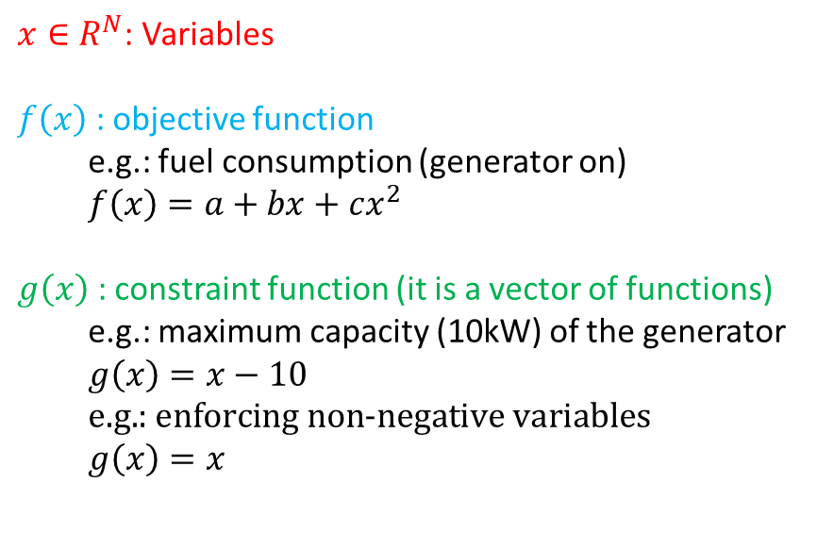
Data + Framework = Model
Mathematical representation of the model
$$\left\{\begin{aligned}min. f(x) \\ s.t. g\left(x\right)≤0\end{aligned}\right.$$
$$\left\{\begin{aligned}min. c^{T}x \\ s.t. Ax≤b\end{aligned}\right.$$
Special case
Nonlinear general model
Linear model
$x∈R^{N}$: Variables
$f\left(x\right)$ : objective function
e.g.: fuel consumption (generator on)
$$f\left(x\right)=a+bx+cx^{2}$$
$g\left(x\right)$ : constraint function (it is a vector of functions)
e.g.: maximum capacity (10kW) of the generator
$$g\left(x\right)=x−10 \\ \text{e}\text{.}\text{g}\text{.: }\text{enforcing} \text{non}\text{−}\text{negative} \text{variables}$$
$$g\left(x\right)=x$$
$x∈R^{N}$: variables
$c$ : vector of the coefficients of the objective f.
Equivalence with non-linear model
$$f\left(x\right)=c_{1}x_{1}+…+c_{N}x_{N}$$
$A$ : matrix of coefficients representing constraints
$b$ : vector of coefficients
equivalence with non-linear model
$$g_{1}\left(x\right)=a_{1,1}x_{1,1}+…+a_{1,N}x_{1,N}−b_{1}$$
$$…$$
$$g_{N}\left(x\right)=a_{N,1}x_{N,1}+…+a_{N,N}x_{N,N}−b_{N}$$

Slide 25
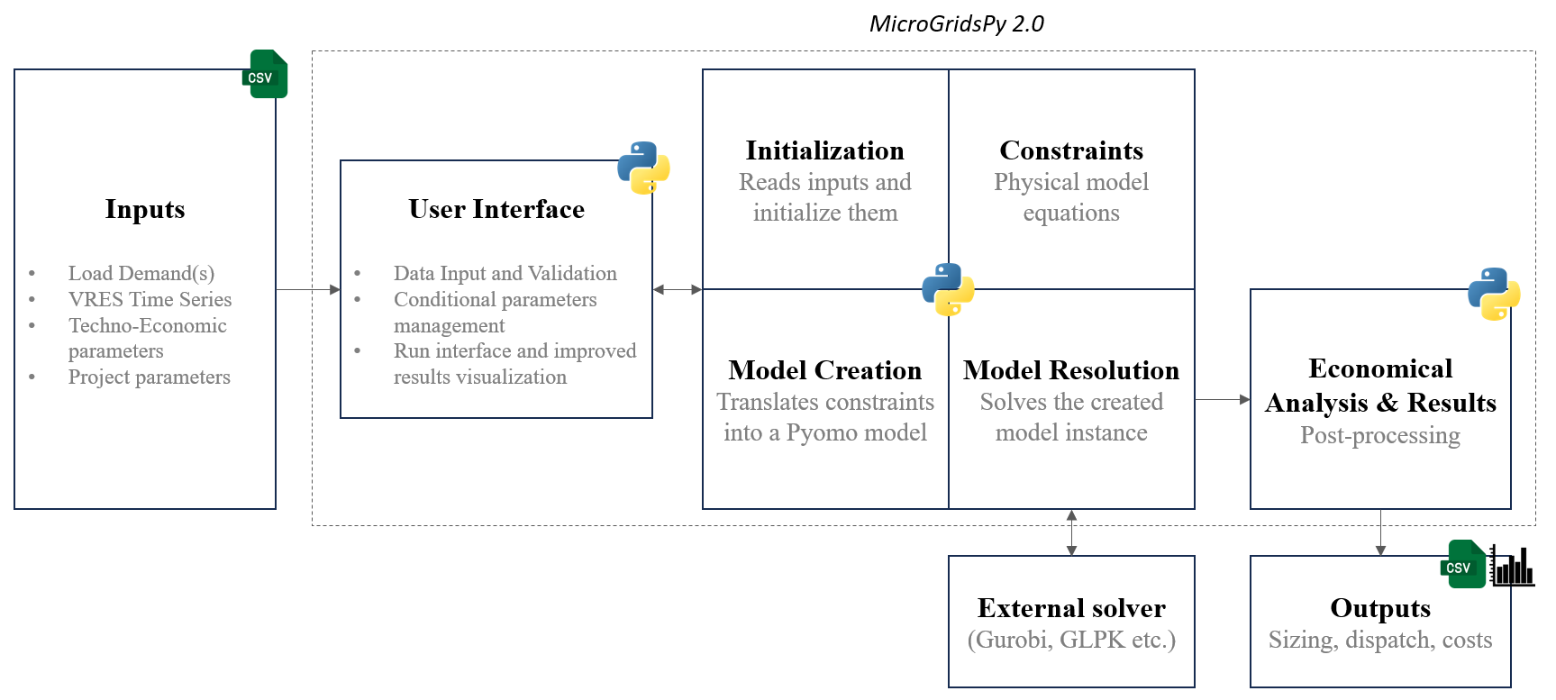
Example: MicrogridsPy
Objective + System representation
(1, 2a and 2b)
Optionals (4):
input & user - interface
Solver interface (3)
Mathematical programming (LP/MILP)
Optionals (4): output
https://microgridspy-documentation.readthedocs.io/

Slide 26
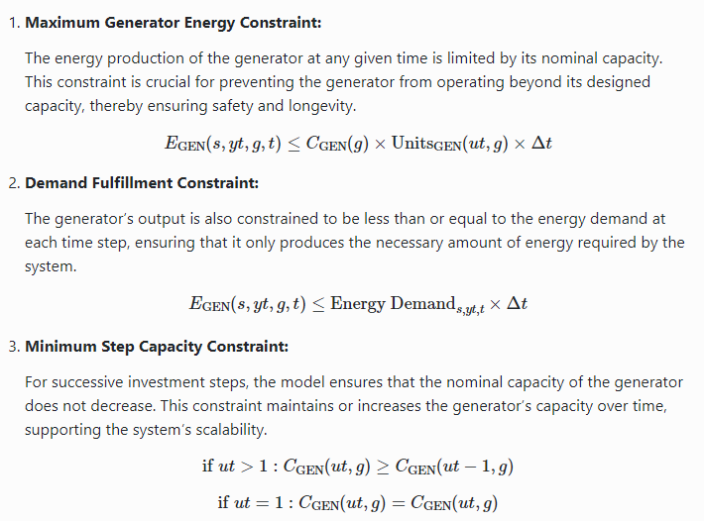
Example: MicrogridsPy
Objective(s) (1)
Net Present Cost
Total Variable Cost
CO2emissions (multi-objective)
Representation of physical components (example: generator)
https://microgridspy-documentation.readthedocs.io/en/latest/formulation.html

