Slide 1

BUSINESS AND SOCIO-ECONOMIC CONTEXTS OF MINI-GRID DEVELOPMENT
Lesson 3:
Policy and Regulations

Slide 2

Lesson 3 Outline
Introduction​
Definitions
Importance of Policy And Governance in Mini-Grid Development
Faza Mini-Grid Case Study (Kenya)
Policy and Regulatory Frameworks
Policy to support mini-grid development​
Rokota Mini-Grid Case Study (Nigeria)
Community Engagement and Capacity Building​
Capacity Building & Community Engagement Strategies

Slide 3

Introduction
"Good governance with sound policies is the cornerstone of a thriving society. When policies are crafted with foresight and inclusivity, they empower communities, drive sustainable development, and foster economic growth. ​
Conversely, ineffective policies can lead to stagnation and inequity, stalling progress and widening the gap between rich and poor. The impact of policy on the world is profound and far-reaching, shaping the quality of life for millions and defining the future of nations."​
Ban Ki-moon,
Former Secretary-General of the United Nations

Slide 4
Definitions
Policy: a course or principle of action adopted or proposed by an organization or individual.
Regulation is the controlling of an activity or process, usually by means of rules or an official rule or the act of controlling something
Governance: the act or process of governing or implementing policies and regulations
Policy and governance refer to the frameworks and regulations established by governments and institutions to manage and support energy projects, including mini-grids.
'Policy shapes the everyday lives of people, determining access to resources, opportunities, and the overall well-being of communities'.
Barack Obama, Former President of the United States
Notes:
how policy and governance impact mini-grid development:
Regulatory Framework
Licensing and Permits: Simplified and clear processes for obtaining necessary approvals.
Grid Interconnection Policies: Regulations that allow easy integration of minigrids with the main grid.
Standards and Quality Control: Establishment of technical standards to ensure reliability and safety.
Financial Incentives
Subsidies and Grants: Financial support to reduce initial capital costs.
Tax Incentives: Tax breaks or reductions on minigrid-related equipment.
Tariff Structures: Flexible and fair pricing policies for electricity.
Institutional Support
Capacity Building: Training programs for local operators and communities.
Public-Private Partnerships: Collaboration between government and private sector.
Research and Development: Government support for innovation in minigrid technologies.
Market Conditions
Competition Policies: Promoting competition to lower costs and improve service quality.
Consumer Protection: Ensuring fair practices and protection for consumers.
Renewable Energy Integration: Encouraging the use of renewable energy sources.
Institutional and Governance Structures
Decentralized Governance: Empowering local entities in mini-grid management.
Coordination Among Agencies: Ensuring effective communication and cooperation.
Monitoring and Evaluation: Regular assessment of projects to ensure standards are met.

Slide 5





IMPORTANCE OF POLICY AND GOVERNANCE IN
MINI-GRID DEVELOPMENT
Profitability
Frameworks that offer financial support and regulatory stability improve profitability by lowering costs and making investments more appealing.
Sustainability
Frameworks that incorporate environmental and social criteria ensure that mini-grid projects are sustainable and have a positive impact on local communities and the environment.
Feasibility
Clear regulatory guidelines and access to funding improve the feasibility of mini-grid projects by simplifying the development process and addressing financial barriers.
Accountability
Transparent management processes and regular monitoring ensure that mini-grid projects are run efficiently, and stakeholders are held accountable.
Reliability
Technical standards and support mechanisms in policies and frameworks ensure that mini-grids operate reliably, providing consistent and safe electricity to users.

Slide 6

FAZA MINIGRID (Kenya): OVERVIEW
Faza Mini-Grid was developed to provide reliable, sustainable electricity to a remote community previously lacking energy access.
Technology: Hybrid system with solar power
Location: Faza Village, Pate Island, Kenya
Population: 2,000 residents
Activities: Agriculture, fishing, and trading
Project Start Date: 2018
Project Aim: Reduce reliance on less sustainable energy sources like kerosene lamps.

Slide 7
FAZA MINIGRID: FRAMEWORKS & OUTCOMES
SUPPORTIVE FRAMEWORKS
Regulatory Framework:
            Kenya Energy Act 2019 supports renewable energy and mini-grid projects.
            EPRA provides streamlined licensing and permits.
Financial Incentives:
Government and international donor subsidies and grants reduce initial costs.
Import duty and VAT exemptions on renewable energy equipment.
Community Engagement:
  Regular public consultations address community needs.
  Training programs equip locals for system maintenance.
OUTCOMES
Faster Implementation: Strong regulatory support and financial incentives streamline project execution.
Cost Reduction: Financial incentives help lower economic barriers.
Improved Sustainability: Building local capacity and securing community support enhances long-term project viability.
Socio-Economic Gains: The project spurs economic growth and improves healthcare and educational opportunities.

Slide 8





POLICY AND REGULATORY FRAMEWORKS
Policy and regulatory frameworks directly influence the socio-economic conditions of communities by shaping how energy systems are planned, implemented, and operated.
Regulatory Framework
Financial Incentives
Institutional Support
Market Conditions
Governance Structures

Slide 9
Policy and regulations to support mini-grid development​
Regulatory Framework
Licensing and Permits: Simplified and clear processes for obtaining necessary approvals.
Grid Interconnection Policies: Regulations that allow easy integration of minigrids with the main grid.
Standards and Quality Control: Establishment of technical standards to ensure reliability and safety.
Financial Incentives
Subsidies and Grants: Financial support to reduce initial capital costs.
Tax Incentives: Tax breaks or reductions on minigrid-related equipment.
Tariff Structures: Flexible and fair pricing policies for electricity.
Institutional Support
Capacity Building: Training programs for local operators and communities.
Public-Private Partnerships: Collaboration between government and private sector.
Research and Development: Government support for innovation in minigrid technologies.
Market Conditions
Competition Policies: Promoting competition to lower costs and improve service quality.
Consumer Protection: Ensuring fair practices and protection for consumers.
Renewable Energy Integration: Encouraging the use of renewable energy sources.
Governance Structures
Decentralized Governance: Empowering local entities in mini-grid management.
Coordination Among Agencies: Ensuring effective communication and cooperation.
Monitoring and Evaluation: Regular assessment of projects to ensure standards are met.

Slide 10
REGULATORY FRAMEWORKS
Regulations play a crucial role in ensuring the safe, reliable, and fair operation of mini-grids. They establish standards and guidelines that protect users, ensure technical compatibility, and promote economic feasibility.
Safety Standard
Regulations establish safety requirements for the design, construction, and operation of mini-grids, protecting users from electrical hazards and ensuring system stability.
Technical Standards
Regulations specify technical requirements for components like generators, batteries, and inverters, ensuring compatibility and interoperability within the mini-grid system.
Tariff Regulation
Regulations set guidelines for tariffs charged by mini-grid operators, ensuring fair pricing and affordability for the community.
Grid Integration
Regulations outline the process for connecting mini-grids to the main grid, facilitating backup power and power exchange between systems.
Effective regulatory frameworks are crucial for the successful development of mini-grids.
They should balance the need for investor confidence, consumer protection, and alignment with national energy goals.

Slide 11



FINANCIAL INCENTIVES
These are tools used by governments to encourage investment by reducing costs and providing support.
Subsidies
Financial assistance from the government to lower the initial costs of projects.
A government grant that covers part of the expenses for solar panels.
Feed-in Tariffs (FiTs)
Guaranteed payments to energy producers for the electricity they supply to the grid.
Tax Breaks
Reductions in taxes to encourage investment in certain projects.
Tax credits for companies that invest in mini-grid projects, reducing their overall tax bill.
A fixed rate is paid to mini-grid operators for each kilowatt-hour of electricity they generate from renewable sources.
For mini-grid development, these incentives help lower setup and operational costs, making it easier to bring sustainable energy to remote and rural areas. This improves energy access and supports local economies.

Slide 12


INSTITUTIONAL SUPPORT
Institutional support encompasses the formal organizational structures, rules, and informal norms that assist in the provision of services, including mini-grid projects. Effective governance structures are crucial for implementing policies that promote development. Institutional support can come from both governmental bodies and international organizations.
Decentralization & Local Engagement
Decentralized governance structures that involve local councils in the management of mini-grid projects, promoting transparency and community ownership.
Partnership Development
Collaborating with non-governmental organizations, private sector entities, and international agencies to leverage additional resources and expertise.
Training & Capacity Building
Programs aimed at enhancing the skills and knowledge of individuals involved in project development and maintenance.
Funding & Grants
Grants from international organizations or government funds that cover part of the expenses for setting up mini-grids in underserved areas.

Slide 13





MARKET CONDITIONS
Peace and Stability
Demographics
Supply and Demand
Speculation and Expectation
International Transactions
Market conditions refer to the external and internal environment where businesses operate, shaped by policies, regulations, and economic factors. These conditions affect the product, price, place, and promotion of mini-grids and their development.
Peace and stability enhance the feasibility mini-grid projects by reducing the risk of disruptions to energy supply and operations due to political unrest or conflict. Stable environments are more attractive for implementing mini-grid initiatives.
Demographic shifts, such as aging populations or increasing urbanization, can influence consumer behavior, workforce availability, and demand for services like energy.
Regions experiencing rising energy needs or unreliable grid access may drive higher demand for mini-grids, ensuring a reliable electricity supply and vise-versa.
Positive economic expectations and investor confidence boost funding and development in mini-grid projects, as optimistic market sentiment about growth encourages financing energy infrastructure, including mini-grids.
Investors may find it more advantageous to invest in projects in countries with strong currencies, potentially lowering financing costs and increasing the project viability of mini-grid development.

Slide 14
GOVERNANCE STRUCTURES
These are systems of processes, functions, structures, rules, laws, and norms that ensure activities are conducted in a manner that is fair, transparent, and accountable, promoting stability and trust within various sectors, including the public, private, and non-profit domains.
Legislative Framework
These include laws on corporate governance, labor, environmental protection, and financial regulations. Provides oversight, reduces risks of malpractices, and ensures adherence to standards.
Regulatory Agencies
Agencies enforce laws and regulations, monitor compliance, and address violations. Provides oversight, reduces risks of malpractices, and ensures adherence to standards.
Policies and Standards
Guidelines set by professional or regulatory bodies that outline expectations and procedures. Ensuring consistency, promoting best practices, and enhancing accountability.
Governance Bodies
Bodies that oversee adherence to policies, regulations, and ethical standards. They play a critical role in ensuring that an organization operates effectively, transparently, and within the bounds of legal and regulatory frameworks.
They provide the necessary rules and oversight to ensure legal compliance, promote ethical behavior, and protect stakeholders' interests.

Slide 15




Permits & Approvals for Mini-Grid Development
  Necessary permits and approvals are essential for the successful development and operation of mini-grid projects. These regulatory steps ensure that mini-grids are legally compliant, environmentally sustainable, technically integrated, and properly authorized.
Construction permits
Required for construction activities associated with mini-grid installation.
Environmental permits
Necessary environmental impact assessments and clearances based on location.
Approvals from the utility company for connecting the mini-grid to the main grid.
Land permits
Required permissions from local authorities to use land for mini-grid construction
Grid Connection permits

Slide 16



Permits and Approvals for Mini-Grid Development
  Necessary permits and approvals are essential for the successful development and operation of mini-grid projects. These regulatory steps ensure that mini-grids are legally compliant, environmentally sustainable, technically integrated, and properly authorized.
Permit Type | Description
Land Use Permits | Required permissions from local authorities to use land for mini-grid construction.
Environmental Permits | Necessary environmental impact assessments and clearances based on location.
Construction Permits | Required for construction activities associated with mini-grid installation.
Grid Connection Permits | Additional approvals from the utility company for connecting the mini-grid to the main grid.

Slide 17


ROKOTA MINI-GRID (Nigeria): Overview
Location: Rokota, Niger State, Nigeria
Technology: A solar hybrid 64kWp plant, covering an area of about 1 km²
Population: 3000 people.
Project aims: Improve the quality of life for the residents
Support local economic activities.

Slide 18
Rokota Mini-Grid : Supportive Frameworks
Regulatory Framework
        Nigerian Electricity Regulatory Commission (NERC): Provides guidelines and licenses for mini-grid operations, ensuring compliance with safety and performance standards.
        Rural Electrification Agency (REA): Supports the implementation of rural electrification projects, including mini-grids.
        Mini-Grid Regulation 2017: Specific regulations that facilitate the deployment of mini-grids in underserved areas.
Financial Incentives
Subsidies and Grants: Provided by the Nigerian government and World Bank to make the project financially viable.
Import Duty and VAT Exemptions: Exemptions on renewable energy equipment to lower overall project costs.
Technical and Infrastructure Support
Technical Assistance Programs: International and national technical assistance to ensure the mini-grid meets technical standards and operates efficiently.
Infrastructure Development: Support for complementary infrastructure such as roads and communication networks, improving access and operational efficiency.
Discussion task: Discuss possible project outcomes based on the policy and regulatory frameworks

Slide 19
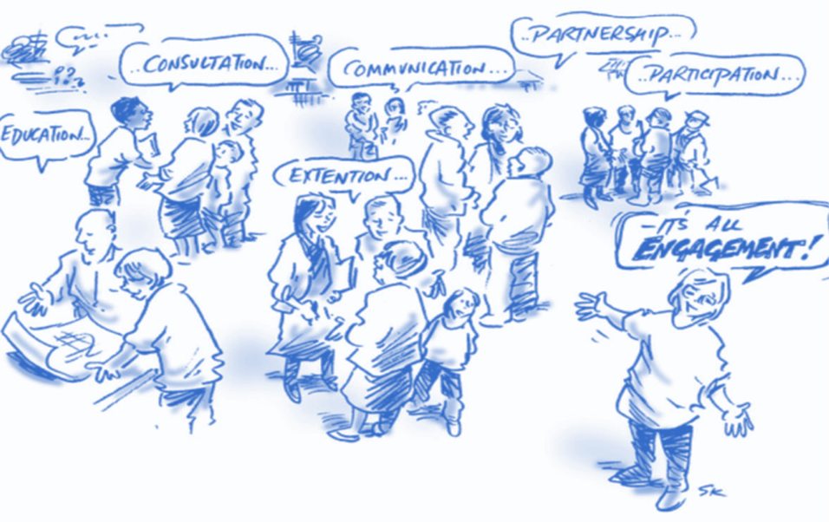



Capacity Building and Community Engagement
Community Engagement
Involving the community in decision-making to ensure the mini-grid meets their needs, fostering ownership and responsibility.
Capacity Building
Developing the skills and knowledge of community members to manage, maintain, and sustain mini-grid systems.
Effective community engagement and capacity building are essential for the successful operation and sustainability of mini-grid systems. When community members are equipped with the skills and knowledge to operate and maintain these systems, several benefits are realized:
                Improved system reliability and maintenance
                Increased community involvement and ownership
                Ensured long-term project success and sustainability
Notes:
Capacity Building equips community members with the skills to manage and maintain mini-grids. Community Engagement involves them in decision-making, ensuring the mini-grid meets local needs and fostering ownership. Together, they enhance system reliability, reduce costs, and ensure long-term project success.
Effective community engagement and capacity building are crucial for the successful operation and sustainability of mini-grid systems. By ensuring community members have the skills and knowledge to operate and maintain mini-grid systems, several benefits are achieved:
Enhanced System Reliability and Maintenance:
Equipping community members with operational skills reduces downtime and technical issues, leading to better reliability of the mini-grid system.
Improved maintenance knowledge supports sustainable management of energy resources, ensuring long-term efficiency and effectiveness of the project.
Community Involvement and Ownership:
Involving the community in planning and decision-making processes ensures that the mini-grid system is tailored to local needs and preferences.
This fosters a sense of ownership and responsibility among community members, encouraging greater support and maintenance efforts.
Long-Term Project Success and Sustainability:
Community engagement contributes significantly to the long-term success and sustainability of mini-grid projects.
When communities are actively engaged, they are more likely to support the project financially and through active participation, which enhances its overall sustainability.
By integrating community engagement with capacity building initiatives, mini-grid projects can not only address immediate energy needs but also empower communities to sustainably manage their energy resources for the future.

Slide 20
Capacity Building & Community Engagement Strategies
Workshops and Meetings
Identify Local Needs
Skills Development
Sustainable Implementation
Monitoring and Feedback

