Slide 1

ENTREPRENEURSHIP IN THE OFF-GRID SOLAR ENERGY SECTOR
Lesson 1: Introduction to the Solar Off-Grid Sector in Africa
Author: A. Dib

Slide 2
Lesson 1: Learning Outcomes
After completing this lesson, you will :
Have an overview of the off-grid energy sector in Sub-Saharan Africa
Understand the strategic drivers and opportunities of the off-grid energy sector in Africa
Have an overview of the Solar Energy Statups Landscape

Slide 3
Introduction to Solar Off-Grid Sector in Africa
In the recent 2023 SDG7 progress report it is revealed that access to electricity continues to be a significant impediment to socioeconomic progress in Sub-Saharan Africa. As of 2021, over 80 percent of the global population lacking electricity resided in this region. Although there has been gradual improvement in the access rate over the past decade, the number of people without electricity has remained unchanged due to population growth. Consequently, 567 million individuals still lacked access to electricity in 2021, despite Africa boasting 60% of the world’s best solar resources.
The majority of the 650 million people without electricity will be in Sub-Saharan Africa. Promoting private sector investments is critical for accelerating electricity access. Rural electrification is notably expensive, necessitating innovative solutions beyond traditional grid extension, including micro-grids and isolated systems. A balanced approach integrating grid extension with off-grid solutions, like mini-grids and individual systems, is essential for universal electricity access
Notes:
Ref. : https://www.aecfafrica.org/powering-rural-africa-with-household-solar-solutions/

Slide 4
Introduction to Solar Off-Grid Sector in Africa
Africa and specifically, Sub-Saharan Africa, with its vast population lacking access to electricity, presents a significant market for decentralized renewable energy (RE) solutions, especially off-grid solar systems. These systems are crucial for achieving universal access to electricity and vital in remote and rural areas where grid extension is not feasible or cost-effective.
Declining costs of solar technologies, along with innovative business models such as Pay-as-you-go (PAYG), micro leasing for solar products and solar product distribution networks, have made solar energy increasingly accessible to previously underserved households.
According to the International Renewable Energy Agency (IREA), the costs of solar photovoltaic (PV) modules have dropped by around 80% between 2010 and 2020 (IRENA, 2021). Additionally, a study conducted by Lighting Global and Dalberg Advisors reported that the prices of solar lanterns in Africa reduced by approximately 80% between 2010 and 2019 (Lighting Global, 2020).

Slide 5
Introduction to Solar Off-Grid Sector in Africa
A study conducted by Lighting Global and Dalberg Advisors reported that the prices of solar lanterns in Africa reduced by approximately 80% between 2010 and 2019 (Lighting Global, 2020). This expansion is being driven by African solar companies and social enterprises (some of which are foreign-owned), deploying off-grid solar home systems, solar lanterns, and mini-grids to power homes and businesses.
The implementation of household solar solutions in Africa has brought about transformative impacts. Families now have extended hours of lighting, can power appliances, charge mobile phones, access information and communication technologies as they enjoy safer environments. This has improved educational opportunities, and communities’ wellbeing in general. Moreover, Solar energy is replacing hazardous and expensive lighting alternatives like kerosene lamps, reducing household health risks and expenses.

Slide 6
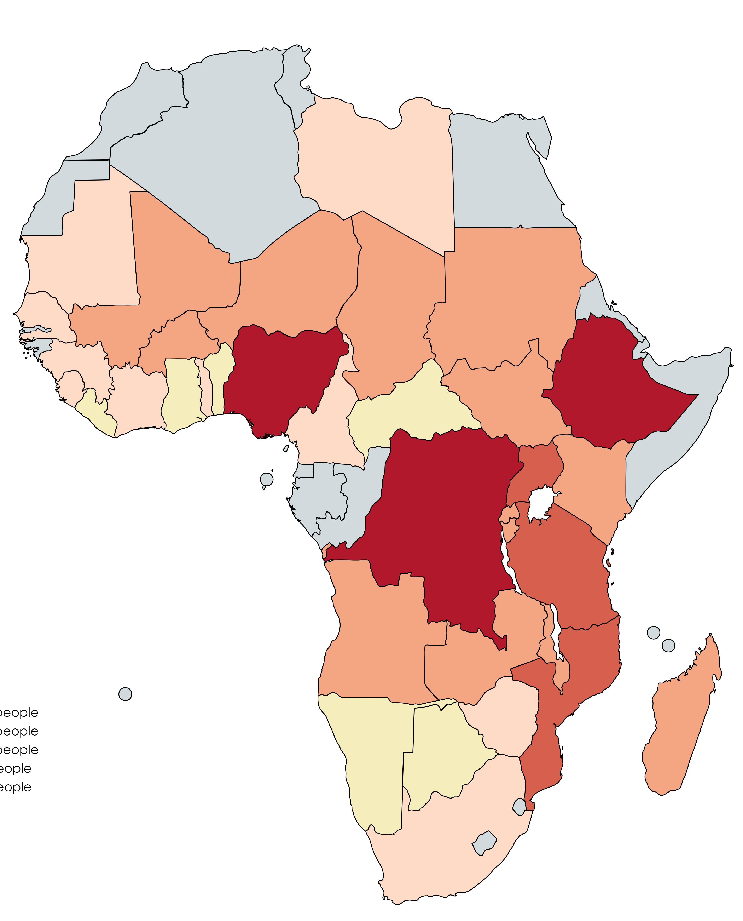
The scale of the problem
Electricity access deficit by country
The scale of the problem is huge
Of the 900 million people without electricity access in the world, 565 million (72%) live in Sub-Saharan Africa.
Almost 80% of the energy consumed in Sub-Saharan Africa is generated through inefficient combustion of solid biomass - mainly wood or charcoal - for cooking. This is increasing deforestation, greenhouse gas emissions, habitat destruction and the loss of nature.
660-674 million people expected to remain unelectrified in 2030.
1.8-1.9 billion people expected to remain without clean cooking in 2030
> 50 million people
> 20 million people
> 10 million people
> 5 million people
> 2 million people
Electricity access deficit by country
*Source : Open Capital Advisors analysis of SDG7 tracking data and UN Population Division data.

Slide 7
Solar Off-Grid Sector in Africa
The off-grid solar sector in Africa has emerged as a critical solution for providing sustainable energy to the continent's underserved populations. With traditional grid expansion being slow and costly, off-grid solar technologies offer a viable alternative to electrify remote and rural areas.
Africa's off-grid solar market has experienced substantial expansion over the past decade, driven by innovative business models, technological advancements, and supportive policies. Approximately 70 million people in Africa have gained access to electricity through off-grid solar solutions in the past three years​​. The sector has played a crucial role in bridging the energy access gap, particularly in rural and underserved areas where grid extension is economically and logistically challenging.

Slide 8
Strategic Drivers and Opportunities
Climate Change and Resilience
Climate change poses a significant challenge to the African continent, with increasing frequency and severity of extreme weather events impacting agricultural productivity and food security. Off-grid solar solutions can enhance the resilience of communities by providing reliable energy for essential services, such as water pumping for irrigation and powering health facilities​​.

Slide 9
Strategic Drivers and Opportunities
Gender Equality and Economic Empowerment
The off-grid solar sector also presents opportunities for advancing gender equality. Women are increasingly participating as entrepreneurs and employees in the solar energy value chain, contributing to economic growth and community development. Initiatives that focus on gender-smart investing are crucial in bridging the gender gap in access to finance and energy​

Slide 10
Strategic Drivers and Opportunities
Technological Advancements:
Solar Home Systems (SHS): The proliferation of SHS has enabled millions of households to access clean energy for lighting, phone charging, and powering small appliances. These systems are often bundled with energy-efficient appliances, enhancing their utility and attractiveness​​.
Battery Storage: Innovations in battery technology, including lithium-ion batteries, have significantly reduced costs and improved energy storage capabilities, facilitating the reliable use of solar energy​​.

Slide 11
Strategic Drivers and Opportunities
Financial Innovations:
Pay-As-You-Go (PAYG) Models: PAYG financing models have revolutionized the off-grid solar market by allowing customers to pay for solar products in affordable installments using mobile money. This model has increased accessibility and affordability, particularly for low-income households​​.
Digital Finance Integration: The integration of digital finance, including mobile banking and micro-lending, has further accelerated the adoption of off-grid solar solutions. Digital finance platforms enable seamless transactions, enhancing customer experience and financial inclusion​​.

Slide 12
Strategic Drivers and Opportunities
Supportive Policies and Investments:
Government Initiatives: Various African governments have implemented policies and incentives to promote off-grid solar solutions, including tax exemptions, subsidies, and regulatory support. These initiatives have created a conducive environment for market growth​​.
International Funding: Significant investments from international development agencies, private investors, and philanthropic organizations have bolstered the sector. These funds are often directed towards scaling up successful business models and expanding market reach​​

Slide 13
Solar Mini-Grid Landscape
160,000 Mini-grids needed to reach universal electricity access by 2030
91 bn $ Investment required to meet mini-grid targets
380m current population size to be connected to mini-grid solutions
$2.6bn value of grant, subsidy, and bilateral loans mobilised for mini-grids by Development Finance Institutions and Development Partners
9,000 mini-grids planned as at 2021
20m energy access beneficiaries from planned mini-grids

Slide 14
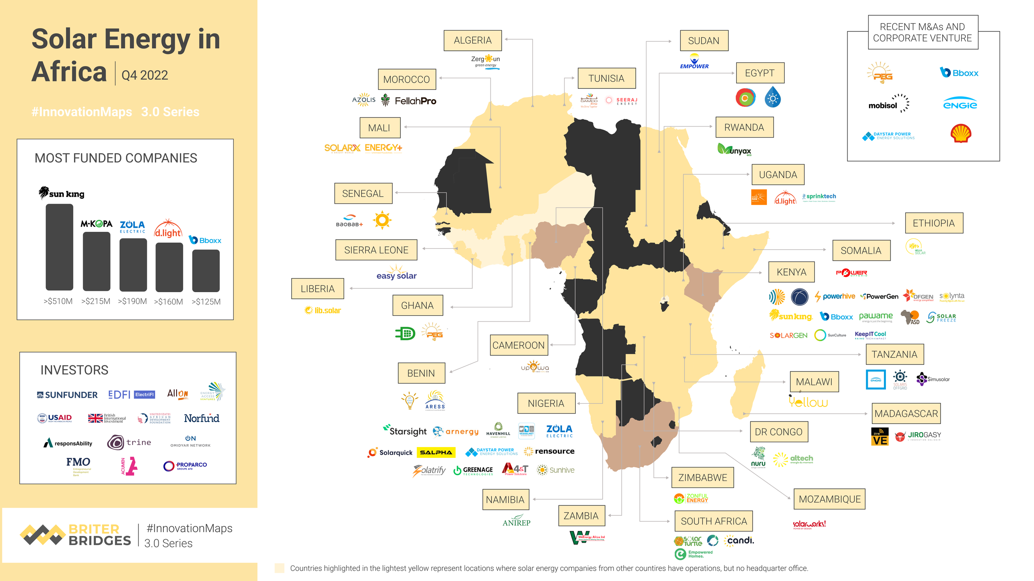
Solar Energy Startups Landscape
‘’Startups with Africa presence draw 58%
of global off-grid solar funding’’
Notes:
Ref. : https://briterbridges.com/stories/2022/10/20/the-solar-energy-startup-landscape-in-africa

Slide 15
Solar Energy Startups Landscape
Off-grid solar sector raised $425 million in 158 deals in 2023, with a significant $281 million from debt financing.
Sun King, d.light, Engie Energy Access, M-KOPA, Zola, and Bboxx accounted for 58% of total investments, highlighting Africa-focused ventures.
Startups in the sector address energy access challenges by offering tailored solutions for communities without electricity.
Notes:
Ref. : https://dabafinance.com/en/news/startups-with-africa-presence-draw-most-of-off-grid-solar-funding

Slide 16
Solar Energy Startups Landscape
Solar energy startups increase access to electricity to underserved people in rural and urban areas across Africa, empowering households and businesses whose livelihood and daily life and work depend on a reliable power supply.
The solutions include:
      Democratising access to quality energy products for consumers;
      Providing access to solar systems for commercial users
      Improving financial inclusion for underserved communities
      Improving financial inclusion for underserved communities
      Reducing operational costs for farmers
Notes:
Ref. : https://briterbridges.com/stories/2022/10/20/the-solar-energy-startup-landscape-in-africa

Slide 17
1.Democratising access to quality energy products for consumers
Solar home systems (SHS) are increasingly replacing the use of harmful kerosene lanterns in parts of Africa without access to grid connection. SHS allow users to have lighting, charge their phones, and power their electrical appliances. One of the most funded providers of SHS in Africa is the Kenyan solar company Sun King (formerly Greenlight Planet). To enable its customers to afford its off-grid solar solutions, Sun King allows payments in instalments of as little as $0.22 per day after an initial deposit. Payback periods for the SHS typically take up to 12 months and collection is made via mobile money systems such as MPESA. This model, referred to as pay-as-you-go (PAYGo), allows users to pay per unit of electricity used. It also provides a means of owning solar assets which include mobile solar lanterns and cookstoves. Several solar companies have adopted PayGo to deliver fast and reliable access to clean energy products for low-income households in Africa.
Some of them include M-KOPA, d.light, and Easy Solar.
Notes:
Ref. : https://briterbridges.com/stories/2022/10/20/the-solar-energy-startup-landscape-in-africa

Slide 18
2.Providing access to solar systems for commercial users
In addition to providing solar home systems for individuals and households, a number of solar companies offer solar solutions to commercial users. This reduces their dependence on diesel generators and the grid to power their operations resulting in cost savings. Senegalese-based solar company Oolu is a leading example of installing and maintaining solar systems for commercial and industrial clients across West Africa. An example of a commercial application of off-grid solar systems for businesses is powering telecommunication base stations to provide network coverage in remote areas with unreliable power supply.
Notes:
Ref. : https://briterbridges.com/stories/2022/10/20/the-solar-energy-startup-landscape-in-africa

Slide 19
3.Improving financial inclusion for underserved communities
Some startups have expanded the piloting of the PayGo model to provide financing for entertainment and refrigeration products such as smartphones, TV, and fridges. This enables people without a bank account or a credit history to have access to financial services to enhance their quality of life. M-KOPA is an example of a solar company that offers credit products, including cash loans, to financially underserved communities.
Notes:
Ref. : https://briterbridges.com/stories/2022/10/20/the-solar-energy-startup-landscape-in-africa

Slide 20
4. Improving financial inclusion for underserved communities
Some startups have expanded the piloting of the PayGo model to provide financing for entertainment and refrigeration products such as smartphones, TV, and fridges. This enables people without a bank account or a credit history to have access to financial services to enhance their quality of life. M-KOPA is an example of a solar company that offers credit products, including cash loans, to financially underserved communities.
Notes:
Ref. : https://briterbridges.com/stories/2022/10/20/the-solar-energy-startup-landscape-in-africa

Slide 21
5. Reducing operational costs for farmers
Off-grid solar energy is being used in Africa to power agricultural appliances such as water pumps, coolers, and processing machines to provide irrigation, refrigeration, and agro-processing respectively. Commonly referred to as productive use leveraging solar energy (PULSE) appliances, they provide opportunities for smallholder farmers to improve their efficiency and increase their income. Solar startups in Africa, like Kenya-based SunCulture, are piloting and scaling PULSE solutions for farmers to mitigate and adapt to the effects of climate change.
Notes:
Ref. : https://briterbridges.com/stories/2022/10/20/the-solar-energy-startup-landscape-in-africa

Slide 22
In Conclusion
We have explored the pressing need for sustainable and reliable energy solutions in a region where access to electricity remains a significant barrier to socioeconomic progress. With over 80% of the global population lacking electricity residing in Sub-Saharan Africa, the imperative to adopt innovative and decentralized renewable energy solutions has never been more critical.

Slide 23
In Conclusion
We have delved into the strategic drivers and opportunities that propel the off-grid solar sector forward. The declining costs of solar technologies, innovative business models like Pay-As-You-Go (PAYG), and supportive policy frameworks have made solar energy accessible to millions who were previously underserved.
The role of solar energy in enhancing resilience to climate change, promoting gender equality, and empowering economic growth through entrepreneurship has been highlighted. It is evident that the off-grid solar sector in Africa holds immense potential to bridge the energy access gap and drive sustainable development.

Slide 24
Course References
Babayomi, Oluleke & Babatunde, Olubayo & Denwigwe, Iheanacho & Shomefun, Tobi & Adedoja, Oluwaseye & Somefun, Comfort & Olukayode, Kevwe & Attah, Amarachi. (2023). A review of renewable off-grid mini-grids in Sub-Saharan Africa. Frontiers in Energy Research. 10. 1089025. 10.3389/fenrg.2022.1089025.
Jain, Pushpendra & Jain, Prem & Dhafana, P. (2014). Addressing barriers to off-grid rural electrification in Africa: The Botswana and Namibia experience. Energy and Power Engineering. 8. 1351-1359.
Muok, Benard. (2021). Solar Energy in Africa Possibilities & Capabilities Solar Energy in Africa.
Abdelrazik, Maryam & Ehab, Sara & Hassan, Mariam & Hatem, Tarek. (2022). Climate action: Prospects of solar energy in Africa. Energy Reports. 8. 11363-11377. 10.1016/j.egyr.2022.08.252.
Bishoge, Obadia & Kombe, Godlisten & Mvile, Benatus. (2020). Renewable energy for sustainable development in sub-Saharan African countries: Challenges and way forward. Journal of Renewable and Sustainable Energy. 12. 10.1063/5.0009297.
The Lean Startup: How Today's Entrepreneurs Use Continuous Innovation to Create Radically Successful Businesses | Eric Ries, ISBN-10 ‏: ‎ 9780307887894, ISBN-13 : 978-0307887894
Business Model Generation: A Handbook for Visionaries, Game Changers, and Challengers (The Strategyzer series) | Alexander Osterwalder, Yves Pigneur, ISBN-10 ‏ : ‎ 9780470876411, ISBN-13 ‏ : ‎ 978-0470876411
Value Proposition Design: How to Create Products and Services Customers Want (The Strategyzer Series) | Alexander Osterwalder, Yves Pigneur, Gregory Bernarda , ISBN-10 : 1118968050 , ISBN-13 :978-1118968055
Derisking Renewable Energy Investment: Off-Grid Electrification, A Framework to Support Policymakers in Selecting Public Instruments to Promote Private Investment in Solar PV-Batter Mini-Grids in Developing Countries | ETH Zürich & UNDP Report, December 2018
Off-Grid Electricity in Africa Market Review and Opportunities for the UK and Japan | ITPENERGISED report, August 2019
RE-thinking Access to Energy Business Models | Gangemi Editore spa, December 2019, ISBN 978-88-492-3804-4
White paper on Off-Grid access to renewable energy: 10 priority areas to do more, together | SER, the French Renewable Energy Trade Association Report, February 2020
Off-Grid Solar Market Trends Report 2022:State of the Sector | International Bank for Reconstruction and Development|The World Bank Report, October 2022
Financial management handbook for off-grid solar companies, lessons on financial management from tailored support | USAID Power Africa and Open Capital Report, November 2023

