Slide 1

ENTREPRENEURSHIP IN THE
OFF-GRID SOLAR ENERGY SECTOR
Lesson 6:Value Proposition Canvas
Author: A. Dib

Slide 2
Lesson 6 Learning Outcomes :
After completing this module, you will be able to:
Understand the framework of the Value Proposition Canvas (VPC)
Get an overview of VPC and its application in the off-grid energy sector
Understand the importance of aligning value propositions with customer needs
Understand the Unique Value Proposition UVP template and craft a clear and compelling UVP for the off-grid energy sector

Slide 3
Lesson 6 Contents:
Value Proposition Canvas (VPC): Introduction
Customer Profile
Value Map
How the VPC works ?
Unique Value Proposition Template
Task: Build a Unique Value Proposition

Slide 4
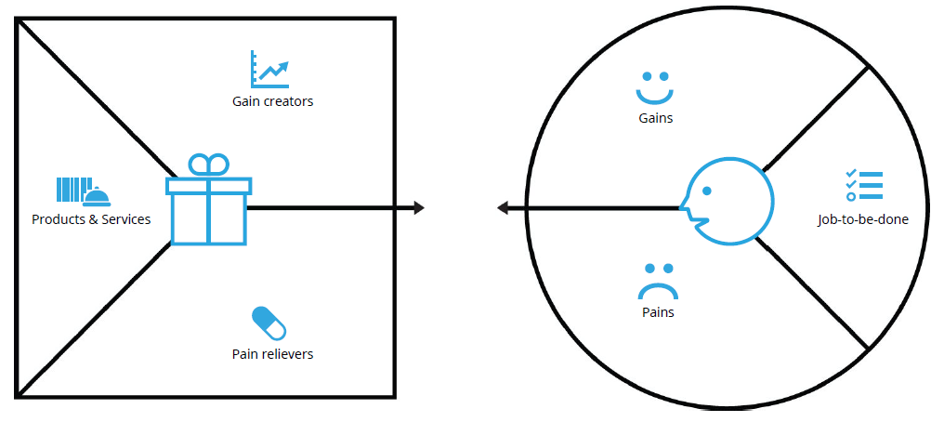

Value Proposition Canvas (VPC): Introduction
The Value Proposition Canvas (VPC) is a strategic tool developed by Alexander Osterwalder (the same who developed the BMC!) to help businesses create products or services that are deeply aligned with their customers' needs and expectations.
It acts as a framework for designing and refining value propositions by ensuring a close fit between the product or service and the target audience. The VPC is an integral part of the Business Model Canvas and focuses specifically on the interaction between two components: the Customer Profile and the Value Map.
Value Map
Customer Profile
Notes:
https://www.energymrc.ng/business-models-in-the-off-grid-renewable-energy-market/

Slide 5
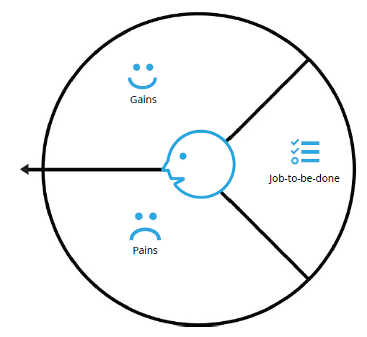
Customer Profile
The Customer profile side of the canvas represents the customer’s point of view and is divided into three key sections:
1. Customer jobs; 2. Customer Pains; 3. Customer Gains.
1. Customer Jobs:
These are the tasks, challenges, or problems customers are trying to solve in their personal or professional lives. In the off-grid solar energy context, customer jobs could include accessing affordable lighting, phone charging, or powering small devices.
Customer Jobs describe what customers are trying to get done in their work and in their lives
Notes:
https://www.energymrc.ng/business-models-in-the-off-grid-renewable-energy-market/

Slide 6
Customer Profile
Customer Jobs (cont):
Customers jobs describe the things your customers are trying to get done in their work or in their life.
  Functional jobs : When customers complete a specific task
  Social jobs : How customers want to be perceived by others
  Personal/emotional jobs : When customers seek a specific emotional state
  Supporting jobs : Co-creator of value, transfer of value
Notes:
https://www.energymrc.ng/business-models-in-the-off-grid-renewable-energy-market/

Slide 7
Customer Profile
2. Customer Pains :
This refers to anything that frustrates or prevents the customer from completing their jobs effectively. For example, in rural African communities, common pains include the high cost of energy, health hazards from using kerosene, or the limited availability of reliable energy solution.
Customer Pains describe bad outcomes, risks, and obstacles related to customer jobs
Notes:
https://www.energymrc.ng/business-models-in-the-off-grid-renewable-energy-market/

Slide 8
Customer Profile
Customer Pains (cont) :
Pains describe anything that annoys your customers before, during, and after trying to get a job done (obstacles, risks etc.).
Undesired outcomes, problems, and characteristics
  Functional >> a solution doesn´t work
  Social >> customer looks bad doing this
  Emotional >> customer feels bad doing this
  Undesired >> doing this is boring
Obstacles
− Prevention >> customer lacks the time
Risks (undesired potential outcomes)
− Negative consequences >> customer might lose credibility doing this
Notes:
https://www.energymrc.ng/business-models-in-the-off-grid-renewable-energy-market/

Slide 9
Customer Profile
3. Customer Gains :
These are the benefits or outcomes that customers expect or desire from a product or service. For off-grid solar customers, gains could include lower energy costs, improved health, access to clean energy, or the ability to improve daily life with reliable electricity.
Customers Gains describe the additional benefits the customers may seeking
Additional benefits that customers desires or would be surprised−Social gains
    − Positive émotions
    − Cost savings
Notes:
https://www.energymrc.ng/business-models-in-the-off-grid-renewable-energy-market/

Slide 10
Customer Profile: Do’s and Don’ts
Do’s | Dont’s
Do prepare a unique value proposition for each customer segment Do include also social and emotional jobs Do act like an anthroplogist and "forget" your offering Do use lots of sticky notes on the customer profile Do make gains and pains tangible (e.g. How long is "too long »?) | Don’t mix several customer segments into one profile Don’t focus only on functional jobs Don’t list jobs, pains and gains with your value proposition in mind Don’t identify too few jobs, pains and gains Don’t be vague in description of pains and gains
Notes:
https://www.energymrc.ng/business-models-in-the-off-grid-renewable-energy-market/

Slide 11
Value Map
On the other side of the VPC, the Value Map represents the company’s perspective on how it will create value for the customer, the Value Map features of a specific value proposition in your business model in a more detailed way (product and service characteristics, pain relievers, and gain creators). It is also divided into three components: 1. Products and Services; 2. Gain creators; 3. Pain relievers.
1. Products and Services:
The specific products, services, or features a company offers to meet customer needs. For Azuri Technologies, this includes solar home systems (SHS) and the PAYG financing model.
List of all Product/Service Characteristics a value proposition is built around
Notes:
https://www.energymrc.ng/business-models-in-the-off-grid-renewable-energy-market/

Slide 12
Value Map
Products and Services (cont):
The list of what you offer, all the product/service characteristics your customers can see in your “shop window”.
Key characteristics of the product/service :
    Should allow customers to get their jobs done
    Customer can see them and use them for evaluation of the offer
    Customer can use them to compare with offers from competitors - Essential decision-factors for the customer
    Directly related to the customers’ satisfaction
  Other management tools like Kano Model and/or Product Model could be used here
Notes:
https://www.energymrc.ng/business-models-in-the-off-grid-renewable-energy-market/

Slide 13
Value Map
2. Gain creators :
These are the benefits or value-added features that make the product or service desirable. For Azuri, gain creators include improved access to education (thanks to reliable lighting), economic empowerment (through job creation and productive use of energy), and better health outcomes (from reduced reliance on harmful fuels).
Describe how your products/services create customer gains.
Notes:
https://www.energymrc.ng/business-models-in-the-off-grid-renewable-energy-market/

Slide 14
Value Map
Gain Creators (cont):
Gain Creators describe how your product/service create additionalcustomer gains.
Contribute to long term customer loyalty
Unexpectedbenefits: they are not missed when they are absent
May cause enormous satisfaction
Focus on relevance for customers and where your product/service can make a difference
Notes:
https://www.energymrc.ng/business-models-in-the-off-grid-renewable-energy-market/

Slide 15
Value Map
3. Pains relievers :
These are the ways in which the product or service helps alleviate the pains identified in the Customer Profile. For Azuri, pain relievers include affordable payment options, mobile payment integration (e.g., M-Pesa), and clean, safe energy alternatives to kerosene.
Describe how your products/services alleviate customer pains
Notes:
https://www.energymrc.ng/business-models-in-the-off-grid-renewable-energy-market/

Slide 16
Value Map
Pain relievers (cont):
Pain relievers describe how exactly your product/service alleviatespecific customerpains.
Eliminationor reduction of the things that annoy your customersbefore, during, or after they are trying to complete a job or that prevent them from doing so
Great value propositions focus on pains that matter to customers, in particular extreme pains
    No need for pain reliever for every pain you’ve identified in the customer profile
  Focus only on few pains that they alleviate extremely well
Notes:
https://www.energymrc.ng/business-models-in-the-off-grid-renewable-energy-market/

Slide 17
Value Map Do’s and Don’ts
Do’s | Dont’s
Do list only the bundle of products and services that jointly form a value proposition for a specific customer segment Do make honest and realistic choices | Don’t list all your products and services for all customer segments Don’t try to address all customer pains and gains
Notes:
https://www.energymrc.ng/business-models-in-the-off-grid-renewable-energy-market/

Slide 18
How the VPC works ?
The goal of the VPC is to ensure alignment between what the customer needs and what the company offers. By mapping out customer pains, gains, and jobs, and then matching those with products, pain relievers, and gain creators, businesses can ensure that their value propositions are effectively addressing real-world problems and opportunities.
The canvas also serves as a tool for refining products over time, as businesses can continuously adjust their offerings based on customer feedback and evolving needs. In competitive markets, like the off-grid solar energy sector, this approach ensures that companies like Azuri Technologies remain customer-centric and responsive to the specific challenges their users face.
By leveraging the VPC, companies can better understand how their product aligns with their target market, leading to more successful and impactful solutions. This is especially crucial in developing economies, where aligning the value proposition with real customer pain points and needs can drive adoption, customer loyalty, and long-term business success.
Notes:
https://www.energymrc.ng/business-models-in-the-off-grid-renewable-energy-market/

Slide 19
Customer Profile – Value Map | Fit
Fit :
Are you addressing essential customer gains and pains?
FIT
Are you addressing the relevant jobs for the customer to get done?
Notes:
https://www.energymrc.ng/business-models-in-the-off-grid-renewable-energy-market/

Slide 20
Unique Value Proposition Template
We recommend the use of the Strategyzer ad-lib value proposition template, The ad-lib Value Proposition Template is a structured tool designed by Strategyzer to help businesses quickly generate various versions of their value proposition by filling in predefined blanks.
This method simplifies the process of identifying what your product or service offers, who it serves, and why it's beneficial, making it especially useful for startups, innovators, and marketing teams. By using this template, you can shape multiple alternative directions for your value proposition, aiding in decision-making and refinement.
Utility of the Ad-lib Value Proposition Template:
It helps teams clearly define the unique benefits their product or service provides to customers. This enhances internal understanding and external communication.
You can rapidly prototype and test different value propositions without getting bogged down in unnecessary details.
This tool brings together various stakeholders (such as marketing, product development, and sales teams) to focus on a unified message.
Notes:
https://www.energymrc.ng/business-models-in-the-off-grid-renewable-energy-market/

Slide 21
Unique Value Proposition Template
How to Use the Value Proposition Template:
The Ad-lib template typically follows a structure like this: “Our (product/service) helps (target customer) who want to (solve a specific problem or achieve a goal) by (providing specific benefit), unlike (competitor or alternative), which (lacks or offers lesser benefits).”
Customise the Template: Fill in the blanks with specific details about your offering. For example, instead of simply saying "helps customers," be precise about how your product solves a problem or creates value.
Test Multiple Versions: Create several versions of your value proposition using different key terms to compare the potential impact of each.
Refinement: After creating 3-5 alternatives, review and refine them based on feedback or further testing with your team or customers.
Notes:
https://www.energymrc.ng/business-models-in-the-off-grid-renewable-energy-market/

Slide 22






Task: Build a Unique Value Proposition
Our
products / services
Helps
user segment
Who wants to
user segment
by
verb e.g. reducing, avoiding
a user pain
and
increasing, enabling
a user gain
unlike
competing value proposition
Notes:
https://www.energymrc.ng/business-models-in-the-off-grid-renewable-energy-market/

