Slide 1

Off-Grid Energy Systems Modelling
Lesson 5 X (Extra)
Modelling a Community Scale Load Curve

Slide 2

Outline of the Lesson
Load Demand Estimation Techniques
Understand the most common approaches and methodologies to derive the load demand of an area, building or system, by the aggregation of single appliances’ energy needs and use patterns
Statistical Methods for Advanced Load Estimation
Learn about the limits of the previously listed methods and dig deep into advanced stochastic methods to overcome the limitations of the other techniques
Use of Open-Source Software RAMP
Learn to use a bottom-up stochastic software, with excel tables as input files, to compute high-resolution community load profiles

Slide 3
Learning Outcomes of the Lesson
At the end of this unit, participants will be able to :​
Understand the most common approaches and methodologies to derive the load demand of an area, building or system, by the aggregation of single appliances’ energy needs and use patterns
Appreciate the limits of the previously listed methods and dig deep into advanced stochastic methods to overcome the limitations of the other techniques
Use a bottom-up stochastic software, with excel tables as input files, to compute high-resolution community load profiles

Slide 4
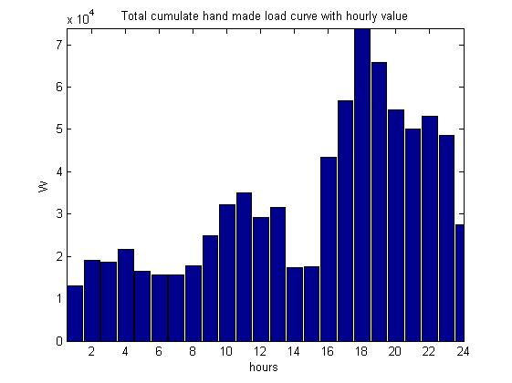
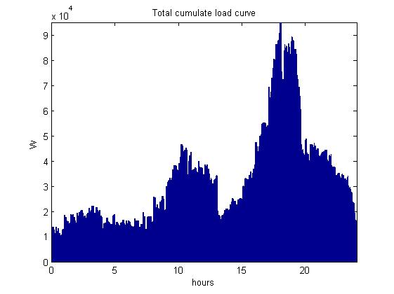
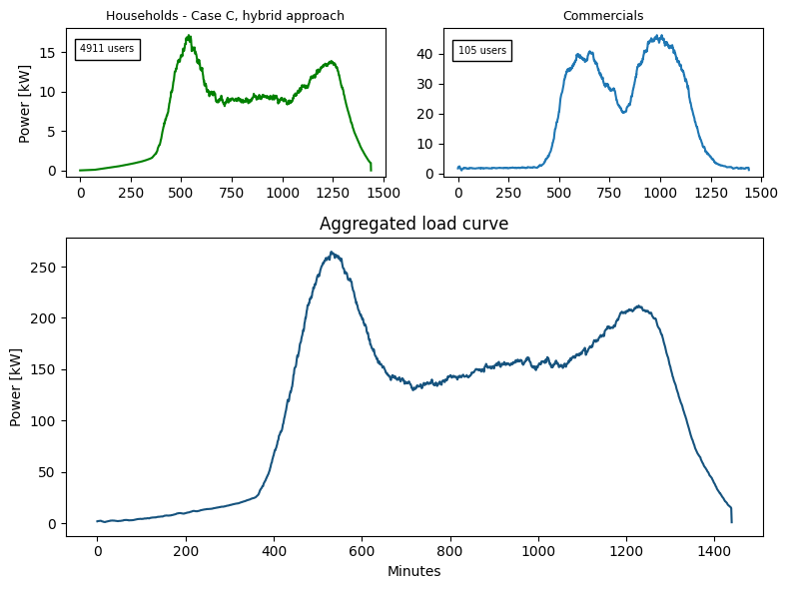
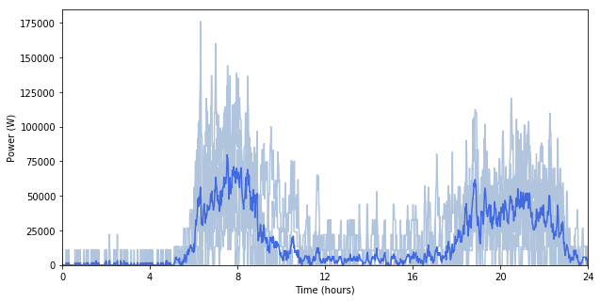
Load time series data
Time-dependent electricity estimated need of a given area or system. It is typically measured in Watts (or kilowatts, megawatts, etc.) and captures how electricity demand varies over different periods, usually in hourly or sub-hourly intervals.
Various examples of load curves
Load Curve
It underscores information such as peak demand, variability, baseload, and socioeconomic influences, essential for developing efficient, community-specific energy systems that provide reliable electricity.
Peak Power
Baseload
Energy Consumption [kWh]
Example of aggregated load curve for an informal settlement in Nairobi [1]
Source for Image: [1] Stevanato et al., Access to Electricity in Informal Settlements: Literature Review and Load Curve Estimation, IEEE PES/IAS PowerAfrica, Marrakech, Morocco, 2023, doi: 10.1109/PowerAfrica57932.2023.10363327
Notes:
Let’s first of all what we mean by load curve. The load curve is the graphical representation of a set of time-dependent data, of the amount of energy needed timestep-by-timestep, expressed as average power required during the timestep.
It’s easy to deduce how the area under the curve, is the energy required by the reference system during the time-period. In other words, we can say is a richer information compared to the amount of energy consumed in a day, a month or a year, as it gives precise temporal information on when the load demand happens, allowing for more sophisticated energy system planning.

Slide 5
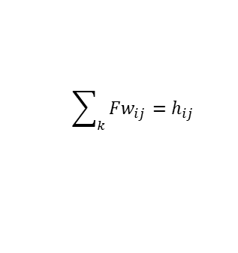
Estimating Load Demand
Approach 1 involves aggregating the energy consumption from various user classes and their respective appliances over time. This method accounts for the number of users, types and quantities of appliances, and the specific times when these appliances are used.
This approach requires the following general steps:
Classify the Users
Identify Appliances
Measure appliance power
Estimate usage duration
Define functioning windows
Compute single user consumption
Aggregate class consumption
Estimate total demand
Fw1
Fw2
time
Functioning windows (Fw)
$$\sum_{k}{Fw_{ij}}=h_{ij}$$
Energy consumed
by a single class
i | Type of electric Appliance
j | Type of User Class
N_{j} | Number of users within class j
n_{ij} | Number of appliances i within class j
P_{ij} [W] | Power rate of appliance i within class j
h_{ij} [h/day] | Functioning duration of appliance i within class j
Energy consumed
by a single user
Notes:
Various methods exist to estimate load demands, starting from the knowledge of User’s behaviors and appliance ownership. The first and most intuitive one consists in identifying categories of users, let’s say for example High Consumption Households, Low Consumption Households, School and Hospital. Then listing which appliance every user owns, their relative power, and when each appliance is used during the day and for how much time.
Now is just a matter of summing up all the power drawn by each appliance, by every user, during the specific times of use.

Slide 6


Estimating Load Demand
Approach 1 cannot consider the complexities involved in pinpointing the exact moments appliances are used, especially given the daily and seasonal variations. This method also presumes that all appliances within a user class are used concurrently, leading to a potential overestimation of peak power demand
When appliances are ON?
Information about the functioning moments of the appliances are strictly required, but it is difficult (i.e. light) and sometimes impossible (i.e. fridge) to define them
Week/weekend days and seasonal variations require a lot of information
Which appliances are ON?
All the nij appliances are considered ON at the same time (coincidence factor is equal to 1 for each appliance)
The load curve typically overrates Power Peak
Notes:
The main drawback of this approach is that we are implicitly assuming that all the appliances, owned by the users in one category, are simultaneously switched on, and then simultaneously switched off. For examples, all the 100 households in the community turn on the TV at 7PM and turn it off at 9PM, leading to an overestimation of the peak load, because of this forced overlapping of functioning times.

Slide 7
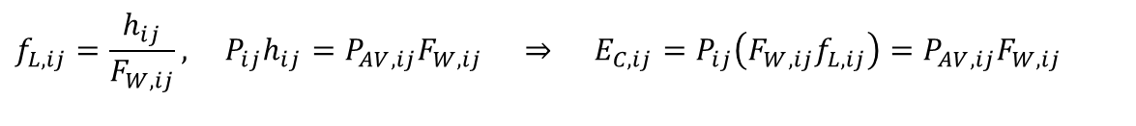
Estimating Load Demand
Approach 2 assumes that within these windows, the usage of appliances is not fixed and there is no single correct pattern of use. Instead of assuming constant power draw throughout the functioning window, this approach calculates energy consumption based on the average power used over the time the appliance is actually on.
This approach requires the following general steps:
Classify the Users
Identify Appliances
Measure appliance power
Estimate usage duration
Define Functioning windows
Operate nominal energy consumption
Incorporate load factors
Compute single user consumption
Aggregate class consumption
Estimate total demand
time
time
time
time
$$f_{L,ij}=\frac{h_{ij}}{F_{W,ij}}, P_{ij}h_{ij}=P_{AV,ij}F_{W,ij} ⇒ E_{C,ij}=P_{ij}\left(F_{W,ij}f_{L,ij}\right)=P_{AV,ij}F_{W,ij}$$
N_{j} | Number of users within class j
n_{ij} | Number of appliances i within class j
P_{ij} | Power rate of appliance ij
Fw_{ij} | Functioning windows in a day for appliance ij
f_{L,ij} | Load factor appliance ij
Energy consumed by a single user of a single appliances
Notes:
We know instead that every user inside a category will act in a randomly different way from the others, still following a broader trend. We can say that we know that each user will use TV for 2 hour, between 6PM and 10 PM, but those 2 hours, will be different for every user, and across every day. In order to take this into account, an approach is to define “functioning windows”, in our example 6 to 10 PM, and include a load factor to spread the energy consumed over that time. In this way, we are taking into account the non-coincidence of appliances use across users.

Slide 8
Estimating Load Demand
Approach 2 : cannot consider the complexities involved in pinpointing the exact moments appliances are used and the amount of power actually demanded.
When appliances are ON?
Appliances are considered ON for all the duration of the functioning windows even if the real functioning duration is shorter
They are not considered functioning at the nominal power, but at the average power value that preserves the value of the energy consumed during the day
Which appliances are ON?
The coincidence behaviour is indirectly considered
The load curve typically underrates Power Peak
Notes:
The obvious drawback, is the opposite compared to the first approach, we are missing the moments when appliance use actually overalap. Leading to underestimation of peak demand.

Slide 9

Estimating Load Demand
Advanced Approach: can better estimate Power Peaks, accounting for high uncertainty in load demand in unelectrified or partially electrified rural areas, and incorporating varying daily load curves through a stochastic approach.
      1
Stochastic method to define switching on time of appliances
      2
Operation model of the appliances
RAMP is an open-source software suite for the stochastic simulation of any user-driven energy demand time series based on few simple inputs
Notes:
So how to avoid over-estimating or under-estimating the peak demand? One approach, consists in moving from an aggregated representation of load users, to the simulation of each single user behavior distinctly, accounting for the stochastic behavior of each user. To this purpose, we introduce RAMP – an open-source software for the stochastic simulation of any user-driven energy demand time series based on few simple inputs.

Slide 10
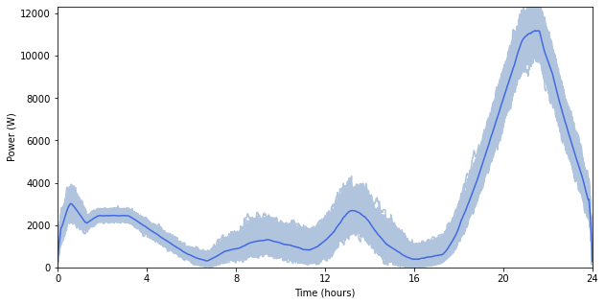
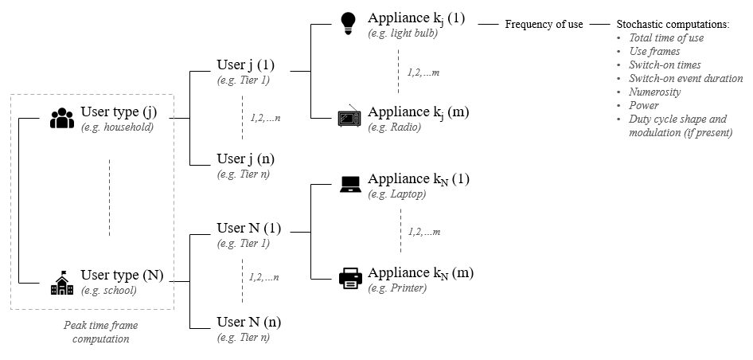
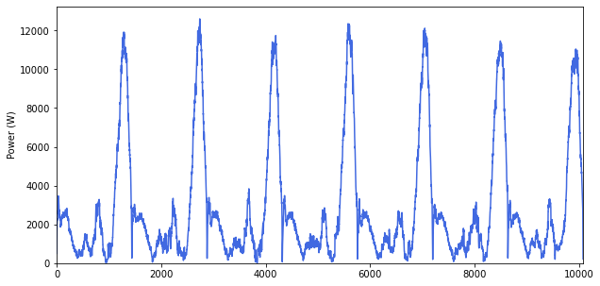
RAMP software
RAMP is an open-source software designed for scenarios where only rudimentary information on user behaviour is available, allowing for the characterization of users and appliances, the definition of operating windows, and the application of load factors to yield a finely detailed energy usage profile on a minute basis.
A bottom-up stochastic model for the generation of high-resolution multi-energy profiles
https://github.com/RAMP-project/RAMP
Graphical sketch of the modelling layers constituting the simulation process.
Examples of load curve demands estimated using RAMP software
Source [2]: F. Lombardi, S. Balderrama, S. Quoilin, E. Colombo, Generating high-resolution multi-energy load profiles for remote areas with an open-source stochastic model, Energy, 2019, https://doi.org/10.1016/j.energy.2019.04.097.
Notes:
RAMP, Remote Areas Multi-energy Profiles Generator, is a open-source bottom-up energy demand simulator, especially conceived for simulating load demand profiles of rural and isolated communities, and in this lesson we will see a possible application of RAMP to off-grid energy systems modelling.

Slide 11



Bottom-up Approach
It details individual energy use to create a community-level load curve, requiring extensive data on appliance ownership and usage, typically gathered through surveys. These are suitable for community-level applications but it may be imprecise in terms of demand prediction effectiveness.
Which appliances?
Number and types of appliances
Power ratings
When?
Typical times when each appliance is used
Specific peak usage times for heavy appliances
Frequency of use
For how much time?
Average usage duration for each appliance per day
Total operating hours for critical appliances that run continuously
From Appliances ownership to Estimating load curves
Notes:
The only information that RAMP requires are:
Which categories of users are present in the community
How many users per category
Which appliances each user category owns, and how many
The nominal power of such appliances
How the users use the appliances throughout their typical day

Slide 12
Bottom-up Approach
Define user classes within a type
Characterize user appliances within a class
Define functioning windows for each appliance
Notes:
Then the model will stochastically simulate the daily use of each appliance by each user, aggregating this information into one single load curve for the entire community.

Slide 13

Getting Ready – Installing Anaconda
Python is an open-source, community-based, non-profit, interpreted high-level programming language. It is the most widespread language in scientific research. It hosts thousands of thematic libraries for specific purposes (e.g. matplotlib, numpy, pyomo)
Anaconda “is a free and open source distribution of the Python and R programming languages for data science and machine learning related applications […] that aims to simplify package management and deployment” (Wikipedia)
https://repo.continuum.io/archive/
Notes:
In order to work with RAMP, you will need to set up a Python environment. We suggest anaconda if you are a first time python user, but feel free to use your favourite IDE.
To download and install anaconda follow the link in the slide.

Slide 14
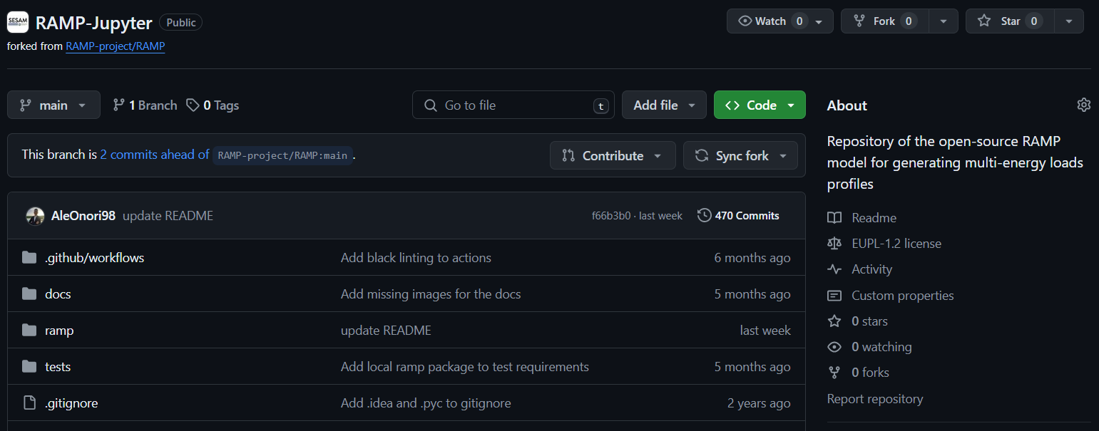

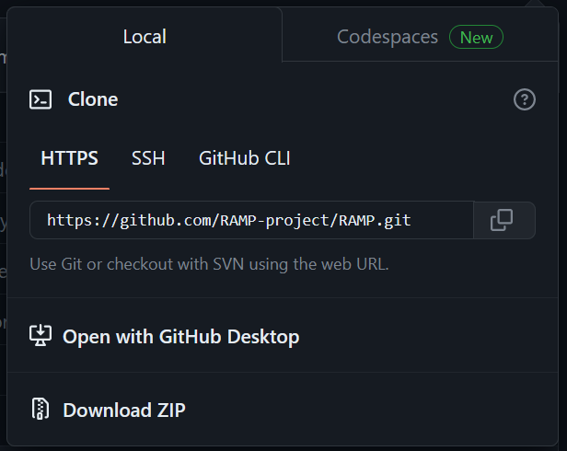
Getting Ready – Downloading RAMP
To download the necessary files you can navigate to:
https://github.com/SESAM-Polimi/JupyRAMP
Notes:
We will be working with a very specific version of RAMP, called Jupy-RAMP, that is a jupyter-notebook based interface for RAMP. You will need to download the necessary material from the github link indicated in the slide, and clicking on the green button “Code”, and then “Download ZIP”

Slide 15
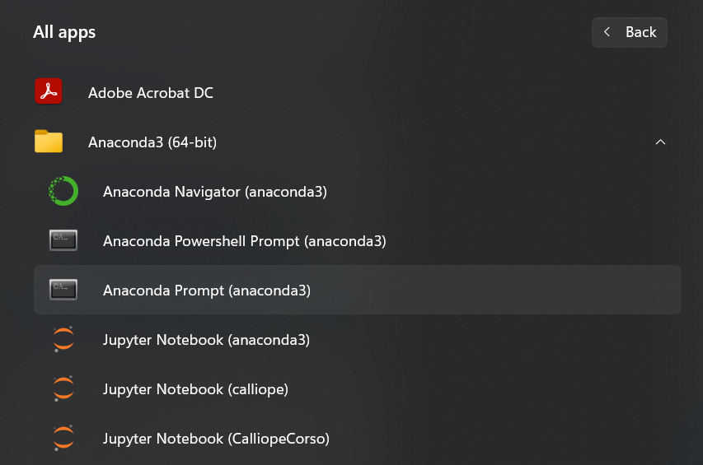
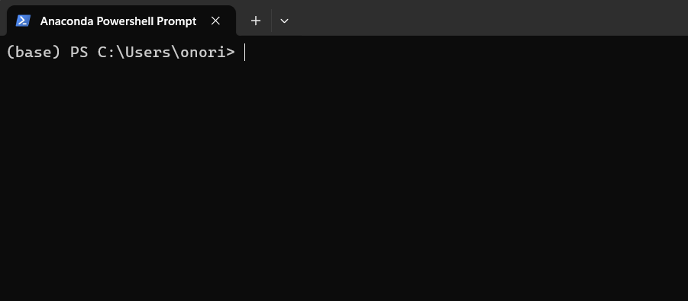
Getting Ready – Anaconda Prompt
Now you have “Anaconda Prompt” among your apps, inside the folder Anaconda
From now on, when you are required to input a string of command, you will have to input it here in the Anaconda prompt, not in the windows command prompt
Notes:
If you correctly installed Anaconda, you will see among your apps the “Anaconda Prompt”. Launch it.

Slide 16
Setting the RAMP environment
1) Create a new environment, named ramp, with python 3.8:
(base) … > conda create --name ramp python=3.8
2) Activate the ramp environment:
(base) … > conda activate ramp
3) Install the RAMP package using pip:
(ramp) … > pip install rampdemand
4) Install Jupyter Notebook using conda:
(ramp) … > conda install jupyter notebook
Notes:
Within anaconda prompt, we will first create an environment, copy-paste the text in bold in the first box.
Then we will activate the environment, copy-paste the text in bold in the second box
We will then install all the necessary dependencies, copy-paste the string in bold in the third box
And finally install jupyter notebook, to use JupyRAMP, copy-paste the string in bold in the last box

Slide 17
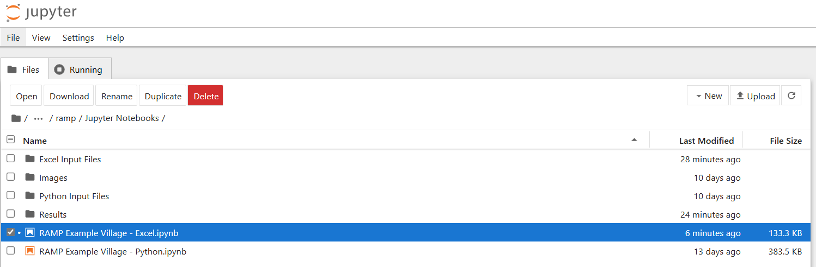
Getting Ready – Launching Jupyter
1) Activate the ramp environment:
(base) … > conda activate ramp
2) Launch Jupyter Notebook:
(ramp) … > jupyter notebook
3) Navigate within the folder and open the RAMP Example Village file:
Notes:
Now every time you want to use ramp, you will have to open the anaconda prompt, activate the environment by typing “conda activate ramp”, and launch the notebook by simply typing “jupyter notebook”.
From inside the notebook, you will be able to navigate your way to the JupyRAMP folder you downloaded before.

Slide 18
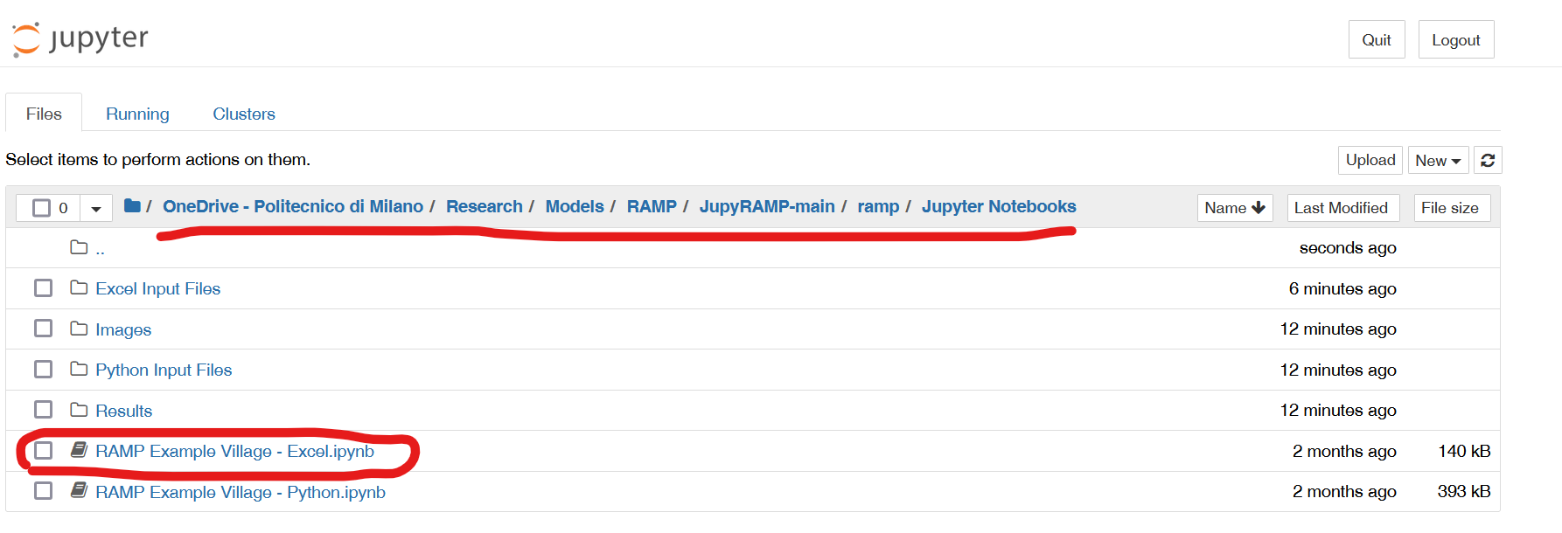
Getting Ready – Launching Jupyter
Notes:
Reach the “RAMP Example Village – Excel” file, by following the path indicated in slide and open it. You will reach a guided file on how to select an inpul file, rin it, and explore the results.

Slide 19

Excel Input files
Input_file_1.xlsx
Models basic electric appliances like lightbulbs, radios, TVs, fridges, etc., providing default examples for their representation.
Input_file_2.xlsx
Demonstrates modeling user-driven thermal loads using a "shower" appliance example, where nominal power can be externally input via a ".csv" file, reflecting groundwater temperature changes.
Input_file_3.xlsx
Shows how to model electric cooking appliances for both repetitive (e.g., breakfast) and varied main meals (e.g., lunch, dinner), incorporating user preferences and a preference index to account for daily meal choice variability.
Jupyter Notebook for data input and visualization of results
Notes:
Three example input files are already provided to you, you can use them as starting point for modelling your own remote area load profile. They are in excel and JupyRAMP reads them in that form.

Slide 20
Inputs – Detail (1)
Dimension | Description | Range [unit] | Default
user_name | User to which the appliance is bounded
num_users | Number of users of that category
user_preference | Number of different daily preferences the user has | Int | 0
name | Name of the appliance | - | -
number | Number of that specific appliance of the specified kind | 0 – inf [-] | 1
power | Power rating of appliance (average) | 0 – inf [W] | 0
num_windows | Number of distinct time windows | 0 – 3 [-] | 1
func_time | Total time the appliance is on during the day (not dependent on windows) | 0 – 1440 [min] | 0
time_fraction_random_variability | Percentage of total time of use that is subject to random variability. For time (not for windows) randomizes the total time the appliance is on | % | 0
func_cycle | Minimum time the appliance is on after switch on event | 0 – 1440 [min] | 1
fixed | If ‘yes’, all the ‘n’ appliances of this kind are always switched on together | - | No
Notes:
Here you find a detailed explanation of all the parameters that compose the input file, use this slide as reference for building your model.

Slide 21
Inputs – Detail (2)
Dimension | Description | Range [unit] | Default
fixed_cycle | Number of duty cycle, 0 means continuous power, if not 0 you have to fill the cw (cycle window) parameter (up to 3) | Int[0,1,2,3,4] | 0
occasional_use | Defines how often the appliance is used, e.g. every second day will be 0.5 | % | 1
flat | Allows to model appliances that are not subject to any kind of random variability, such as public lighting | Yes, no | No
thermal_P_var | Range of change of the power of the appliance or for power of duty cycles | % | 0
pref_index | Defines prefer index for association with random User daily preference behaviour. | <= user pref | 0
wd_we_type | Specify whether the appliance is used only on weekdays (0), weekend (1) or the whole week (2) | Int[0,1,2] | 2
window_x_start | Moment of the day when functioning window n starts | 0 – 1440 min | 0
window_x_end | Moment of the day when functioning window n ends | 0 – 1440 min | 0
random_var_w | Percentage of total window duration that is subject to random variability. For windows randomizes the total duration of the window | % | 0
Notes:
This is a continuation of the previous slide.

Slide 22


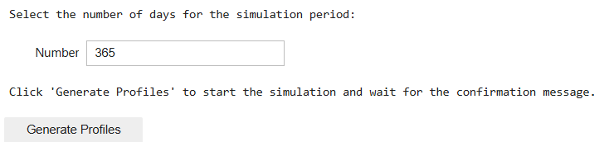
Jupyter Notebook Walkthrough
This Jupyter Notebook is well-commented, and the process is outlined step-by-step to facilitate easy navigation and execution. Please run the code cells progressively without skipping steps, as each cell may depend on the previous ones.
Step 1: Select and upload the Excel file containing your input data. Then, press Verify upload to confirm.
RAMP Inputs
Step 2: Set the number of different days (profiles) to be generated. Then, press Generate Profiles to start the simulation process.
Notes:
This Jupyter Notebook is well-commented, and the process is outlined step-by-step to facilitate easy navigation and execution. Please run the code cells progressively without skipping steps, as each cell may depend on the previous ones.
Be careful in not modifying the cells that say “WARNING – do not modify”

Slide 23
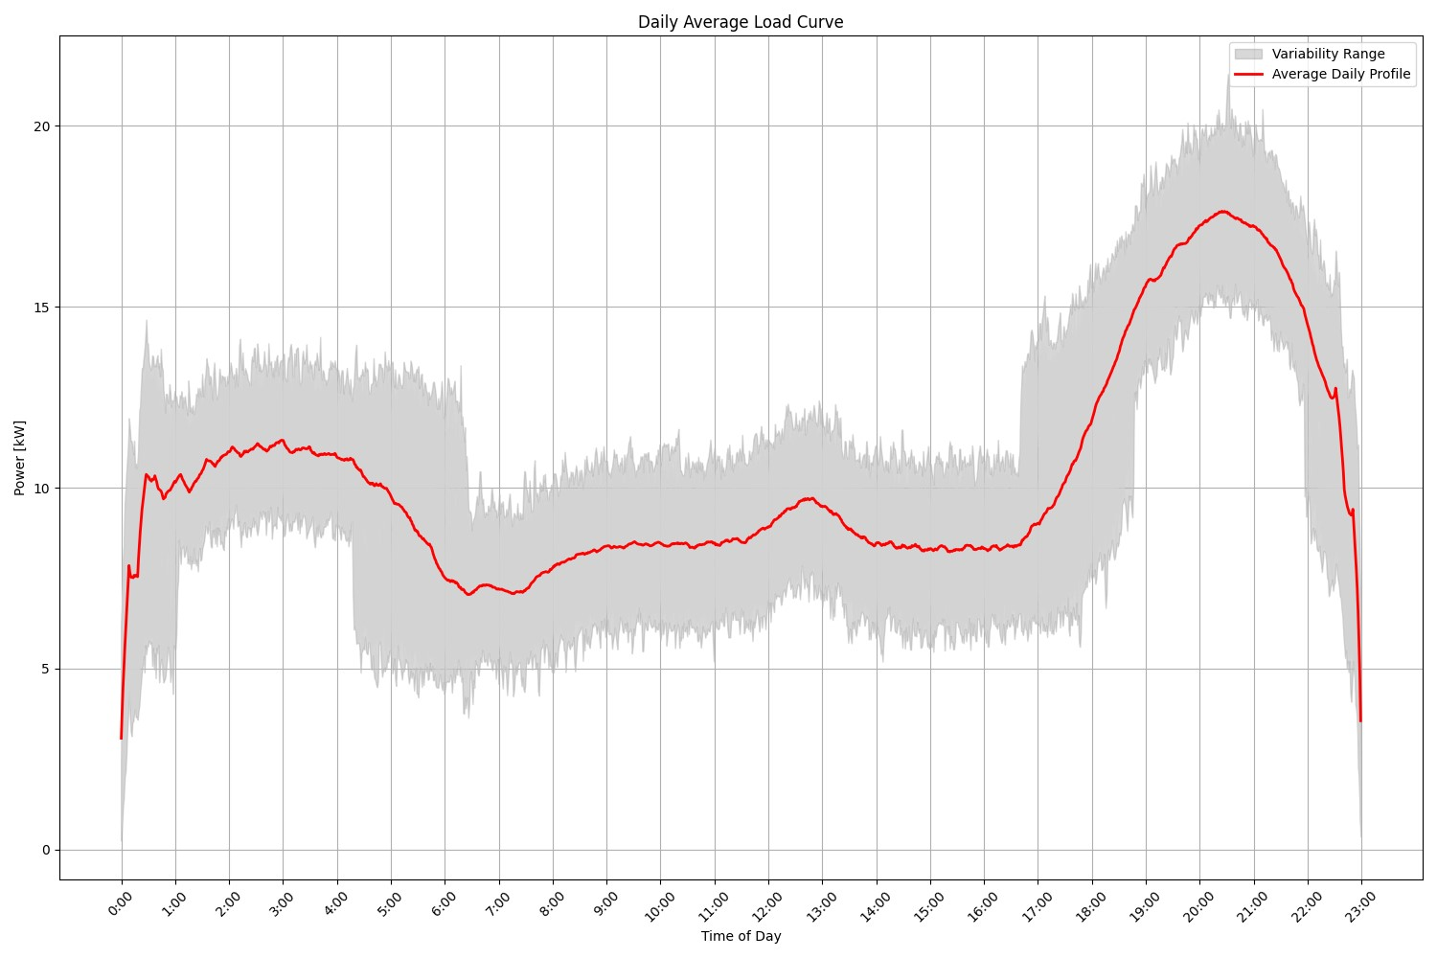
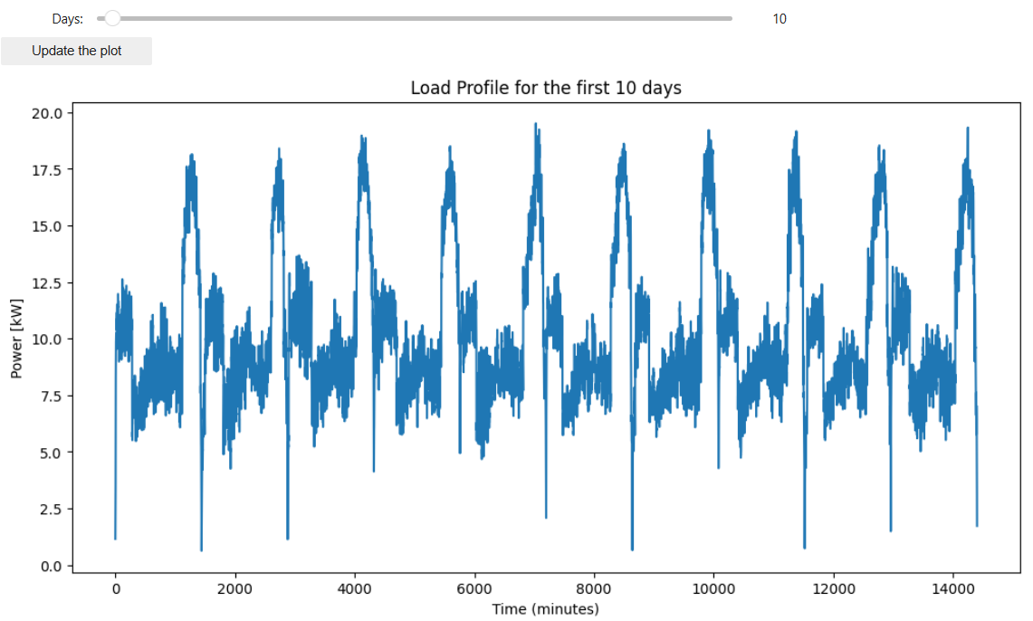

Jupyter Notebook Walkthrough
Step 3: View the simulation results including daily and cumulative load profiles, as well as energy consumption patterns across different user categories.
ramp/Jupyter Notebooks/Results/daily_average_load_curve.png
Notes:
Through the jupytet notebook you will have access to both graphical results.

Slide 24
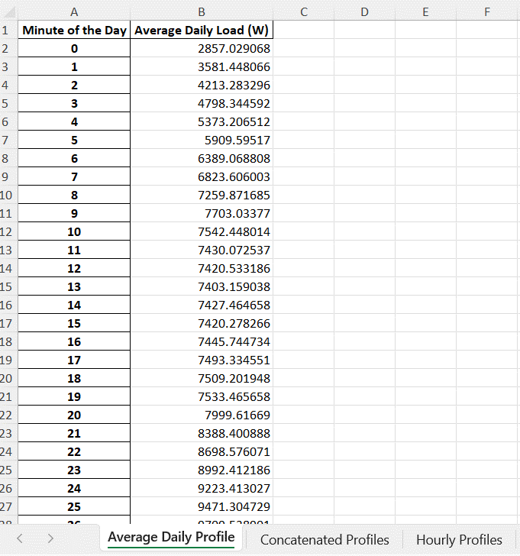
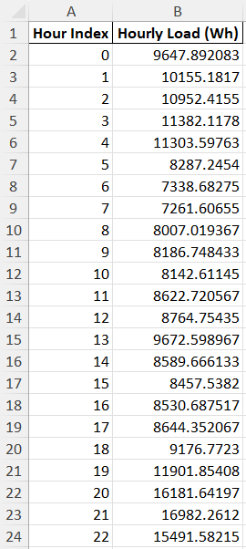
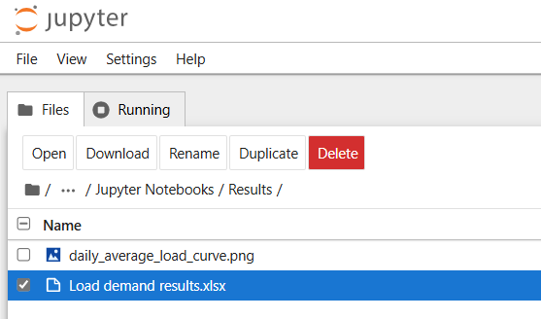
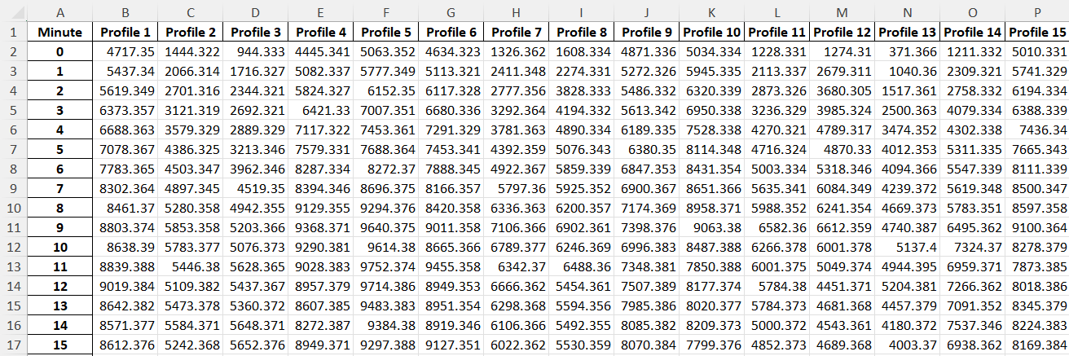
Jupyter Notebook Walkthrough
Step 4: Export the simulation results, including daily load profiles and average daily load, into an Excel file named Load demand results.xlsx.
ramp/Jupyter Notebooks/Results/Load demand results.xlsx
Notes:
And excel format timeseries of the load curve you generated.

Slide 25
References
[1] N. Stevanato et al., Access to Electricity in Informal Settlements: Literature Review and Load Curve Estimation, IEEE PES/IAS PowerAfrica, Marrakech, Morocco, 2023. https://doi.org/ 10.1109/PowerAfrica57932.2023.10363327
[2] F. Lombardi, S. Balderrama, S. Quoilin, E. Colombo, Generating high-resolution multi-energy load profiles for remote areas with an open-source stochastic model, Energy, 2019. https://doi.org/10.1016/j.energy.2019.04.097.
[3] Lombardi et al., (2024). RAMP: stochastic simulation of user-driven energy demand time series. Journal of Open Source Software, 9(98), 6418, https://doi.org/10.21105/joss.06418
[4] https://github.com/RAMP-project/RAMP
[5] https://github.com/SESAM-Polimi/JupyRAMP
Notes:
Here are the references used for this lesson.

