Slide 1

BUSINESS AND SOCIO-ECONOMIC CONTEXTS OF MINI-GRID DEVELOPMENT
Lesson 2:
Socio-Economic Contexts in
Mini-Grid Development

Slide 2

Lesson 2 Outline
• Introduction​ to mini-grid contexts
· Overview of Energy Modelling and Its Purpose​
· Socio-Economic Factors​
· Impact of Socio-Economic Factors on Mini-Grid development
· Socio-Economic Modelling Techniques​
· Socio-Economic Impact Assessment (SEIA)​
· Hypothetical case study – Jijilo
· Hypothetical case study – Kulal Island

Slide 3
Lesson 2 Learning Outcomes
At the end of this lesson, the student will be able to:
Understand the role of socio-economic factors in energy modelling for mini-grids.
Apply socio-economic modelling techniques to a real-world mini-grid project
Understand the value of a socio-economic impact assessment for mini-grid projects.

Slide 4
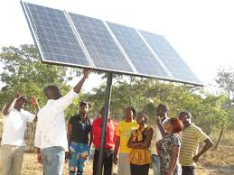
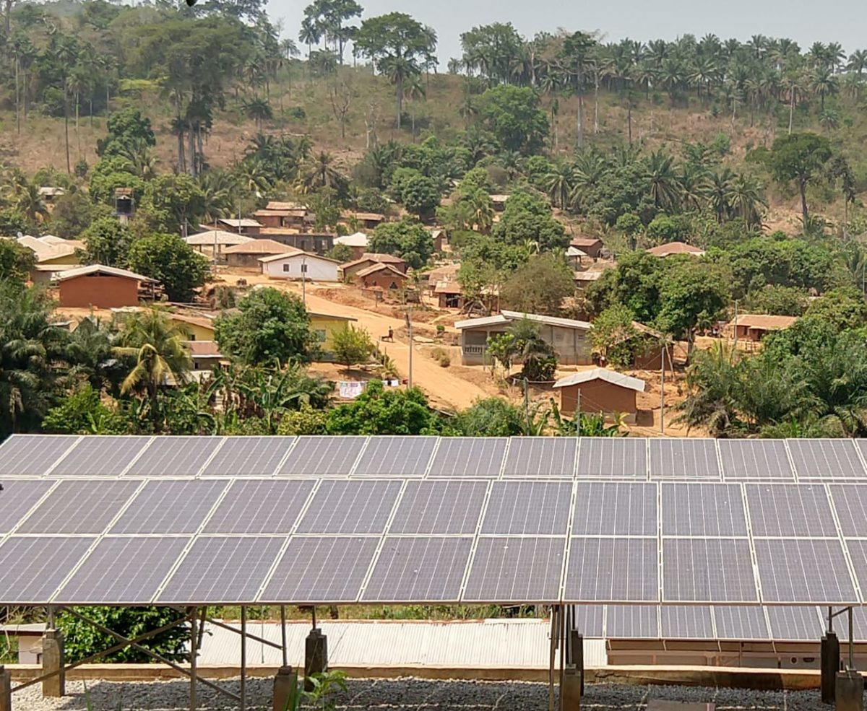
Introduction to mini-grid contexts
Mini-grids are promising solutions to addressing the challenges of energy access.
For societal benefit, it is important to integrate them within the socio-economic aspects of the communities they serve.
This entails understanding the demographic, economic, and social dynamics characterizing these regions.
Rural electrification through mini-grids: Challenges ahead
Jörg Peters , Maximiliane Sievert , Michael A. Toman

Slide 5
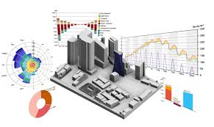
Overview of Energy Modelling and Its Purpose
Energy Modelling: The process of creating a mathematical systematic representation of a community's energy system to simulate energy demand & supply and analyze and predict its behavior under various conditions.
Purpose: Helps in planning and optimizing the design of energy systems like mini-grids.
  Key Components and Variables in Mini-Grid Energy Modelling
  Energy Demand Forecasting: Predicting future energy needs based on current usage patterns and socio-economic factors.
  Load Profiles: Understanding the patterns of energy use throughout the day and across different seasons to design systems that meet peak demand.
  Energy Supply Options: Evaluating different sources of energy (e.g., solar, wind, diesel) to determine the most efficient and reliable mix for the mini-grid.

Slide 6



Why Are Socio-Economic Factors Crucial in Mini-Grid Energy Modelling?
Socio-Economic characteristics of a population influence their behaviors, needs, and capacities in relation to their use of energy.
Understanding Needs: Socio-economic factors provide insights into the community’s energy consumption patterns and preferences.
Designing Solutions: Tailored mini-grid solutions based on community needs ensure higher adoption and satisfaction.
Accessibility and Affordability: Designing pricing strategies aligned with income levels and employment rates makes energy services more accessible.
Notes:
Socio-economic factors encompass the social and economic characteristics of a population that influence their behaviors, needs, and capacities.
In the context of energy, these factors include income levels, population density, local industries, education, and employment rates, which all play a significant role in determining energy demand and the ability to pay for energy services.
Relevance: Understanding socio-economic factors is crucial in energy modeling, particularly for mini-grids, as they directly impact the planning, design, and long-term success of energy projects. Accurate modeling requires comprehensive knowledge of the community’s socio-economic profile to ensure that the mini-grid system is tailored to meet local needs effectively and sustainably.

Slide 7









Socio-Economic Factors
Economic Factors
Population Size and Growth
Income
Education Levels
Urban vs. Rural Distribution
Age Distribution
Employment Rates
Economic Activities
Levels
Health Indicators
Social Infrastructure
Demographic Factors
Social
Factors
Notes:
Understanding the socio-economic contexts of energy modelling is crucial for accurately predicting and managing energy demand. This involves examining a variety of demographic, social, and economic factors that influence energy consumption patterns.
Demographic Factors
Larger and growing populations increase energy demand as consumption needs rise. Urban areas, with their concentrated populations, typically require more energy than rural areas. Additionally, younger populations tend to use more electronic devices, resulting in higher energy consumption compared to older populations.
Social Factors
Education levels play a significant role in energy consumption. Higher education correlates with greater awareness of energy efficiency and a higher likelihood of adopting renewable technologies, which can influence overall energy demand and sustainability practices.
Economic Factors
Income levels and employment rates are closely linked to energy consumption. Higher-income households can afford more appliances and energy-intensive services, leading to increased energy use. Similarly, higher employment rates boost disposable income, resulting in greater energy consumption. Local economic activities, such as agriculture or manufacturing, also significantly impact energy demand, as different industries have varying energy needs.

Slide 8










How Socio-Economic Factors Affect Energy Demand & Supply
DEMAND
Industries
Employment
Income Levels
Population Age
Population Density
SUPPLY
.
Natural Resources
Peace &Stability
Policy & Laws
Technology Advancement
Infrastructure Development
Notes:
Understanding the socio-economic factors influencing energy demand and supply is essential for effective energy modelling. Key factors include income levels, population density, local industry, education levels, and employment rates, each having distinct impacts on energy consumption and the viability of energy supply systems like mini-grids.
Higher income levels drive increased energy consumption for appliances and services while also providing the financial means to support advanced and reliable mini-grid systems. For example, rising incomes in a rural area can lead to greater demand for irrigation and household appliances, necessitating upgrades to local mini-grids.
Population density also plays a crucial role, with dense populations leading to concentrated energy consumption and reducing the cost per connection. This makes mini-grids more viable, as seen in urban slums where high energy demand requires efficient distribution networks.
Local industries significantly increase energy demand, particularly for manufacturing and operations, which in turn necessitates robust and reliable energy supply systems. A village experiencing growth in small-scale manufacturing would require a mini-grid capable of handling higher loads and ensuring consistent supply.
Education levels impact energy demand by increasing awareness and adoption of energy-efficient technologies. Educated communities are more likely to adopt innovative and sustainable energy solutions, such as solar home systems, which can reduce the peak load on mini-grids.
Employment rates influence energy consumption by boosting disposable income, leading to increased use for both productive and household purposes. High employment rates can ensure the financial sustainability of mini-grid projects through stable revenue. For instance, a region with high employment in the service sector may see increased electricity demand during evening hours when people return home from work.
By considering these socio-economic factors, energy models can better predict and manage energy demand and supply, ensuring more efficient and sustainable energy systems.

Slide 9



Socio-Economic Factors Impact on the Development of Mini-Grids
Aspect | Description | Example
Feasibility | Feasibility studies must account for socio-economic data to determine the potential user base and their ability to pay for energy services. | An area with low-income households may require subsidies or innovative financing models to make mini-grid projects feasible.
Design | The design of the mini-grid must consider the specific energy needs of the community, influenced by socio-economic factors. | In an agricultural community, the design might include provisions for powering irrigation systems and processing equipment.
Sustainability | Long-term sustainability of mini-grids hinges on the community’s ability to maintain and operate the system, which is closely linked to their socio-economic status. | Community ownership models may work well in areas with strong social cohesion and high levels of local engagement.

Slide 10
Overview of Socio-Economic Modelling Techniques
Socio-economic modeling techniques involve analyzing the social and economic conditions of a community to ensure that energy solutions meet their specific needs. These techniques consider factors such as population size, income levels, employment rates, education, and local industries, which all influence energy demand and consumption patterns.
Technique | Description | Example | Output
Statistical Analysis | Analyze socio-economic data to identify energy demand trends. | Using regression analysis to see how household income affects electricity consumption. | Reports highlighting key drivers of energy consumption.
Geographic Information Systems (GIS) | Map and analyze socio-economic data to visualize energy needs. | Mapping population density and electricity access to prioritize mini-grid deployment. | Maps identifying priority areas for mini-grid projects.
Surveys and Field Studies | Collect data directly from the community on energy use and socio-economic conditions. | Conducting household surveys to understand energy usage and preferences. | Reports on community energy needs and barriers to adoption.
Econometric Models | Use economic theories and statistical techniques to predict future energy demand. | Developing models to forecast electricity consumption based on income growth and population changes. | Forecasts and policy recommendations for mini-grid projects.
Notes:
Statistical Analysis: Using statistical methods to analyze socio-economic data and identify trends that influence energy demand.
Geographic Information Systems (GIS): Mapping and spatial analysis of socio-economic data to visualize energy needs and resource availability.
Surveys and Field Studies: Collecting data directly from the community to understand their energy consumption patterns, preferences, and socio-economic conditions.
Econometric Models: Applying economic theories and statistical techniques to predict future trends in energy demand based on socio-economic variables.

Slide 11






Socio-Economic Impact Assessment (SEIA)
A socio-economic impact assessment (SEIA) evaluates the potential social and economic impacts of a mini-grid project on the surrounding community.
For mini-grids to bring significant positive impacts to socio-economic development and cultural dynamics in the communities they serve, they ought to be implemented in a way that respects local contexts and values.
Below are some impacts to consider :
Employment Opportunities
Income Generation
Education and awareness
Business Development
Agricultural Productivity
Community Participation and Empowerment
Healthcare and wellbeing
Policy and Governance
Environmental Impact
Infrastructure Development
Notes:
Each of these areas should be thoroughly researched and assessed to understand the full spectrum of potential impacts, both positive and negative, that the mini-grid project could have on the surrounding community.
Employment Opportunities: Assess how the mini-grid project could create jobs both directly (installation, maintenance) and indirectly (support services, local businesses).
Income Generation: Evaluate the potential for increased income among community members due to new economic activities or cost savings from reliable electricity access.
Education and Healthcare: Analyze how improved electricity access could enhance educational outcomes (e.g., better study conditions, access to digital learning resources) and healthcare services (e.g., reliable power for medical facilities).
Local Business Development: Consider the impact on local businesses, including opportunities for new ventures (e.g., shops, internet cafes) and improved productivity (e.g., extended operating hours).
Agricultural Productivity: Assess how electricity access could benefit agricultural practices (e.g., irrigation, processing facilities) leading to increased yields and income for farmers.
Community Well-being: Evaluate the overall quality of life improvements such as enhanced safety (better street lighting), social connectivity (charging stations for mobile devices), and improved living conditions.
Cultural Dynamics: Consider how the introduction of electricity might influence cultural practices and traditions, both positively (e.g., access to media and information) and potentially negatively (e.g., changes in traditional lifestyles).
Environmental Impact: Examine the project's environmental footprint, including the use of renewable energy sources, mitigation of carbon emissions, and potential impacts on local ecosystems.
Infrastructure Development: Analyze the broader infrastructure improvements that may accompany the mini-grid project(e.g., road upgrades, telecommunications).
Community Participation and Empowerment: Assess opportunities for community involvement in project planning, implementation, and decision-making, ensuring local ownership and empowerment.

Slide 12


SEIA Considerations in Mini-grid Modelling
SEIA considerations in mini-grid modeling ensure that the potential social, economic, and environmental impacts are thoroughly evaluated to maximize benefits and mitigate adverse effects for the community.
This includes assessing health improvements, protecting cultural resources, supporting local businesses, managing population changes, and ensuring equitable distribution of economic benefits.
Social Impacts:
    Access to electricity and its effects on education, healthcare, productivity, and livelihoods.
    Potential social conflicts related to land use, resource allocation, or benefit sharing.
    Impacts on community institutions and social dynamics.
Economic Impacts:
    Creation of jobs during mini-grid construction and operation.
    Increased economic activity due to reliable electricity access (e.g., businesses, agriculture).
    Potential changes in energy costs for households and businesses.
    Distributional impacts, ensuring equitable access to the benefits of the mini-grid across the community.

Slide 13












Socio-Economic Impacts
POSITIVE IMPACT
Improved healthcare access due to reliable power for medical facilities.
Reliable power fosters cohesion as communities unite to achieve common goals.
Job creation and support for local businesses through reliable power infrastructure
Improved quality of life with access to modern amenities and reduced energy costs
Health & Well-being
Community Cohesion
Economy & Employment
Income & Lifestyle:
NEGATIVE IMPACT
Noise pollution and health risks from improper waste disposal during construction.
Unequal access to power can lead to tension and disparities in distribution.
Economic inequality and reliance as a result of short-term jobs during construction phases
Increased disposable income may lead to higher risks of crime, substance abuse, & rising living costs.
Notes:
The SEIA evaluates the potential social and economic impacts of a mini-grid project on the community. By identifying potential positive and negative impacts, the SEIA helps design mini-grids that maximize benefits and mitigate adverse effects.
Health and Well-being
Positive Impact: Improved healthcare access and cleaner air due to reliable power for medical facilities and reduced pollution.
Negative Impact: However, noise pollution from generators and health risks from improper waste disposal can detract from these benefits.
Community and Family Cohesion
Positive Impact: Stronger community ties and increased activities facilitated by reliable power, enhancing social cohesion.
Negative Impact: Nevertheless, unequal access to benefits can lead to social tensions within the community.
Economy and Employment
Positive Impact: Job creation and support for local businesses through reliable power infrastructure development.
Negative Impact: Yet, economic inequality and reliance on short-term jobs during construction phases can pose challenges.
Income and Lifestyle
Positive Impact: Higher disposable income and improved quality of life with access to modern amenities and reduced energy costs.
Negative Impact: However, increased disposable income may also correlate with higher risks of crime, substance abuse, and rising living costs.
Mitigation Strategies:
To maximize benefits and mitigate adverse effects, using renewable energy sources can minimize pollution.
Establishing proper waste management and recycling programs is crucial.
Ensuring transparent and inclusive decision-making processes and engaging local communities in planning can help maintain compatibility with traditional practices.
Conducting thorough land use assessments and seeking community input are vital. Mapping and protecting cultural sites should be incorporated into planning processes.
Developing long-term employment and training programs ensures sustainable job opportunities, while equitable access to business opportunities and support for local entrepreneurs is essential.
Planning for scalable infrastructure and services to accommodate population changes, upgrading and expanding infrastructure, and implementing community programs to promote responsible income use are also important.
Monitoring the cost of living and implementing measures to ensure affordability of essential services and goods will help maintain a balanced and thriving community.

Slide 14



HYPOTHETICAL CASE STUDIES
Dear Student,
The next slides present two hypothetical case studies designed to illustrate how socioeconomic factors impact the development of mini-grids.
Reflect on these two examples to understand the real-world implications of energy projects in diverse communities.
Explore and consider how economic conditions, literacy levels, technical skills, and cultural contexts shape the implementation and success of renewable energy solutions. These insights will help you critically analyze and strategize solutions for sustainable energy development in your own projects.

Slide 15
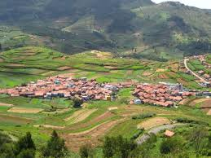

HYPOTHETICAL CASE STUDY #1 : Jijilo
You represent a non-profit organization tasked with bringing sustainable energy to the rural village of Jijilo through the development of a solar mini-grid. Jijilo, nestled in a rural setting, is known for its vibrant agricultural community. Residents primarily rely on farming and small-scale trading for their livelihoods.
As you explore Jijilo and its socioeconomic context, you observe:
A significant portion of villagers have limited literacy and technical skills.
The village population is spread out across a large area.
Agriculture serves as the main economic activity, contributing to the community's livelihoods with varying incomes.
The village has ample land available.

Slide 16



Jijilo - Discussion
To develop a solar mini-grid, operational stability and economic sustainability are crucial.
We need to understand energy consumption patterns, peak hours of demand, and available energy sources which are factors greatly influenced by the socio-economic aspects of a population.
Below are some impacts :
Load Profiles
Energy Demand Forecasting
The population's income reliability and fluctuation will significantly affect energy demand forecasting. Unstable incomes lead to erratic energy usage that are varying and unpredictable making it challenging to predict consumption patterns accurately while reliable income periods may show steady energy demand.
The community's literacy and technical skills affect energy supply options. Limited skills can hinder operation and maintenance of advanced systems like solar-battery setups, requiring simpler technologies or training. Initial skepticism towards new technologies may persist due to knowledge gaps.
As agriculture is the major economic activity, villagers leave in the morning and return in the evening, consuming more energy during these times. The village's load profile will show distinct morning and evening peaks with a midday dip. Seasonal variations will impact energy demand, with higher usage during peak agricultural periods.
Energy Supply Options

Slide 17
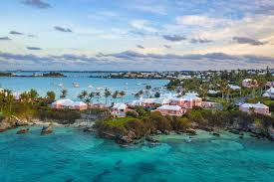
HYPOTHETICAL CASE STUDY #2 : Kulal Island
Kulal Island is a picturesque tourist destination attracting thousands of tourists annually. It faces energy challenges, relying on costly, polluting, and unreliable diesel generators. You are representing a renewable energy consulting firm tasked with guiding the Island owners who plan to develop a mini-grid to solve their energy problems.
As you explore Kulal Island, you make some observations:
The island relies heavily on tourism with many hotels, restaurants, and recreational facilities.
The island has abundant sunlight and wind resources, ideal for renewable energy.
Residents are highly literate and skilled .
Environmental preservation is important for locals and tourists.

Slide 18
Kulal Island - Discussion
The island owners and residents aim for a stable, cost-effective, and environmentally sustainable energy solution to support their tourism-based economy, enhance attractiveness, and engage the community. To achieve this, they must understand energy consumption patterns, peak demand hours, and available energy sources, influenced by socioeconomic factors. Here are some impacts to consider:
Load Profiles
Energy Demand Forecasting
Fluctuating tourism income significantly affects energy demand forecasting. During peak tourist seasons, income levels can vary widely, leading to erratic and unpredictable energy usage patterns. Similarly, during periods of steady and high tourist arrivals, there tends to be more consistent energy demand.
The island's abundant sunlight and wind resources create a favorable environment for renewable energy development. Solar power, harnessed through photovoltaic panels, and wind energy, utilizing turbines, offer sustainable alternatives to traditional diesel generators.
The island's literate and skilled population influences the load profile through energy-efficient practices. Their understanding enables adoption of technologies like LED lighting and smart energy systems, adjusting usage to stabilize demand, especially during peak tourist seasons, for a sustainable energy profile.
Energy Supply Options

Slide 19
Lesson 2: References
This unit was developed by Strathmore University and is based on the following resources:
Guidelines for Demand Data Collection for Rural Access to Electricity Projects. Stevanato, N., Sangiorgio, I., Baldelli, G., Farah, A., Mereu, R.,Colombo, E., Banda, S., Wacera, A., Oribo, N., Silva, I., Tomas Fillol, L., & Pinomaa, A
Assessing the opportunities and challenges facing the development of off-grid solar systems in Eastern Africa: The cases of Kenya, Ethiopia and Rwanda. Joshua Mugisha ,Mike Arasa Ratemo, Bienvenu Christian Bunani Keza, Hayriye Kahveci

