Slide 1

ENTREPRENEURSHIP IN THE OFF-GRID SOLAR ENERGY SECTOR
Lesson 9: How to Pitch Your Solar Energy Project to Investors
Author: A. Dib

Slide 2
Lesson 9 Learning Outcomes
After completing this lesson, you will be able to:
Understand the structure of a pitch deck
Develop each section of a pitch deck with clarity and focus
Tailor your pitch for seed funding or Series A rounds
Deliver your pitch with confidence and persuasion
Recognise the Five Life Cycle Stages of a Startup

Slide 3
Lesson 9 contents
Section 1: Pitch Deck Fundamentals
Section 2: Essential slides for a Pitch Deck
Section 3: Crafting a Pitch Deck
Section 4: Delivering Your Pitch
Section 5: Case Study : Oolu’s pitch
Five Life Cycle Stages of a Startup

Slide 4
Section 1: Pitch Deck Fundamentals
Pitching your project to investors is a crucial step in securing funding, which can make or break a startup. Whether you're pitching for seed funding or Series A, understanding how to structure and deliver a compelling pitch is essential. This unit will guide you through the key elements of a successful pitch deck and how to deliver it effectively.
What is a Pitch Deck?
A pitch deck is a concise presentation that outlines your business, the problem you're solving, your solution, and why investors should care. It’s not just about providing information but telling a story that captivates and convinces potential investors. The deck should be simple, clear, and visually appealing. the deck is a means of showcasing the essence of your business​
The main goals of a pitch deck :
Spark interest
Convince investors of the viability of your project
Facilitate deeper discussions
Notes:
https://www.ycombinator.com/library/2u-how-to-build-your-seed-round-pitch-deck
https://www.ycombinator.com/library/4T-how-to-design-a-better-pitch-deck
https://www.ycombinator.com/library/8d-how-to-build-a-great-series-a-pitch-and-deck

Slide 5

Section 1: Pitch Deck Fundamentals: Example
Before starting, let’s take a look at the first Pitch of a Solar company : Oolu
https://www.ycombinator.com/companies/oolu

Slide 6
Section2: Essential slides for a Pitch Deck
When creating a pitch deck, focus on these essential slides:
Title Slide:
    Company name, logo, and tagline.
    Keep it clean and professional to set the tone.
Problem Statement:
Clearly define the problem you're solving. Investors need to understand that there’s a significant and pressing issue in the market.
Quantify the problem whenever possible​
Solution:
Describe your product or service and how it solves the problem.
Keep it simple and direct. Visuals can help to demonstrate your solution in action.
Notes:
https://www.ycombinator.com/library/2u-how-to-build-your-seed-round-pitch-deck
https://www.ycombinator.com/library/4T-how-to-design-a-better-pitch-deck
https://www.ycombinator.com/library/8d-how-to-build-a-great-series-a-pitch-and-deck

Slide 7
Section2: Essential slides for a Pitch Deck
Market Opportunity:
Present the size of the market, your target audience, and growth potential.
Investors want to know that your solution targets a scalable opportunity​(
Business Model:
Explain how you make money. Whether it's a subscription, freemium, or a commission-based model, be clear about your revenue streams.
Include any partnerships or distribution strategies that enhance your business model.
Traction:
Highlight key metrics like revenue, customer growth, or partnerships.
This is crucial, especially for Series A pitches, as investors want evidence that you are growing;
Notes:
https://www.ycombinator.com/library/2u-how-to-build-your-seed-round-pitch-deck
https://www.ycombinator.com/library/4T-how-to-design-a-better-pitch-deck
https://www.ycombinator.com/library/8d-how-to-build-a-great-series-a-pitch-and-deck

Slide 8
Section2: Essential slides for a Pitch Deck
Competition:
Map out your competitive landscape, showing where you stand.
Investors expect you to acknowledge competitors and demonstrate how you’re different or better​(
Team:
Showcase the expertise and experience of your core team.
Investors often back strong teams more than just the idea​(
Financials:
Present a high-level view of your financial projections, including revenue, expenses, and profit forecasts for the next 3-5 years
Avoid getting too technical, but ensure the numbers align with your market opportunity and business model
Ask:
Be specific about how much funding you are seeking and what it will be used for.
Explain the milestones you aim to achieve with this investment​
Notes:
https://www.ycombinator.com/library/2u-how-to-build-your-seed-round-pitch-deck
https://www.ycombinator.com/library/4T-how-to-design-a-better-pitch-deck
https://www.ycombinator.com/library/8d-how-to-build-a-great-series-a-pitch-and-deck

Slide 9
Section 3: Crafting a Pitch Deck
Seed round pitch
Seed round investors focus on vision, potential, and market fit. While your business may still be early in its lifecycle, your pitch should exude clarity and confidence.
Key tips for a seed round pitch:
Focus on vision: Your idea must seem fresh, impactful, and viable​
Be concise: Limit your deck to 10-12 slides to keep the investor’s attention.
Strong problem-solution narrative: This is the heart of your seed pitch. Make it clear why your solution stands out
Notes:
https://www.ycombinator.com/library/2u-how-to-build-your-seed-round-pitch-deck
https://www.ycombinator.com/library/4T-how-to-design-a-better-pitch-deck
https://www.ycombinator.com/library/8d-how-to-build-a-great-series-a-pitch-and-deck

Slide 10
Section 3: Crafting a Pitch Deck
Series A pitch
A Series A pitch requires more detail and proven metrics than a seed round. Investors at this stage are looking for clear signs of product-market fit, traction, and scalability.
Key focus areas for Series A Pitch :
Traction and Metrics: Highlight user growth, revenue, and engagement​
Scalability: Demonstrate how your business can scale and dominate its market​
Financial Projections: Offer realistic financial models, supported by your early results and growth plans​
Notes:
https://www.ycombinator.com/library/2u-how-to-build-your-seed-round-pitch-deck
https://www.ycombinator.com/library/4T-how-to-design-a-better-pitch-deck
https://www.ycombinator.com/library/8d-how-to-build-a-great-series-a-pitch-and-deck

Slide 11
Section 4: Delivering Your Pitch
The way you deliver your pitch is as important as the content. Follow these key guidelines:
Practice: Rehearse your pitch multiple times to ensure smooth delivery.
Tell a story: Structure your pitch as a narrative, with a clear beginning, middle, and end.
Be ready for questions: Investors will probe your assumptions and ask tough questions.
Prepare answers to common questions about competition, growth, and financials​
Creating a strong pitch deck and delivering it effectively is a skill that takes practice.
Focus on crafting a clear, compelling narrative, backed by solid data, and delivered with confidence.
Whether you're raising seed funding or Series A, the goal is the same: to convince investors that your project is worth their time and money.

Slide 12
Section 5: Case Study : Oolu’s pitch
To see how what we stated in the previous sections is applied in real pitch lets see again Oolu’s pitch during the YC S15 Demo Day.
Oolu is a leading solar energy company operating in West Africa, with its headquarters based in Senegal. Founded in 2015, Oolu's mission is to provide affordable and reliable off-grid solar energy solutions to rural and peri-urban communities that lack access to electricity. The company aims to improve energy access through innovative solar home systems, which are both environmentally friendly and financially accessible through a pay-as-you-go model.
By offering solar products like solar panels and battery storage, Oolu empowers families and small businesses to reduce their dependency on costly and polluting energy sources like kerosene and diesel. Oolu operates in countries such as Senegal, Mali, Burkina Faso, Niger, and Nigeria, and it has rapidly expanded its customer base, reaching thousands of homes in underserved areas.
https://www.ycombinator.com/companies/oolu

Slide 13

Section 5: Case Study : Oolu’s pitch
Title Slide:
Company name, logo, and tagline

Slide 14
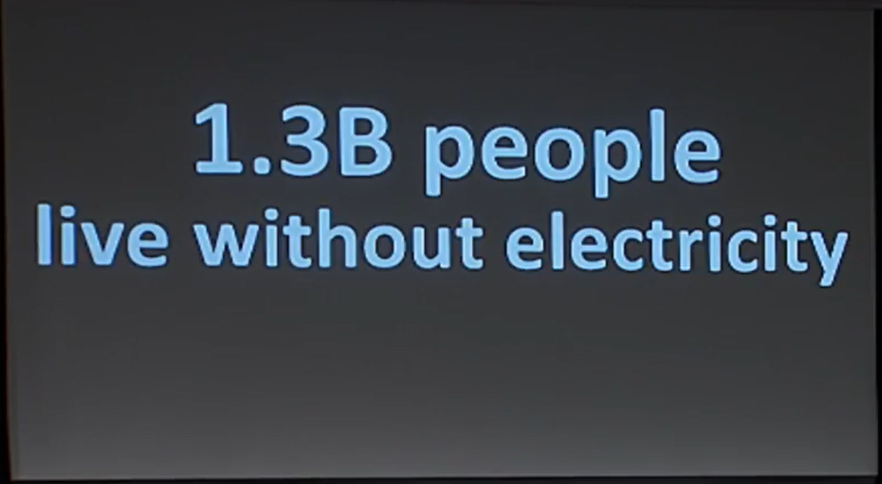
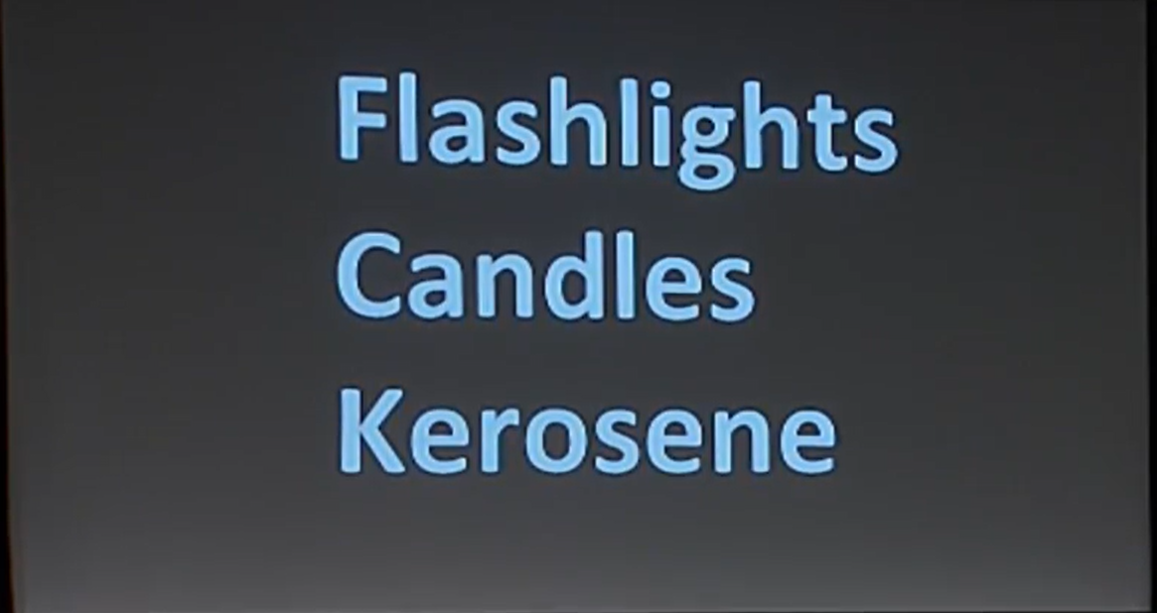
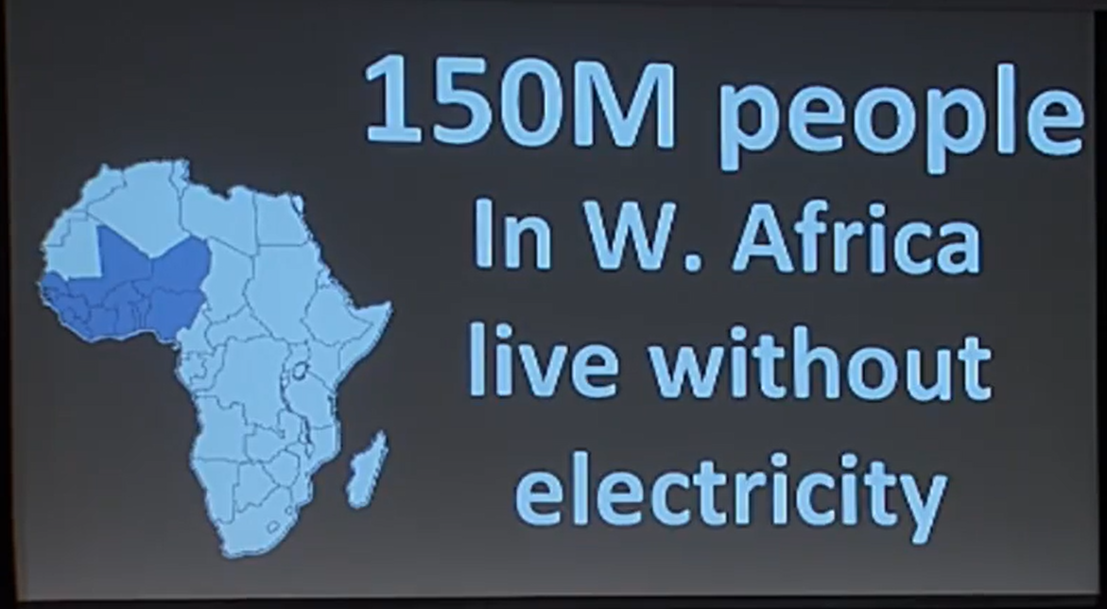
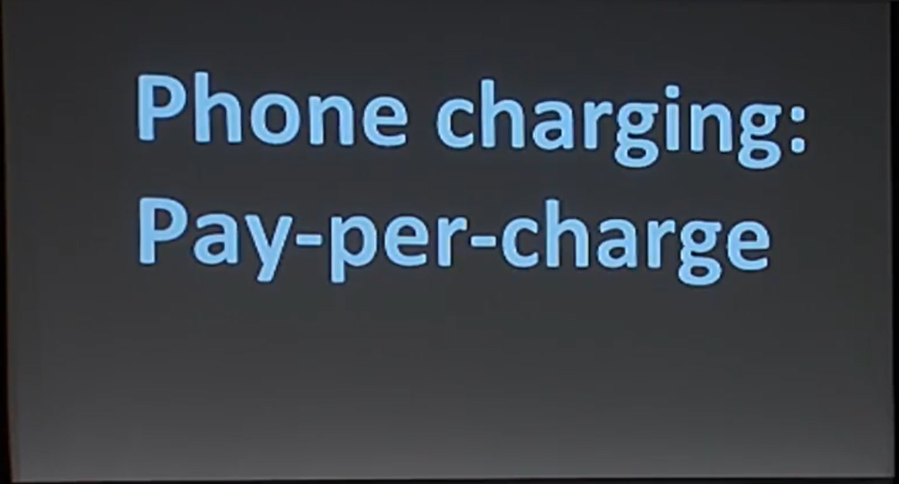
Section 5: Case Study : Oolu’s pitch
Problem Statement:
Problems | Data evidence
Alternative solutions

Slide 15
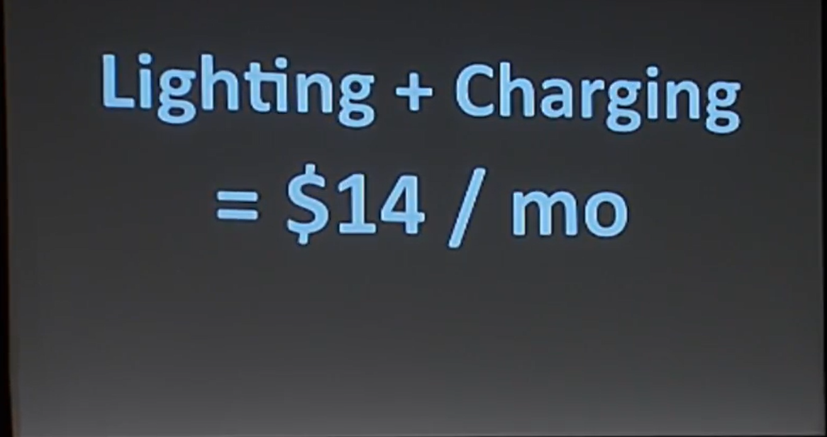
Section 5: Case Study : Oolu’s pitch
Competition:
Map out your competitive landscape, showing where you stand.

Slide 16
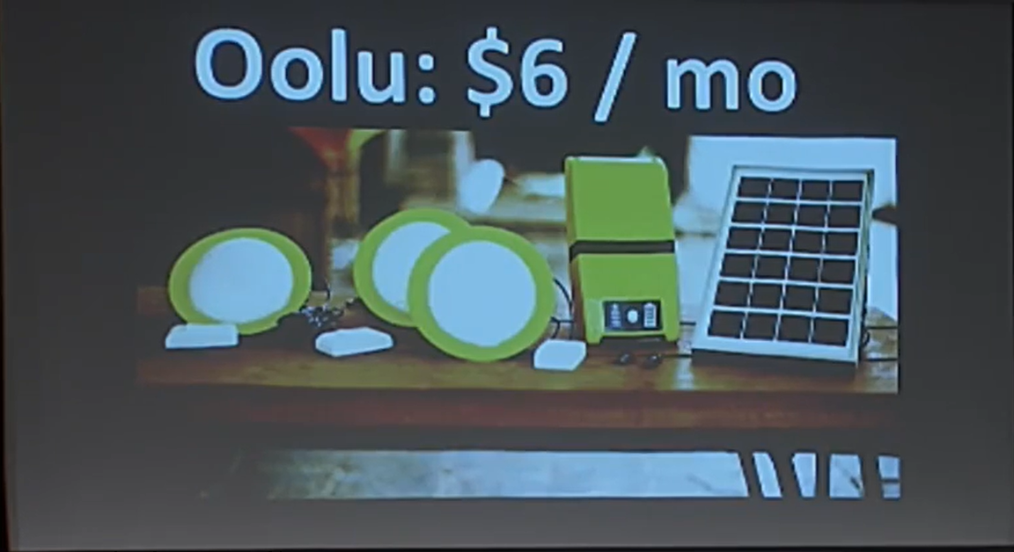
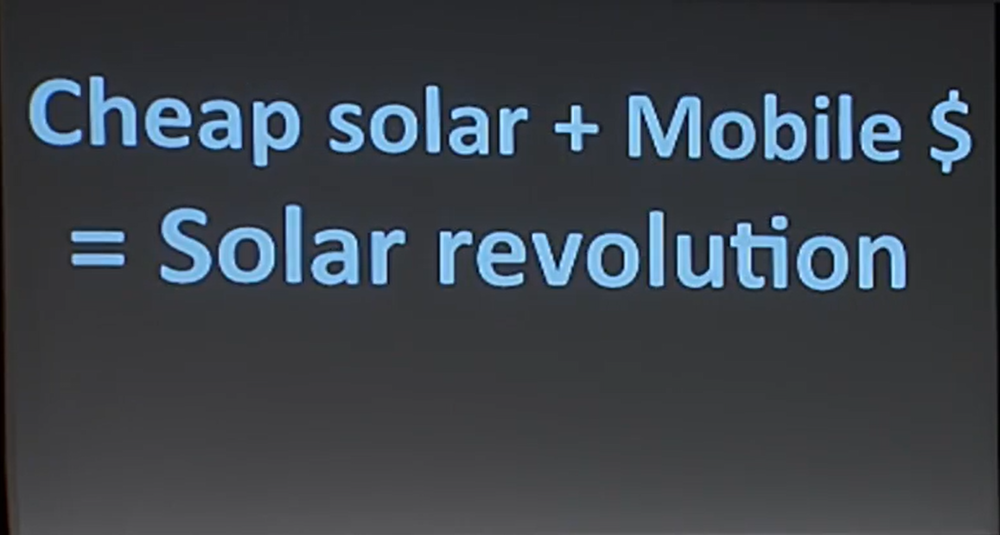
Section 5: Case Study : Oolu’s pitch
Solution:
Describe your product or service and how it solves the problem.
Keep it simple and direct. Visuals can help to demonstrate your solution in action.

Slide 17
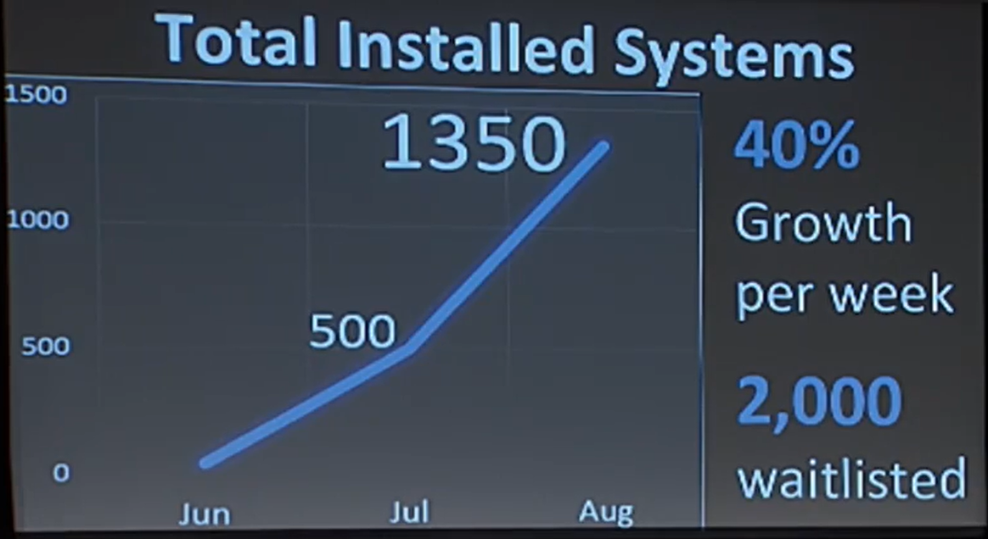
Section 5: Case Study : Oolu’s pitch
Traction:
Highlight key metrics like revenue, customer growth, or partnerships.

Slide 18
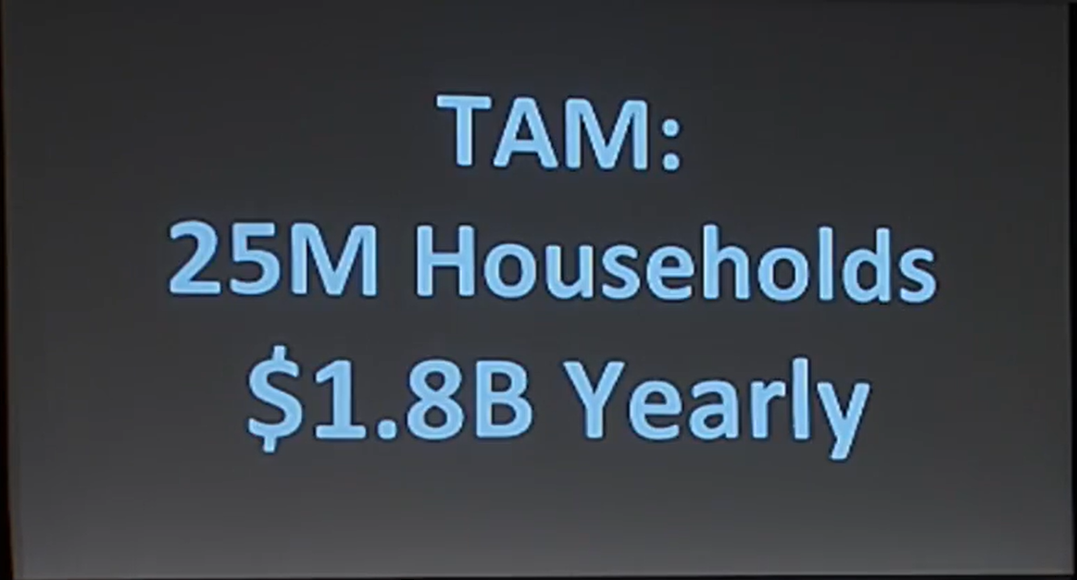
Section 5: Case Study : Oolu’s pitch
Market Opportunity:
Present the size of the market, your target audience, and growth potential.

Slide 19
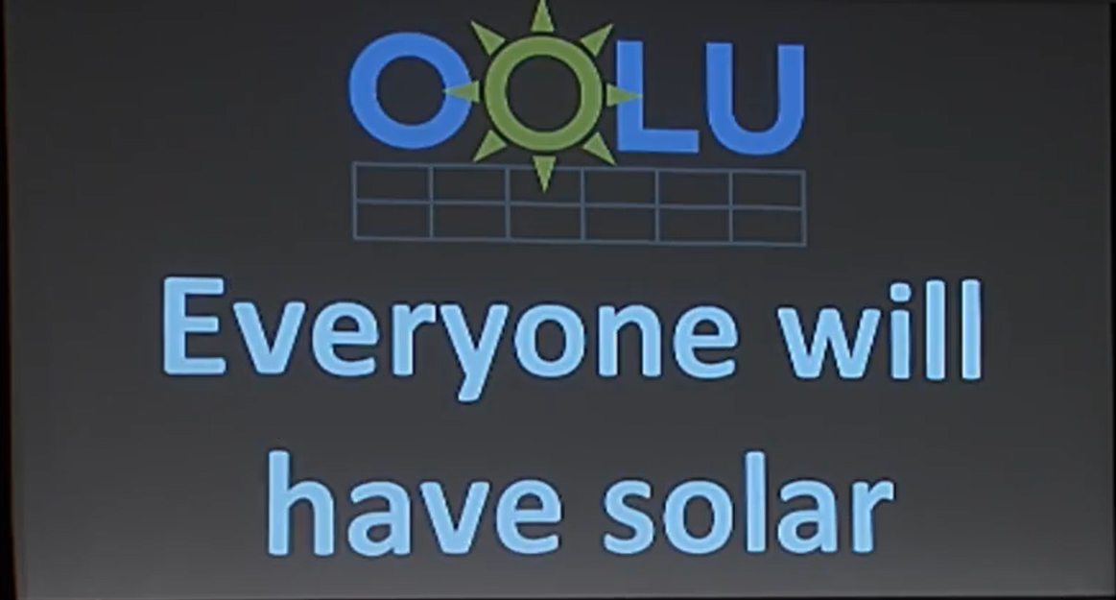
Section 5: Case Study : Oolu’s pitch
Closing Slide

Slide 20
Five Life Cycle Stages of a Startup
The lifecycle of a startup is generally divided into several stages, each characterised by different levels of development, funding needs, and investor expectations. Below is a breakdown of the common stages: idea, seed, Series A, B, C, and beyond.
1. Idea Stage
This is the very beginning of a startup's journey, where the focus is on developing the concept and vision for the business. At this stage, the startup typically has:
No product (or a basic prototype)
No customers or revenue
A focus on researching the market, validating the idea, and assembling a founding team.
Funding at this stage usually comes from personal savings, family and friends, or early-stage investors like angel investors. The goal is to secure enough funding to move from idea to product development.

Slide 21
Five Life Cycle Stages of a Startup
2. Seed Stage
At the seed stage, the startup is beginning to create and refine its product or service. It may have:
A prototype or minimum viable product (MVP)
Early customer feedback or user testing
Some evidence of market demand.
Funding is usually secured from angel investors, early-stage venture capital (VC) firms, or seed funds. The amounts are typically smaller, aimed at building the product, acquiring initial customers, and proving the viability of the business model. The focus is on laying the groundwork for scalability.

Slide 22
Five Life Cycle Stages of a Startup
3. Series A
By Series A, the startup has likely launched its product, shown early signs of success, and is now looking to scale. Key characteristics of this stage include:
Proven product-market fit with solid customer feedback
Growing revenue or user base
A clear plan for growth and scalability.
Investors at this stage, typically venture capital firms, look for startups that have a strong product-market fit but need funding to expand. The funding is typically used for hiring, marketing, and refining the product further to achieve larger market penetration.

Slide 23
Five Life Cycle Stages of a Startup
4. Series B
At the Series B stage, the startup is focused on expanding its reach and solidifying its position in the market.
By this stage, it usually has:
Consistent revenue growth
A well-defined customer base
Plans to expand operations, marketing, and geography.
Series B investors, typically larger VC firms, provide funding for the company to scale more aggressively, enhance its infrastructure, and expand its market share. The business at this stage may also start facing more competition, so the goal is often to solidify market leadership.

Slide 24
Five Life Cycle Stages of a Startup
5. Series C and Beyond
Series C and later rounds (Series D, E, etc.) are about further scaling and potentially preparing the company for an initial public offering (IPO), acquisition, or other forms of exit. Startups at this stage are often:
Profitable or very close to profitability
Seeking international expansion, new product lines, or acquisitions
Focused on maximising market share or dominating new markets.
Funding comes from late-stage investors, private equity firms, or even hedge funds. The amounts raised are significantly larger, and the risk is generally lower than at earlier stages. The startup is seen as a more established business, and the focus shifts to expansion on a global scale or establishing dominance in its industry.

Slide 25
Five Life Cycle Stages of a Startup
Summary of Startup Life Cycle Stages
Stage | Focus | Typical Investors | Funding Purpose
Idea Stage | Concept development, market research | Personal savings, friends, family | Create a prototype, validate the idea
Seed Stage | Early product development, market validation | Angel investors, seed funds | Build product, acquire first customers
Series A | Scaling up, market expansion | Venture capital firms | Grow user base, optimise product, hire staff
Series B | Rapid growth and expansion | Larger VC firms | Expand operations, marketing, geography
Series C+ | Market leadership, IPO preparation | Private equity, hedge funds | International expansion, new product lines
Notes:
https://www.energymrc.ng/business-models-in-the-off-grid-renewable-energy-market/

