Slide 1

BUSINESS AND SOCIO-ECONOMIC CONTEXTS OF MINI-GRID DEVELOPMENT
Lesson 1: ​
Introduction to Business Models

Slide 2
Lesson 1: Outline
Introduction to Business model
Business Model Innovation (BMI)
Business Model Canvas (BMC)
Business Model Patterns/ Archetypes
Business Model /Architypes in Rural Electrification
Mini-grid Business Model Design Considerations

Slide 3
Lesson 1: Learning outcomes
At the end of this lesson, the participant should be able to: ​
  1.Understand the fundamentals of business models;​
  2.Understand various business model patterns/archetypes;
  3. Examine some business model considerations for mini-grid projects.

Slide 4
Introduction
Definition:
  A business model can generally be described as the logic behind how an organization creates, delivers, and captures value.
Origins:
  First mentioned in academic literature in the early 1950s and explored further in the 1990s with the rise of e-commerce and the New Economy (a shift from the traditional brick-and-mortar model to more online-based and high-tech services).
Popularity and Challenges:
  Surged during the dot-com boom but faced criticism during the dot-com bubble burst. Reinstated importance due to globalization, tech advancements, and shorter market cycles.
Misuse and Ambiguity:
  Often misused as a buzzword, interchangeably with terms like strategy and revenue model. Some descriptions only capture one aspect, leading to ambiguity.
Diverse Interpretations:
  Lacks consensus in definition, leading to diverse interpretations among scholars. Conceptualizations serve specific contexts, encompassing various functions.

Slide 5
Business Model innovation (BMI)
Business Model Innovation (BMI)
  Involves crafting, altering, or specifying fundamental framework and elements of a business model.
  Aims to develop fresh value propositions, seize novel market opportunities, and attain a competitive edge.
Importance of BMI:
  Crucial for both existing and new business models.
  Encompasses entrepreneurial activities and creation/implementation of new business models.
  Can involve radical restructuring or alteration of existing business models.
Relationship with Business Model Design and Reconfiguration:
  Positioned as a subset of both business model design and reconfiguration.
  BMI could help to create new models or alter existing ones.

Slide 6
Business Model Canvas
Business Model Canvas, created by Alex Osterwalder and Yves Pigneur (2005),
is an entrepreneurial tool.
It facilitates the description, design, challenge, invention, and pivoting of your business model.
This method is widely employed in leading organizations and start-ups globally.
The Business Model Canvas is a template that allows you to:
  Visualize and communicate a simple story of your current business model.
  Utilize the canvas to devise new business models, whether you're a start-up or an established business.
  Manage a portfolio of business models.

Slide 7
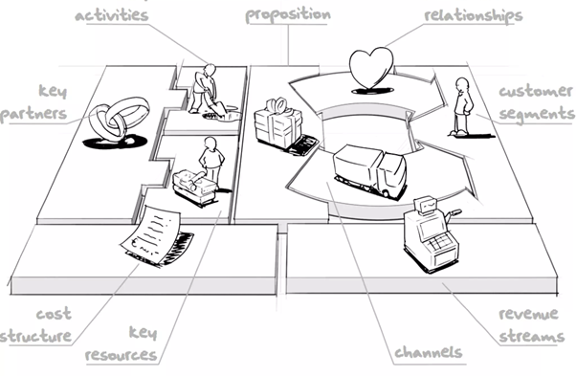
Business Model Canvas (BMC)
The Business Model Canvas comprises nine key elements
Figure 1: Business model canvas. The figure is adopted from the "Business Model Generation" , Alexander Osterwalder, Willy, 2010.

Slide 8
Business Model Patterns/Archetypes
A customizable configuration of various business model blocks to enhance an organization's overall business model.
Business model patterns offer valuable insights for developing and re-configuring business models.
They are already tested and proven models that can be replicated for creating or improving business models. Business model archetypes are components of a business model that serve as a base for innovation.
For example, the conventional bricks and mortar pattern involves physical store presence and in-person sales or service operations. The bricks and clicks pattern integrates digital marketplaces with physical shops, reflecting the shift towards digital services.

Slide 9
Examples of business model archetypes
Archetype example | Description | Specific area relating to the BMC
Open content | Accessible content development by a global community of contributors as a voluntary work | Value proposition development
Digital service provider | Produce and deliver different type of services online
Digitization | Offer a traditionally physical product with a digital format
Data as a service | Provide data files for customers over the internet | Value proposition
energy as a service | Provide energy service to customer without having to make upfront investments
Flexible pricing | Vary prices based on demand of the product or service
Freemium | Provide basic services for free while charging a premium for advanced features or contents | Payment/ Pricing model
Pay what you want | Setting the price based on customers willingness to pay
Flat rate | Charge a single fixed price for a service and allow the customer to have unlimited access in exchange
Subscription | Provide products or services at a regular interval to customers for recurring upfront fee | Revenue Stream
Usage fee | Charge customers depending on their usage amount
Pay per use | Charge for each use of a product or service
Revenue sharing | Share the revenues with other stakeholders to create a symbiotic relationship | Channel/Value delivery
Shared infrastructure | Share a common infrastructure among several operators
Repurposer | Involves repurposing existing key resources to meet proven demand or target new customer groups, creating new value propositions by effectively utilizing these resources. | Customer segment
Resource castle | Establish a competitive edge through key resources that are challenging or impossible for competitors to replicate. | Key Resource

Slide 10
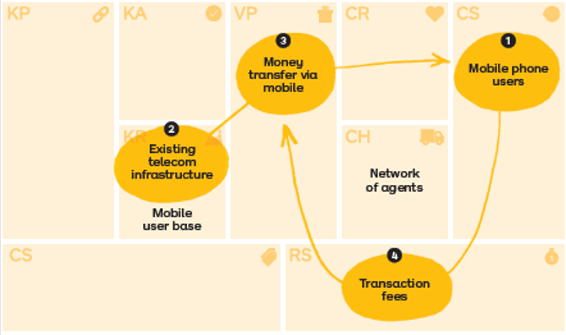
M-Pesa Repurposer pattern
Figure 2: Repurposor model. The figures and contents are adopted from the book "The invincible company" and Strategizer.com

Slide 11
Sample architypes for mini-grids /rural electrification:
Pay-as-you-go: Allowing users to pay for electricity consumed as needed
Pay-as-you-store (Chill) / Chilling-as-a-Service: Enabling agricultural producers in the cold-value chain to pay for using cold storage facilities when required
Anchor-Business-Community (ABC) Model :Minimizing uncertain power demand risk by initially targeting anchor customers, followed by businesses and communities
Appliance Financing: Offering appliances with credit to rural customers to stimulate electricity demand
Revenue Sharing: Allocating a portion of total generated income to stakeholders to encourage and maximize rural community participation
KeyMaker: Engaging rural manufacturers reliant on mini-grid power in the value chain of product trading businesses
Energy-Telecom-Nexus: Providing integrated power, telecom, and digital services to underserved communities lacking mobile broadband coverage and electricity
Energy-Food-Nexus: Empowering agricultural cooperatives as central load mini-grid users and supplementing household loads with excess power
Split Asset: Alleviating the developer's capital cost burden by dividing financing for generation and distribution assets between the developer and government or community Infrastructure

Slide 12
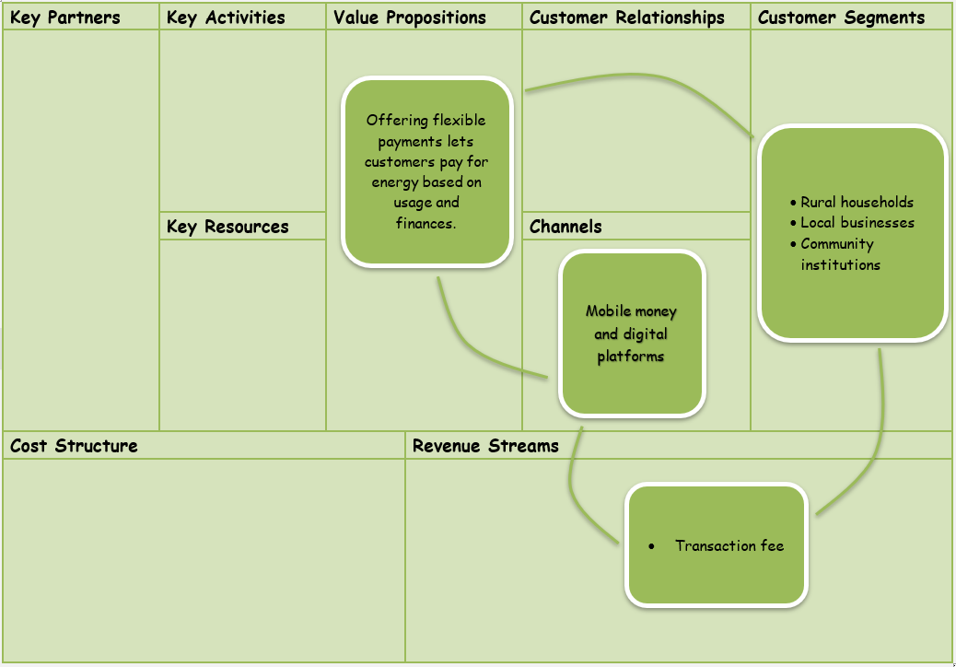
Example 1: Pay-as you-go payment model
Pay-as you-go
Flexible payments -
It lets customers pay for energy based on usage and finances.

Slide 13
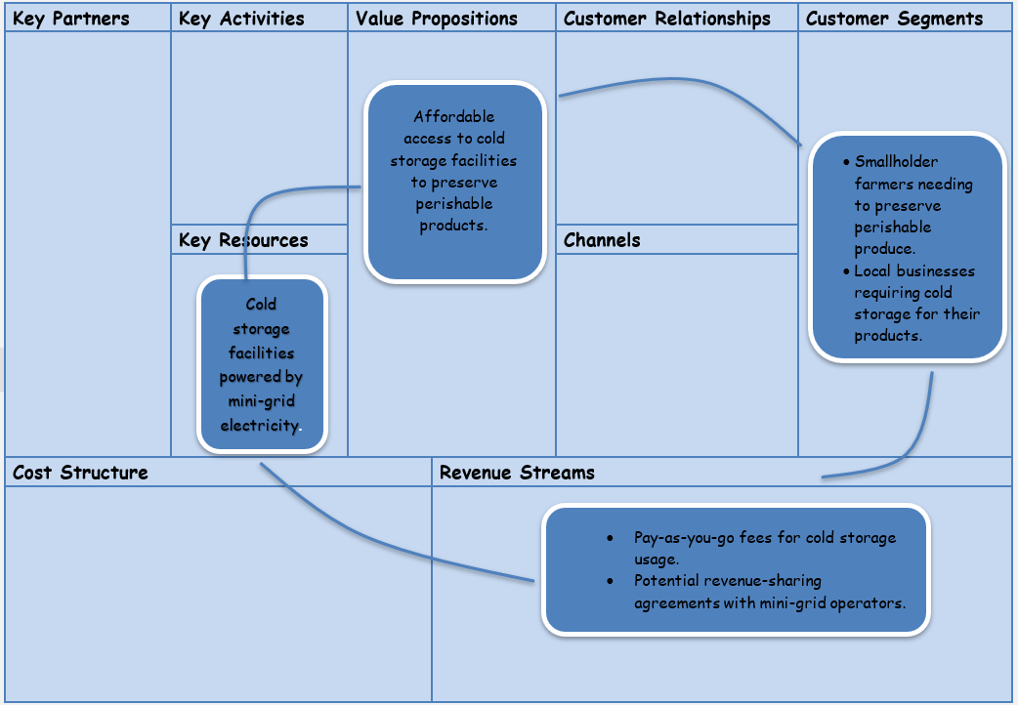
Example 2: Pay-as-you-chill
Pay-as-you-chill
Affordable access to cold storage facilities to mini-grid customers.

Slide 14
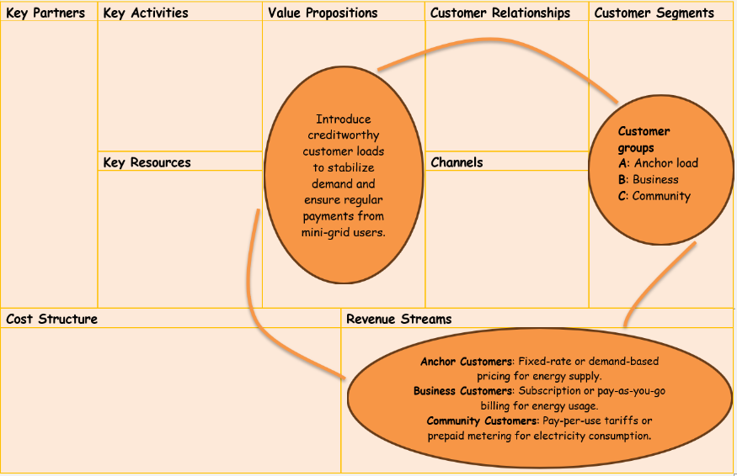
Example 3: ABC business model pattern
The ABC model (Anchor, Business, and Community)
emphasizes customer segmentation as a pivotal factor for ensuring the financial stability of a mini-grid.

Slide 15

Business model patterns as tool for designing mini-gird business model
To create a business model, different business model patterns can be applied in various areas of an organization's business model.
Business model patterns are crucial for creating and re-configuring the business model.
Business model patterns serve as essential building blocks for creating, refining, and adapting business models.

Slide 16
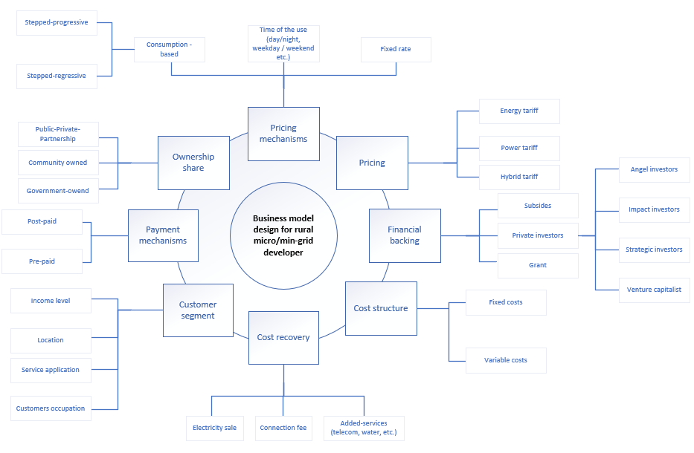
Business model design considerations
Developing a mini-grid involves various considerations for a developer, such as pricing, securing financial backing, determining ownership share, and more.
Figure 2. illustration of developers' business model design. Own Compilation.

Slide 17
Conclusion
The successful development of mini-grid business models relies on understanding business model patterns and key considerations.
Topics covered include ownership structure, pricing strategies, payment methods, customer segments, cost recovery, financial backing, community engagement, regulatory compliance, and technological choices.
A holistic approach ensures that energy needs are met while promoting long-term sustainability and success.

Slide 18
References
Osterwalder, A., & Pigneur, Y. (2010). Business Model Generation: A Handbook for Visionaries, Game Changers, and Challengers . John Wiley and Sons.
Osterwalder Alexander, Pigneur, Y., Smith, A., & Etiemble, F. (2020). The Invincible Company: How to Constantly Reinvent Your Organization with Inspiration From the World's Best Business Models. John Wiley and Sons.
Dibaba, H. (2023), Measuring success: Evaluating the business model of rural mini-grid ecosystems.Energy Research and Social Science. 106,103296. doi.org/10.1016/j.erss.2023.103296

