Slide 1

Off-Grid Energy Systems Modelling with MicroGridsPy
Lesson 5: Load Demand Assessment

Slide 2

Lesson 5: Contents
Understanding Load Demand Significance
The critical role of load demand in designing efficient and reliable off-grid energy systems, including how it influences system sizing and capacity planning
Energy End-Use Analysis
Various energy end-uses in rural communities, such as lighting, appliances, and heating, and understand their impact on overall load demand
Load Estimation Methods
Different load estimation methods (top-down, hybrid, bottom-up) and their applications in practical scenarios for accurate demand prediction in off-grid systems
Load Demand Assessment within MicroGridsPy
MicroGridsPy interface page and features
Notes:
This unit is designed to introduce learners to the critical aspects of load demand assessment in off-grid energy systems. We'll cover the significance of load demand in designing efficient and reliable systems, how it influences sizing and capacity planning, and delve into energy end-use analysis in rural communities. You'll learn about various load estimation techniques, including top-down, hybrid, and bottom-up approaches. Finally, we'll explore how to assess load demand within MicroGridsPy, focusing on inputting and analyzing field data. By the end, you'll have a solid foundation for designing and optimizing off-grid energy systems.

Slide 3
Lesson 5 Learning Outcomes
At the end of this unit, participants will be able to :
Grasp the critical role of load demand in designing efficient and reliable off-grid energy systems, including how it influences system sizing and capacity planning;
Learn to identify and analyse the various energy end-uses in rural communities, such as lighting, appliances, and heating, and understand their impact on overall load demand;
Acquire knowledge of different load estimation methods (top-down, hybrid, bottom-up) and their applications in practical scenarios for accurate demand prediction in off-grid systems;
Master the use of the MicroGridsPy interface page and features, learning to input and analyse field data
Notes:
This lecture is designed to introduce learners to the critical aspects of load demand assessment in off-grid energy systems. We'll cover the significance of load demand in designing efficient and reliable systems, how it influences sizing and capacity planning, and delve into energy end-use analysis in rural communities. You'll learn about various load estimation techniques, including top-down, hybrid, and bottom-up approaches. Finally, we'll explore how to assess load demand within MicroGridsPy, focusing on inputting and analyzing field data. By the end, you'll have a solid foundation for designing and optimizing off-grid energy systems.

Slide 4
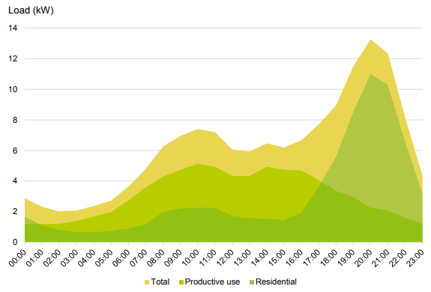

Load Demand
Load demand represents the total power consumption of all the electrical appliances, equipment, and devices that need to be powered by the off-grid system. In the context of off-grid energy systems, load demand is a critical factor in determining the size and capacity of the system for a set of different aspects of the system planning:
Preventing System Overload or Underutilization
Determining load demand aids in choosing the right capacity for each component. An undersized off-grid system might fail to meet energy needs, causing power shortages and user inconvenience. Conversely, an oversized system may lead to wasted investment and resource inefficiency.
Battery Sizing
Analysing energy usage patterns is crucial for deciding on the necessary battery storage size to harness surplus energy during high solar output for use when sunlight is low or absent.
System Performance and Reliability
Properly sizing the off-grid system based on load demand ensures that it can provide a reliable and continuous power supply
Cost Efficiency
Proper system sizing to match load demand can optimize costs; oversizing incurs unnecessary costs, while undersizing may necessitate regular maintenance and system enhancements.
Average Mini-grid load profiles for a typical rural village [1]
Regardless of how refined the energy model is, in terms of technological characterization and resolution, low-quality input data for demand will affect the entire model and its outcomes. As a core component and primary goal of these models, demand data significantly impacts the results.
Source for Image: [1] State of the Global Mini-grids Market – Report 2020
Notes:
Load demand represents the total power consumption of all electrical devices that need to be powered by the off-grid system. It is a critical factor in determining the system's size and capacity. Accurate load demand assessment helps prevent system overload or underutilization, ensuring each component has the right capacity. It also plays a crucial role in battery sizing, allowing for efficient energy storage and usage.
Properly sizing the system based on load demand ensures reliable performance and continuous power supply. It also optimizes cost efficiency by avoiding the unnecessary expenses of an oversized system and the frequent maintenance needs of an undersized one.

Slide 5

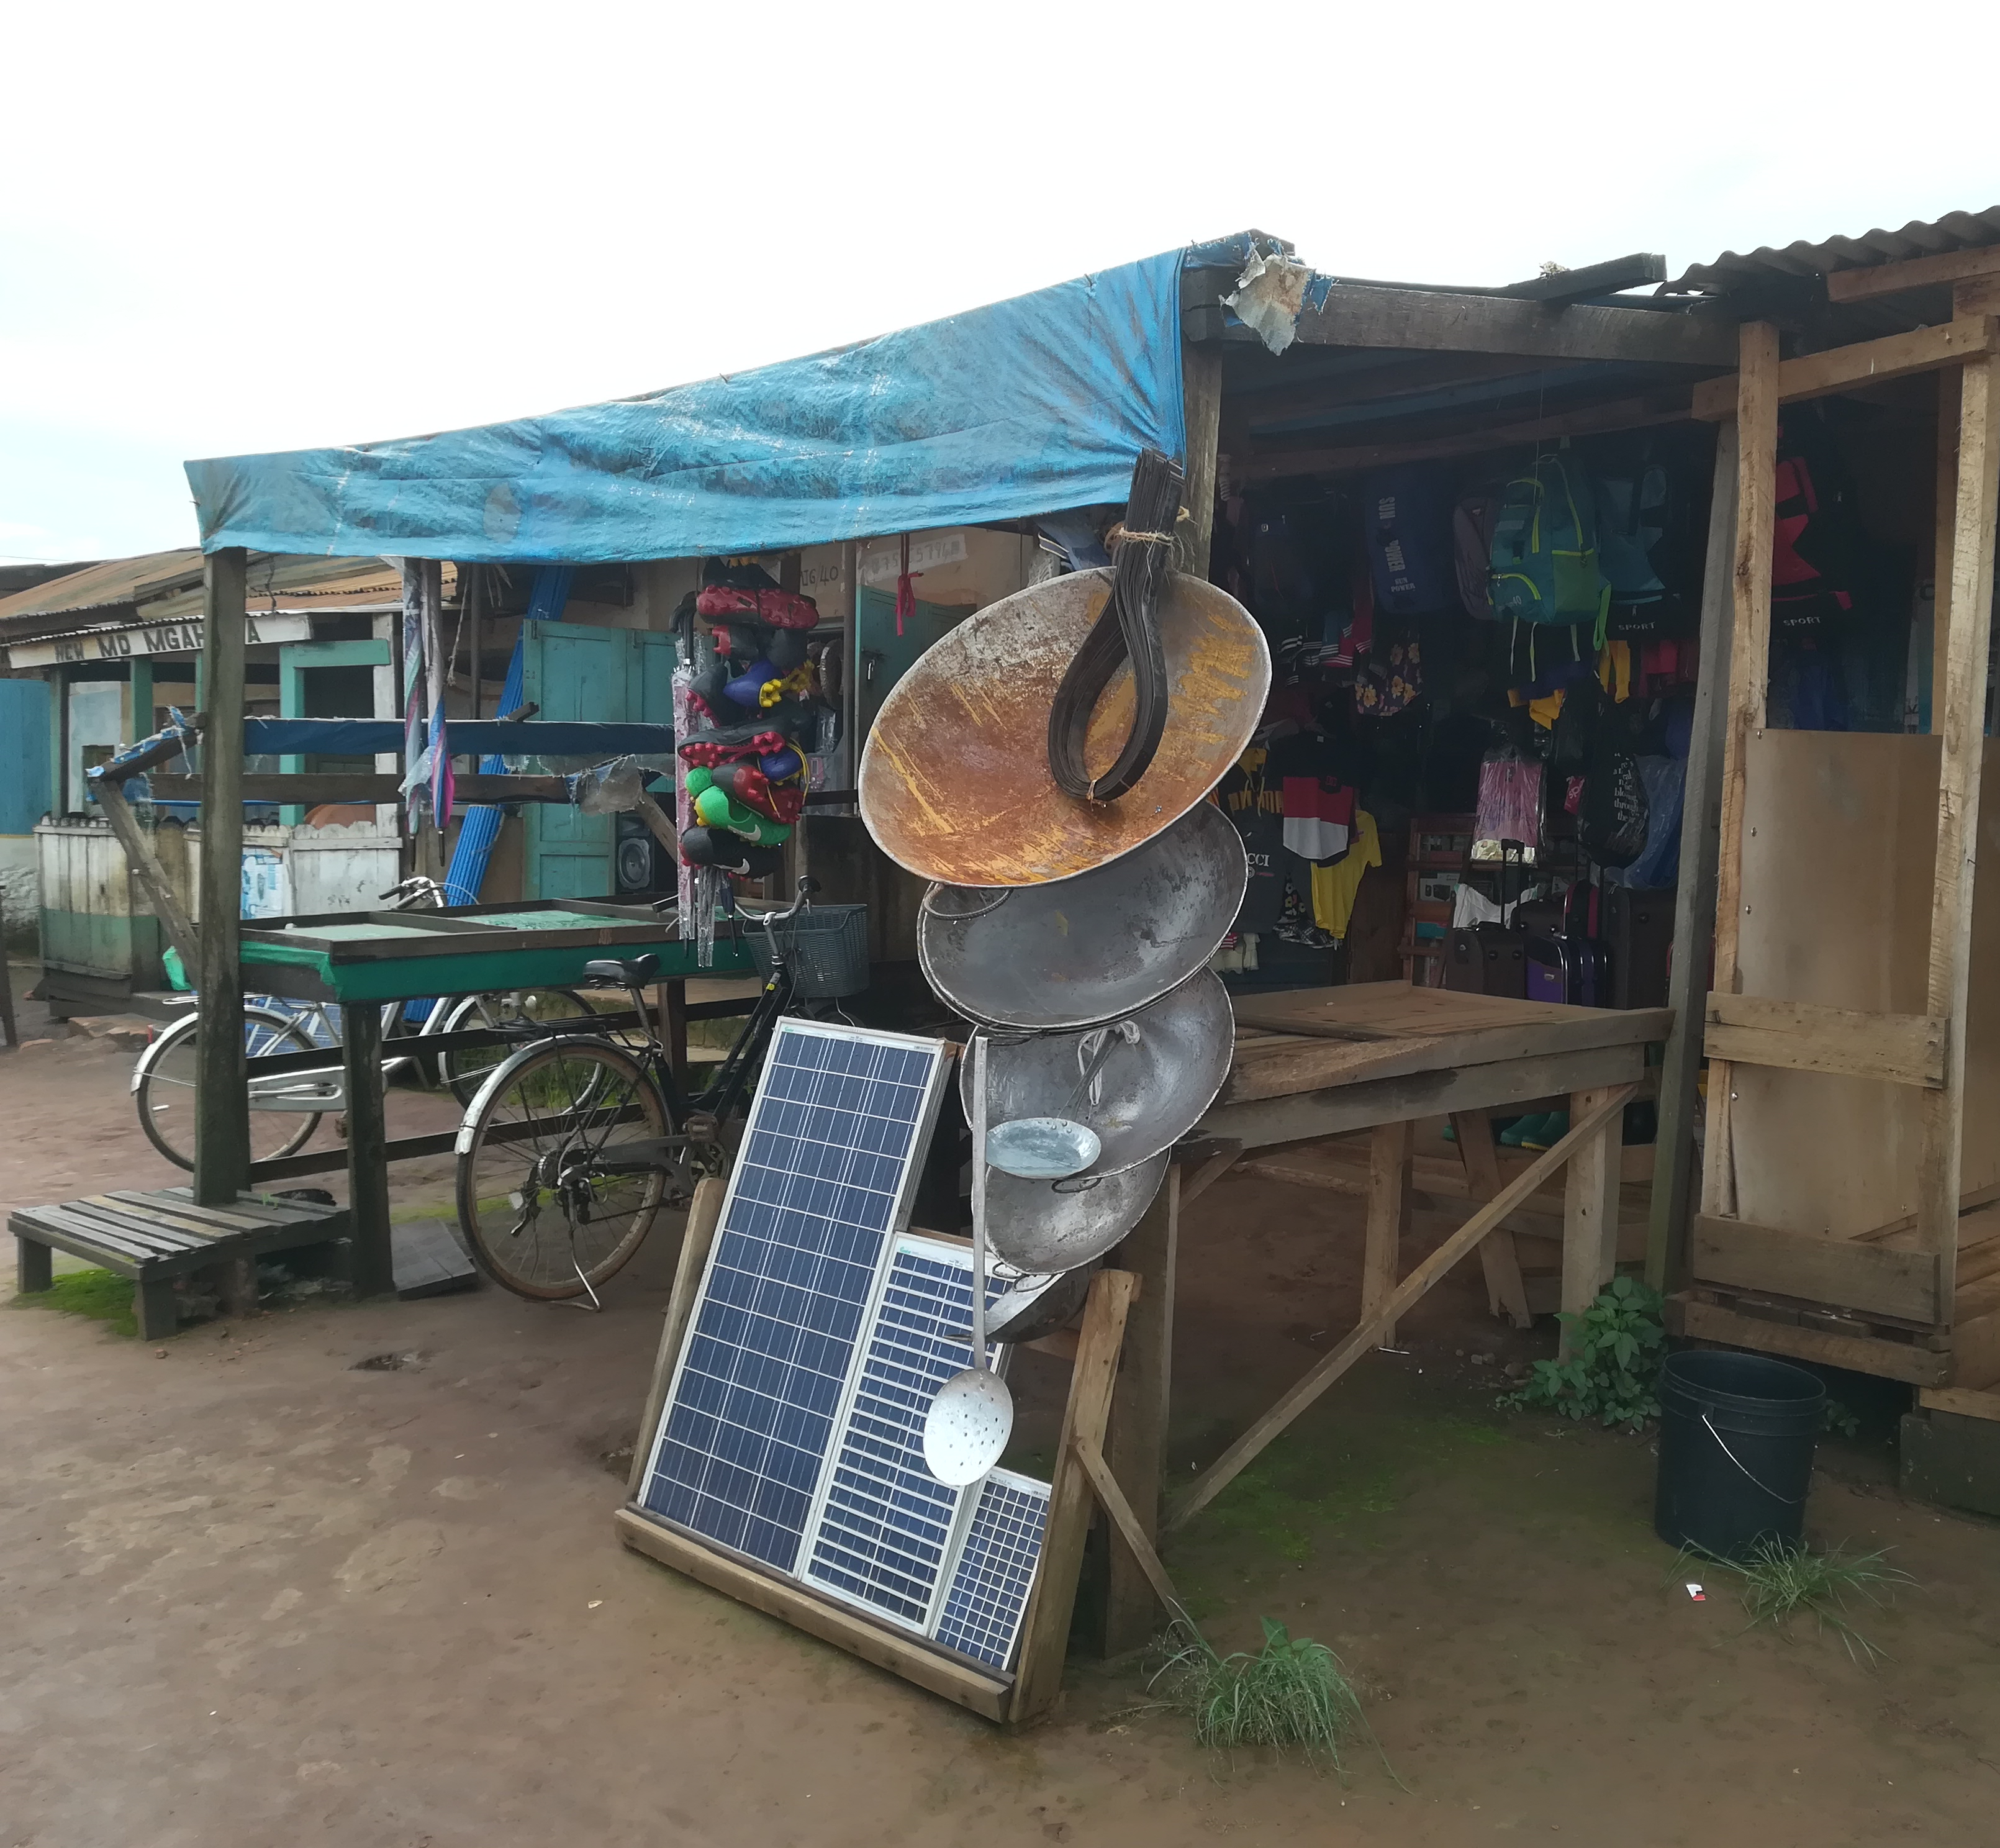



Energy end-use analysis
To assess the energy demand of rural off-grid communities, it is essential to know their potential energy end-uses, including the alternative solutions that are commonly used to cover the existing energy needs.
Lighting
In rural areas, lighting is a key use of energy, often the only use for those without high-power devices. Conventional fuel expenditures, such as kerosene and candles, often gauge lighting needs, but solar lamp use is increasing, particularly in sub-Saharan Africa.
Electrical Appliances
Low-power radios and phones are common in rural homes, with more power-intensive appliances like TVs and refrigerators acquired as socioeconomic conditions improve. Usage depends on electricity access reliability.
Productive Uses
Energy powers labour-saving machinery, boosting income and productivity, with usage reliant on stable electricity for high-power demand.
Cooking and Heating
Energy for cooking and water heating dominates rural household use, with many still using biomass fuels. High-power electric appliances for these needs are restricted to areas with reliable electricity access.
On-field pictures of electrical appliances
Notes:
To assess the energy demand of rural off-grid communities, it is essential to understand their potential energy end-uses and the alternative solutions commonly employed to meet existing energy needs. Lighting is a primary use of energy, with solar lamps increasingly replacing kerosene and candles in sub-Saharan Africa.
Electrical Appliances such as radios and phones are common, with TVs and refrigerators becoming more prevalent as conditions improve, depending on reliable electricity access.
Productive Uses include energy for machinery that boosts income and productivity, requiring stable electricity for high-power demand.
Cooking and Heating are dominated by biomass fuels, with electric appliances used in areas with reliable electricity.

Slide 6
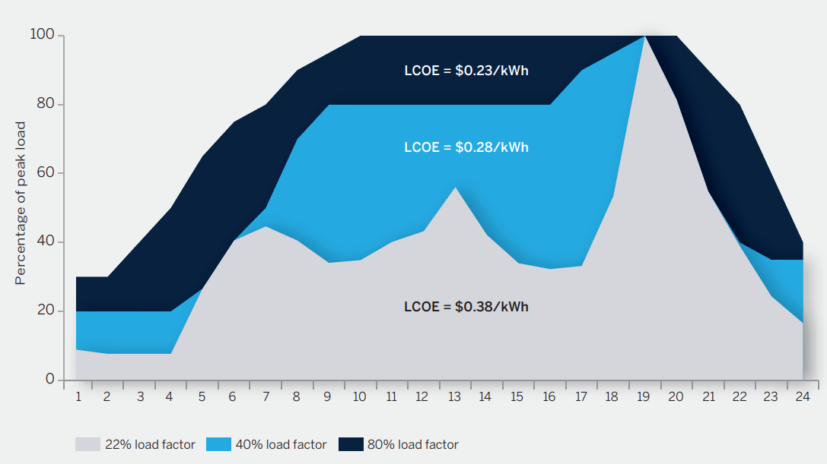
Demand Side Management
Literature indicates that the combination of increased productive uses and strategic time-allocation of energy intensive activities can lead to significantly decrease the Levelized Cost of Electricity (LCOE) of the system
Increasing productive uses of mini grid electricity brings to:
Reduction in LCOE
Increased finance viability
New jobs and increased economic activity
Benefits for national utilities since it increases customers’ ability to pay higher tariffs.
The impact of productive electricity uses on the daily load profile and levelized cost of energy [1]
Notes:
Literature indicates that the combination of increased productive uses and strategic time-allocation of energy-intensive activities can significantly decrease the Levelized Cost of Electricity (LCOE) of the system.
Increasing productive uses of mini-grid electricity brings several benefits:
Reduction in LCOE: By optimizing the use of electricity, the overall cost per unit of electricity decreases.
Increased financial viability: Improved utilization of the mini-grid enhances its economic sustainability.
New jobs and increased economic activity: Enhanced electricity use stimulates local economies by creating jobs and boosting productivity.
Benefits for national utilities: Increased ability of customers to pay higher tariffs can improve the financial health of national utilities.
The graph illustrates how productive electricity uses impact the daily load profile and reduce the LCOE at different load factors. By strategically managing demand, mini-grids can become more cost-effective and economically beneficial for rural communities.

Slide 7
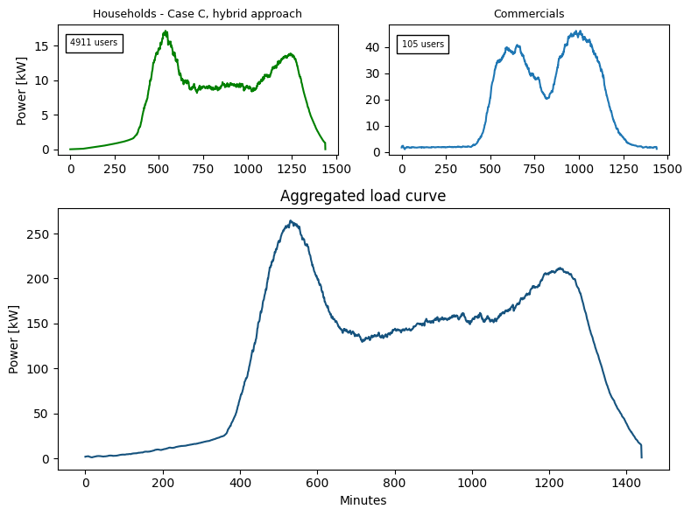


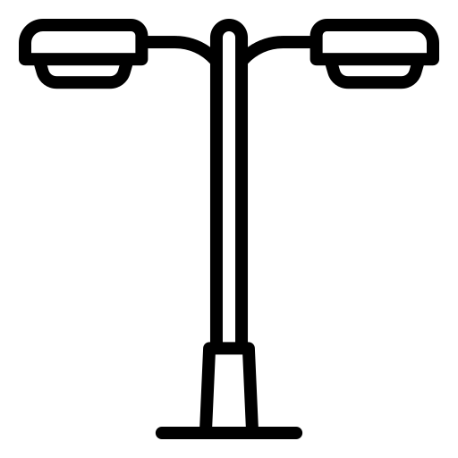
Load Curve Profile
It provides information about electric use on consumers side in terms of energy consumed and/or power required by a single device, a single consumer, a group of consumers, several different groups within an area.
Households
Peak Power
Commercials
Baseload
Schools
Energy Consumption [kWh]
Hospitals
Street Lightning
Example of aggregated load curve for an informal settlement in Nairobi [1]
…….
Source for Image: [1] Stevanato et al., Access to Electricity in Informal Settlements: Literature Review and Load Curve Estimation, IEEE PES/IAS PowerAfrica, Marrakech, Morocco, 2023, doi: 10.1109/PowerAfrica57932.2023.10363327
Notes:
The goal of collecting information about energy end-use is to estimate the load curve. The load curve provides information about electric use on the consumer side in terms of energy consumed and power required. This data can be analyzed for a single device, a single consumer, a group of consumers, or several different groups within an area.
For instance, the load curves for households and commercial users can show different patterns of energy usage as it’s clear from the slide. The load curve usually helps identify key parameters like peak power, baseload, and overall energy consumption. Understanding these patterns is crucial for designing systems that can efficiently meet the varying demands of different user groups, such as schools, hospitals, and street lighting.

Slide 8
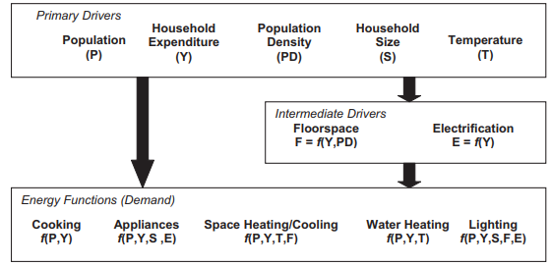
Load Demand Estimation Methods
There are different methods that have been proposed by academic researchers [2] in the field for estimating off-grid electricity demand with the purpose of improving and facilitating the mini grids’ design process:
Top-Down Approach
It assign estimated peak power and energy consumption to user categories annually or daily, using macroeconomic parameters and wealth indices. These are suitable for large-scale applications and usually investigate evolve demand forecasts over time.
Hybrid Approach
It address the limitations of the first two by integrating survey data with broader methods to account for the dynamic nature of energy access and the potential for load profile changes due to project success or appliance acquisition trends.
Bottom-up Approach
It detail individual energy use to create a community-level load curve, requiring extensive data on appliance ownership and usage, typically gathered through surveys. These are suitable for community-level applications but it may be imprecise in terms of demand prediction effectiveness.
Relationship between drivers and energy functions [3]
Notes:
How to estimate the load curve? There are different methods proposed by academic researchers for estimating off-grid electricity demand to improve and facilitate the mini-grid design process.
The Top-Down Approach assigns estimated peak power and energy consumption to user categories annually or daily, using macroeconomic parameters and wealth indices. This method is suitable for large-scale applications and typically investigates evolving demand forecasts over time.
The Bottom-Up Approach details individual energy use to create a community-level load curve, requiring extensive data on appliance ownership and usage, usually gathered through surveys. While suitable for community-level applications, it may be imprecise in terms of demand prediction effectiveness.
The Hybrid Approach integrates survey data with broader methods to address the dynamic nature of energy access and potential load profile changes due to project success or appliance acquisition trends.

Slide 9

On-field Survey Data Collection
A way of providing the demand input is on field visits to the beneficiary community. This is normally done through deployment of on-site data collection campaigns in the specific areas of interest, for then deriving potential loads, which can increase considerably the project’s investment costs.
Participatory Rural Appraisal (PRA)
Engage with community members through interactive sessions
Collect qualitative and quantitative information on energy usage
Activities: Resource mapping, seasonality analysis, and daily routine charting
Focused Group Discussions (FGDs)
Facilitate discussions with specific user groups (e.g., businesses, schools)
Identify collective energy needs and peak demand times
In-depth understanding of communal energy dynamics
Workshops with Local Authorities and Energy Providers
Collaborate to access existing energy consumption data
Understand infrastructure capabilities and constraints.
On-field picture of workshops and data collection activities
Possible issues and challenges:
Cost and budget constraints
Language and Cultural Barriers can lead to misinterpretation of questions or responses
Reluctance to Participate due to privacy concerns or distrust towards outsiders
Time Constraints
Notes:
In the majority of cases, estimating the load curve requires collecting on-field data from the beneficiary community. This involves deploying on-site data collection campaigns to gather potential load information, which can significantly impact project investment costs. The three common approaches are:
Participatory Rural Appraisal (PRA) involves engaging community members through interactive sessions to collect qualitative and quantitative energy usage data. This includes resource mapping, seasonality analysis, and daily routine charting.
Focused Group Discussions (FGDs) facilitate detailed conversations with specific user groups, like businesses and schools, to identify collective energy needs and peak demand times, enhancing our understanding of community energy dynamics.
Workshops with Local Authorities and Energy Providers help access existing energy consumption data and understand infrastructure capabilities and constraints.

Slide 10



Bottom-up Approach
Off-grid load curves are significantly influenced by usage patterns that reflect the specific behaviours, needs, and resources of a community. In particular:
Seasonal variations
Changes in appliance usage with seasons (e.g., more use of fans in summer, heaters in winter)
Cultural and community events
Special events that lead to atypical usage patterns (e.g., festivals, community gatherings)
Behavioral Patterns
Daily routines that influence energy consumption (e.g., meal preparation times, school hours, business operating hours)
Energy Access Policies
Any rules or agreements within the community about energy rationing or prioritization of certain appliances
Which appliances?
Number and types of appliances
Power ratings
When?
Typical times when each appliance is used
Specific peak usage times for heavy appliances
Frequency of use
For how much time?
Average usage duration for each appliance per day
Total operating hours for critical appliances that run continuously
From Appliances ownership to Estimating load curves
Basic Approach
Advanced Approach
Notes:
Let’s focus on the bottom-up approach which is the most suitable for narrowed off-grid rural application. This approach examines:
Which appliances are used, considering the number, types, and power ratings.
When these appliances are used, noting typical usage times, peak usage times, and frequency of use.
For how much time each appliance is used daily, including total operating hours for critical appliances.
Seasonal variations, cultural and community events, behavioral patterns, and energy access policies also play a crucial role.

Slide 11

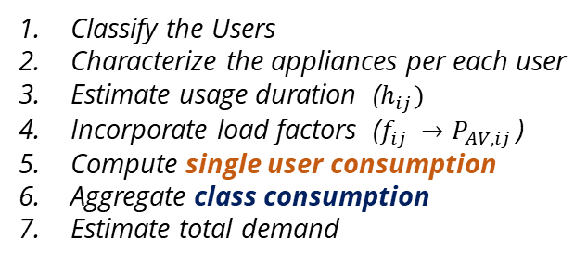
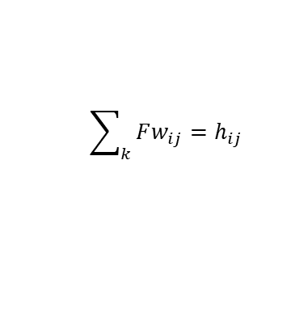
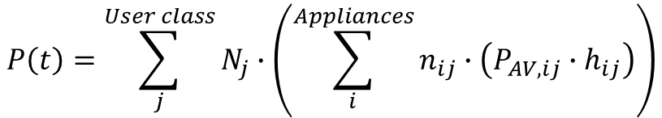
Basic Approach
Basic Approach: involves aggregating the energy consumption from various user classes and their respective appliances over specific usage time windows. The energy consumption is operated based on the average power used over the time the appliance is actually on within the functioning window
Energy consumed by a single class
Classify the Users
Characterize the appliances per each user
Estimate usage duration ($h_{ij})$
Incorporate load factors ($f_{ij }→P_{AV,ij }$)
Compute single user consumption
Aggregate class consumption
Estimate total demand
$$P\left(t\right)=\sum_{j}^{User class}{N_{j}∙\left(\sum_{i}^{Appliances}{n_{ij}∙\left(P_{AV,ij}∙h_{ij}\right)}\right)}$$
Energy consumed by a single user
$$f_{ij}=\frac{P_{AV,ij}}{P_{ij}}$$
Load factor
Fw1
Fw2
time
Functioning windows (Fw)
$$\sum_{k}{Fw_{ij}}=h_{ij}$$
time
Notes:
The analytical process to assess load demand starts with estimating the energy consumed by different appliances over specific usage time windows. The energy consumption by a single user class is then calculated using the equation on the slide by considering the number of users, the number of each type of appliance, the power rating of each appliance, and the duration of their use.
A functioning window refers to a specific time period during which an electrical appliance operates. As shown on the left side of the slide, the initial approach would be considering, as time ‘t’ varies, the power consumption of an appliance taking on only two values: its power rate or zero. This means that during the functioning window, the appliance is either consuming its rated power or it is off. Then, moving on the right side, we could introduce the concept of load factor. The load factor is calculated dividing the functioning duration of a specific appliance within a specific user class over the total functioning window for that appliance in that class and it represents the proportion of time an appliance is operating compared to its total potential operating time.
The load factor addresses the challenge of pinpointing the exact times when an appliance's consumption occurs. The specific energy consumed by an appliance can be known, but the exact timing may not be available. Therefore, the power consumed is spread over the entire functioning window, resulting in more homogeneous data and enabling the calculation of the average power.

Slide 12

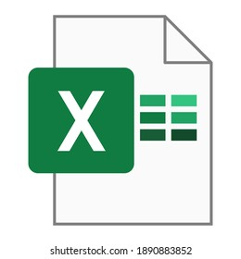
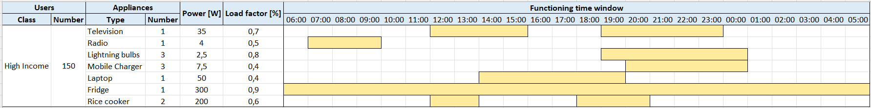
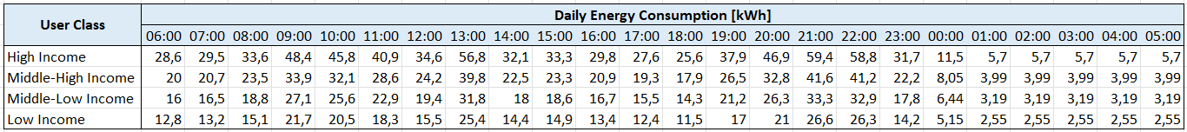
Basic Approach
One basic approach for estimating a load curve involves using Excel to characterize users and appliances, define functioning windows, apply load factors, and calculate total energy consumption on an hourly basis, resulting in a detailed energy usage profile.
Characterize the rural village
Example: 1500 households: 350 high income, 400 middle-high income, 500 middle-low income, 250 low income
Characterize the users
Estimate the number of appliances, their ratings and usage
Operate the energy consumption related to each user class
Example of a Basic Approach Excel implementation for load curve estimation using load factors
Notes:
One basic approach for estimating a load curve using the described approach involves Excel to characterize users and appliances, define functioning windows, apply load factors, and calculate total energy consumption on an hourly basis, resulting in a detailed energy usage profile. In this Excel example, household consumption is estimated, with appliances listed in the rows and their usage within the day highlighted using colours.

Slide 13

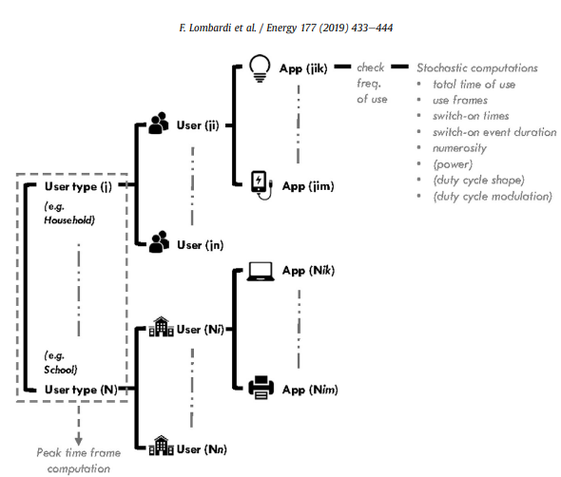
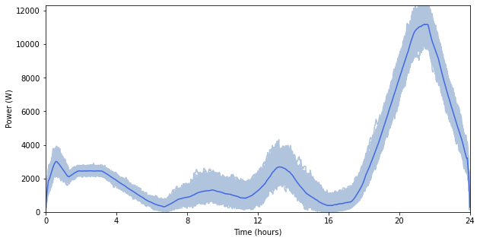
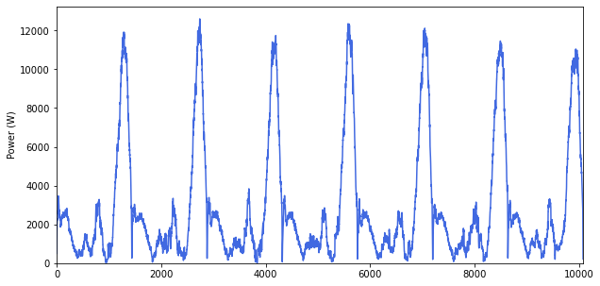
Advanced Approach
Advanced approach creating load curves employs RAMP, an open-source software designed for scenarios where only rudimentary information on user behaviour is available, allowing for the characterization of users and appliances, the definition of operating windows, and the application of load factors to yield a finely detailed energy usage profile on a minute basis.
A bottom-up stochastic model for the generation of high-resolution multi-energy profiles
Graphical sketch of the modelling layers constituting the simulation process. Source of Image: [4]
Examples of load curve demands estimated using RAMP software
Notes:
More advanced approaches to estimate load curve employs stochastic methods, defining the switching times based on a probability distribution within the functioning windows. This is the case of RAMP software, an open-source software designed for scenarios where only rudimentary information on user behaviour is available, allowing for the characterization of users and appliances, the definition of operating windows, and the application of load factors to yield a finely detailed energy usage profile on a minute basis.

Slide 14





Load demand Archetypes
Load curve archetypes in off-grid rural areas are typical patterns of electricity usage that represent the collective energy consumption behaviours of the community. The proposed approach in [5] it has been developed 100 archetypes of household users in Sub-Sahara Africa (SSA), characterized by different set of appliances (wealth parameter), seasonal variations in the time of use of the appliances (latitude parameter) and different seasonal use of ambient cooling devices (climate zone parameter).
5 Wealth (Tiers)
Each level is considered to own a different basket of appliances, created starting from a systematic review of the literature on electricity use in rural SSA
5 x 5 x 4 = 100 households archetypes
5 Latitude zones
Latitude will determine different sunrise and sunset hours so that this parameter determines a seasonal change in appliances times of use
+
5 health center archetypes
+
4 Climate zones
Different climates can be found in different areas of SSA, and the need for cooling in the households will happen in different moments of the years
1 school archetype
Built-In Feature in MicroGridsPy:
Load demand estimation with archetypes of Sub-Saharan rural villages
$$lat≤20°$$
Notes:
In MicroGridsPy, it is possible to rely on built-in load curve archetypes for Sub-Saharan Africa. These archetypes are the result of a recent study that developed 100 household archetypes, supplemented by 5 health center archetypes and 1 school archetype, characterized by different sets of appliances (wealth parameter), seasonal variations in appliance usage (latitude parameter), and different seasonal use of ambient cooling devices (climate zone parameter). These archetypes reflect typical patterns of electricity usage in off-grid rural areas, representing the collective energy consumption behaviors of the community. Specifically, the study identified:
- 5 Wealth Tiers: Each level corresponds to a different basket of appliances, based on a systematic review of literature on electricity use in rural Sub-Saharan Africa.
- 5 Latitude Zones: Latitude determines different sunrise and sunset hours, influencing seasonal changes in appliance usage times.
- 4 Climate Zones: Different climates across Sub-Saharan Africa affect the need for cooling in households at various times of the year.

Slide 15
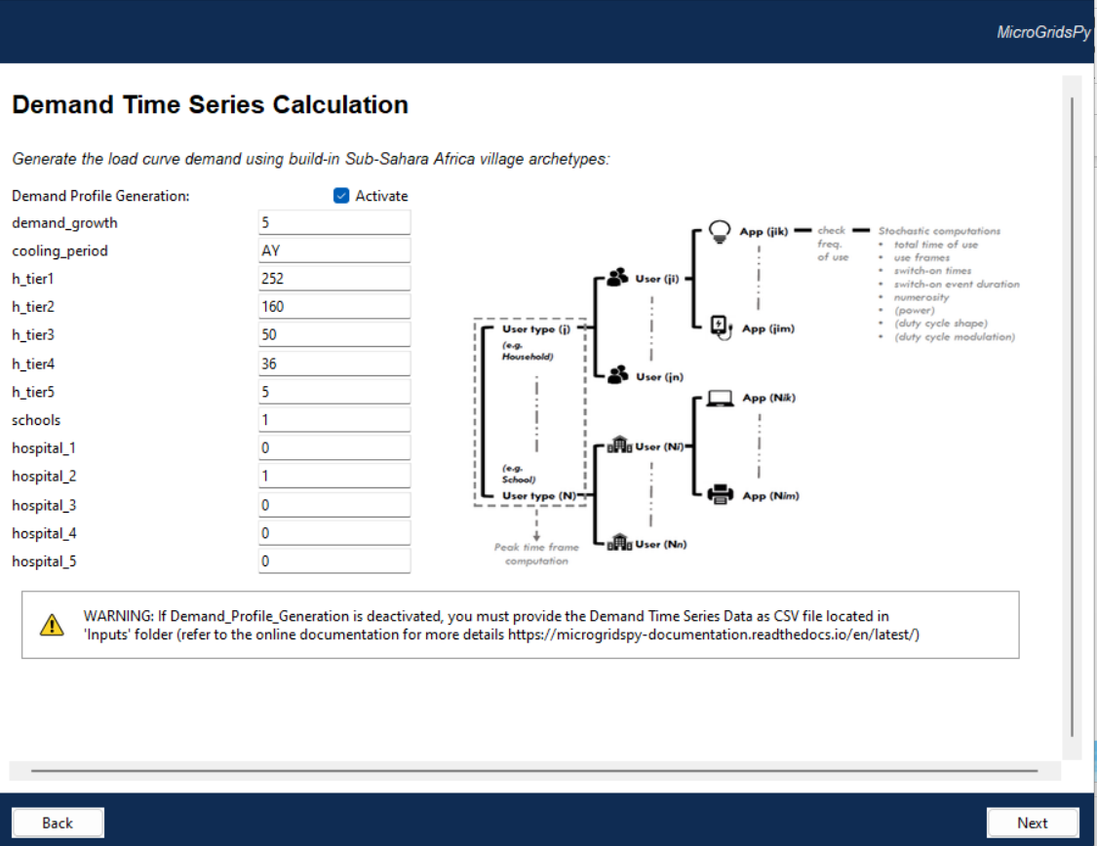


Endogenous Load Demand Estimation
Demand drivers
Estimate the demand growth as a percentage change expected annually and select the cooling period to consider seasonal variations in energy usage:
NC = No Cooling is required
AY = Cooling is required All Year
OM = Cooling is required from October to March
AS = Cooling is required from April to September
Households
Number of households across various wealth tiers, reflecting the socioeconomic diversity of the village. The wealthier classes own more energy intensive appliances and in larger number.
Public Services
Number of educational and healthcare facilities in the village. It includes 5 tiers of health facilities, ranging from rural dispensaries (Tier 1) to sub-county hospitals (Tier 5). Similarly, it adopts an archetypical load for a rural primary school.
Code/Demand_archetypes
Notes:
Within the MicroGridsPy user interface, there is a specific section dedicated to load demand assessment, enabling endogenous load demand estimation based on archetypes for Sub-Saharan Africa.
This section allows users to estimate demand growth as a percentage change over time and select the cooling period to account for seasonal variations in energy usage as well as input the number of households across various wealth tiers, reflecting the socioeconomic diversity of the village. Wealthier classes typically own more energy-intensive appliances and in larger numbers.

Slide 16
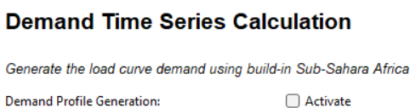
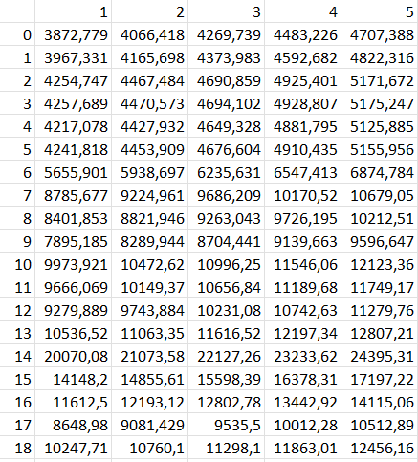

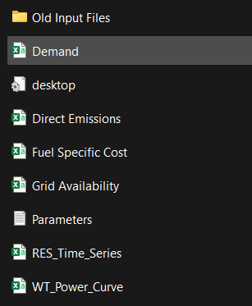

Exogenous Load Demand
Numbered columns equal to the number of years
1 2 …
1
2
3
4
5
6
7
8
9
10
11
12
13
….
Hourly electricity demand in W for year of the time horizon
Code/Inputs/Demand.csv
Hours in a year
Notes:
However, if users do not want to simulate load demand endogenously based on archetypes, they can upload their own data. The Exogenous Load Demand section in MicroGridsPy allows users to upload a CSV file containing their specific load demand data.
This file should have numbered columns equal to the number of years in the simulation period. Each column should contain hourly electricity demand in watts for each hour of the year. This method provides flexibility for users who have detailed, custom data that better fits their specific project needs.

Slide 17
References
[1] ESMAP, Mini-Grids for Half a Billion People, 2022
[2] Riva et al., Long-term energy planning and demand forecast in remote areas of developing countries: Classification of case studies and insights from a modelling perspective, Energy Strategy Reviews, https://doi.org/10.1016/j.esr.2018.02.006
[3] Daioglou et al., Model projections for household energy use in developing countries, Energy, https://doi.org/10.1016/j.energy.2011.10.044
[4] Lombardi et al., Generating high-resolution multi-energy load profiles for remote areas with an open-source stochastic model, Energy, https://doi.org/10.1016/j.energy.2019.04.097
[5] Stevanato et al., Archetypes of Rural Users in Sub-Saharan Africa for Load Demand Estimation, IEEE PES/IAS PowerAfrica, Marrakech, Morocco, 2023, doi: 10.1109/PowerAfrica57932.2023.10363287

