Slide 1

Off-Grid Energy Systems Modelling with MicroGridsPy
Lesson 4: Introduction to MicroGridsPy

Slide 2

Lesson 4: Content
Energy System Definition and Problem Formulation
Defining and configuring MicroGridsPy energy systems, incorporating various energy sources and storage options, and learn to formulate optimization problems to determine the most efficient system configuration
Understanding MicroGridsPy Inputs
Significance of input data, such as time series for load and renewable energy availability, and various techno-economic parameters, crucial for tailoring the simulation to specific scenarios
Mathematical Formulation in MicroGridsPy
Mathematical foundations underlying MicroGridsPy, including the optimization algorithms and constraints used to determine the optimal design and operation of microgrids
Results in MicroGridsPy
Comprehensive introduction to the different set of results provided by MicroGridsPy
Notes:
This lecture is designed to introduce learners to MicroGridsPy software, providing a comprehensive overview of how to define and configure energy systems, formulate optimization problems, and interpret results within the MicroGridsPy framework. The aim is to understand the significance and variety of input data, such as time series data and techno-economic parameters, mathematical foundations underlying MicroGridsPy and provide a comprehensive introduction to the different set of results provided by the model at the end of the optimization process.

Slide 3
Lesson 4: Learning Outcomes
At the end of this unit, participants will be able to :
Understand how to define and configure MicroGridsPy energy systems
Understand MicroGridsPy Inputs
Understand the Mathematical Formulation in MicroGridsPy
Understand the different set of results Results in MicroGridsPy
Notes:
This lecture is designed to introduce learners to MicroGridsPy software, providing a comprehensive overview of how to define and configure energy systems, formulate optimization problems, and interpret results within the MicroGridsPy framework. The aim is to understand the significance and variety of input data, such as time series data and techno-economic parameters, mathematical foundations underlying MicroGridsPy and provide a comprehensive introduction to the different set of results provided by the model at the end of the optimization process.

Slide 4
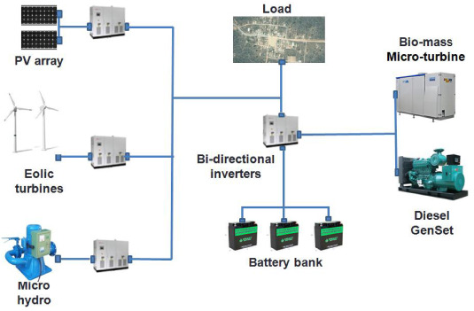
Energy System Definition
Energy System
The system combines a renewable generation technology (e.g. Solar PV, Wind turbine etc.), managed via bi-directional inverters and a storage system (e.g.: battery bank), and generators, diesel or biomass, ensure backup power. This configuration maintains a reliable electricity supply, balancing renewable energy with dependable backup.
MicroGridsPy energy system visualization
Load Demand
Biomass Micro-Turbine
PV modules
Renewable Generation Technologies
Backup systems
Bi-directional Inverters
Wind Turbines
Diesel Generator
Battery bank
Storage systems
Notes:
The first important concept in the process of defining and solving an optimization problem with MicroGridsPy is the energy system definition. In general terms, an energy system encompasses the infrastructure and interconnected components that generate, convert, distribute, and utilize energy. In MicroGridsPy, the energy system includes a network of renewable generation technologies, like solar PV and wind turbines, which are coordinated through bi-directional inverters, allowing for the two-way flow of electricity. The system might be integrated with storage technology such as battery banks that help to mitigate the intermittency of renewable sources. For added resilience, backup systems like diesel generators or biomass micro-turbines could be added to ensure a consistent energy supply.

Slide 5
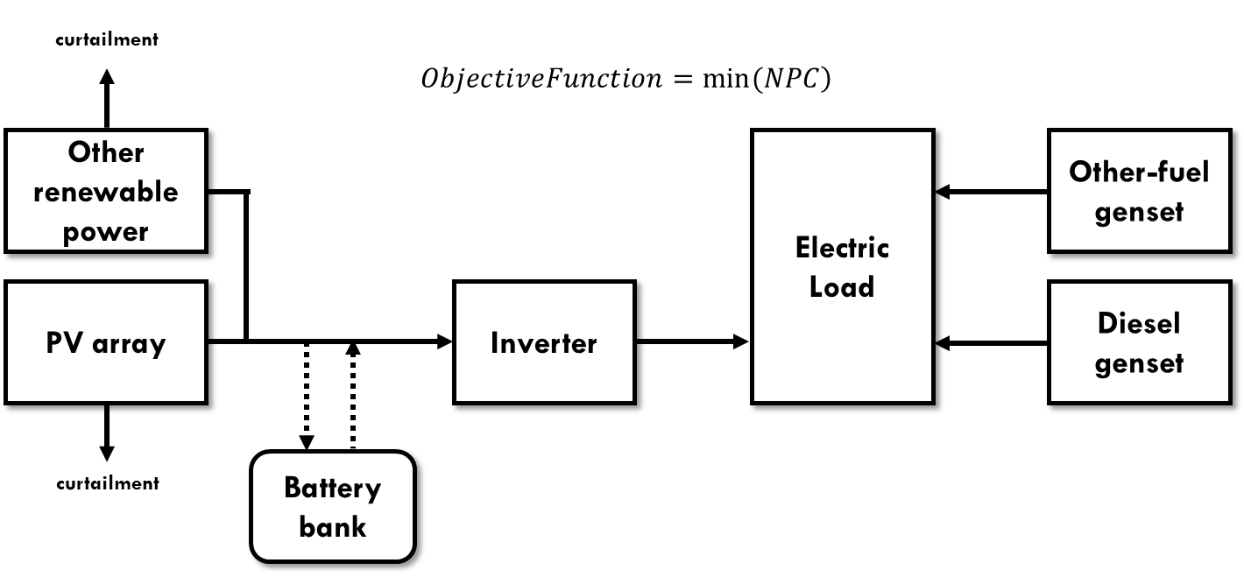
Problem Formulation
Problem
Determine the combination of installed capacities of RES, Batteries and Generators that makes the lowest Net Present Cost (NPC) for the lifetime of the project and accomplishes the constraints of the system.
1 - Define the inputs
Techno-economic parameters
Time series data
2 - Set constraints
Configuration settings
Optimization settings
Modelling equations
3 - Optimize the objective function
Net Present Cost (NPC)
Emissions
4 - Results
Sizing and dispatch
Costs
MicroGridsPy problem visualization and components interlinks
Notes:
Having presented the general energy system, let's now explore the specific steps for solving the optimization problem using MicroGridsPy. The goal is to configure the lowest Net Present Cost (NPC) combination of renewable sources, batteries, and generators, all while adhering to system constraints.
First, MicroGridsPy requires different inputs, including techno-economic parameters that describe costs and efficiencies, alongside time series data which informs on energy demands and weather conditions. Next, the software set constraints that govern the system configuration, optimization settings, and the modeling equations that dictate how the system components interact. The optimization of the objective function is our third step. Here, the focus is on minimizing the NPC, using algorithms that explore different configurations to identify the most cost-efficient solution. Finally, the optimization yields results that detail the sizing and dispatch strategies for each component, as well as the overall costs. In the next slides, each steps would be explored in further detail, starting with load demand.

Slide 6
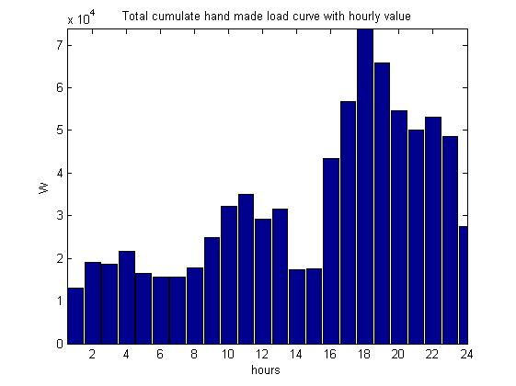
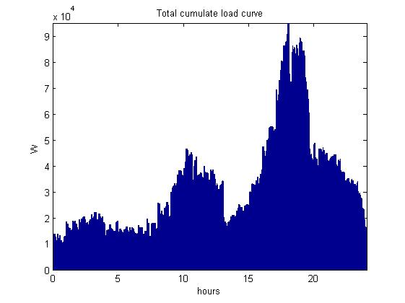

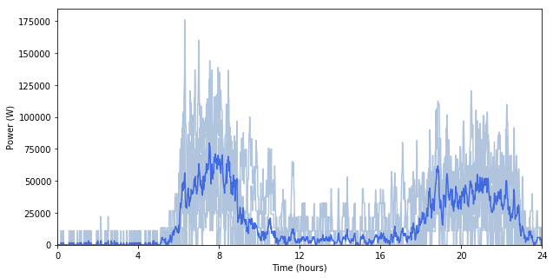
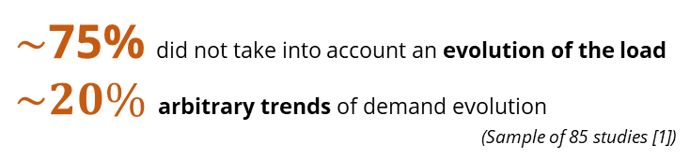
Input: load time series data
Time-dependent electricity estimated need of a given area or system. It is typically measured in Watts (or kilowatts, megawatts, etc.) and captures how electricity demand varies over different periods, usually in hourly or sub-hourly intervals.
Various examples of load curves
Load Curve
It underscores information such as peak demand, variability, baseload, and socioeconomic influences, essential for developing efficient, community-specific energy systems that provide reliable electricity.
Demand forecast
Demand forecasting is crucial for tailoring energy systems to rural communities' future needs. It ensures efficient, cost-effective system sizing, adapting to varying demand influenced by development and population changes.
$\sim$75% did not take into account an evolution of the load
$\sim 20\%$ arbitrary trends of demand evolution
(Sample of 85 studies [1])
Notes:
Load time series data represents the estimated electricity needs of a given area or system and is typically measured in Watts, or larger units like kilowatts and megawatts. Understanding this data is crucial as it captures how electricity demand varies over different periods, often displayed in hourly or sub-hourly intervals. These curves provide important insights such as peak demand, variability, baseload, and how socioeconomic factors influence electricity usage, essential information for developing efficient, community-specific energy systems that are reliable and responsive to local needs. Furthermore, for designing mini-grids with optimization models, we typically refer to a 20-year time horizon. This long-term perspective is necessary for the actualization of costs and the functioning of the algorithm, ensuring that investments are optimized over the lifespan of the infrastructure. However, accurate demand forecasting represents a significant challenge. It requires not only understanding current demand but also projecting how changes in population, technology, and economic conditions will influence future energy needs. According to a recent study by Riva et al, approximately 75% of studies do not consider the evolution of the load when making these forecasts, often relying on arbitrary trends. This oversight can lead to inefficiencies and increased costs, emphasizing the need for more sophisticated forecasting techniques.

Slide 7
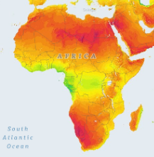
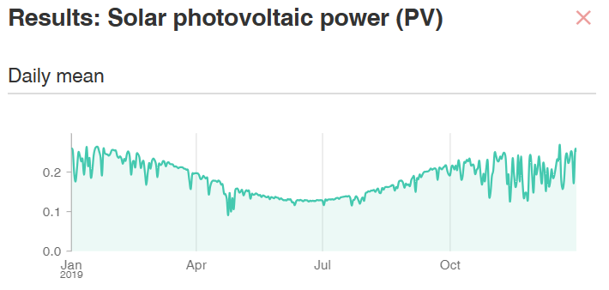
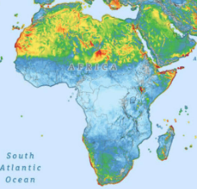
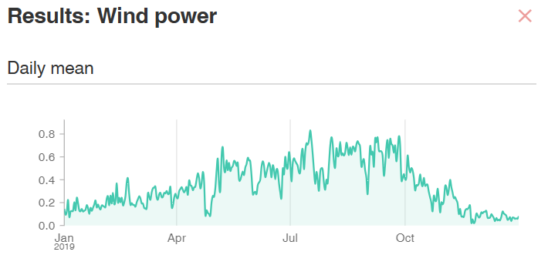
Input: renewables time series data
Estimated electricity production for each unitary generation technology at a specific time and location. It is typically measured in Watts (or kilowatts, megawatts, etc.) and illustrates how electricity production varies over time and by source, usually in hourly or sub-hourly intervals.
Solar Resource Availability
It reflects the amount of sunlight accessible at a specific location over time. This dataset is typically characterized by parameters like solar irradiance, panel efficiency, optimal panel tilt and orientation, local climate conditions, and system losses. These elements determine the potential energy output of solar panels.
Solar Atlas of Africa [2]
Wind Resource Availability
It tracks wind speed and direction at specific locations. Key factors for estimating wind turbine electricity production include wind speed, the turbine's power curve, cut-in and cut-out speeds, air density, and turbine height. These elements together determine the potential energy output of wind turbines.
Wind Atlas of Africa [3]
Examples of daily average load factor for solar and wind [4]
Notes:
In addition to load demand, renewable time series data is essential for energy system optimization. This data estimates electricity production from generation technologies like solar PV and wind power, typically recorded in hourly or sub-hourly intervals, and helps assess renewable energy variability and availability. In particular:
- Solar Resource Availability: Reflects sunlight access over time, determined by solar irradiance, panel efficiency, tilt and orientation, local climate, and system losses.
Wind Resource Availability: Tracks wind speed and direction, considering factors like the turbine’s power curve, cut-in and cut-out speeds, air density, and turbine height.
Accurate renewable energy data is crucial for sizing and optimizing mini-grids, ensuring effective use of renewable sources to meet local energy demands.

Slide 8
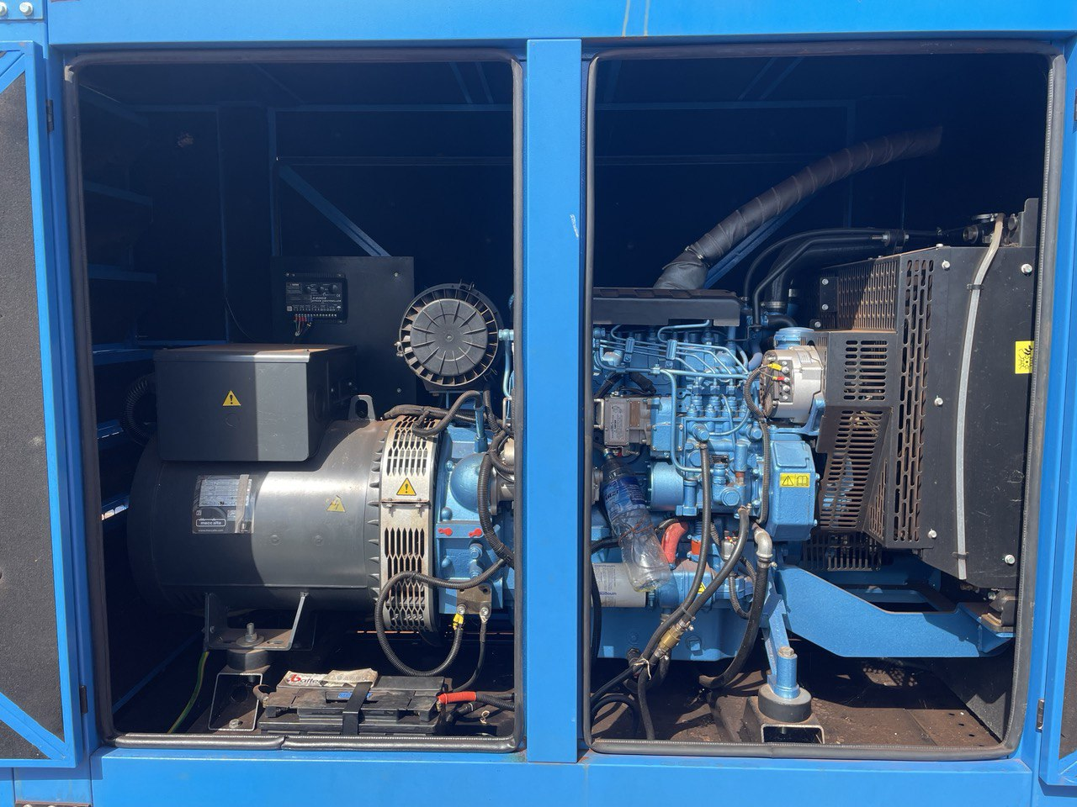
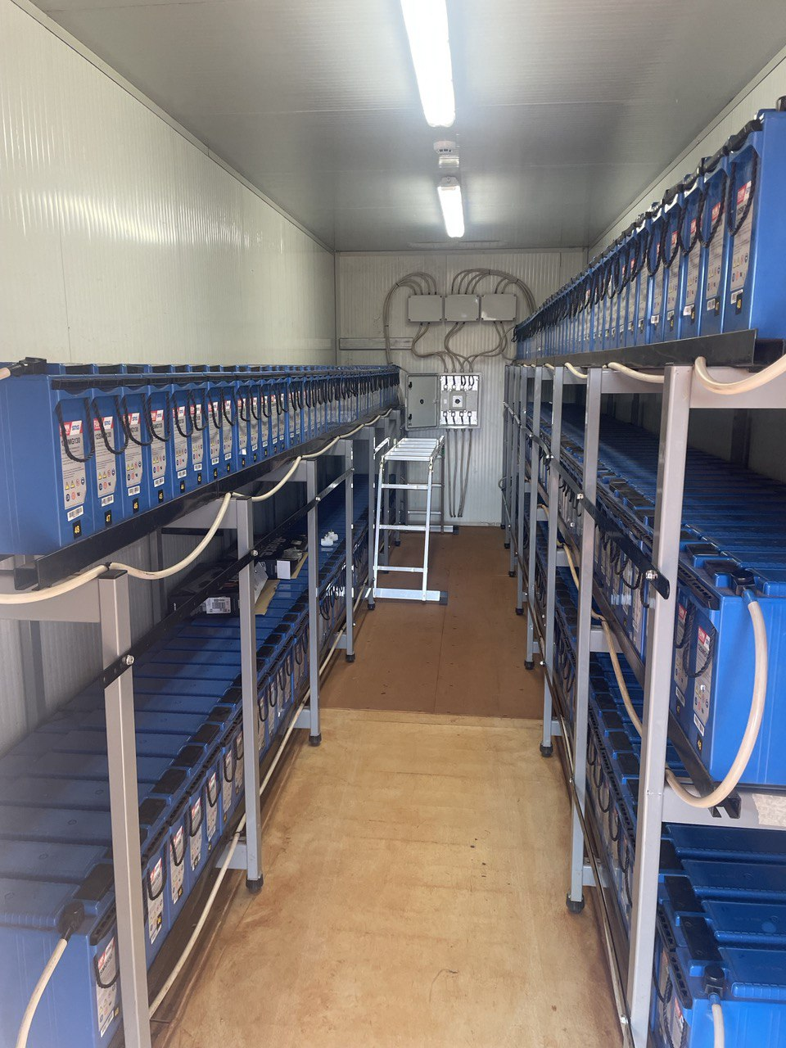
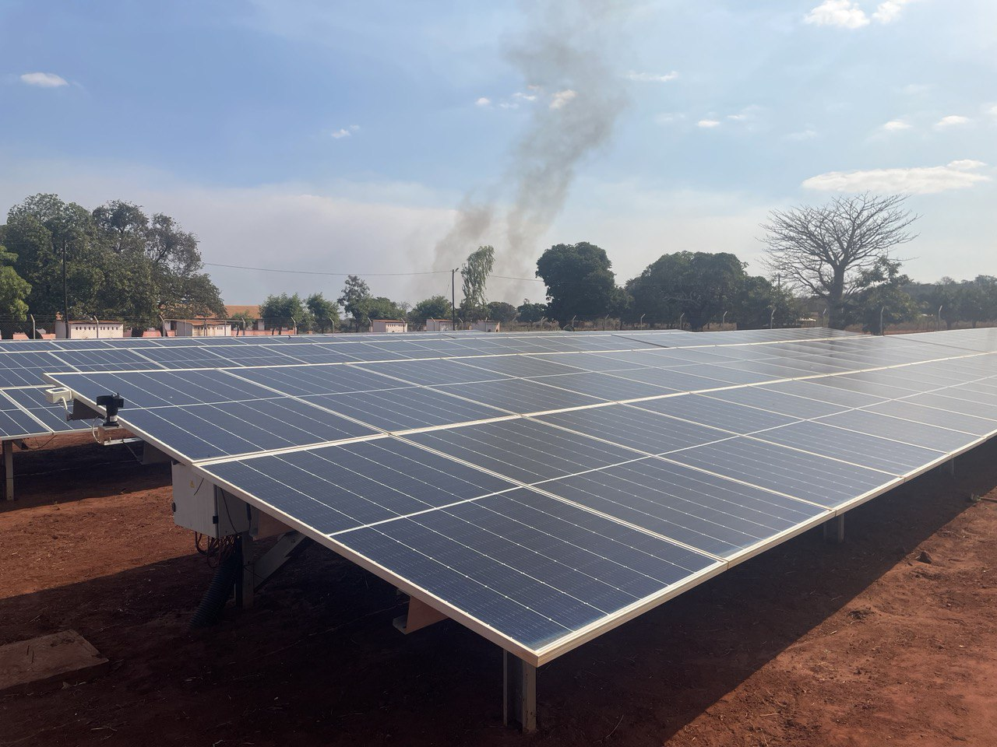
Input: Techno-economic parameters
Parameters definition requires detailed data to accurately reflect the system's economic, technical, and ecological dimensions, thereby ensuring a robust and comprehensive optimization model.
Specific Investment costs [e.g. $/W]
It encompasses all initial financial outlays required to acquire, install, and commission various components of the energy system.
Examples: CAPEX, PV installation, Wind turbine erection etc.
Specific Operation costs [e.g. $/Wh]
They cover the recurring expenses associated with the daily operation and maintenance of the energy system over its lifetime.
Examples: OPEX, maintenance costs etc.
Performance Metrics [e.g. %]
They represent the effectiveness with which each component converts energy from one form to another, maintains power quality, and ensures system durability and reliability.
Examples: lifetimes, efficiencies, depth of discharge etc.
Environmental factors [e.g. kgCO₂/kW]
They assess the environmental footprint of the energy system, considering the sustainability and ecological implications of its operation.
Examples: unit of indirect emissions, direct emissions etc.
On-field pictures of solar panels, battery bank and diesel generator
Notes:
Building on our understanding of load demand and renewable time series data, we also need to consider key techno-economic parameters to develop a robust optimization model. These parameters include specific investment costs, which cover initial financial outlays for components like PV installations and wind turbines, and specific operation costs, which account for recurring expenses such as daily operation and maintenance. Performance metrics, such as lifetimes and efficiencies, measure the effectiveness and reliability of system components, while environmental factors evaluate the ecological impact by considering emissions. By integrating these detailed parameters, we ensure a comprehensive and sustainable approach to mini-grid optimization.

Slide 9

Mathematical Formulation
MicroGridsPy utilizes configuration and technology parameters as well as temporal data to optimize energy systems, balancing cost and efficiency while adhering to operational constraints.
Configuration Parameters
Time horizon
Renewable penetration
Battery independence
Lost load
Discount rate
Decision Variables
Objective Functions
Capacity of each technology Units of renewables capacity
Net present costs
Total operation costs
Technology Parameters
Specific technology costs
Specific emissions
Efficiencies
Lifetime
Secondary Variables
Constraints
Hourly energy produced
Fixed and variable costs
Total emissions
Optimization constraints
Renewables constraints
Technologies functioning equation
Time Series Data
Load Demand
Renewables electricity production
Notes:
Having covered the input data, let's now explore the mathematical formulation in MicroGridsPy. MicroGridsPy uses decision variables, including the capacity of each technology and units of renewable capacity, to determine the optimal sizing. Secondary variables capture detailed aspects like hourly energy produced, fixed and variable costs, and total emissions.
The core of the optimization lies in the objective functions, which aim to minimize net present costs and total operation costs. These functions guide the model to find the most cost-effective solutions while meeting energy demands. Constraints are crucial to ensure the model's feasibility, including optimization constraints, renewable energy limits, and technology operation equations.

Slide 10

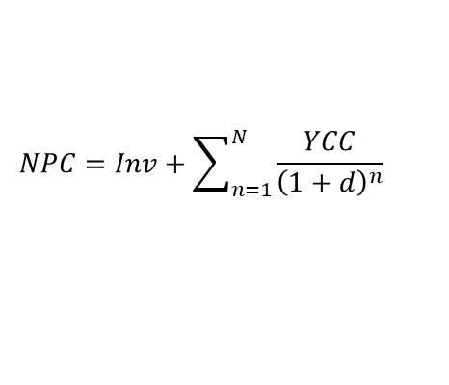
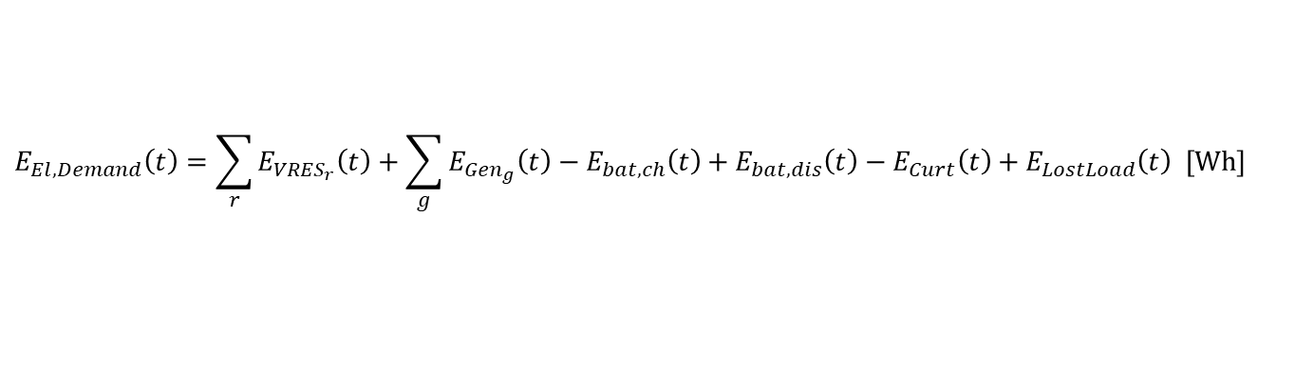
Mathematical Formulation
The model optimizes costs, ensuring energy production meets demand within defined constraints for system balance and efficiency.
Total Investment Cost
Yearly Operation Cost
Objective function:
$$NPC=Inv+\sum_{n=1}^{N}{\frac{YCC}{{\left(1+d\right)}^{n}}}$$
$$YCC=C_{O\&M}+C_{fuel}+C_{LostLoad}+C_{Batt.rep}$$
$C$: Variable cost
Total Actualized Operation Cost
$$E_{El,Demand}\left(t\right)=\sum_{r}{E_{{VRES}_{r}}\left(t\right)}+\sum_{g}{E_{{Gen}_{g}}\left(t\right)}−E_{bat,ch}\left(t\right)+E_{bat,dis}\left(t\right)−E_{Curt}\left(t\right)+E_{LostLoad}\left(t\right) [Wh]$$
Energy balance:
Optimization Constraints:
Renewable penetration, battery independence, lost load fraction equations etc.
Technology Constraints:
Renewables, batteries and generator functioning equations
Notes:
The main underlying equations are the objective function and the energy balance. The objective function aims to minimize the total costs, including initial investments and ongoing operational costs, over the system's lifetime. It takes into account expenses like operation and maintenance, fuel, lost load, and battery replacement.
The energy balance ensures that the electricity demand at any given time is met by the combined output from renewable sources, generators, and batteries. This balance accounts for the energy produced, stored, and any losses or curtailments.
To ensure the system operates efficiently, the model incorporates various constraints. Optimization constraints cover aspects like renewable energy penetration and battery independence, while technology constraints ensure the proper functioning of all system components.

Slide 11
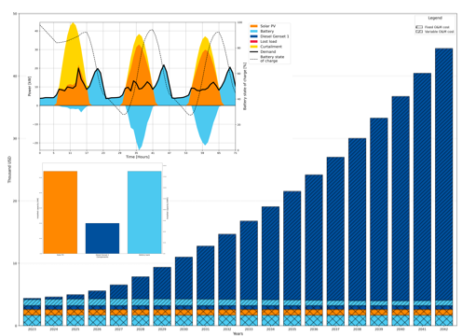
Results
MicroGridsPy offers a comprehensive array of results and plots, important for evaluating and optimizing mini-grid performance, including financial viability, operational efficiency, and energy reliability.
Sizing
Optimal installed capacity of each technology
Costs
Aggregated Investments costs
Aggregated Operation costs
Total cost metrics: NPC and LCOE
Yearly Energy and Cash flows
Yearly non-actualized costs for each technology
Yearly energy share for each technology
Energy time series data
Hourly data of the system’s energy balance, including technology energy production, battery energy flows, demand, lost load, and curtailment.
Examples MicroGridsPy results: dispatch, size and cash-flow plot
Notes:
MicroGridsPy generates comprehensive results essential for evaluating and optimizing mini-grid performance, focusing on financial viability, operational efficiency, and energy reliability. Key outputs include the optimal installed capacity of each technology, aggregated investment and operation costs, and total cost metrics like Net Present Cost (NPC) and Levelized Cost of Energy (LCOE). The model also provides yearly energy and cash flow data, showing costs and energy distribution for each technology, along with hourly energy balance data that includes production, storage, demand, and losses. These results enable informed decision-making for optimizing mini-grid systems.

Slide 12
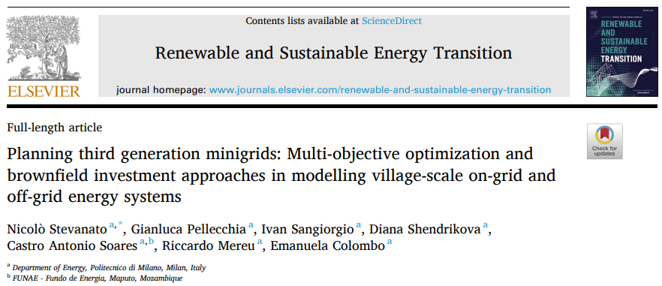
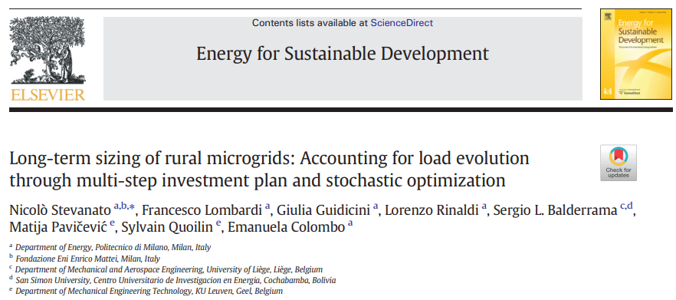

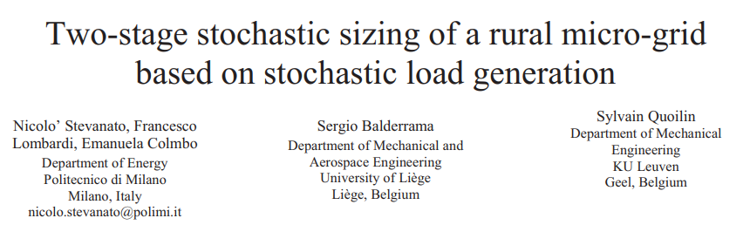
MicroGridsPy in Literature
MicroGridsPy has been referenced in various academic and industry literature, showcasing its relevance and application as a tool for optimizing and planning mini-grid systems.
Complete list of publications here: https://microgridspy-documentation.readthedocs.io/en/latest/index.html
Notes:
MicroGridsPy has been referenced in various academic and industry literature, showcasing its relevance and application as a tool for optimizing and planning mini-grid systems.

Slide 13
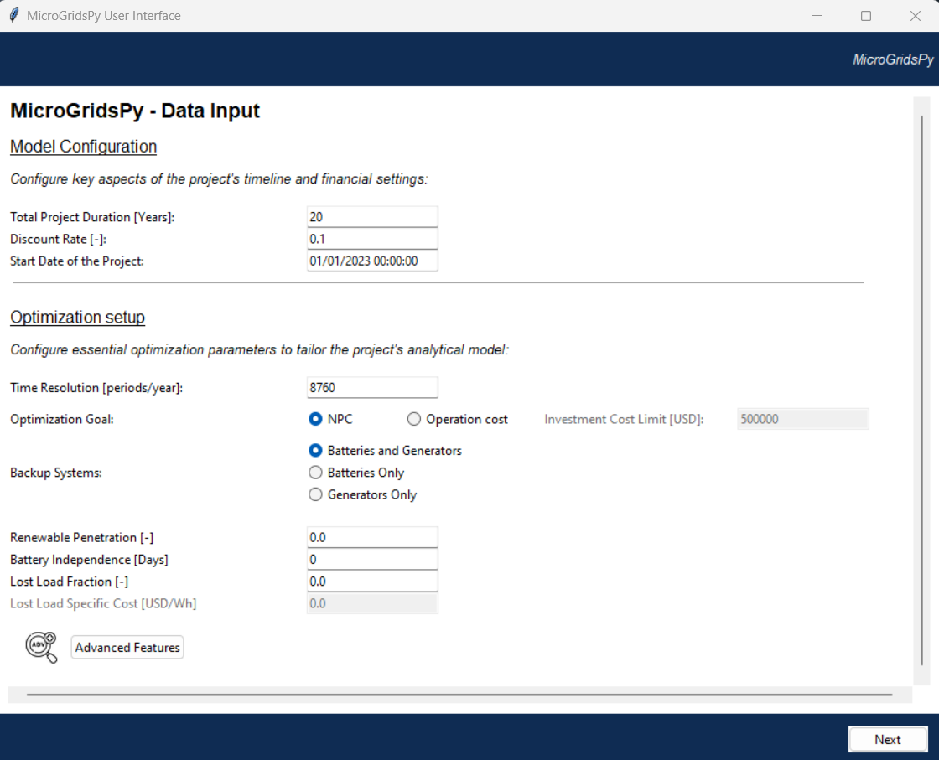
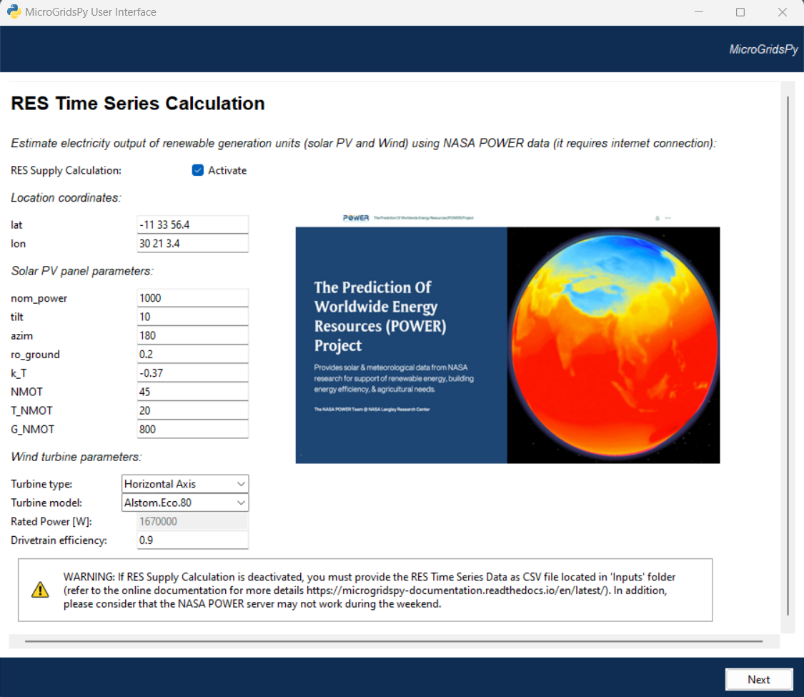
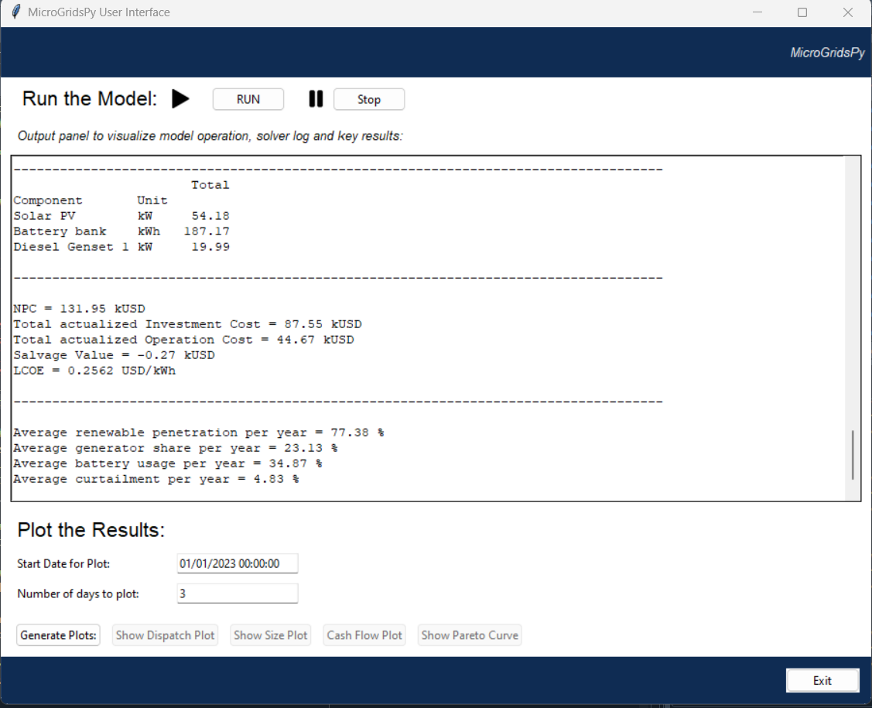
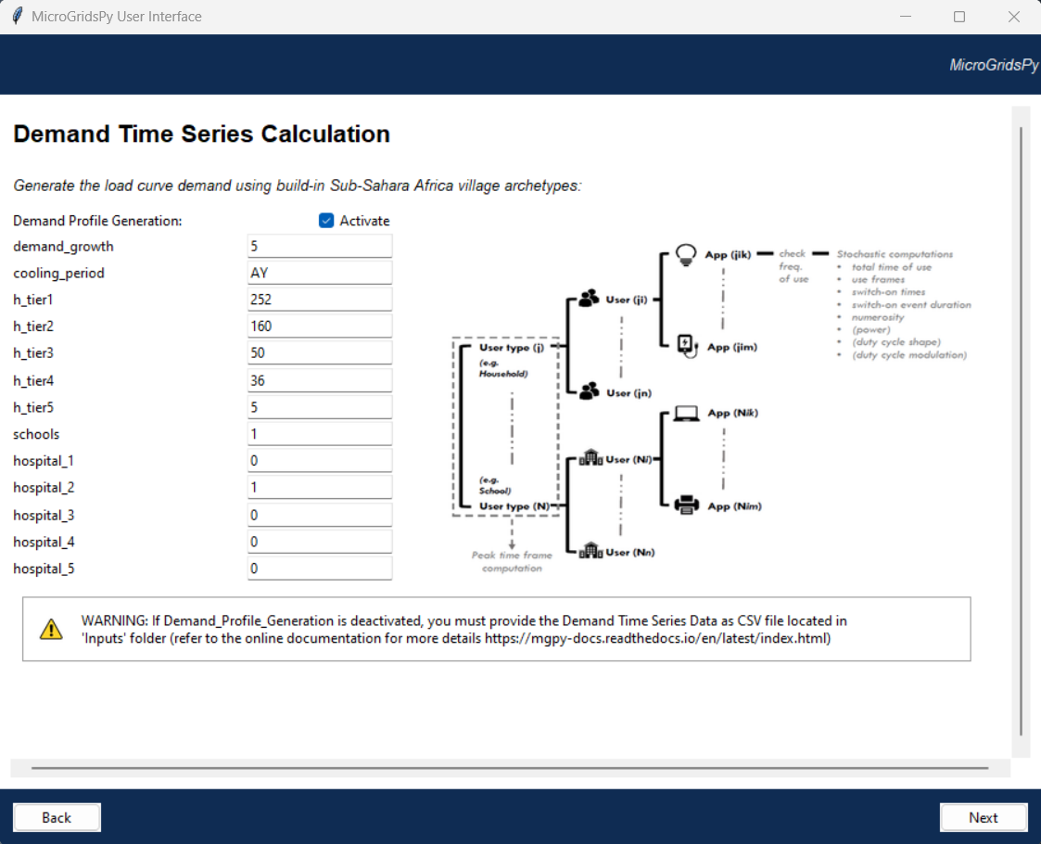
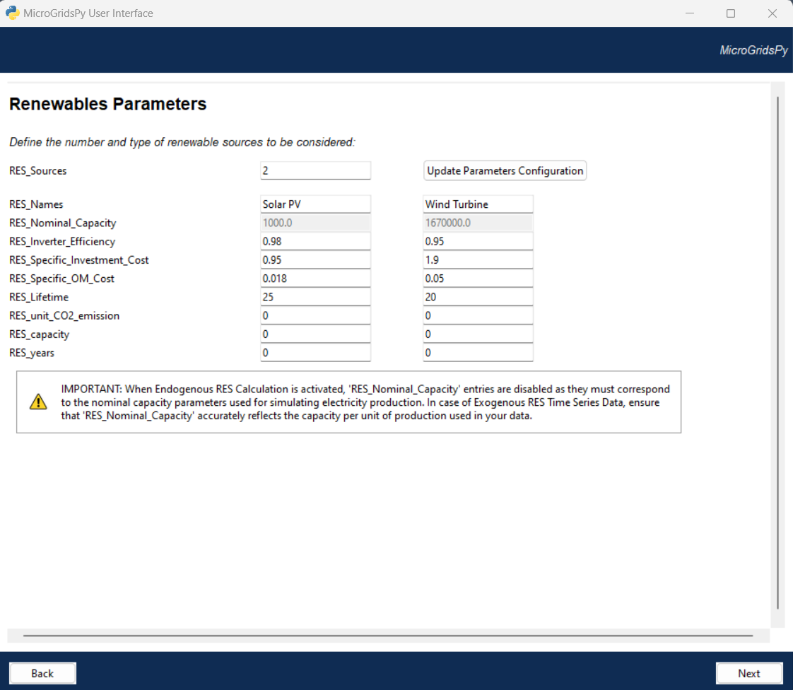


Graphical User Interface
The graphical user interface (GUI) application provides a user-friendly way to define and input data for MicroGridsPy. It is organized into different pages, each tailored to a specific aspect, with default configuration settings and parameters.
Comprehensive Data Input and Validation
Features robust data input for basic parameters, RES time series, and technology configurations, with input validation and tooltips on each page for accurate and clear data entry.
Dynamic Parameters Management and Visualization
The interface dynamically updates and manages parameter entries in response to user selections. This automatic enablement and disablement of options streamline the data input process, enhancing user interaction and decision-making through effective visualization.
Efficient Run Functionality and Results Visualization
It includes functionalities for progress tracking and visual display of results, making the modelling process seamless and efficient.
Run this python script within your working IDE to open the application
Code/User Interface/app_main.py
Notes:
An important feature of the new release of the software is the graphical user interface (GUI). This user-friendly interface simplifies data definition and input for MicroGridsPy, with different pages tailored to specific aspects and default settings for ease of use.
The GUI offers comprehensive data input and validation, ensuring accurate entry for parameters, renewable energy sources, and technology configurations. Dynamic parameters management and visualization automatically updates entries based on user selections, enhancing decision-making through effective visual aids. Additionally, efficient run functionality and results visualization features progress tracking and visual display of results, making the modeling process seamless and efficient.

Slide 14
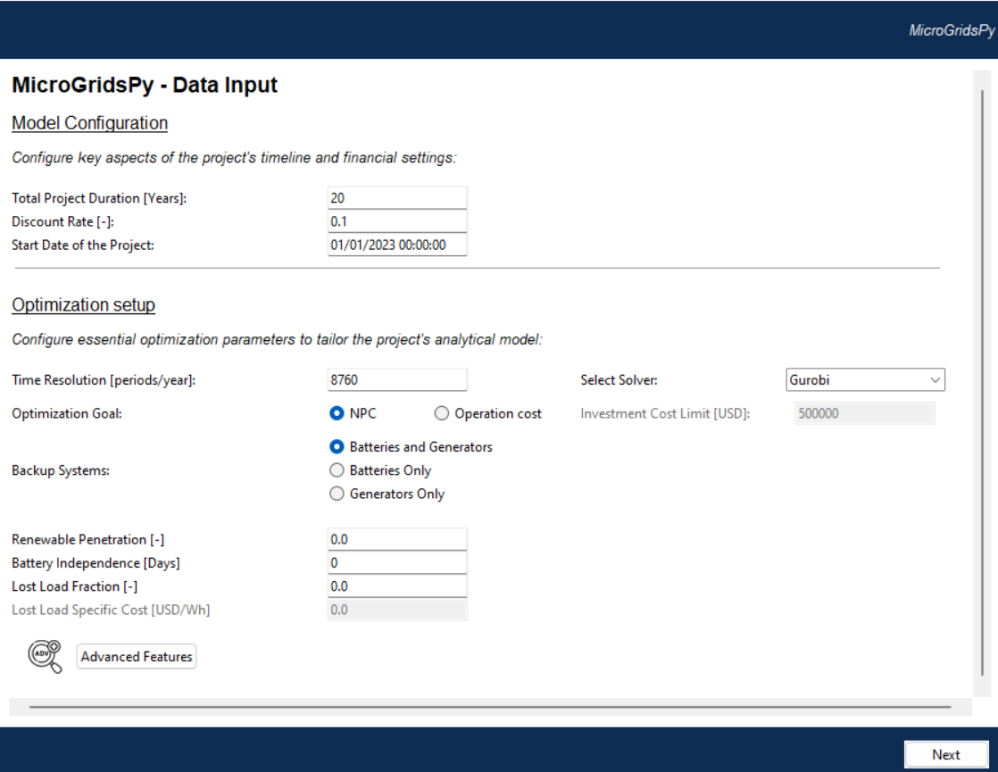

Model Configuration
Total Project Duration [years]
Discount Rate [%] (0-1)
They mainly affect the actualization of the costs and, therefore, the technology selection and sizing of the mini-grid.
Time Resolution
It affects result accuracy. Users can adjust it, but must ensure that any external time series data correspondingly match this resolution
Optimization Goal
Net Present Cost: focuses on optimizing both investment and operation costs
Operation Cost: targets minimizing only operational expenses with an option to limit capital expenditure
Notes:
Launching the interface, the first step is model configuration, involving key aspects of the project's timeline and financial settings. This includes the total project duration in years and the discount rate, which affect the actualization of costs and influence technology selection and mini-grid sizing. Time resolution is also crucial as it impacts result accuracy. Users can adjust this setting, but must ensure any external time series data aligns with the chosen resolution. The optimization goal can be set to minimize either the net present cost, which focuses on both investment and operation costs, or the operation cost, targeting only operational expenses with an option to limit capital expenditure.

Slide 15

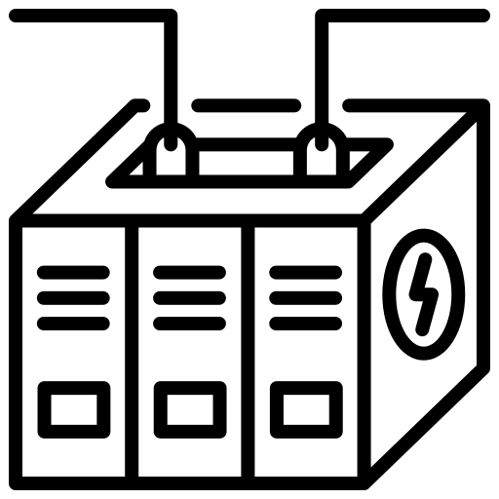
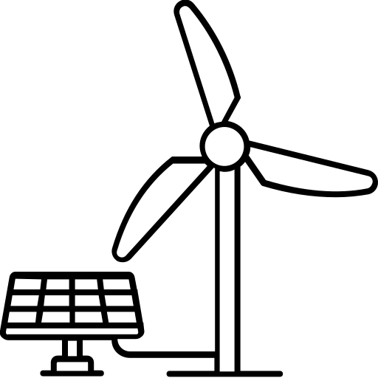

Model Configuration
Backup and Storage Systems
The user has the option to specify constraints on the types of technologies used for backup and storage within the model
Optimization constraints
Renewable Penetration: minimum percentage of total electricity from renewable sources
Battery Independence: number of days the battery can power the grid without external support
Lost Load Fraction and Cost: Threshold for unmet demand, with associated costs applicable only if there's a non-zero lost load
Notes:
Additionally, users can specify backup and storage systems, choosing between batteries, generators, or both. They can also set optimization constraints such as the minimum percentage of electricity from renewable sources, the number of days the battery system can independently power the grid, and thresholds for unmet demand with associated costs.

Slide 16



Model Configuration
vs
GLPK Gurobi and CPLEX are currently compatible with MicroGridsPy:
GLPK: An open-source, free-to-use option for small to medium optimization problems
Gurobi: A faster, commercial solver suitable for large problems. Free for academic use; installation recommended from Gurobi's website. Requires license activation.
CPLEX: A high-performance commercial solver suitable for complex and large-scale optimization tasks. Requires a license for use.
GLPK is suitable for a range of optimization problems but operates slower than commercial solvers like Gurobi or CPLEX on large or complex issues. Performance can vary, with Gurobi often being significantly faster, which is crucial for large-scale or urgent tasks
Notes:
Next, the model configuration includes selecting the optimization solver. GLPK and Gurobi are currently compatible with MicroGridsPy, providing integrated options in the interface. GLPK is an open-source, free-to-use option suitable for small to medium optimization problems. Gurobi is a faster, commercial solver suitable for large problems, free for academic use but requiring a license activation from Gurobi’s website. Another option is CPLEX, a high-performance commercial solver ideal for complex and large-scale optimization tasks, which also requires a license for use.

Slide 17
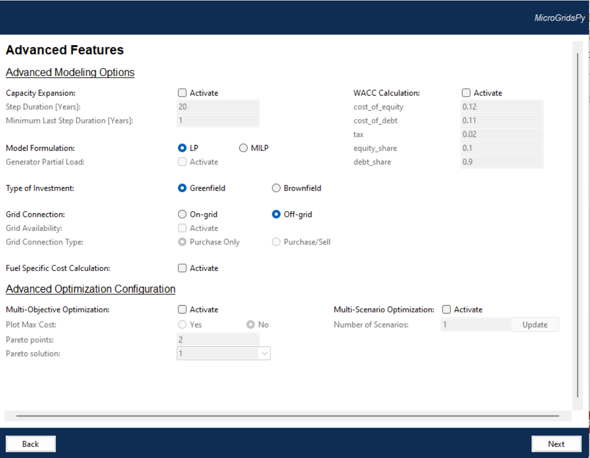

Advanced Features
It enables advanced features such as capacity expansion, special financials setup, grid connection options, and advanced linear or mixed-integer optimization. It also supports multi-objective and scenario-based optimization.
Notes:
The new release of the software enables also advanced features such as capacity expansion, special financial setups, grid connection options, and advanced linear or mixed-integer optimization. It also supports multi-objective and scenario-based optimization. However, these advanced features are out of the scope and will not be addressed in this course.

Slide 18
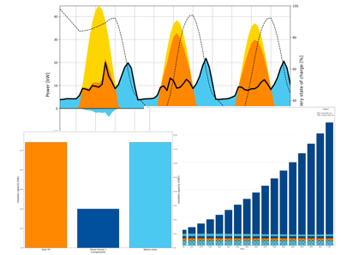
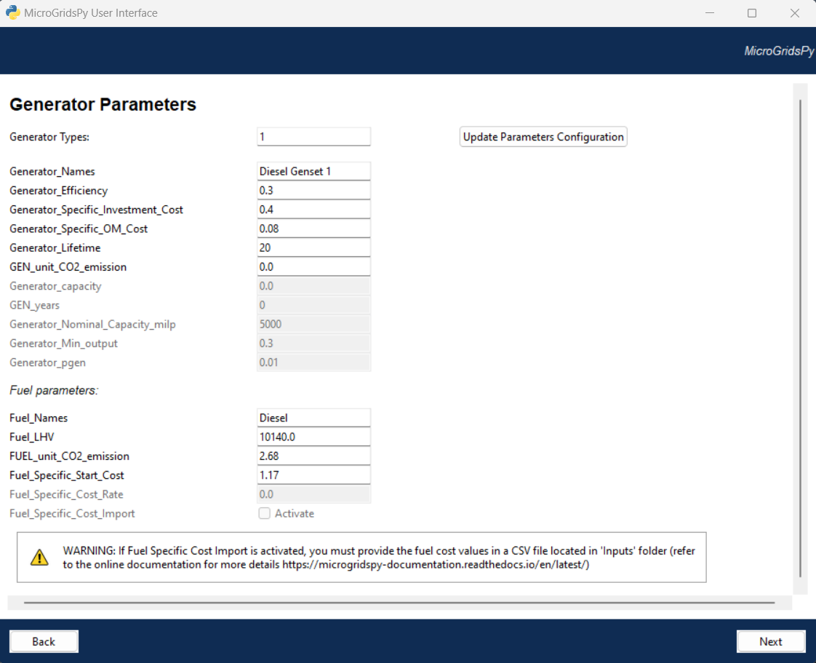
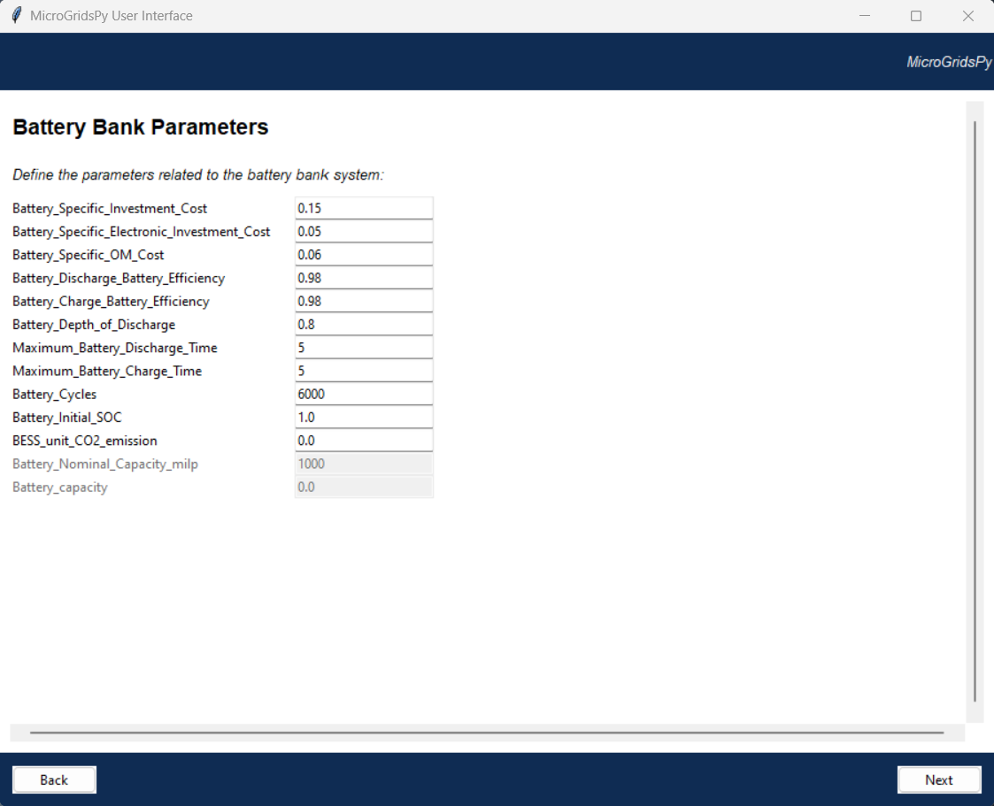
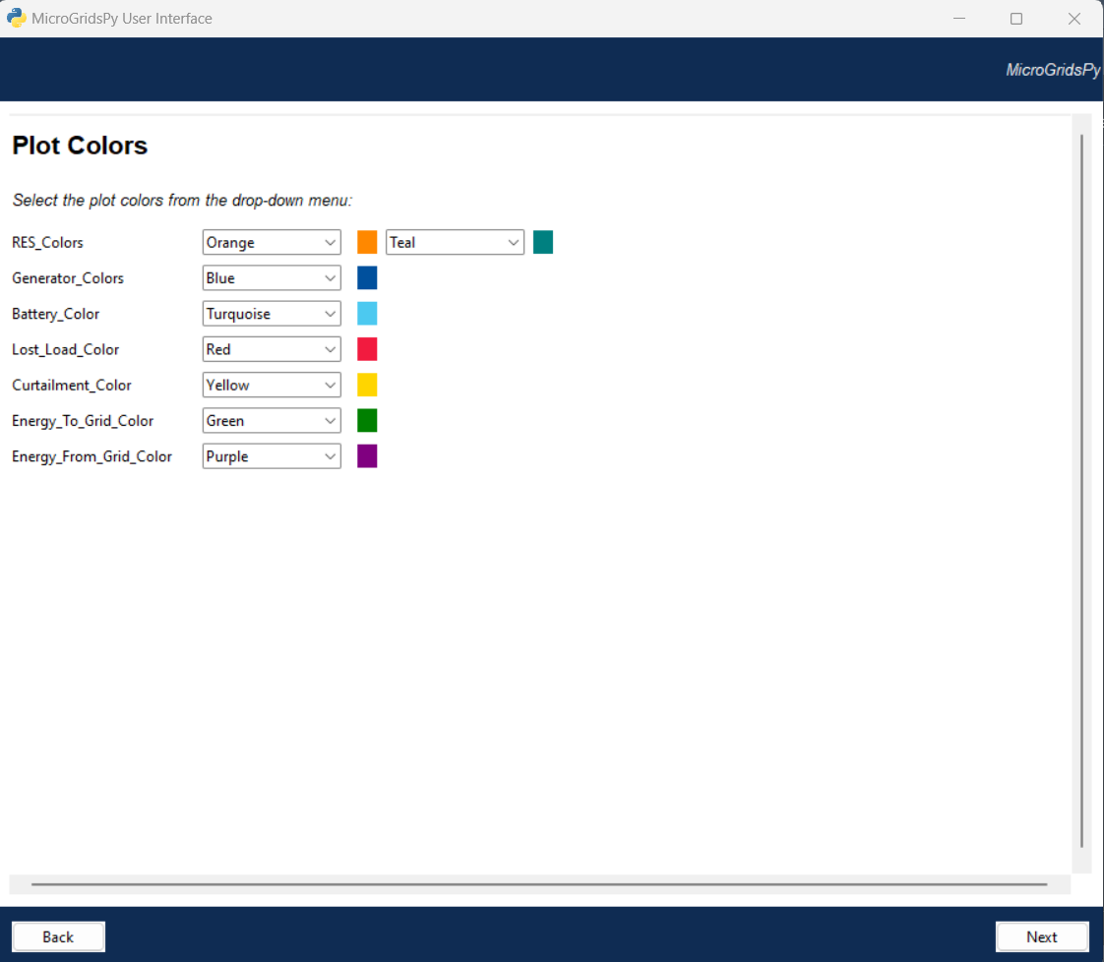
Default Configuration
The default settings and data implemented in the interface refer to an exemplative case study in Zambia's Bangweulu Wetlands. This basic scenario includes a 20-year time horizon, solar and wind renewable energy sources, linear programming optimization and backup systems comprising battery storage and diesel generators, without extra features or advanced models.
Please note that the default values provided in the MicroGridsPy interface are purely exemplative and may not strictly represent realistic values for actual implementations. It is essential to tailor these settings to specific project requirements and real-world conditions for accurate simulations and results.
Notes:
The default settings and data implemented in the interface refer to an exemplary case study in Zambia's Bangweulu Wetlands. This basic scenario includes a 20-year time horizon, solar and wind renewable energy sources, linear programming optimization, and backup systems comprising battery storage and diesel generators, without extra features or advanced models. It is important to note that the default values provided are purely exemplary and may not strictly represent realistic values for actual implementations. Tailoring these settings to specific project requirements and real-world conditions is essential for accurate simulations and results.

Slide 19
References
[1] Riva et al., Long-term energy planning and demand forecast in remote areas of developing countries: Classification of case studies and insights from a modelling perspective, Energy Strategy Reviews 2018, http//doi.org/10.1016/j.esr.2018.02.006
[2] Global Solar Atlas, https://globalsolaratlas.info/map
[3] Global Wind Atlas, https://globalwindatlas.info/en
[4] Renewables Ninja, https://www.renewables.ninja/

